Slide 1
Module C3
Post-exposure Management of Human Infection with Novel Influenza A Viruses:
Use of Neuraminidase Inhibitors

Slide 2
Key Concepts
Antiviral medications should be used to treat symptomatic persons that a clinician thinks may have an avian/novel influenza A virus infection
  Treat as soon as possible
  Test, but do not delay treatment to wait for laboratory confirmation
Antiviral medications can be used to prevent influenza virus infection in asymptomatic individuals if treatment is started promptly after exposure
In settings with limited antiviral availability, symptomatic individuals should be prioritized for treatment
  Asymptomatic individuals should be monitored and started on treatment doses of antiviral medications if symptoms develop
  Epidemiologic assessment of the degree of potential exposure to the virus should be used to determine which exposed asymptomatic individuals may benefit from use of antiviral drugs to prevent infection.

Slide 3
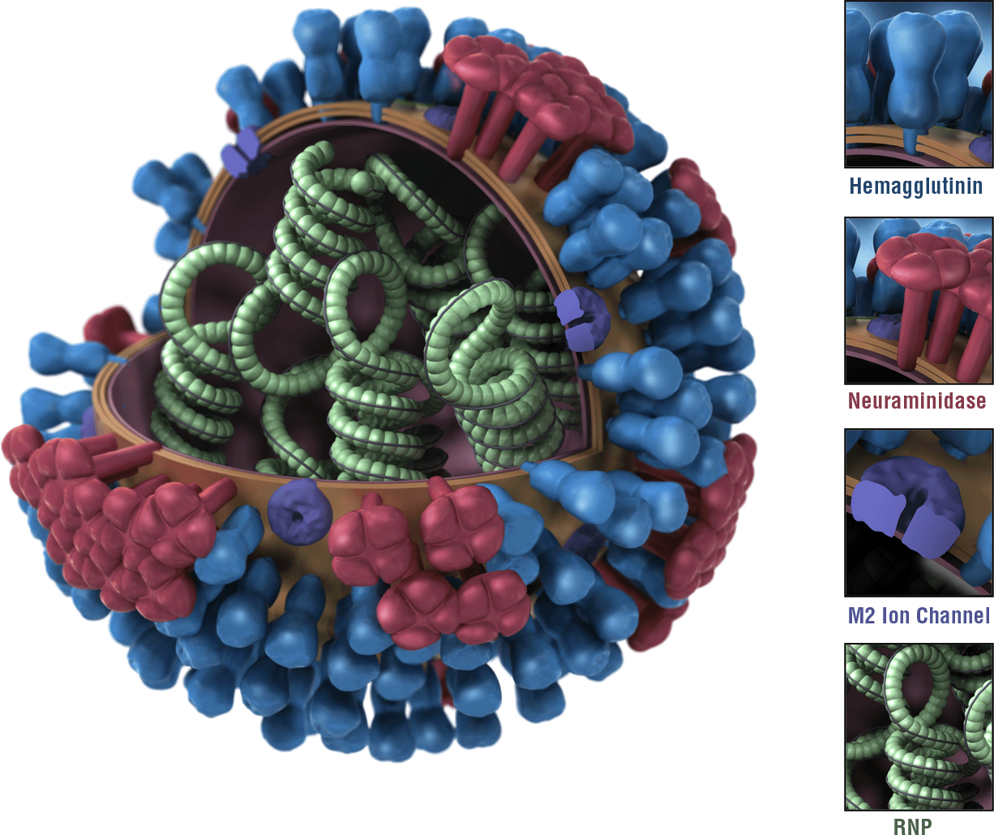
WHO Oseltamivir Treatment Guidance
For any symptomatic patients suspected to have a novel influenza A virus infection, the WHO recommends antiviral treatment with a neuraminidase inhibitor, such as oseltamivir, as soon as possible
Neuraminidase inhibitors work best early in infection:
Don’t wait for lab results to start treatment
http://www.who.int/csr/resources/publications/swineflu/h1n1_guidelines_pharmaceutical_mngt.pdf?ua=1
Notes:
Image: https://www.cdc.gov/flu/images.htm

Slide 4
WHO A(H5N1) and A(H7N9) Guidance
WHO has published guidance for the treatment and post exposure prevention of infection with avian influenza A(H5N1) virus
WHO has not published guidance for treatment of infection with avian influenza A(H7N9) virus
- Guidance for treatment of A(H5N1) virus is applicable
WHO has published guidance for use of antivirals for post-exposure prevention of infection of close contacts of a patient with confirmed avian influenza A(H7N9) virus infection and/or high risk poultry/environmental exposures
- It is different from guidance for post-exposure prevention of
avian influenza A(H5N1) virus infection

Slide 5
Oseltamivir Use for Avian Influenza A(H5N1) Virus
Treatment: For confirmed infections or symptomatic adults, oseltamivir 75mg twice daily should be used as soon as possible
Prevention: For asymptomatic adults at risk (next slide), oseltamvir 75mg once daily is recommended for 7-10 days
Weight-adjusted doses recommended for children one year of age or older
WHO Rapid Advice Guidelines on pharmacological management of humans infected with avian influenza A (H5N1) virus, May 2006

Slide 6
Definition for A(H5N1): Level of Risk Exposure Groups*
High risk – (should use antivirals)
Household or close family contacts of a suspected or confirmed A(H5N1) patient
Moderate risk – (might use antivirals)
Personnel involved in handling sick animals or decontaminating affected environments (including animal disposal) if PPE may not have been used properly.
Individuals with unprotected and very close direct exposure to sick or dead animals infected with the A(H5N1) virus or to particular birds that have been directly implicated in human cases.
Health care personnel in close contact with suspected or confirmed A(H5N1) patients, without any or with insufficient PPE
Lab personnel who might have an unprotected exposure to virus containing samples
Low risk – (should probably not use antivirals)
Health care workers not in close contact (distance greater than 1 metre) with a strongly suspected or confirmed A(H5N1) patient and having no direct contact with infectious material from that patient
Health care workers who used appropriate PPE during exposure to A(H5N1) patients
Personnel involved in culling non‐infected or likely non‐infected animal populations as a control measure
Personnel involved in handling sick animals or decontaminating affected environments (including animal disposal), who used proper PPE
*Applies to asymptomatic persons only. All symptomatic persons should be treated as soon as possible
Notes:
Don’t go into detail on this slide.
High risk
Household or close family contacts of a strongly suspected or confirmed H5N1
patient, because of potential exposure to a common environmental or poultry source
as well as exposure to the index case
Moderate risk exposure groups are currently defined as:
Personnel involved in handling sick animals or decontaminating affected
environments (including animal disposal) if personal protective equipment may not
have been used properly.
• Individuals with unprotected and very close direct exposure to sick or dead animals
infected with the H5N1 virus or to particular birds that have been directly implicated
in human cases.
• Health care personnel in close contact with strongly suspected or confirmed H5N1
patients, for example during intubation or performing tracheal suctioning, or
delivering nebulised drugs, or handling inadequately screened/sealed body fluids
without any or with insufficient personal protective equipment. This group also
includes laboratory personnel who might have an unprotected exposure to virus containing
samples.
Low risk exposure groups are currently defined as:
• Health care workers not in close contact (distance greater than 1 metre) with a
strongly suspected or confirmed H5N1 patient and having no direct contact with
infectious material from that patient.
Health care workers who used appropriate personal protective equipment during
exposure to H5N1 patients.
• Personnel involved in culling non‐infected or likely non‐infected animal populations
as a control measure.
• Personnel involved in handling sick animals or decontaminating affected
environments (including animal disposal), who used proper personal protective
equipment.

Slide 7
Evidence for A(H7N9) Antiviral Guidance
Epidemiological transmission patterns of A(H7N9) virus
Poultry / environment-to-human transmission of A(H7N9) virus is rare
Human-to-human A(H7N9) virus transmission is uncommon
  “Thought to have occurred in only a few occasions among family members, and has not been reported in healthcare workers.”
  There have been some reports of nosocomial transmission
  May be reconsidered if nosocomial transmission more common
No evidence of sustained human-to-human A(H7N9) virus transmission to date
Reports of the acquisition of antiviral resistance emerging during antiviral use
Reports of oseltamivir resistance after once a day dosing
During the 2009 A(H1N1)pdm09 pandemic, several reports suggested oseltamivir resistance emerged among persons taking once a day dosing
Ref: Post-exposure antiviral chemoprophylaxis of close contacts of a patient with confirmed H7N9 virus infection and/or high risk poultry/environmental exposures http://www.who.int/influenza/human_animal_interface/influenza_h7n9/13_January_2013_PEP_recs.pdf?ua=1
Ref: Baz M, et al. . Emergence of oseltamivir-resistant pandemic H1N1 virus during prophylaxis. N Engl J Med 2009; 361:2296–7.
Notes:
Poultry/environment-to-human transmission of H7N9 virus is rare.
Human-to-human H7N9 virus transmission is uncommon
From published H7N9 guidance: “Thought to have occurred in only a few occasions among family members, and has not been reported in healthcare workers.”
This is outdated, as since it was published, have been some reports of nosocomial transmission. Guidance may be reconsidered if nosocomial transmission more common.
No evidence of sustained human-to-human H7N9 virus transmission to date.
Reports of oseltamivir resistance after once a day dosing
During the 2009 H1N1 pandemic, the standard regimen for post-exposure antiviral dosing for seasonal influenza may have increased the risk of emergence of oseltamivir-resistant H1N1 virus infection

Slide 8
Oseltamivir Use for Influenza A(H7N9)
Treatment: For confirmed infections or symptomatic adults, oseltamivir 75mg twice daily should be used as soon as possible
Prevention: Routine post-exposure use of antiviral medications to prevent illness is generally not recommended
  For some asymptomatic adults at risk (next slide), empiric use of oseltamivir 75 mg twice daily for 5 days (treatment dose) can be considered
Weight-adjusted doses for children 1-12 years of age
Ref: Post-exposure antiviral chemoprophylaxis of close contacts of a patient with confirmed H7N9 virus infection and/or high risk poultry/environmental exposures http://www.who.int/influenza/human_animal_interface/influenza_h7n9/13_January_2013_PEP_recs.pdf?ua=1

Slide 9
WHO: A(H7N9) Post-Exposure Use for Prevention
Empiric post-exposure use of oseltamivir for prevention of illness can be considered for the following asymptomatic persons who had A(H7N9) virus exposure:
  Underlying medical conditions who have a recent exposure to poultry, live poultry market or environments contaminated by A(H7N9) virus
  A substantial unprotected or prolonged exposure to an ill patient with influenza A(H7N9) virus infection
    Unprotected healthcare workers
    Aerosol generating procedures
  Higher risk of complications from influenza virus infection
    Patients with immunosuppression
    Neonates / infants
    Pregnant and early post-partum women
    Elderly adults
    Persons with chronic co-morbidities
    Other highly vulnerable patients
Ref: Post-exposure antiviral chemoprophylaxis of close contacts of a patient with confirmed A(H7N9) virus infection and/or high risk poultry/environmental exposures http://www.who.int/influenza/human_animal_interface/influenza_h7n9/13_January_2013_PEP_recs.pdf?ua=1
Notes:
Initiation of empiric post-exposure antiviral treatment:
Oseltamivir 75 mg orally twice daily for 5 days
Rational for this is that is presumes influenza virus infection has occurred

Slide 10
Asymptomatic Persons with A(H7N9) Virus Exposure
The WHO does not recommend routine post-exposure use of antiviral drugs for any group and never for asymptomatic persons who do not meet previous criteria
However:
If an exposed person not initially given post-exposure antivirals later develops symptoms, they should be tested, managed and given prompt empiric antiviral treatment
Low threshold to treat symptomatic exposed persons, even if patient has mild symptoms
Notes:
Just because the WHO doesn’t recommend routine post-exposure use of antiviral drugs for any group and never for asymptomatic persons who do not meet previous criteria, don’t forget to properly assess, manage and promptly treat anyone with exposure who does develop symptoms, as discussed in clinical module 2.

Slide 11
Evidence for A(H7N9) Antiviral Guidance
Lack of knowledge on appropriate dose and duration of antiviral use to prevent illness for asymptomatic individuals after exposure to A(H7N9) virus
Severely immunosuppressed persons:
  May not manifest fever with influenza virus infection or may have atypical symptoms
  May not meet a definition of influenza-like illness
Ref: Post-exposure antiviral chemoprophylaxis of close contacts of a patient with confirmed H7N9 virus infection and/or high risk poultry/environmental exposures http://www.who.int/influenza/human_animal_interface/influenza_h7n9/13_January_2013_PEP_recs.pdf?ua=1
Notes:
There is a lack of knowledge on appropriate dose and duration of antiviral use after exposure to A(H7N9) virus.
Severely immunosuppressed persons have a higher risk of having their diagnosis missed, and thus they are at risk of being potentially inappropriately treated if treated with once daily dosing.
Such patients may not manifest fever with influenza virus infection or who might have atypical symptoms
Such patients may not meet a definition of influenza-like illness.

Slide 12
Settings with limited supplies of oseltamivir
Oseltamivir supplies may be limited in certain settings
WHO provides general guidance on supply management at first-level health care facilities
In settings with limited antiviral availability, treatment of symptomatic individuals should be prioritized
  Exposed individuals should be monitored and started on treatment as soon as possible if symptoms develop
http://www.who.int/hiv/pub/imai/national/handbook/en/
Notes:
One challenge using oseltamivir for treatment and prevention avian influenza infection is that oseltamivir supplies may be limited in certain settings.
WHO provides general guidance on supply management at first-level health care facilities, which may be useful in considering strategies for standard procedures of supply management at first-level health care facilities.
Given possible constraints on oseltamivir supply in certain settings, the fundamental principle for usage in settings with limited antiviral availability, symptomatic individuals should be prioritized for treatment. Exposed individuals should be monitored and started on treatment as soon as possible symptoms develop

Slide 13
Key Concepts
Antivirals should be used to treat influenza virus infection in symptomatic individuals
  Treat as soon as possible
  Test, but do not delay treatment to wait for laboratory confirmation
Antivirals can be used to prevent influenza virus infection in asymptomatic individuals if given early after exposure
In settings with limited antiviral availability, symptomatic individuals should be prioritized for treatment
  Asymptomatic individuals should be monitored and started on treatment if symptoms develop
  Risk should be used to determine which exposed asymptomatic individuals may benefit from use of antiviral drugs to prevent infection
Notes:
Also review key concepts from slide 9:

Slide 14

Discussion Questions
In your country / region, is there timely training on use of antivirals for post exposure of novel/avian influenza A virus?
Notes:
Facilitator: discuss this question with participants. Also review key concepts from slides 8 and 9:
For confirmed infections or symptomatic adults, oseltamivir 75mg twice daily should be used as soon as possible
Empiric post-exposure use of oseltamivir for prevention of illness can be considered for the following asymptomatic persons who had A(H7N9) virus exposure:
Underlying medical conditions who have a recent exposure to poultry, live poultry market or environments contaminated by H7N9 virus
A substantial unprotected or prolonged exposure to an ill patient with an influenza A(H7N9) virus infection
Unprotected healthcare workers
Aerosol generating procedures
Higher risk of complications from influenza virus infection
Patients with immunosuppression
Neonates / infants
Pregnant and early post-partum women
Elderly adults
Persons with chronic co-morbidities
Other highly vulnerable patients

Slide 15
Background Information for Review Question
A patient was admitted to the general hospital ward 5 days previously for pneumonia.
  The patient:
  Was symptomatic for two days prior to hospitalization
  Was not placed on isolation at that time and shared a general ward room with 3 other people
  Deteriorated clinically and was intubated and transferred to the ICU
  Had laboratory testing that confirmed avian influenza A(H7N9) virus infection today
Notes:
This is the background information about a patient. We will review this information and then proceed to a discussion question on the next slide.

Slide 16
Review Question (continued)
Which of the following people are considered to have a higher risk of exposure to an influenza A(H7N9) virus infection?
  An immunocompromised cancer patient, whose bed was next to the patient for 5 days
  The healthy 30 year-old son, who visited the patient twice and cared for the patient in the hospital
  The pregnant daughter-in-law, who visited and cared for the patient prior to being in the hospital
  The physician, who intubated the patient and who may have had a breach in PPE
  The 25 year-old janitor, who cleaned the patient’s room once before diagnosis
Notes:
Cancer patient—yes
Son—probably not.
Daughter-in-law—high risk for influenza complications (pregnant)
Physician—higher risk because (high risk, aerosol generating procedures)
Janitor--not

Slide 17
Review Question
If at-risk asymptomatic persons are to receive post-exposure antiviral treatment, what drug and dose should be used for those exposed to A(H7N9)?
  A. Oseltamivir 75 mg po daily for 10 days
  B. Oseltamivir 75 mg po twice daily for 5 days
  C. Zanamivir 75 mg inhaled twice daily for 5 days
Notes:
Answer B.

Slide 18
Discussion Questions
In your country/region, are influenza antiviral medications readily available at first-line health centers? If supplies are limited, how do you prioritize use?
Notes:
Facilitator: Ask participants to discuss if influenza antiviral medications are readily available at first-line health centers in their country/region. If supplies are limited, how do you prioritize use?
In settings with limited antiviral availability, symptomatic individuals should be prioritized for treatment
Asymptomatic individuals should be monitored and started on treatment if symptoms develop
Risk should be used to determine which exposed asymptomatic individuals may benefit from use of antiviral drugs to prevent infection

Slide 19
Discussion Questions
What are some potential risks of not using antiviral treatment for asymptomatic persons exposed to a novel influenza A virus?
Notes:
Facilitator: Ask participants to discuss the risks related to not using antiviral treatment on exposed asymptomatic persons.
Potential risks of not using antiviral treatment on asymptomatic persons
Exposed, susceptible person develops illness that possibly could have been prevented – this new infection puts more people at risk of exposure
Any human infection with a novel influenza A virus could offer the virus an opportunity to recombine with a seasonal influenza A virus, with the possibility of producing a new influenza A virus that spreads more easily among humans (pandemic potential)
Increased anxiety and fear among exposed persons
Others?

Slide 20
Thank you
The findings and conclusions in this presentation are those of the authors and do not necessarily represent the official position of the Centers for Disease Control and Prevention.

Slide 21
Resources
WHO guidelines for investigation of human cases of avian influenza A(H5N1)
  http://www.who.int/csr/resources/publications/influenza/WHO_CDS_EPR_GIP_2006_4/en/
WHO case definitions for human infections with influenza A(H5N1) virus
  http://www.who.int/influenza/resources/documents/case_definition2006_08_29/en/index.html
WHO guidelines for global surveillance of influenza A(H5N1)
  http://www.who.int/influenza/surveillance_monitoring/global_surveillance_h5_guidelines_06_02_2004/en/index.html
Clinical management of human infection with avian influenza A (H5N1) virus
  http://www.who.int/influenza/resources/documents/clinical_management_h5n1_15_08_2007/en/index.html

Slide 22
Resources
Avian Influenza A(H7N9) virus
  http://www.who.int/influenza/human_animal_interface/influenza_h7n9/en/index.html
Interim WHO surveillance recommendations for human infection with avian influenza A(H7N9) virus
  http://www.who.int/influenza/human_animal_interface/influenza_h7n9/InterimSurveillanceRecH7N9_10May13.pdf
Post-exposure antiviral chemoprophylaxis of close contacts of a patient with confirmed H7N9 virus infection and/or high risk poultry/environmental exposures
  http://www.who.int/influenza/human_animal_interface/influenza_h7n9/13_January_2013_PEP_recs.pdf?ua=1
Tool for influenza pandemic risk assessment (TIPRA)
  http://apps.who.int/iris/bitstream/10665/250130/1/WHO-OHE-PED-GIP-2016.2-eng.pdf?ua=1

