Slide 1
Module C5
Infection Control in Healthcare Settings

Slide 2
Learning Objectives
Correctly describe the importance of infection prevention and control (IPC)
Correctly describe the chain of transmission in healthcare settings
Name 7 components of standard precautions
Describe current IPC recommendations for emerging respiratory pathogens

Slide 3
Section 1
Importance of IPC in the
Healthcare Facility

Slide 4

Have You Heard the Term IPC Before?
Please raise your hand if you have
Notes:
Image: Purchased on Shutterstock. Stock vector ID: 760361773

Slide 5
What Does IPC Stand For?
I = Infection
P = Prevention
(and)
C = Control

Slide 6

Question
Why practice IPC in the healthcare facility?
Notes:
Image: Purchased on Shutterstock. Stock vector ID: 584901160

Slide 7

Why practice IPC in the healthcare facility?
Pathogens are too small to see with the naked eye but can cause infections
You don’t know who has an infection
IPC can prevent spread of pathogens
Notes:
Image: Purchased on Shutterstock. Stock vector ID: 584901160

Slide 8

Who is at Risk of Infections in Healthcare Settings?
Everyone
Patients
Healthcare personnel
Visitors/family members
Notes:
Image: Purchased on Shutterstock. Stock vector ID: 584901160

Slide 9

Discussion Questions
How often do you have refresher training on IPC?
What challenges do you typically encounter when doing IPC in your country or specific location?
Notes:
Facilitator notes: Take 5 minutes to lead a brief discussion with the entire group. Ask participants to volunteer to state how often they have ICP refresher training.
If there is still time, also discuss the second question. (this question can be animated on the slide so the facilitator can show it only if there is time)

Slide 10

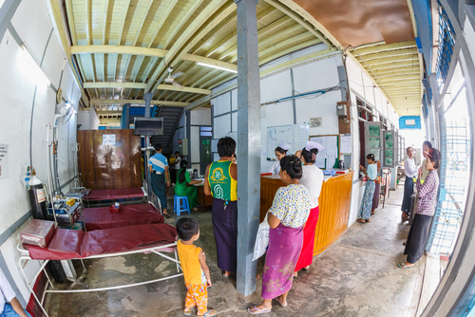
Goals of Infection Prevention and Control
Protect yourself
Protect your patients
Protect your community
Notes:
Top image: Purchased on Shutterstock. Stock photo ID: 88400317
Bottom image: Purchased on Shutterstock. Stock photo ID: 684243691

Slide 11
Work in Pairs: Add Arrows to Show Directions Of Transmission in Healthcare Settings
Patients
Patients
Environment
Visitors/Family members
Healthcare personnel
Notes:
In the next 2 slides, we will work in pairs to think about how transmission may occur between the factors/people listed in each box.

Slide 12
Critique this Diagram
Patients
Patients
Environment
No
Visitors/Family members
Healthcare personnel
Notes:
You have 2 minutes. Could you please work with the person next to you and try to think of a few points regarding why you think this diagram is not ideal.
Facilitator note: Ask a few people to talk about their answers before showing the next slide.
Answers: the arrows have one direction. There should be more arrows pointing back and forth between boxes as shown in the next slide.

Slide 13
Critique this Diagram
Patients
Patients
Environment
Yes
Visitors/Family members
Healthcare personnel
Notes:
Answers: the arrows on the previous slide went in just one direction. There should be more arrows pointing back and forth between boxes as shown in this slide.

Slide 14
Importance of IPC in Healthcare Settings
Prevent spread of pathogens
Protect patients, visitors/family members, and health care workers
Contain emerging pathogens (e.g., Ebola, influenza) that amplify in healthcare settings
Note: IPC must be practiced every day during patient care and strengthened when an outbreak occurs
Notes:
So far, only limited and unsustained human to human transmission of H7N9 influenza, but nosocomial transmissions have been reported.
A pandemic virus may develop from viral adaptation to human hosts, either by mutations or reassortment between influenza viruses. This could be a virus that is readily transmissible, causes severe disease and against which there is no preexisting immunity

Slide 15
Next Topics
General IPC
IPC for Novel Influenza A Viruses associated with severe disease
Considerations for IPC preparedness
Practical scenario

Slide 16
Section 2
General Infection Prevention and Control

Slide 17
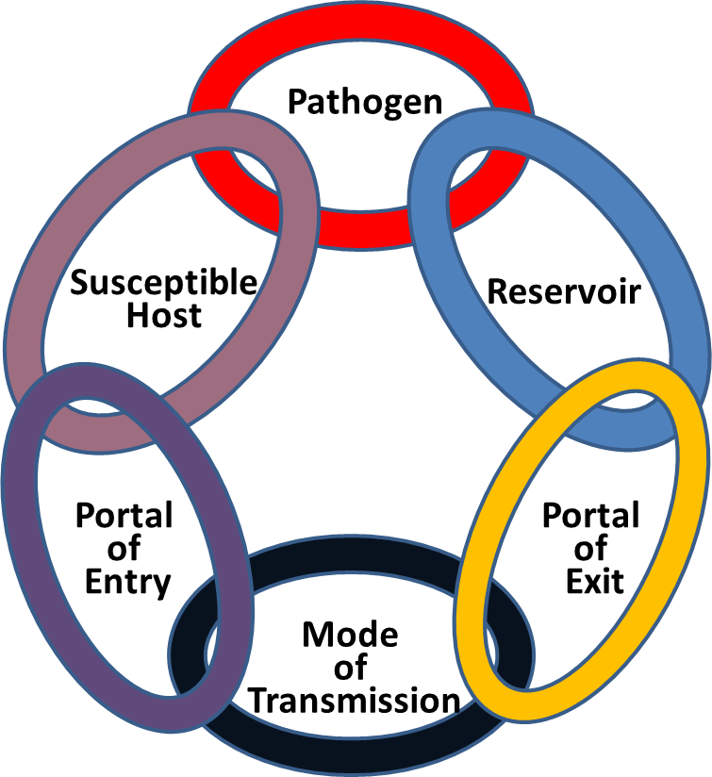
General IPC
Chain of Transmission
For infection to spread, all steps must be connected
Notes:
Image copyright unknown, no similar replacement image found

Slide 18
General IPC
Chain of Transmission
Please give examples of:
Pathogen
Reservoir
Port of Exit and Entry
Mode of Transmission
Susceptible host
Notes:
Image copyright unknown, no similar replacement image found

Slide 19
General IPC
Chain of Transmission
IPC’s goal is to break the links
Notes:
Image copyright unknown, no similar replacement image found

Slide 20

How Can You Break the Links?
Follow Standard Precautions
AND
Transmission-based Precautions
Notes:
Image: Purchased from Shutterstock. Stock illustration ID: 624397796

Slide 21


General IPC
What are Standard Precautions?
Notes:
Standard Precautions are intended to be applied to the care of all patients in all healthcare settings, regardless of the suspected or confirmed presence of an infectious agent. (HICPAC)
Top Image: Purchased on Shutterstock. Stock vector ID: 584901160
Bottom Image: Purchased on Shutterstock. Stock vector ID: 760361773

Slide 22
General IPC
What are Standard Precautions?
Foundation for preventing transmission of infectious agents in all healthcare settings and assume that every person is potentially infected or colonized with a pathogen that could be transmitted in the healthcare setting
Notes:
Standard Precautions are intended to be applied to the care of all patients in all healthcare settings, regardless of the suspected or confirmed presence of an infectious agent. (HICPAC)

Slide 23


General IPC
What are the key elements of Standard Precautions?
Notes:
Top Image: Purchased on Shutterstock. Stock vector ID: 584901160
Bottom Image: Purchased on Shutterstock. Stock vector ID: 760361773

Slide 24
General IPC
What are the key elements of Standard Precautions?
Hand hygiene
Personal protective equipment (PPE)
Environmental cleaning and disinfection
Injection safety
Reprocessing of medical equipment
Linen and waste management
Respiratory hygiene and cough etiquette

Slide 25
Discussion Questions
How often do you have training on standard precaution procedures as part of your job?
Do you feel you have all the equipment and resources you need to implement standard precautions? If not, what are the challenges?
Notes:
Facilitator notes: Take 5 minutes to lead a brief discussion with the entire group. Ask participants to volunteer to state how often they have training on standard precaution procedures.
If there is still time, also discuss the second and third questions. (these questions will be animated on the slide so the facilitator can show it only if there is time)

Slide 26


General IPC
Can you define Transmission-based Precautions?
Notes:
Top Image: Purchased on Shutterstock. Stock vector ID: 584901160
Bottom Image: Purchased on Shutterstock. Stock vector ID: 760361773

Slide 27
General IPC
Can you define Transmission-based Precautions?
Precautions to prevent infections based on modes of transmission
  Contact Precautions
  Droplet Precautions
  Air-borne Precautions

Slide 28

Transmission-Based Contact Precautions
Example?
Methicillin-resistant Staphylococcus aureus (MRSA), carbapenem-resistant Enterobacteriaceae, Clostridium difficile
Placement?
Ideally, single room
PPE?
Gown and gloves
Rationale
Transmissions occur through healthcare personnel
(HCP)’s hands and clothes
Notes:
Contact Precautions is for suspected or known infections that are spread by touch or contact with the patient or the patient’s environment
Image: Purchased from Shutterstock. Stock photo ID: 549442960

Slide 29
Transmission-Based Droplet Precautions
Example?
Meningitis, pertussis, seasonal influenza
Placement?
Ideally, single room
>1 m apart
PPE?
Eye protection and a mask, or face shield
Rationale
Transmissions occur through droplets that land within one meter
Notes:
Droplet Precautions is for suspected or known infections spread by splashes generated by coughs, sneezes
Top Image: Purchased from Shutterstock. Stock photo ID: 549442960
Bottom Image: Purchased from Shutterstock. Stock photo ID: 88400317

Slide 30
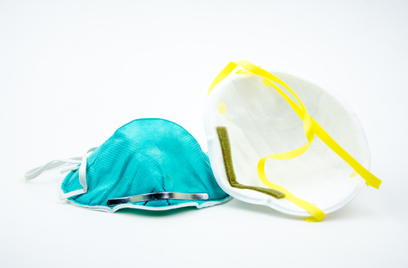
Transmission-Based Airborne Precautions
Example?
Tuberculosis, measles, chickenpox
Placement?
Airborne infection isolation room (AIIR*)
PPE?
N-95 or higher respirator
Rationale
Transmissions occur through small particles (<5µm) floating in the air
Notes:
Airborne infection isolation room (AIIR)
Infections spread by particles that remain viable and suspended in the air for long periods of time
Image: Purchased from Shutterstock. Stock photo ID: 185179208

Slide 31
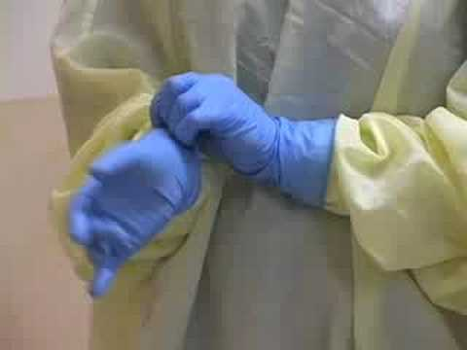
Putting on PPE

Slide 32
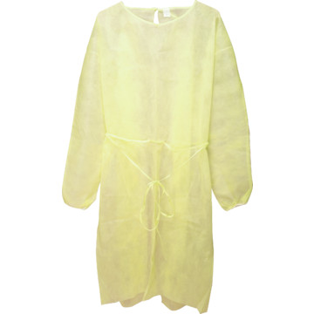
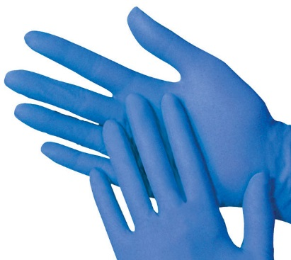
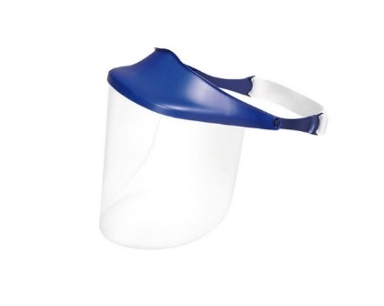
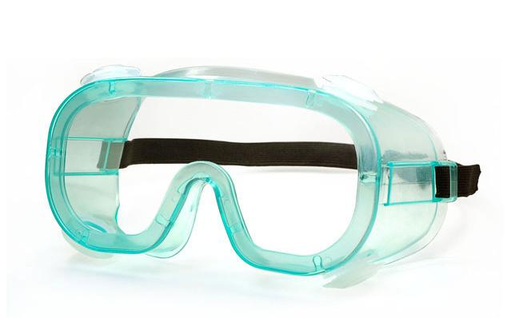
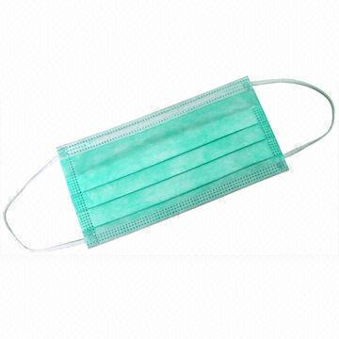
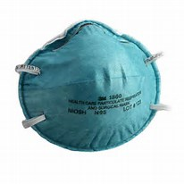
What is the Correct Order for Putting on a PPE?
_____________
_____________
_____________
_____________
*Combination of PPE will affect sequence – be practical
Notes:
The gown should be donned first. The mask or respirator should be put on next and properly adjusted to fit; remember to fit check the respirator. The goggles or face shield should be donned next and the gloves are donned last. Keep in mind, the combination of PPE used, and therefore the sequence for donning, will be determined by the precautions that need to be taken.

Slide 33

What is the Correct Order for Putting on a PPE?
Gown
Mask or Respirator
Googles or Face shield
Gloves
*Combination of PPE will affect sequence – be practical
Notes:
The gown should be donned first. The mask or respirator should be put on next and properly adjusted to fit; remember to fit check the respirator. The goggles or face shield should be donned next and the gloves are donned last. Keep in mind, the combination of PPE used, and therefore the sequence for donning, will be determined by the precautions that need to be taken.

Slide 34
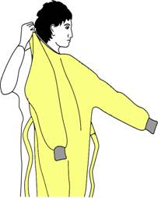
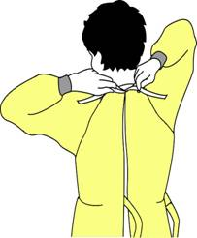
How to Put on a Gown
Select appropriate type and size
Opening is in the back
Secure at neck and waist
If gown is too small, use two gowns
  Gown #1 ties in front
  Gown #2 ties in back

Slide 35
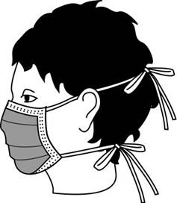
How to Put On a Mask
Place over nose, mouth and chin
Fit flexible nose piece over nose bridge
Secure on head with ties or elastic
Adjust to fit

Slide 36
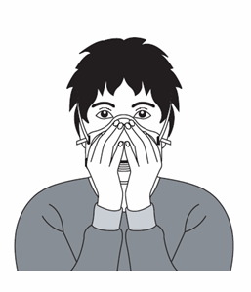
How to Put On a Particulate Respirator
Place over nose, mouth and chin
Fit flexible nose piece over nose bridge
Secure on head with elastic
Adjust to fit
Perform a fit check –
  Inhale – respirator should collapse
  Exhale – check for leakage around face

Slide 37
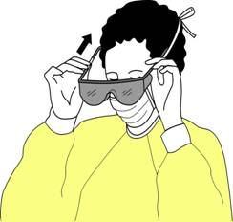
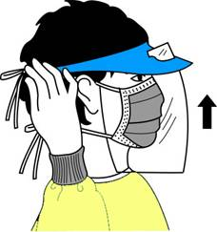
How to Put On Eye and Face Protection
GOGGLES: Position goggles over eyes and secure to the head using the ear pieces or headband
OR
FACE SHEILD: Position face shield over face and secure on brow with headband
Adjust to fit comfortably

Slide 38
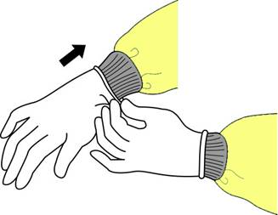
How to Put On Gloves
Put on gloves last
Select correct type and size
Insert hands into gloves
Extend gloves over isolation gown cuffs

Slide 39
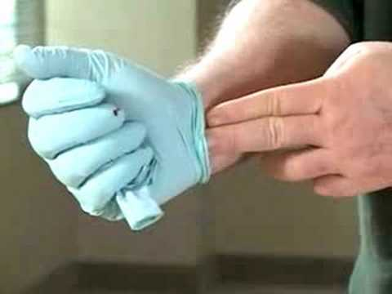
Removing PPE

Slide 40

What is the Correct Order for Removing PPE?
_____________
_____________
_____________
_____________
*Combination of PPE will affect sequence – be practical
Notes:
The gown should be doffed first, followed by goggles or face shield, then gown, then mask or respirator.

Slide 41

What is the Correct Order for Removing PPE?
Gloves
Goggles or Face shield
Gown
Mask or Respirator
*Combination of PPE will affect sequence – be practical
Notes:
The gown should be doffed first, followed by goggles or face shield, then gown, then mask or respirator.

Slide 42
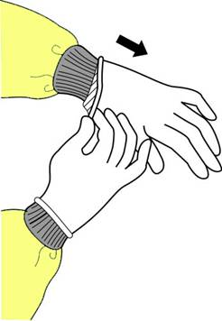
How to Remove Gloves
Grasp outside edge near wrist
Peel away from hand, turning glove inside-out
Hold in opposite gloved hand

Slide 43
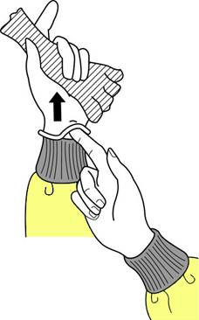
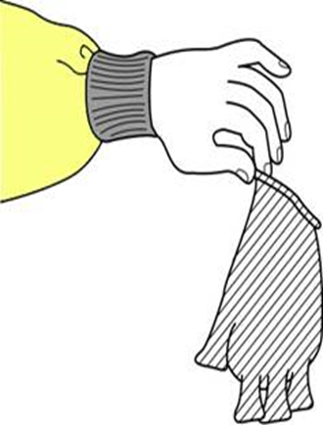
How to Remove Gloves (cont.)
Slide ungloved finger under the wrist of the remaining glove
Peel off from inside, creating a bag for both gloves
Discard in appropriate waste bin

Slide 44

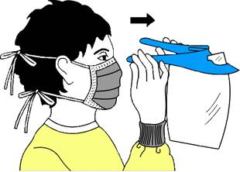
How to Remove Goggles or Face Shield
Grasp ear or head pieces with ungloved hands
Lift away from face
Place in designated receptacle for reprocessing or disposal

Slide 45
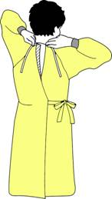
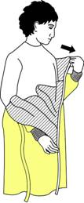
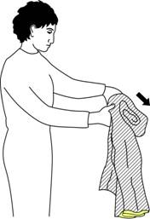
How to Remove an Isolation Gown
Unfasten ties
Peel gown away from neck and shoulder
Turn contaminated outside toward the inside
Fold or roll into a bundle
Discard in appropriate waste bin

Slide 46
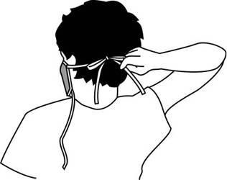
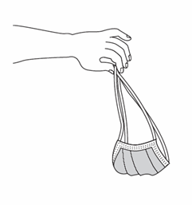
How to Remove a Mask
Untie the bottom tie, then top tie
Remove from face and discard in appropriate waste bin

Slide 47
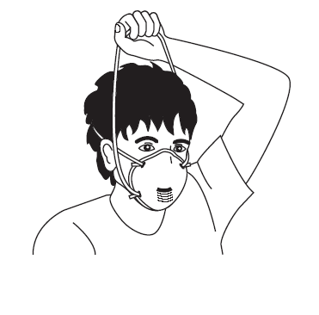
How to Remove a Particulate Respirator
Lift the bottom elastic over your head first
Then lift off the top elastic
Discard in appropriate waste bin

Slide 48

What if PPE is Not Available?

Slide 49
No Gloves Available?
If gloves are not available, what would you do?
  Use plastic bags attached and closed with tape or elastic bands
  Make sure there are no holes prior to use
  Dispose in the medical waste bin after use

Slide 50
No Boots Available?
If boots are not available, what would you do?
  Wear two layers of plastic bags and tie with tape
  Dispose after use

Slide 51
No Gown Available?
If gowns are not available, what would you do?
Wear a cotton surgical gown that can be washed and reused
Alternatively, you can get gowns sewn from local fabric. Gowns must be:
  Open at the back and close with ties at the neck and waist
  Knee-length with collar wraps around the neck and elastic bands to close the gown around the wrist

Slide 52
No Aprons Available?
If aprons are not available, what would you do?
  Make aprons from plastic sheeting, large trash bags, rubber coated or plastic cloth normally used to cover kitchen tables
  The apron should:
    Be impermeable to liquid
    Have hooks or ties that fasten around the neck
    Have ties at the waist that reach around and tie at the back
    Be long enough to cover the top of the boots to provide additional protection from spills running inside boots

Slide 53
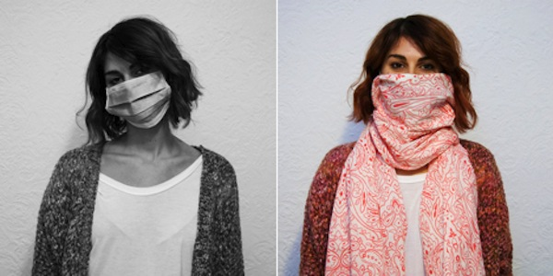
No Masks Available?
If a disposable mask is not available, what would you do?
Use a clean large cloth, such as a scarf or other material to cover the mouth and nose
  Make sure it is tied securely

Slide 54

No Goggles or Face Shield Available?
If goggles or a face shield are not available, what would you do?
Obtain eyeglasses with clear lenses from a local eyeglass shop or in the market
  Place ties on the ear holders
  Tie the eyeglasses around the back of the head so they will not fall off when a healthcare worker bends over a patient
REMEMBER: The order of doffing is critical regardless of whether you are using standard issue or improvised PPE!

Slide 55
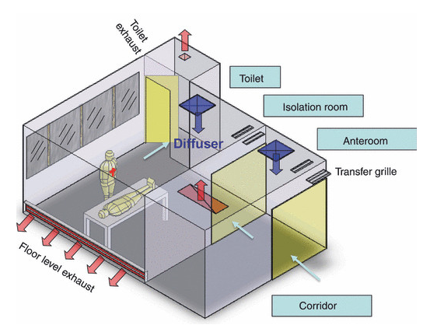
Airborne Infection Isolation Room (AIIR)
AIIR is an isolation room designed with special air handling and ventilation systems to prevent transmission of airborne infections
https://www.researchgate.net/figure/44671285_fig1_Figure-1-An-illustration-of-the-currently-recommended-ventilation-design-for-airborne
Notes:
Note: this is an example of a good AIIR.
Can someone tell me what you see in this image?
Facilitator note: ask a few people to describe the image, then say “As you can see, it has an anteroom-that’s where HCP put on and take off PPE, and there is a toilet ensuite- which is important for patient isolation.”
Facilitator note: Then ask these questions:
What do you think the arrows represent?
Answer: airflow.
According to this air flow, what do you think the pressure in the room would be?
Answer: Negative pressure.
What would you do if you cannot have a system to generate such an airflow?
Answer: consider natural ventilation

Slide 56
Discussion Questions
How often do you have training on transmission-based procedures as part of your job?
How do transmission-based precautions work in your country or specific location for droplet and air-borne transmission specifically?
Notes:
Facilitator notes: Take 5 minutes to lead a brief discussion with the entire group. Ask participants to volunteer to state how often they have training on transmission-based procedures.
If there is still time, also discuss the second question. (this question will be animated on the slide so the facilitator can show it only if there is time)

Slide 57
Section 3
IPC guideline for novel influenza A

Slide 58
WHO IPC Guideline for Avian Influenza
Avian Influenza, Including Influenza A (H5N1), in Humans: WHO Interim Infection Control Guideline for Health Care Facilities
http://www.wpro.who.int/emerging_diseases/documents/docs/AI_Inf_Control_Guide_10May2007.pdf
Published in 2007 – before H7N9 was identified
There may be higher risk of human-to-human transmission for H7N9 than H5N1
Notes:
Recommendations in the following slides are based on WHO Interim Infection Control Guideline for Healthcare Facilities. It was published in 2007 before H7N9 was identified. According to limited information we currently have, it is possible there may be a higher risk of human-to-human transmission for H7N9 than H5N1.

Slide 59
WHO IPC Guideline for Avian Influenza
Standard Precautions and Droplet Precautions should be used in all healthcare facilities
For aerosol-generating procedures, apply Airborne Precautions

Slide 60
Overview of Recommendations: Avian Influenza
Minimize exposures upon arrival
Isolation or patient placement
PPE
Precautions for aerosol-generating procedures
Visitor access
Environmental cleaning
Monitor exposed healthcare personnel

Slide 61
Discussion Questions
Is following any of the WHO recommendations problematic in your country or specific location?
e.g., limiting/controlling visitor access, access
to PPE, lack of sufficient space for isolation, lack of
proper cleaning supplies/equipment, etc.?
If certain WHO recommendations are difficult to follow where you work, why is this and what do you think is needed to make the recommendations easier to follow/implement?
Notes:
Facilitator notes: Take 5 minutes to lead a brief discussion with the entire group. Ask participants if any of the recommendations are difficult to implement where they work.
If there is still time, also discuss the second question. (this question can be animated on the slide so the facilitator can show it only if there is time)

Slide 62

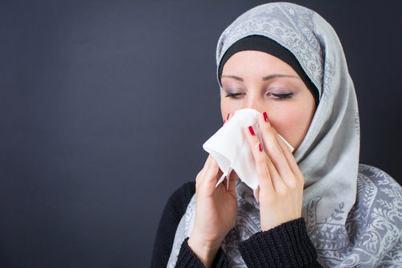

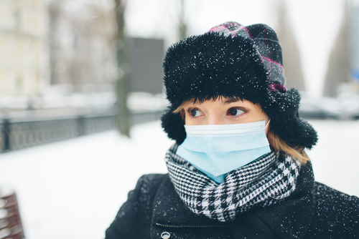
Minimize Potential Exposures upon Arrival at Health Care Facility
Respiratory hygiene and cough etiquette for all
Mask for patients with flu symptoms
Notes:
Images purchased from Shutterstock.
Top left: Stock illustration ID: 224864566
Top right: Stock photo ID: 410205490
Bottom left: Stock photo ID: 368558357
Bottom right: Stock photo ID: 165429086

Slide 63

Minimize Potential Exposures upon Arrival at Health Care Facility
Early recognition and isolation of cases
Droplet precautions for flu symptoms
Separate patients with flu symptoms
Notes:
Images purchased from Shutterstock.
Bottom left: Stock photo ID: 165429086
Bottom right: Stock photo ID: 534374536

Slide 64
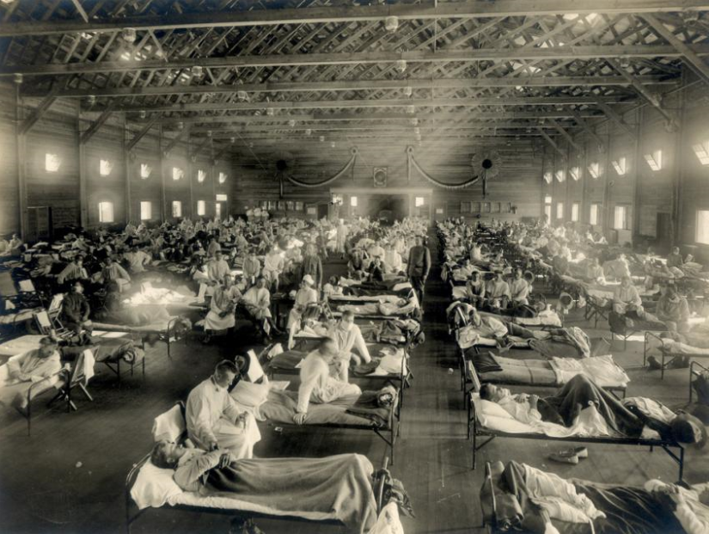
Isolation or Patient Placement
Place a patient in an adequately ventilated single room*
If a single room is not available, cohorting patients in designated room
https://www.google.com/search?biw=1680&bih=944&tbm=isch&sa=1&q=cohort+rooms+for+flu&oq=cohort+rooms+for+flu&gs
Notes:
*AIIR if available (CDC guidance)
Keep door closed and windows open
Patient should wear facemask at all times if tolerable
HCP should wear N95 mask to provide care

Slide 65
Isolation or Patient Placement
Limit patient movement in the facility as much as possible
Limit the number of persons entering the isolation room
Keep >1m distance between beds

Slide 66


Discussion Question
What infection precautions do you need to provide care to confirmed, probable, or patient under investigation (PUI)?
Notes:
Top Image: Purchased on Shutterstock. Stock vector ID: 584901160
Bottom Image: Purchased on Shutterstock. Stock vector ID: 760361773

Slide 67
Discussion Question - answer
Question: What infection precautions do you need to provide care to confirmed, probable, or patient under investigation (PUI)?
Answer: Standard Precautions PLUS Droplet Precautions at the minimum

Slide 68


Discussion Question
Upon entry into the isolation room, what PPE do you wear?
Notes:
Top Image: Purchased on Shutterstock. Stock vector ID: 584901160
Bottom Image: Purchased on Shutterstock. Stock vector ID: 760361773

Slide 69
Discussion Question - answer
Upon entry into the isolation room, what PPE do you wear?
Gloves, gown, mask, eye protection
Why?
Notes:
As you remember from the previous slide, HCP need to apply contact and droplet precautions to prevent H7N9 transmission. Gloves and gowns are needed for contact precautions and masks and face shield are for droplet precautions. Masks will prevent droplets from landing on HCP’s mucus membranes in the nose and mouth and face shields prevent droplets from landing on mucus membranes of the eyes.
Left Image: Purchased from Shutterstock. Stock photo ID: 185179208
Middle Image: Purchased from Shutterstock. Stock photo ID: 549442960
Right Image: Purchased from Shutterstock. Stock photo ID: 88400317

Slide 70


Discussion Question
What are examples of aerosol-generating procedures?
Notes:
Top Image: Purchased on Shutterstock. Stock vector ID: 584901160
Bottom Image: Purchased on Shutterstock. Stock vector ID: 760361773

Slide 71
Discussion Question - answer
What are examples of aerosol-generating procedures?
Suctioning of airways
Elective intubation or extubation
Cardiopulmonary resuscitation
Bronchoscopy
Sputum induction
Autopsies

Slide 72


Discussion Question
Why do aerosol-generating procedures have a higher transmission risk?
Notes:
Facilitator note: The answer is on the next slide.
Top Image: Purchased on Shutterstock. Stock vector ID: 584901160
Bottom Image: Purchased on Shutterstock. Stock vector ID: 760361773

Slide 73
Discussion Question - answer
Question: Why do aerosol-generating procedures have a higher transmission risk?
Answer: These procedures are more likely to generate higher concentrations of infectious respiratory aerosols than coughing, sneezing, talking, or breathing

Slide 74
Precautions During Aerosol-generating Procedures
Conduct procedure only if medically necessary and cannot be postponed
Minimize number of HCP
Conduct procedures in an AIIR when available
Wear respiratory protection (N95 mask)
Conduct environmental cleaning following procedures

Slide 75
Visitors Access
Limit visitors
Visits to isolation room should be scheduled, controlled, kept track of
  Screening for flu symptoms before arriving in hospital
  Providing instructions of precautions to visitors
  Reporting flu signs and symptoms if any
Notes:
Exposed visitors should be advised to report any symptoms of acute illness to their health care provider for a period of at least 10 days after the last known exposure

Slide 76
Environmental Cleaning and Waste and Laundry Management
Surfaces
  Standard cleaning and disinfection procedures are adequate
Laundry and food utensils, and medical waste
  Follow hospital standard procedures (e.g., cleaned, then sanitized as appropriate)
Waste
  Treat as infectious waste
  Follow local recommendations if needed

Slide 77
Monitor and Manage Ill and Exposed Healthcare Personnel
Keep track of HCP having contacts with patient or patient care environment
Monitor symptoms for 10 days after last known contact with patient
HCP with patient contact AND developed flu symptoms should not report to work
Notes:
unprotected exposure (i.e., not wearing respiratory protection at the time of contact),
*CDC; Consider excluding HCP with unprotected exposures from work for 10 days

Slide 78

Notes:
Image: Purchased on Shutterstock. Stock vector ID: 584901160

