Slide 1
Module C6
Infection Prevention & Control Preparedness
Division of Healthcare Quality Promotion
Centers for Disease Control and Prevention

Slide 2
Learning Objectives
Describe the importance of Infection Prevention and Control (IPC) preparedness
Describe the elements of IPC preparedness
Describe different strategies for IPC preparedness

Slide 3
Outline
WHY: Importance of IPC preparedness
WHAT: Elements of IPC preparedness
HOW: Strategies for IPC preparedness
Notes:
This presentation will focus on the WHY, WHAT, and HOW of IPC preparedness

Slide 4
Outline
WHY: Importance of IPC preparedness
  Purpose and goals
  Identify, Isolate, Inform
WHAT: Elements of IPC preparedness
HOW: Strategies for IPC preparedness

Slide 5
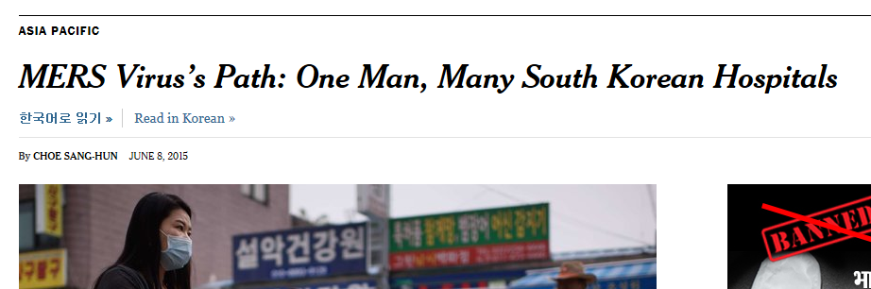

Why is IPC Preparedness Important?
Notes:
IPC preparedness is important to avoid healthcare transmission, outbreaks, or epidemics of illnesses like influenza, MERS, and SARS. The public relies on healthcare to prevent and treat illnesses, not expose them to illnesses.
Images: https://www.nytimes.com/2015/06/09/world/asia/mers-viruss-path-one-man-many-south-korean-hospitals.html
http://www.nytimes.com/2007/01/10/world/americas/10canada.html

Slide 6
Goals of IPC Preparedness
Contain and prevent pathogen transmission
Keep healthcare workers and other patients safe
Maintain functioning of healthcare services
Notes:
These are the 3 goals of IPC preparedness when a new, unusual, or unanticipated situation occurs, such as a novel infection, outbreak, or epidemic

Slide 7

Preparedness
Preparedness happens at all levels
  National
  Regional
  Facility
http://www.psdgraphics.com/psd-icons/psd-magnifier-zoom-icons/
Notes:
IPC preparedness happens at the national, regional, and facility level and involves coordination between all of these levels.

Slide 8




Identify, Isolate, Inform
Identify
Isolate
Inform
Notes:
National and facility efforts should aim to increase the ability of all healthcare facilities to identify a case of H7N9 , isolate a case of H7N9, and inform the public health community in order to prevent illnesses from spreading within healthcare.
Images:
https://thenounproject.com/term/magnifying-glass/1373211/ by n.o.o.m. (attribution required)
https://thenounproject.com/term/people/1033536/ by Adrien Coquet (attribution required)
https://thenounproject.com/term/user/1222481/ by Juan Carlos Altamirano (attribution required)
Inform icon found: https://thenounproject.com/term/talk/232877/ (requires attribution)

Slide 9


Identify
Information used to identify cases
Clinical information
  Risk factors
  Exposures (e.g., sick birds or bird markets, travel)
  Clinical presentation (e.g., more severe illness)
Availability and Timeliness of diagnostic testing
  Rapid diagnostics not recommended for A(H7N9)
  Availability of A(H7N9) confirmatory testing varies and results may be delayed
Notes:
The first step in preventing spread of an illness is identification of cases. To effectively identify a case, it is important to consider information about the pathogen (patient risk factors or exposures, clinical presentation) and the role of diagnostic testing (availability and timeliness, how test results are used).
For H7N9, exposure to sick birds or bird markets, travel to affected area, or presenting with respiratory symptoms is all important information that can be used to identify cases. Initial identification of H7N9 cases is often based only on this clinical information because rapid diagnostics are not recommended and confirmatory testing results are delayed. If isolation and management waited until confirmatory testing results were available, many others would be exposed to the case during this delay.
Image: https://phil.cdc.gov/Details.aspx?pid=20638

Slide 10

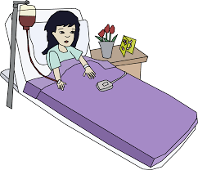
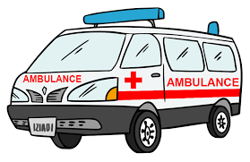
Identify
Identification Locations
Outpatient
Inpatient
Upon arrival to healthcare facilities
Certain images and/or photos on this page are the copyrighted property of 123RF Limited, its Contributors or Licensed Partners and are being used with permission under license. These images and/or photos may not be copied or downloaded without permission from 123RF Limited
Notes:
It is also important to consider the location where cases are identified (outpatient, inpatient, or upon initial presentation.
Image: Patient in bed https://openclipart.org/detail/272617/girl-in-the-hospital (no copyright restrictions)
Image REQUIRES ATTRIBUTION: Clinic waiting room graphic
https://www.123rf.com/photo_49817543_busy-hospital-corridor-activities-nurse-patient-in-queue-waiting-doctor-crowded.html?term=waiting+room
According to the site, the image can be used ‘in a PowerPoint presentation provided that a reasonably prominent statement is included on the same page as the Content as follows: "Certain images and/or photos on this page are the copyrighted property of 123RF Limited, its Contributors or Licensed Partners and are being used with permission under license. These images and/or photos may not be copied or downloaded without permission from 123RF Limited.“’
Image: Ambulance http://www.clipartlord.com/category/transportation-clip-art/cars-clip-art/ambulance-clip-art/ (no copyright restrictions)

Slide 11
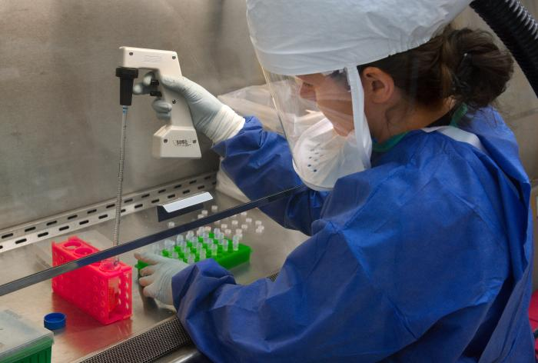
Identify: Examples
Identification: A(H5N1) in Southeast Asia
Identification based on diagnostic tests, not symptoms
Many cases were identified after admission
Delayed appropriate precautions, resulting in exposure to others
Notes:
Isolation for H5N1 in one southeast Asian country was based on diagnostic testing, not symptoms. Patients were not isolated until lab tests confirmed the diagnosis, so they were initially admitted to the ward where other patients and healthcare workers were exposed.
Image: https://phil.cdc.gov/phil/details.asp CDC Image ID #15704

Slide 12
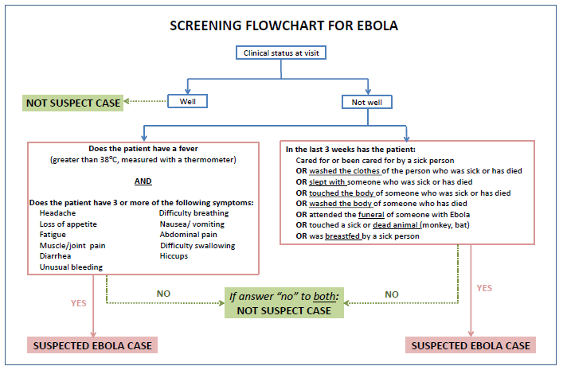
Identify: Examples
Identification: Ebola in West Africa
Identification was difficult because of nonspecific symptoms
Improved by standardized case definitions and algorithms
Notes:
Identifying cases can also be challenging when symptoms are nonspecific for illnesses such as influenza, MERS, SARS. Even some of the symptoms for Ebola were nonspecific, so a standardized case definition was developed, as well as a flowchart/algorithm to help with identification of Ebola cases during screening.

Slide 13

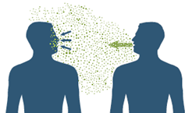

Isolate
Appropriate isolation depends on mode of transmission
Mode of transmission for A(H7N9)
  Touching infected birds or environment then touching eyes, nose, mouth
  droplets/particles that land in eyes, nose, or mouth
  Person-to-person spread (uncommon, non-sustained) by touching or droplets
Notes:
For H7N9, transmission occurs by
touching infected birds or exposure to a contaminated environment then touching eyes, nose, mouth
some studies have shown that the virus is likely aerosolized with transmissibility by droplets
person-to-person spread: no evidence of sustained person-to-person spread, but risk of human-to-human transmission is possibly higher for H7N9 than for H5N1
References:
Fang CF, Ma MJ, Zhan BD, Lai SM, Hu Y, Yang XX, et al. Nosocomial transmission of avian influenza A (H7N9) virus in China: epidemiological investigation. BMJ 2015;351:h5765.
Farooqui A, Liu W, Zeng T, Liu Y, Zhang L, Khan A, et al. Probable Hospital Cluster of H7N9 Influenza Infection. NEJM 2016;374 (6):596-599.
Zhou J, Wu J, Zeng X, Huang G, Zou L, Song Y, et al. Isolation of H65N6, H7N9 and H9N2 avian influenza A viruses from air sampled at live poultry markets. Surveillance and Outbreak Report 2016;21(35):p11-30331.
Chicken image: https://openclipart.org/detail/248294/chickens-coloured (no copyright restrictions)
Sneezing image: Purchased from Shutterstock. Stock vector ID: 201932494

Slide 14
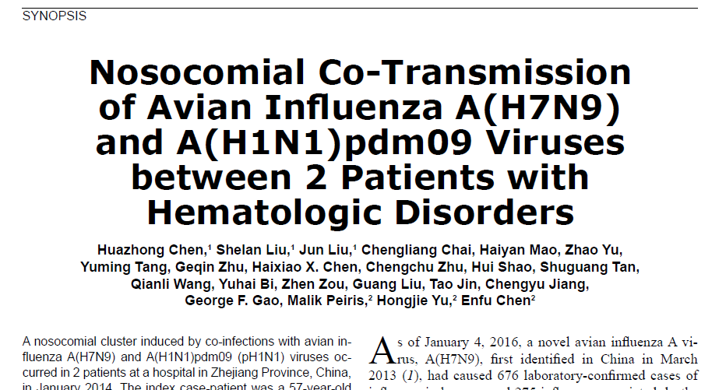
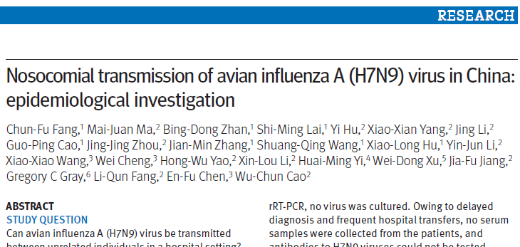
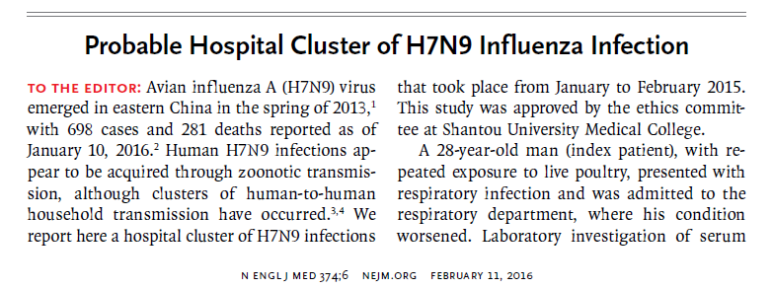
Healthcare or Nosocomial Transmission
Healthcare or nosocomial transmission of A(H7N9) in China
Notes:
There have been several potential instances of nosocomial transmission of H7N9 documented, although an unidentified environmental exposure cannot be completely ruled out.
Fang CF, Ma MJ, Zhan BD, Lai SM, Hu Y, Yang XX, et al. Nosocomial transmission of avian influenza A (H7N9) virus in China: epidemiological investigation. BMJ 2015;351:h5765.
Index patient had exposure to poultry market and the other patient had no bird/poultry exposures. Both patients were admitted to adjacent beds on the same 3 bed ward for 5 days and became symptomatic afterwards.
Genome sequence of both patients were nearly identical.
Chen H, Liu S, Liu J, Chai C, Mao H, Yu Zhao, et al. Nosocomial Co-Transmission of Avian Influenza A (H7N9) and A (H1N1)pdm09 Viruses between 2 Patients with Hematologic Disorders. EID 2016;22(4):598-607.
Index patient had exposure to poultry markets and underwent aerosol-generating procedure (oxygen mask inhalation, negative pressure suction, intubation, mechanical ventilation) during his hospitalization. The other patient had no avian exposure. Viral genetic sequences from both patients were identical.
Farooqui A, Liu W, Zeng T, Liu Y, Zhang L, Khan A, et al. Probable Hospital Cluster of H7N9 Influenza Infection. NEJM 2016;374 (6):596-599.
Index patient with exposure to live poultry. Doctors had close contact with index patients. 3 isolates were more closely related than other samples

Slide 15
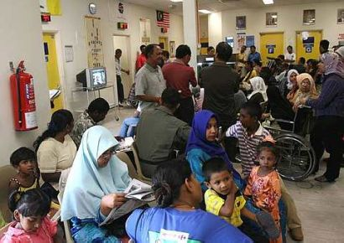
Isolation: Examples
MERS in the Middle East
Crowding makes isolation difficult
Improved early PPE use upon presentation and cohorting
https://cilisos.my/first-ebola-now-mers-should-malaysians-worry-about-an-outbreak/
Notes:
In the Middle East during MERS, crowding made isolation challenging, especially in the emergency department or waiting rooms. After an outbreak, early PPE use such as distributing masks to patients with respiratory complaints was used to prevent transmission in waiting areas and cohorting was used to isolate cases when single isolation rooms were not available.

Slide 16
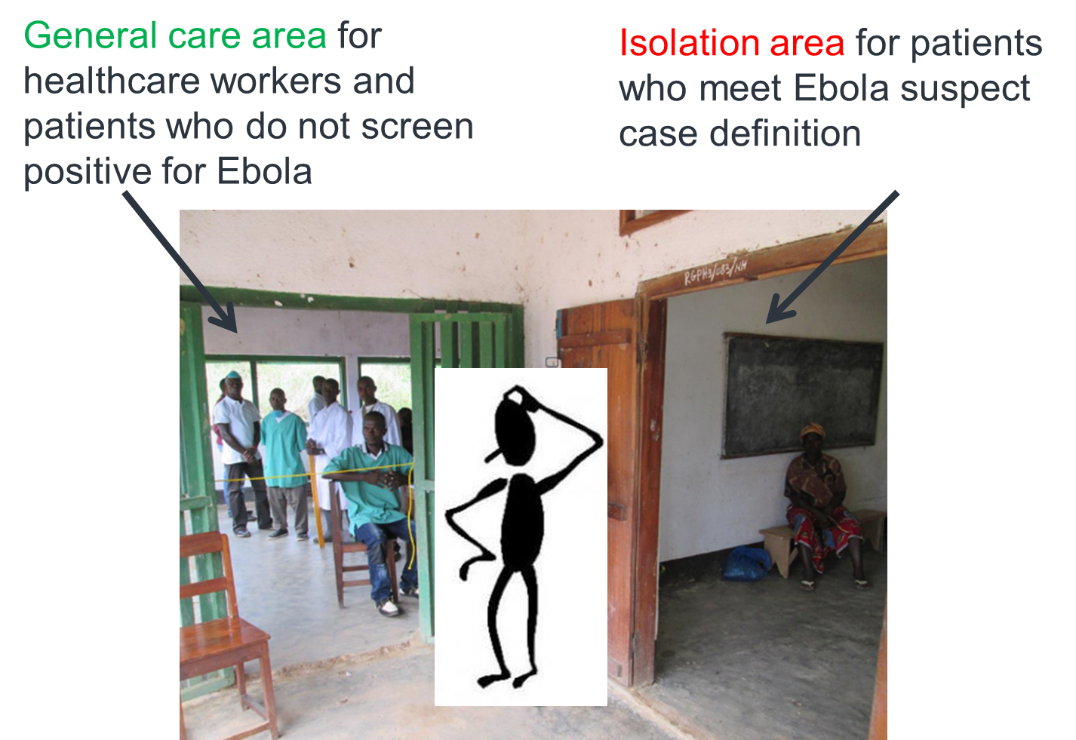

Isolation: Examples
Ebola in West Africa
Outdoor triage and isolation
Cohorting
Separate bathrooms
Notes:
Similarly, in West Africa during Ebola, isolation rooms were often not available so facilities had to use creative alternatives to prevent transmission including moving triage and isolation areas outdoors, cohorting suspected and confirmed patients, and prioritizing separate bathrooms.
Image: Clip art found at http://clipart-library.com/clipart/1390155.htm, but not clear if it’s free for use. No replacement image found that shows general care and isolation area.

Slide 17

Inform
Public health reporting systems allow case information to guide IPC response
  Ensuring facilities with cases have sufficient IPC resources and support
  Coordinating transfer of cases to another facility (when necessary)
IPC activities must be tailored based on epidemiology and number of cases
Notes:
Public health reporting and communication systems allow surveillance information to be shared to guide the public health response, specifically by ensuring that facilities with cases have sufficient IPC resources and support and coordinating the transfer of cases to another facility when necessary because appropriate IPC is not possible.
The IPC activities must be tailored based on the information communicated through this public health reporting system, including epidemiology (e.g. patient population, risk factors) and number of cases
Image purchased from Shutterstock. Stock vector ID: 533872648

Slide 18
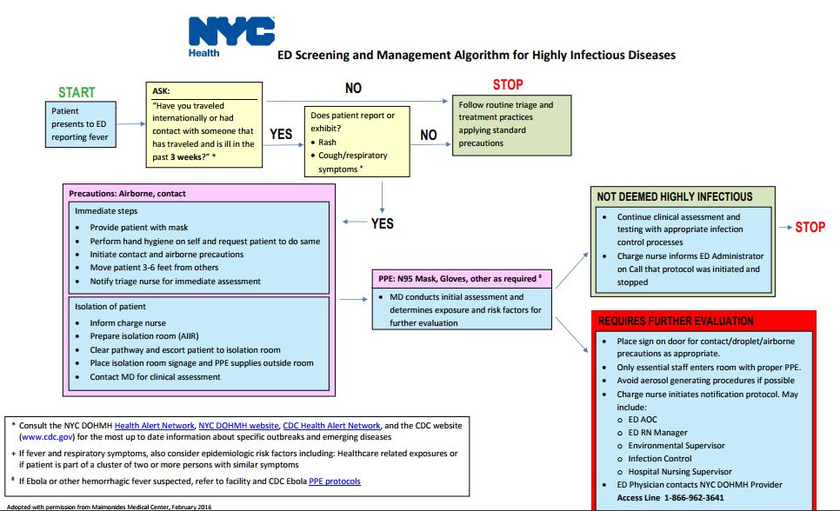

Identify, Isolate, Inform
Identify
Isolate
Inform
https://www1.nyc.gov/assets/doh/downloads/pdf/em/algorithm-template-infectious-disease.pdf
Notes:
Here is an example of an algorithm NYC developed for facilities to identify, isolate, and inform in the event of highly infectious diseases.

Slide 19
Outline
Outline
WHY: Importance of IPC preparedness
WHAT: Elements of IPC preparedness
  IPC guidance and standard operating procedures (SoPs)
  Reporting and communication systems
  Staffing
  Training
  Isolation
  Supplies
HOW: Strategies for IPC preparedness

Slide 20
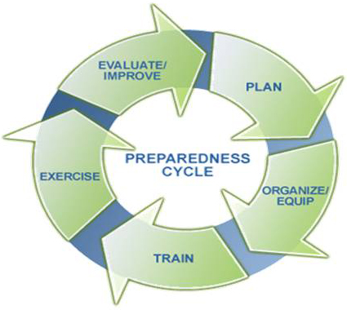
Preparedness
Preparedness: a continuous cycle of planning, organizing, equipping, training, exercising, evaluating, and taking corrective action in an effort to ensure effective coordination
http://www.nwp.usace.army.mil/Missions/Emergency/
Notes:
Preparedness is defined as a continuous cycle. We are focusing on the planning phase, but that includes thinking through and making decisions regarding these other steps.

Slide 21

Discussion Questions
Do you have national or facility-level IPC preparedness plans?
Who is responsible for developing these plans…and then updating or improving the plans?
Notes:
Facilitator notes: Take 5 minutes to lead a brief discussion with the entire group. Ask participants to volunteer to state any whether they make use of national and/or regional ICPs.
If there is still time, also discuss the second question. (this question can be animated on the slide so the facilitator can show it only if there is time)

Slide 22
IPC Preparedness Plan
Consider national IPC preparedness guidance
Consider SOPs and tools to aid implementation
  Standardized case criteria and definitions
  Flowcharts and algorithms for screening and clinical care
  Criteria for patients needing specific transmission-based isolation precautions
Adapt for facility level implementation
Notes:
IPC preparedness relies on guidance documents and implementations tools often created at the national level and adapted by individual facilities.

Slide 23

Communication and Reporting
Public Health Reporting & Communication System
Consider using established or new reporting mechanisms
Timeliness is critical--Established reportable disease surveillance may not be timely enough
Consider hospital-based reporting vs self-reporting by individual patients
https://commons.wikimedia.org/wiki/File:Ghozt_Tramp_-_Business_Communication_Duplicat_model.jpg by Ghozt Tramp
Notes:
Established or new reporting or communication mechanisms can be used to share surveillance information about cases by hospitals or individual patients, but must be timely. This information allows facilities to adjust IPC activities (e.g. screening, isolation) based on accurate and timely information for their area and ensure appropriate IPC supplies.
For example, knowledge of cases nearby may prompt facilities to prepare non-clinical spaces to accommodate patients in isolation. Also, information about the demographics or risk factors of cases identified in the region would help facilities adjust their screening system and algorithms.
Image: https://commons.wikimedia.org/wiki/File:Ghozt_Tramp_-_Business_Communication_Duplicat_model.jpg by Ghozt Tramp (attribution required)

Slide 24
Discussion Questions
How is public health information (including surveillance data) reported in your country?
Is that information used to guide IPC response activities?
Notes:
Facilitator notes: Take 5 minutes to lead a brief discussion with the entire group. Ask participants to volunteer to state the ICP reporting mechanisms they have in place where they work.
If there is still time, also discuss the second question. (this question can be animated on the slide so the facilitator can show it only if there is time)

Slide 25

Inform: Examples
A(H5N1) in Southeast Asia
Established a hotline for self-reporting
Used large-scale messaging to alert all clinicians and public health officials (i.e., GeoChat)
http://blog.socialmaximizer.com/tips-to-build-social-media-trust/
Notes:
During H5N1, one country in southeast Asian
Established a hotline to report cases so that case identification was possible prior to or without presentation to the hospital, thereby minimizing exposures to others
Used a messaging system to send relevant alerts or updates related to the outbreak to all clinicians and public health

Slide 26

Inform: Examples
During a plague outbreak in Southeast Africa
Limited cellular service and road access prevented communication
Used local NGO communication networks
Notes:
During a plague outbreak in SE Africa, health facilities could not communicate with public health officials because of limited cellular service (and even transportation was difficult because of limited road access). Because of this, they were not able to report surveillance data or receive guidance and support on case management from the national level. They used local NGO communication networks to communicate information between remote facilities and national public health authorities.
Photo purchased from Shutterstock. Stock vector ID: 724575262

Slide 27



Communication and Reporting
United States
Email networks may help to share information about urgent public health incidents
Notes:
In the US, several email networks have been established to share urgent public health information to a large audience.

Slide 28


IPC Staffing
Who are national IPC leadership?
Consider identifying IPC leadership and staff at each facility
Consider a clinical staffing plan, ideally with dedicated staff for novel influenza cases
Notes:
It is important to identify leadership at the national and facility level as well as plan for clinical staff to care for suspected or confirmed cases in isolation. Ideally, the number of these dedicated clinical staff would be minimized to limit the number of staff exposed and there would be staff cohorting so these staff would not care for other patients to limit the possibility of transmission via healthcare workers to other patients. Dedicating staff in this way can be logistically difficult and a staffing plan should be established prior to the first case of H7N9 presenting to a facility so the leadership and staff can act swiftly and effectively to implement preparedness plans.

Slide 29

IPC Training
Consider quality IPC foundation for all staff
Think about developing standardized training materials for IPC specific to A(H7N9)
National training or training-of-trainers (TOT) improves standardization
Multiple training methods and conduct refresher trainings are always helpful
Notes:
Training is an important part of routine IPC, as well as IPC specific to an emerging pathogen. In addition to ensuring a quality IPC foundation for staff, specific training on pathogens of interest (such as H7N9) should be developed and conducted prior to presentation of the first H7N9 case so that staff are prepared to implement correct IPC immediately.
For H7N9, this might include
-what clinical information to use to identify potential cases (exposures to sick birds or bird markets, respiratory symptoms as mentioned earlier)
-how to appropriately isolate the patient, including what PPE is required (gloves, gown, N95 mask, and eye protection), how to use it correctly, where the patient should be isolated (in an AIIR or adequately ventilated single room)
Training should include multiple methods at the national and facility levels.
Image: https://openclipart.org/detail/284227/classroom-silhouette-169-hd-with-transparent-blackboard

Slide 30
Isolation
Isolation rooms
Is there availability and capability of AIIR* or ventilated single isolation rooms?
Can you use available isolation rooms strategically?
Are there effective alternatives when demand is greater than availability?
*Airborne Infection Isolation Room
Notes:
Recommendations are that a potential H7N9 cases should be in an adequately ventilated single room, AIIR if available (per CDC guidance).
If AIIR or single isolation rooms are limited, those available should be used strategically for the sickest or most contagious cases or used to cohort multiple cases.
Because not all hospitals may have appropriate isolation rooms, strategies to most efficiently use these isolation rooms can incorporate multiple hospitals in a geographic area.
But when sufficient isolation rooms are not available, consider alternatives to reduce the likelihood of transmission such as…

Slide 31
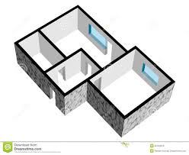

Isolation
Isolation rooms
Make a plan for the availability and capability of isolation rooms
Use available isolation rooms strategically
Consider effective alternatives when demand is greater than availability
H7N9 patients
Non-H7N9 patients
Cohorting
Notes:
Image copyright information unknown, no replacement found.

Slide 32

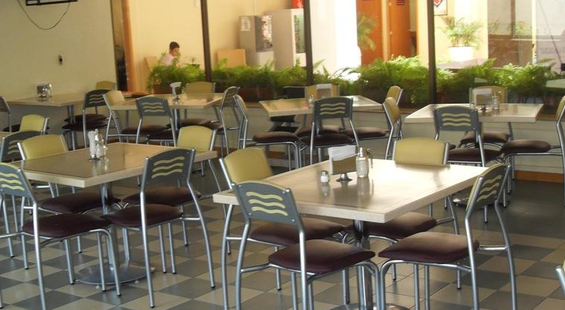
Isolation
Isolation rooms
Make a plan for the availability and capability of isolation rooms
Use available isolation rooms strategically
Consider effective alternatives when demand is greater than availability
Creative use of non-clinical areas
Notes:
Photos purchased from Shutterstock
Left image: Stock vector ID: 396462556
Right image: Stock photo ID: 190963136

Slide 33
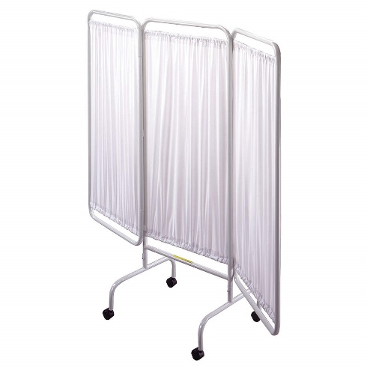
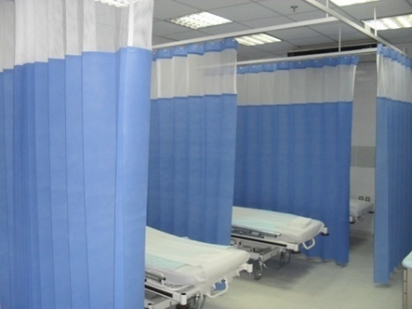
Isolation
Isolation rooms
Make a plan for the availability and capability of isolation rooms
Use available isolation rooms strategically
Consider effective alternatives when demand is greater than availability
Walls or partitions to separate patients
Notes:
https://www.ncbi.nlm.nih.gov/books/NBK143274/#ch5.s27

Slide 34
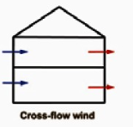
Isolation
Isolation rooms
Make a plan for the availability and capability of isolation rooms
Use available isolation rooms strategically
Consider effective alternatives when demand is greater than availability
Cross-flow wind
Filters or natural ventilation
https://www.ncbi.nlm.nih.gov/books/NBK143274/#ch5.s27
Notes:
https://www.ncbi.nlm.nih.gov/books/NBK143274/#ch5.s27

Slide 35
Isolation
Additional considerations for isolating cases
Clinical care
Patient transport (within and between facilities)
  PPE
  Paths that minimize contact with others
Visitor’s policy
Notes:
Isolation of cases involves factors other than just the isolation room including the delivery of clinical care, patient transport, and PPE.
Provide as much care as possible in isolation and have pre-determined criteria for the procedures, tests, and other care that are appropriate or necessary to do outside of isolation.
Transporting H7N9 cases should be minimized as much as possible, should involved appropriate PPE, and use paths with minimal contact with others
Because of the high risk of H7N9, there should be policy that restricts visitors as much as possible.

Slide 36
Discussion Questions
Which isolation measures have you used?
What challenges have you had in implementing isolation measures?
What could you do at your hospital if no isolations rooms were available?
Notes:
Facilitator notes: Take 5 minutes to lead a brief discussion with the entire group. Ask participants to volunteer to state which isolation measure infrastructure they have available where they work.
If there is still time, also discuss the second and third questions. (these questions can be animated on the slide so the facilitator can show them only if there is time)
Ask about: What if no isolation rooms exist??

Slide 37
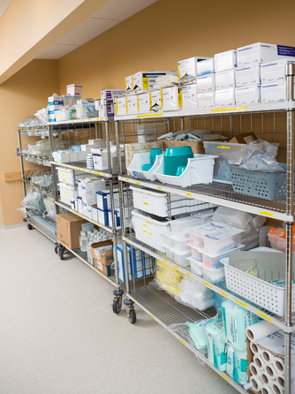
IPC Supplies
Do facilities have appropriate supplies to fulfill function?
Are there plans for timely procurement and distribution of supplies (e.g., stockpiling, redistribution)?
Notes:
Because not all facilities have the same needs, each facility needs to have the appropriate supplies available (e.g. PPE, diagnostic tests, disposable equipment) to serve their expected function, especially when supplies are limited. Some things can be stockpiled, but redistribution of supplies to a ward or hospital with one or more H7N9 cases from other wards or hospitals may be necessary.
Image purchased from Shutterstock. Stock photo ID: 225428374

Slide 38
Outline
Outline
WHY: Importance of IPC preparedness
WHAT: Elements of IPC preparedness
HOW: Strategies for IPC preparedness
  Establish a tiered referral system
  Use Ring IPC to target resources
  Ensure sustainability
  Build a strong IPC foundation
Notes:
Strategies for successful implementation involve close communication between the national and facility level, especially when resources are limited

Slide 39

Tiered Referral System
Few cases of a highly pathogenic or novel illness (i.e., Ebola, A(H7N9))
Referral
All facilities
Identify
Isolate
Inform
Notes:
A tiered referral system is most appropriate when there are few cases of a highly pathogenic or novel illness such as H7N9 and resources are limited. All facilities should be able to identify cases, safely isolate cases, and inform public health authorities, but all facilities may not have the resources to provide long-term, advanced care.
Images:
https://thenounproject.com/term/magnifying-glass/1373211/ by n.o.o.m. (attribution required)
https://thenounproject.com/term/people/1033536/ by Adrien Coquet (attribution required)
https://thenounproject.com/term/user/1222481/ by Juan Carlos Altamirano (attribution required)

Slide 40
Tiered Referral System
Few cases of a highly pathogenic or novel illness (i.e., Ebola, A(H7N9))
Referral
All facilities
Prolonged isolation
Special precautions
Advanced clinical care
Notes:
Because the ability of all facilities to appropriately manage a case may be limited, patients may need to be transferred to a referral facility that is better capacitated to effectively isolate patients, implement special precautions, or administer advanced clinical care.

Slide 41
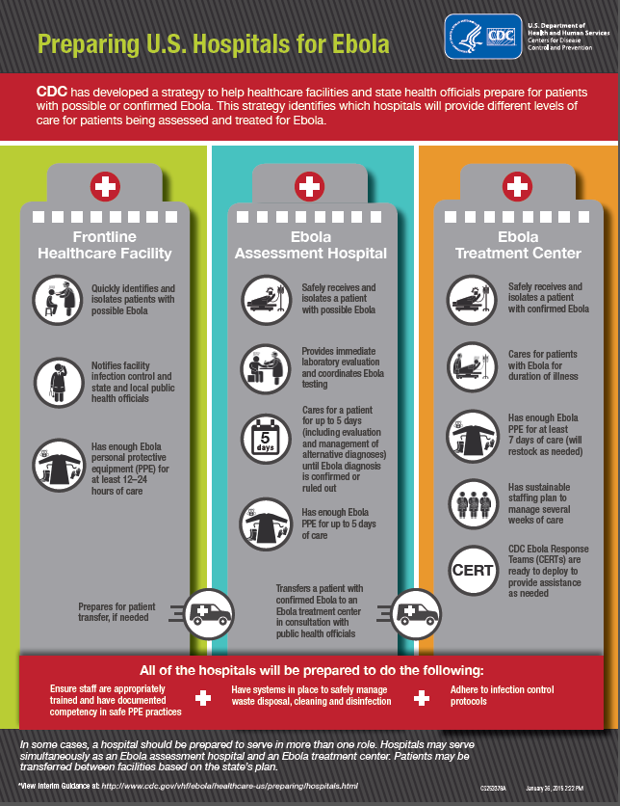
Tiered Referral System: Ebola Example
12-24 hours
4-5 days
weeks
https://www.cdc.gov/vhf/ebola/healthcare-us/preparing/hospitals.html
Notes:
During Ebola, the US established a tiered referral system with 3 tiers of healthcare facilities that each had different responsibilities and different requirements for supplies and resources.

Slide 42
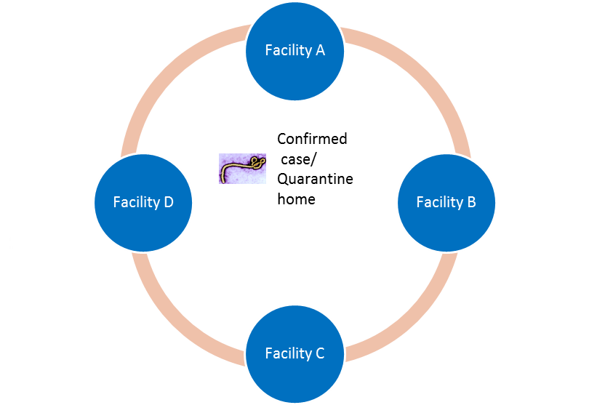
Ring IPC
Focusing limited resources on high-risk healthcare facilities
Used in Liberia during the Ebola epidemic with targeted resources to facilities with:
  Health care workers with a known Ebola exposure
  Neighboring facilities that treated an Ebola case
  Close proximity to the residence of an Ebola case
Ebola case
Notes:
The ‘Ring IPC’ strategy focuses limited resources to the facilities at highest risk of transmission and is most applicable when there is a limited number of cases. During the Ebola epidemic in Liberia, Ring IPC was used to target resources and training to high-risk facilities to prevent Ebola transmission.
Image source unknown.

Slide 43
Discussion Questions
What challenges have you encountered in coordinating IPC between the national and facility levels?
Notes:
Facilitator notes: Take 5 minutes to lead a brief discussion with the entire group. Ask participants to volunteer to state the challenges they have encountered with coordinating IPC between levels.

Slide 44
Sustainability
Leadership buy-in and advocacy
Finances
Knowledge and guidance
Supplies and equipment
Strong IPC foundation
http://www.nwp.usace.army.mil/Missions/Emergency/
Notes:
Because it can be difficult to predict the emergence of novel pathogens, IPC preparedness plans need to be sustainable.

Slide 45
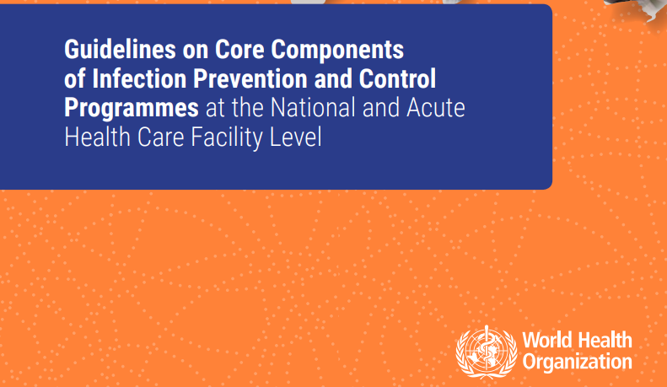
IPC Foundation
Build a strong IPC foundation at the national and facility level
http://www.who.int/gpsc/ipc-components-guidelines/en/
Notes:
A strong IPC foundation is important for routine healthcare as well as planning for the emergence of novel pathogens. In 2016, the WHO released Guidelines on the Core Components of IPC Programmes at the National and Facility Level describing 8 components required of a strong IPC program which can effectively prevent transmission of illnesses such as H7N9 in the healthcare setting

Slide 46
Thank you

