Slide 1
Module E1
Role of Indicator and Event-based Surveillance in Pandemic Early Warning

Slide 2
Learning Objectives
Describe the purpose and rationale for conducting surveillance for respiratory events
Explain the principles of event- and indicator-based surveillance
Define what constitutes an “event”
Outline the steps in an event-based surveillance system
Discuss the elements of successful event-based surveillance

Slide 3
Session Overview
Why conduct surveillance for respiratory events?
What is an event?
What is surveillance?
  Event-based surveillance (EBS)
  Indicator-based surveillance (IBS)
Steps in event-based surveillance
Implementing EBS
Evaluating EBS and elements of successful EBS
Notes:
This module will cover the rationale for conducting surveillance for unusual respiratory events; what constitutes surveillance; what characterizes event based surveillance (EBS) versus indicator-based surveillance (IBS), and the definition of an ‘event.’
We will then shift to a focus on EBS for the remainder of the talk, including the steps of EBS, considerations for implementing EBS, EBS evaluation, and the elements of conducting successful EBS.
This presentation is meant to provide an overview of these core topics and has been adapted from the WHO manual on Early Detection, Assessment and Response to Acute Public Health Events. Each of the topics in this module is covered in more details in the WHO manual (the link to which is found at the end of this slide set).
Since EBS is meant to deal with many epidemic and pandemic threats, the focus of this module will be on respiratory events, as history suggests they are the most likely types of events to produce pandemics.

Slide 4
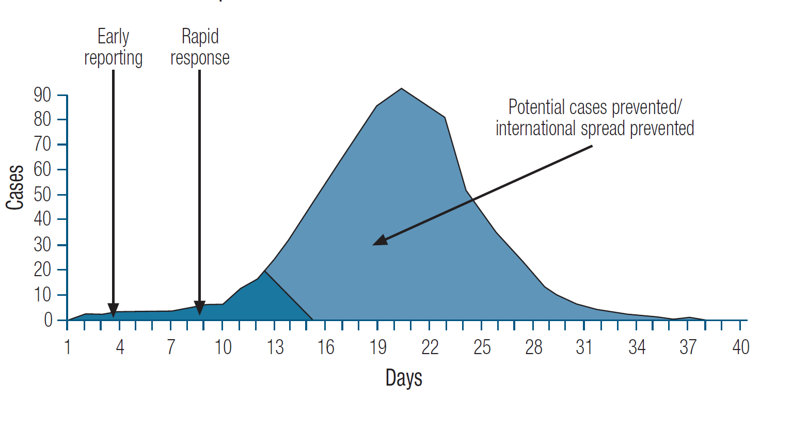
Why Conduct Surveillance for Respiratory Outbreaks?
To rapidly identify and efficiently respond to respiratory threats
  Interrupt disease transmission via control measures
  Identify unusual respiratory outbreaks which may be the first signal of a novel virus with pandemic potential
Source: WHO, The World Health Report 2007.
A Safer Future: global public health security in the 21st century

Slide 5
What is an “Event”?
WHO definition of an ‘event’: ‘A manifestation of a disease or an occurrence that creates the potential for disease.’
WHO definition of an ‘urgent event’: ‘[Those with] serious public health impact and/or unusual or unexpected nature with high potential for spread.’
http://www.who.int/ihr/publications/9789241580496/en/
Notes:
The World Health Assembly developed the International Health Regulations (IHR) to put into place measures to prevent the international spread of disease. According to the IHR, an event is ‘a manifestation of disease or an occurrence that creates the potential for disease’. IHR further defines an ‘urgent event’ as one ‘with serious public health impact and/or unusual or unexpected nature with high potential for spread.’

Slide 6
What is Event-Based Surveillance (EBS)?
The organized collection, monitoring, assessment and interpretation of mainly unstructured ad hoc information regarding health events or risks, which may represent an acute risk to human health
EBS:
A functional component of WHO’s Early Warning and Response system (EWAR)
Requirement of IHR (2005)
http://apps.who.int/iris/bitstream/handle/10665/112667/WHO_HSE_GCR_LYO_2014.4_eng.pdf;sequence=1
Notes:
Now let’s talk a bit more about EBS. As we already mentioned, EBS involves the organized and rapid capture of information with a focus on events that pose a potential risk to public health. Data can be obtained from official data as well as informal or unofficial sources. Examples of the latter include rumors and ad hoc reports. Data may be transmitted through formal channels and informal channels. Events can involve humans or animals.
Many of you may be familiar with the WHO’s Early Warning and Response System (or EWAR). An event-based surveillance is a functional component of EWAR. EBS is also a requirement of IHR.
EBS allows for reporting by healthcare personnel working at any hospital in the country. EBS usually does not utilize case definitions.

Slide 7
What is indicator-based surveillance (IBS)?
  Indicator-based public health surveillance is a traditional way of reporting diseases to public health officials.
  Indicator-based surveillance involves reports of specific diseases from health care providers to public health officials.
  Such information may be described as structured information because the information obtained is standardized.
An example of information obtained through indicator-based surveillance might be reports received on a regular basis and entered routinely into a disease-reporting database on the number of laboratory-confirmed cases of influenza identified at a hospital laboratory.
https://www.cdc.gov/globalhealth/healthprotection/gddopscenter/how.html

Slide 8
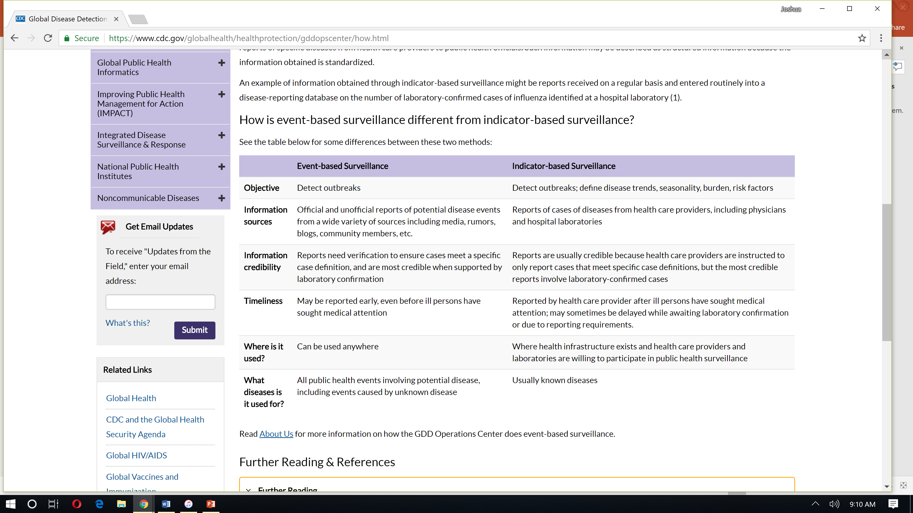
How is EBS different from (and complementary to) IBS?
https://www.cdc.gov/globalhealth/healthprotection/gddopscenter/how.html
Notes:
While the primary objectives of EBS is to detect outbreaks, IBS has the added objectives of monitoring disease trends, seasonality, burden of disease, and risk factors. This makes it very different and because it has all of these objectives may be less effective on its own than EBS at detecting outbreaks. This is why the two systems are complementary. IBS typically includes official and credible reports of disease entities from health care providers while EBS may come from formal (e.g. health care settings) or informal (e.g. communities and other institutions) reports that may not be officials and require a verification that the report is credible. Typically EBS includes reports as events occur. These events may be of unknown cause and without laboratory information. IBS reporting often occurs on a standard time pattern (e.g. weekly or monthly), often requiring the receipt of laboratory results before reporting. EBS can be used in any location that has participants willing and trained to report, while IBS often requires reporting from health care infrastructure. Finally EBS is broad in that it can report events of unknown cause, or even an unknown disease while IBS usually includes reporting of known diseases.
IBS often involves passive reporting whereas EBS often involves active reporting. IBS is often conducted with fixed sources
whereas sources of EBS are often ad hoc. IBS is based on a clear and defined case definitions whereas EBS often does not
utilize case definitions.
Key Point: EBS and IBS are complementary to each other

Slide 9
Events can be detected by two types of surveillance
INDICATOR-BASED SURVEILLANCE
(e.g. SARI and ILI surveillance)
EVENT-BASED SURVEILLANCE
Process | Characteristics of Data
Formalized | Not pre-defined
Flexible | Not standardized
Active | Multiple and Variable
Ad hoc | Informal & formal
Real time | Reliability not established
 | Multiple sources
 | No clear case definitions
 | Collect as much data as possible to assess risk
Process | Characteristics of Data
Systematic | Pre-determined
Routine | Standardized
Passive (mostly) | Limited
Fixed sources (e.g. sentinel sites) | Formal
 | Typically health-care based
 | Routinely analyzed
 | Clear case definitions
Slow to detect outbreaks
but
allows monitoring of trends over time and
measurement of program impact
RAPID REPORTING!
http://www.wpro.who.int/emerging_diseases/documents/docs/eventbasedsurv.pdf
Notes:
Surveillance can be divided into indicator-based surveillance (IBS) and event-based surveillance (EBS).
The processes and characteristics of data collection through IBS and EBS are shown here. Note that IBS and EBS are complementary forms of surveillance, and both contribute to an early warning system focused on rapid and appropriate response to outbreaks such as those caused by novel respiratory pathogens.
IBS involves systematic collection and monitoring of structured data such as indicators that come from predominantly (but not always) healthcare based sources. Under IBS, data is collected routinely and is often collected passively. Established case definitions are used and these may be disease-specific such as a case definition for novel influenza A infection or syndromic such as a case definition for influenza-like illness or severe acute respiratory infection. To identify events or signals, data are analyzed in comparison to baseline values and thresholds. Examples of IBS include epidemiological surveillance, mandatory notification, sentinel surveillance, syndromic surveillance, mortality data, and laboratory data. An event might also be detected in indicator based surveillance if a case meeting a case definition has an association with an exposure of concern.
EBS involves organized collection of ad hoc data, often through active reporting from a variety of diverse sources that may not be defined/identified ahead of time. EBS is often considered more flexible and timely than indicator-based surveillance. We will talk about examples of sources of EBS later in this presentation.
These types of surveillance are also critically important for detecting disease events in animals – primarily domestic but also wild animals.

Slide 10
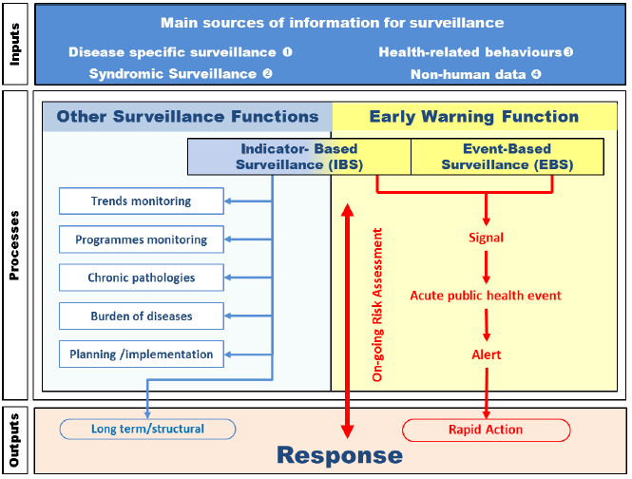
WHO’s Overview of public health surveillance and response functions
As noted later in this presentation EBS signals may have low specificity and a verification step is needed before further action is taken
http://apps.who.int/iris/bitstream/handle/10665/112667/WHO_HSE_GCR_LYO_2014.4_eng.pdf;sequence=1
Notes:
From WHO’s Early detection, assessment and response to acute public health events: Implementation of Early Warning and Response with a focus on Event-Based Surveillance. Interim Version: WHO/HSE/GCR/LYO/2014.4
Sources of information that can be used for the early warning function go far beyond traditional disease-based surveillance (including laboratory confirmation) and syndromic surveillance. They encompass environmental/ecological surveillance (e.g. vector density, water/air quality, climatic data, etc.) and health-related behavioural information (e.g. monitoring of absenteeism in schools or in workplaces, medicine sales and paramedical product such as insect repellent, activities on internet or social networks, etc.) (Figure 1). EWAR should therefore be designed to be sensitive and to detect and respond rapidly to signals and alerts coming from both formal and informal sources, within and outside of the health sector.
As recognized by the WHO mandate in IHR Article 9 related to the use of other sources of information, the national EWAR should integrate collection and analysis of information from any sources beyond that generated by the health system. This type of surveillance is called “Event-Based Surveillance” (EBS). By collecting information before human cases occur or before an event is detected and/or reported through conventional recording and reporting systems, EBS significantly increases the sensitivity of the surveillance system. An effective early warning function ensures a rapid response to acute public health events of all origins, resulting in mitigation of the public health impact. This requires reinforced coordination and close collaboration with all stakeholders within and outside of the health sector.
As noted later in this presentation EBS signals may have low specificity and a verification step is needed before further action is taken

Slide 11
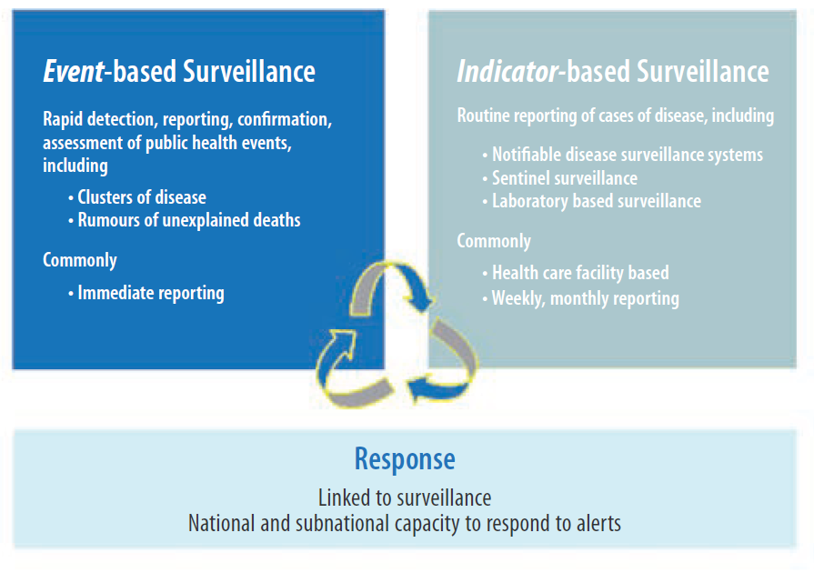
Rationale for EBS
http://www.wpro.who.int/emerging_diseases/documents/docs/eventbasedsurv.pdf
Notes:
Alternative to slide #8

Slide 12

An Example from Vietnam
An Example from Vietnam
Notable outbreaks have been including numerous foodborne outbreaks; hand, foot, and mouth disease; mumps; diphtheria; and chickenpox.
This program significantly decreases the time to reporting of outbreaks, relative to IBS.
https://www.cdc.gov/globalhealth/security/stories/community-based_surveillance.html

Slide 13

Balancing Sensitivity and Specificity
Sensitivity
Specificity
For influenza there is the potential for an EBS system to detect a novel virus in a person with mild or severe respiratory symptoms who has had possible exposure to poultry, or has traveled from a high risk location prior to any decision to seek care.
Because IBS for influenza typically occurs in sentinel hospitals (and not in all locations) these people might not be captured rapidly, or at all, in traditional sentinel (IBS) systems.
However most people with these exposures will not be sick with novel influenza viruses (e.g. during influenza season they are probably more likely to have seasonal influenza) so for this reason event definitions and verification processes must be carefully created and then adjusted to balance sensitivity and specificity to allow the system to be sustainable.

Slide 14
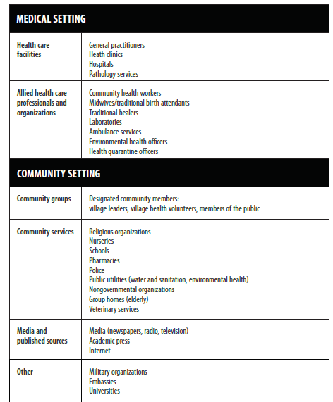
Sources of Reports in EBS
http://www.wpro.who.int/emerging_diseases/documents/docs/eventbasedsurv.pdf
Notes:
Now let’s delve into the sources and steps of EBS in more detail. There are many possible reporting sources for EBS. At its core, EBS is based on a multi-sectorial approach and should include sources outside the traditional healthcare system, and collaboration between human and animal sectors. Animal sectors may include veterinary, agriculture, pet trade, and wildlife.
[Review the sources shown on this slide]
In particular, engaging village health workers may be useful in many countries.
The WHO manual on Early Detection, Assessment and Response to Acute Public Health Events includes a list of regional and international websites involved in early warning.

Slide 15

Discussion Question #1:
What are some sources of event-based surveillance in your country or specific location?
Examples from community groups:
Examples from medical settings:
Notes:
Facilitator notes: Take 5 minutes to lead a brief discussion with the entire group. Ask participants to volunteer to describe an existing surveillance system in their country/location.
Examples include:
IBS often involves passive reporting whereas EBS often involves active reporting. IBS is often conducted with fixed sources
whereas sources of EBS are often ad hoc. IBS is based on a clear and defined case definitions whereas EBS often does not
utilize case definitions.
Key point refresher: IBS and EBS are complementary and sometimes certain attributes may overlap.

Slide 16
Knowledge Check #1:
Are the following examples of IBS or EBS?
An increase in the number of suspected deaths from cholera (using national case definition), drawing on health facility records
Villagers complain to their local leader about the stench from the hundreds of dead fish that appeared in the river yesterday
A factory director contacts health authorities and complains about a constant increase of workers on sick leave
The central pharmacy reports to the health authority that the sale of anti-malarial drugs in non-endemic areas has exceeded the normal pattern
Notes:
Answers:
1: IBS
2: EBS
3. EBS
4. IBS
Source: WHO’s manual on Early Detection, Assessment and Response to Acute Public Health Events (2014)

Slide 17

Steps of EBS
Define events of interest that should be reported
Generate health event report with basic initial information
Assess if a signal is an event of interest
Verify the event
Assess the risk posed by event
Communicate
Response (as indicated)
http://www.who.int/ihr/publications/WHO_HSE_GCR_LYO_2014.4/en/
Notes:
Now let’s talk about the steps involved in EBS. There are 7 key steps:
First, when EBS is being set-up, it is important to define events of interest that should be reported. This includes working with stakeholders to define the list of events to monitor and reassessing and modifying the list periodically, as needed.
When an event occurs, the reporter must generate a health event report with basic initial information. The mechanism of reporting should be outlined and standardized including to whom reporting should occur and in what manner.
The next step is to assess if the signal that is being reported is an event of interest.
Followed by confirming the event.
Then the event must be assessed to decide whether a response is necessary and to guide the scale of the response.
The event should be communicated to the appropriate stakeholders
Finally, if the risk assessment indicates that a response is warranted, the fifth step is to implement timely and appropriate public health or animal health response.
We will use the next few slides to talk about each of these steps in more detail.
Image purchased from Shutterstock. Stock vector ID: 620651927

Slide 18

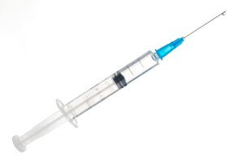

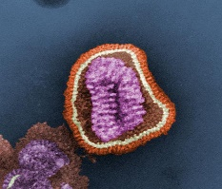


EBS Step 1: Define events of interest that should be reported
UNUSUAL Severe Respiratory Illness
Severe disease in an otherwise young and healthy person
From influenza viruses that are not circulating in humans
Occurring in person(s) with contact with sick animals or who works with animals
Cases in people who have traveled to areas where virus circulation has pandemic potential
Unexplained illness in a health worker who attends to patients with respiratory disease
Influenza virus image CDC/ Dr. Erskine. L. Palmer; Dr. M. L. Martin
Notes:
As a first step in setting up EBS, it is important to define a preliminary list of events that would be considered unusual and would warrant rapid reporting, monitoring and further investigation. Note that as data are gathered through EBS and IBS and/or as the local and national context changes, you may need to modify the initial list of events if they are thought to be too sensitive or restrictive.
This slide and the next slide provide examples of what might be defined as an unusual respiratory event of interest. Let’s start with events that represent unusual cases of severe respiratory infection illness .
[Review the examples on this slides].
An example of severe respiratory illness cases in people who have traveled to areas where virus circulation has pandemic potential would be travelers with severe respiratory illness who have returned from an area with endemic MERS infections.
Question mark photo: Purchased from Shutterstock. Stock vector ID: 584901160
Syringe photo: Purchased from Shutterstock. Stock photo ID: 526465792
Chicken photo: Purchased from Shutterstock. Stock photo ID: 273937919
Health worker photo: Purchased from Shutterstock. Stock photo ID: 755082100
Globe/travel photo: Purchased from Shutterstock. Stock vector ID: 350819573

Slide 19

Unusual Disease Clusters (Outbreaks):
Two or more SARI or hospitalized pneumonia cases in members of the same family, social group or workplace (within 2 weeks)
Other Events of Interest:
Respiratory event that raises concern, fear or alarm in the community
Unexplained, unusual death that raises concern in community
Outbreaks of death or illness in poultry or other animals
Notes:
Unusual disease clusters may also represent unusual respiratory events. For example, two or more SARI or pneumonia cases in members of the same family, social group, or work that occur within 2 weeks of each other could be considered an unusual respiratory event of interest.
Some other respiratory events of interest are also shown here:
Respiratory events that raise concern, fear, or alarm in the community.
An unexplained, unusual death that raises concern in the community
Outbreaks of death or illness in poultry or other animals.
Question mark photo: Purchased from Shutterstock. Stock vector ID: 584901160
Poultry photo: Purchased from Shutterstock. Stock photo ID: 380607640

Slide 20
Discussion Question #2:
Should all possible events be included in EBS in all countries?
Why or why not?
Notes:
Facilitator notes: Take 5 minutes to lead a brief discussion with the entire group.
Points to emphasize:
Each country or jurisdiction will need to decide what diseases, triggers, events are important to be tracked
These decisions need to balance the need to create a very sensitive system with the local resources or capacity to investigate each and every signal or possible event

Slide 21
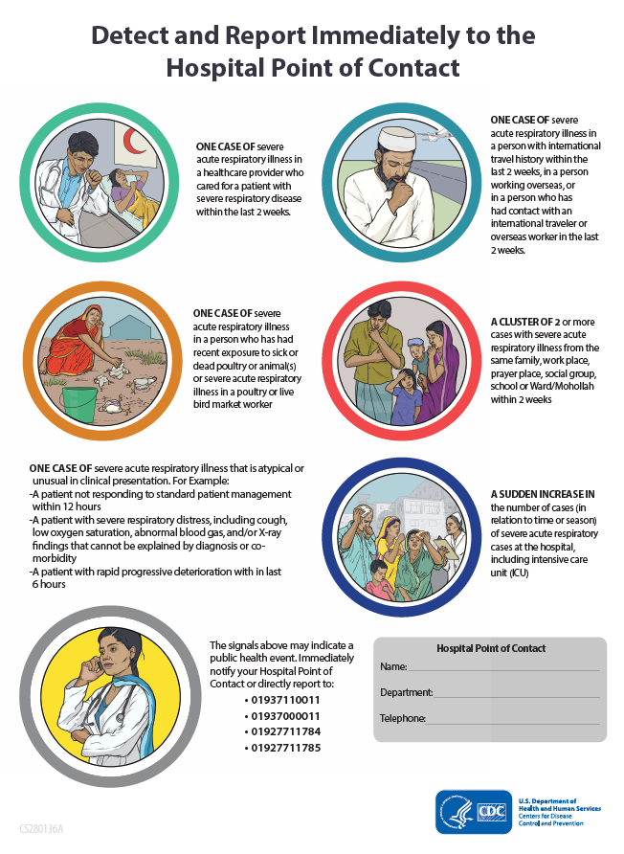
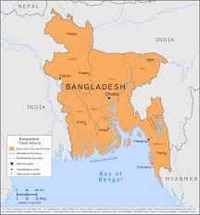
Simple communication of reportable events using plain language, pictures (sample, Bangladesh)
Training EBS Participants on Reportable Events
Notes:
After a country/region determines what events are to be monitored by EBS, the community needs to be informed.
Implementing EBS successfully also requires initial and periodic refresher training of those who are expected to report so that they clearly understand what constitutes an event that should be reported. It can also be helpful to create printed materials outlining reportable events as a reference to EBS system participants. For example, this informational poster includes pictures and text defining reportable events through EBS for respiratory illness in Bangladesh.

Slide 22

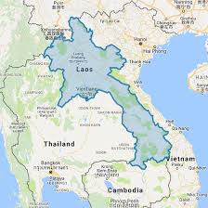
Simple communication of reportable events using plain language, pictures
(source: National center for Laboratory and Epidemiology, Lao PDR)
Training EBS Participants on Reportable Events
Notes:
Another example of training materials that include pictorial representations of reportable events, as well as information about how to report an event (e.g. hotlines) is shown here. This informational poster includes pictures and text defining reportable events of poultry die-offs in Laos.

Slide 23
EBS Step 2: Generate a Health Event Report
Health Event Report Please send this to your Local Health Office or to your regional epidemiology and surveillance unit
1 | Date (today’s date)
2 | What do you want to report? What happened?
3 | When did this happen? (Month, day, year)
4 | Where did this happen? (Municipality or City, Province, Region)
5 | How many have been affected?
6 | Has anyone died? How many?
7 | Other information you have
8 | What is your name and contact number?
Notes:
Basic information about every health event should be reported to facilitate confirmation and assessment of the event. The information should be collected in a standardized manner and the level of detail should be based upon information that is needed to guide action.
Data from each reported event should be collected and stored systematically. A basic form should be used to collect initial information including
Date of the report and the reporters contact information
Description of the event
Date and time of event
Location of the event
Number of individuals affected
Number of deaths
Other pertinent information, including whether any actions have already been taken

Slide 24

EBS Step 2: Generate health event report with basic initial information
Use existing public health infrastructure where available
  Example: EWAR-type systems
  Avoid creating new “parallel” system
  Reporting system must fit within national guidance
Have clear reporting structure
Reporters should have equipment needed to report
Easy and existing reporting methods
24/7 reporting
Existing hotline reporting system in Bangladesh
Notes:
Ideally, EBS should use existing public health infrastructure for reporting and the reporting structure should be clearly defined. Those involved in EBS reporting should have a clear understanding of the type of event that they should report and how to report an event.
Reporters also need access to the necessary forms and/or equipment to submit reports in a timely manner. For examples, if village health workers are expected to transmit reports electronically, then they need access to consistent internet access by computers, mobile phones, or other devices. Hotlines and mechanisms for reporting 24/7 may also be used to facilitate timely reporting of events.
This is a pamphlet from Bangladesh on which several hotline numbers are listed for community-based reporters to use to reach EBS staff.
EWAR: Early warning and response

Slide 25

Example
Implementing EBS: Reporting Structure
Community Health Worker (ASC)
And
Community healers
Health Area
(Head of AS)
Health District
(Head of DS)
Regional Level (DRSP)
Cameroon public health structure
Notes:
As we mentioned on the previous slide, having a clearly defined reporting structure is an important part of surveillance in general and EBS in particular. This is an example of the reporting structure used in Cameroon. There is bidirectional flow of information flowing from the community level through health workers and traditional healers up through the health area, district level, regional level and finally the national level. The reporting structure will vary by country but should include important stakeholders and allow reporting from the community/hospital level up through the national level.

Slide 26
EBS Step 3: Assessing if the Signal is an “Event” of Interest
Possible examples of single case events with relevance to influenza
(for discussion or modification):
Any respiratory illness in a person who is occupationally associated with chickens, pigs, or water fowl or who has been exposed to a poultry die-off
Acute respiratory infection severe enough to recommend hospitalization in a person who recently (within the past 14 days) traveled to China, Middle east, or an area where a pathogen with pandemic potential
Acute respiratory infection severe enough to recommend hospitalization in a healthcare worker who takes care of or was in contact with patient with severe respiratory infection within 14 days of becoming sick
A cluster of acute respiratory infection severe enough to recommend hospitalization that meets the definition of public health emergency of international concern (PHEIC)
A person with any illness due to an untypeable or novel influenza strain
Notes:
Single cases meeting certain criteria may also be events of interest. For example: [review the 5 bullets on this slide]

Slide 27
EBS Step 3: Assessing if the Signal is an “Event” of Interest
Possible examples of case clusters with relevance to influenza
(for discussion or modification):
A cluster (5 or more cases within a 2-week period) of ILI cases that occur in a closed setting (school, barracks, elderly home, prison, etc.)
A cluster (5 or more cases within a 2-week period) of ILI that increases in size (number of cases) or that continues despite appropriate interventions
A cluster of 2 or more patients with acute respiratory infection severe enough to recommend hospitalization among epi-linked persons (e.g. same family, same occupational or social group, same closed settings (schools, army barracks etc.) that results in hospital admission
Notes:
Clusters of ill persons may represent events of interest. For example:
[Review the 3 bullets on this slide]

Slide 28
EBS Step 3: Assessing if the Signal is an “Event” of Interest
Other possible event definitions with relevance to influenza
(for discussion or modification):
Outbreaks of death or illness in fowl (e.g. poultry or ducks)
A sudden, unusual (severity or clinical manifestation) event, or a reported increase in severe disease, or unexplained death (does not have to be respiratory) reported by a clinician or nurse
Notes:
Lastly, an outbreak of death or illness in birds or a sudden, unusual event, or reported increase in severe disease, or unexplained death would constitute an event of interest that would warrant further investigation.

Slide 29
EBS Step 4: Verify the event
  Review and substantiate reported events
    Is information accurate?
    Confirm information especially from unreliable sources
    Eliminate information based on inaccurate rumors
Event reports that are more likely to be true:
Confirmed by multiple different sources of information (i.e. not the same source repeated by secondary informants)
Reported by trained health care workers
Include clear information about PERSON, PLACE and TIME
  (i.e., 5 people from village X developed fever and symptoms of upper respiratory infection after having contact with sick chickens over the last 2 weeks).
Notes:
After an event is reported from a community or hospital-based source, the RRT must assess the credibility of the event. This is the process by which a report from the community, media or health care worker is reviewed and substantiated (i.e., the reported event is considered to have truly occurred). Because the sources of information for event-based surveillance are diverse and of variable quality, it is important to determine if the information is accurate. For example, false information or inaccurate rumors should be eliminated and information form unreliable sources should be confirmed.

Slide 30
Assess the event
Is it a public health threat?
Is further action warranted?
EBS Step 5: Assess the Risk Posed by the Event
‘Risk assessment [is the] systematic process for gathering, assessing and documenting information to assign a level of risk to human health to an event.’
http://www.who.int/ihr/publications/WHO_HSE_GCR_LYO_2014.4/en/
Notes:
Event assessment is the process by which the available information about a confirmed event is analyzed and a judgement is made as to whether the event represents a potential risk to human health and whether a response is required . According to the WHO manual, risk assessment is ‘[see quote in slide]’.
Note that risk assessment is a continuous and ongoing process. An initial assessment should be made within 48 hours of identifying an event and reassessed over time as more information becomes available. Subject matter experts should be engaged in the risk assessment process and the overall risk assessment is usually based on the expert opinion of the risk assessment team.

Slide 31
Risk Assessment within EBS
Reported events should be assessed for risk to human health
This assessment process is focused on the event of interest and is different from:
Influenza Virus-specific Risk Assessments
Influenza-specific risk assessments describe the risk of a specific influenza virus.
Examples:
WHO’s Tool for Influenza Pandemic Risk Assessment (TIPRA)
CDC’s Influenza Risk Assessment Tool (IRAT)
Notes:
Here we are outlining the risk assessment process that occurs within an EBS, such that reported events are assessed for the risk such an event poses to human health.
This risk assessment is focused on a specific event of interest and is different and distinct from influenza virus-specific risk assessments. These influenza-specific risk assessments look at the pandemic risk of a specific virus. WHO’s influenza virus-specific risk assessment is called the Tool for Influenza Pandemic Risk Assessment (TIPRA) and CDC has another influenza-specific tool, called the IRAT.

Slide 32
Assess the event
Is it a public health threat?
Is further action warranted?
EBS Step 5: Assess the Risk of the Event
 | ASSESSMENT QUESTIONS | YES | NO
Human heath events | Does the event involve a notifiable disease or syndrome (e.g. novel or avian influenza)?
 | Can the suspected disease cause outbreaks with a high potential for spread (e.g. novel influenza)?
 | Is there a higher than expected mortality or morbidity from the respiratory infection?
 | Is the disease unusual/unexpected in the community?
 | Is there a cluster of cases or deaths with similar symptoms?
 | Does the disease have possible consequences for trade or travel (e.g. SARS, foot and mouth disease)?
 | Is there suspected nosocomial spread of the respiratory infection (i.e. is the infection being transmitted within a health care setting)?
Non-human health event | Does the event have a known consequence for human health (e.g. suspected novel influenza)?
Notes:
We are focused on the assessing the risk of a report event and the questions on this slide can help guide a risk assessment. If the answer is yes to any of these questions then a more robust investigation is warranted.
Note: in most cases there isn’t any lab criteria to go on at this stage so you would be looking at suspected cases of novel influenza.

Slide 33
What is WHO’s Risk Assessment for Events?
Under the IHR, risk assessment can include assessment of:
risk to human health,
risk of international spread of disease, and
risk of interference with international traffic
Each must be assessed to determine the level of risk to human health and to establish the nature of the potential mitigation and control measures that can be implemented
Risk assessment is an ongoing process as the level of risk may change over time
http://www.who.int/ihr/publications/WHO_HSE_GCR_LYO_2014.4/en/
Notes:
In the context of EWAR, the risk assessment is a systematic and continuous process for gathering, assessing and documenting information to provide the basis for taking action to manage and reduce the negative consequences of an acute public health event. An initial assessment should be made within 48 hours of identifying an event and reassessed over time as more information becomes available. Subject matter experts should be engaged in the risk assessment process and the overall risk assessment is usually based on the expert opinion of the risk assessment team.
Additional details about the risk assessment process can be found in the following WHO manuals and publications:
Rapid Risk Assessment of Acute Public Health Events. (2012)
http://www.who.int/csr/resources/publications/HSE_GAR_ARO_2012_1/en/
Early Detection, assessment and response to acute public health evets: Implementation of Early Warning and Response with a Focus on Event-Based Surveillance. (2014)
http://www.who.int/ihr/publications/WHO_HSE_GCR_LYO_2014.4/en/
Tool for influenza pandemic risk assessment (TIPRA)
http://apps.who.int/iris/bitstream/10665/250130/1/WHO-OHE-PED-GIP-2016.2-eng.pdf?ua=1

Slide 34
Level of risk assigned to an event is based on 3 components:
  suspected or known hazard;
  possible exposure to the hazard
  context in which the event is occurring
Hazard Assessment
Exposure Assessment
Context Assessment
Notes:
The WHO’s general approach to risk assessment includes three components of the assessment: the suspected or known hazard, the level of possible exposure to the hazard, and the context in which the even is occurring. The questions that you saw on the previous slide help inform these three components.

Slide 35
Components of WHO EBS Risk Assessment
EXAMPLES
Can be a virus, bacteria—or even biological, chemical cause
Hazard: pathogen(s) or other etiology causing the event and the associated negative health effects
Exposure: individuals and populations exposed to the likely hazard
Number of people known or likely to have been exposed
Number of exposed persons who are susceptible to the hazard
Context: environment or setting in which the event is taking place
May include the climate, water systems, health of the population, infrastructure
Hazard Assessment
Exposure Assessment
Context Assessment
http://www.who.int/ihr/publications/WHO_HSE_GCR_LYO_2014.4/en/
Notes:
The first component, hazard, refers to the pathogen(s) or other etiology thought to be causing the event. If laboratory-confirmation is available, then identifying the hazard is relatively straightforward. However, early in event detection, the hazard may not be known. In this case, a differential of possible hazards should be developing taking into consideration clinical features, seasonality, geographic area affected, and persons/populations affected.
Additional details about the risk assessment process can be found in the following WHO manuals and publications:
Rapid Risk Assessment of Acute Public Health Events. (2012)
http://www.who.int/csr/resources/publications/HSE_GAR_ARO_2012_1/en/
Early Detection, assessment and response to acute public health evets: Implementation of Early Warning and Response with a Focus on Event-Based Surveillance. (2014)
http://www.who.int/ihr/publications/WHO_HSE_GCR_LYO_2014.4/en/
Tool for influenza pandemic risk assessment (TIPRA)
http://apps.who.int/iris/bitstream/10665/250130/1/WHO-OHE-PED-GIP-2016.2-eng.pdf?ua=1

Slide 36
Components of WHO EBS Risk Assessment
Risk characterization: the level of risk should be assigned to an event after the hazard, exposure and context assessments are completed
Often qualitative, based on the expert opinion of the team
http://whqlibdoc.who.int/hq/2012/WHO_HSE_GAR_ARO_2012.1_eng.pdf
Notes:
For more information on risk assessment:
Rapid Risk Assessment of Acute Public Health Events. Geneva: World Health Organization; 2012 (WHO/HSE/GAR/ARO/2012.1; http://whqlibdoc.who.int/hq/2012/WHO_HSE_GAR_ARO_2012.1_eng.pdf , accessed 31 March 2014).
Operational guidance on rapid risk assessment methodology. Stockholm: ECDC; 2011 (http://ecdc.europa.eu/en/publications/Publications/1108_TED_Risk_Assessment_Methodology_Guidance.pdf, accessed 31 March 2014).
Guide for Application of Risk Analysis Principles and Procedures during Food Safety Emergencies. Rome: FAO/WHO; 2011. (http://www.fao.org/docrep/014/ba0092e/ba0092e00.pdf, accessed 31 March 2014).

Slide 37
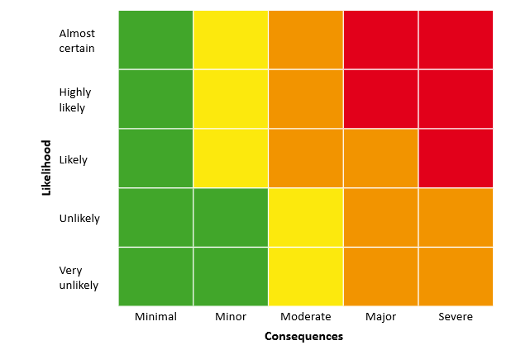
WHO’s risk matrix showing clearly delimited boundaries between categories
likelihood of further spread
consequences (type and magnitude) to public health
Notes:
WHO has developed a risk matrix which can be used by the team assessing the public health event to estimate:
-the likelihood of further spread of severe cases of respiratory disease and,
-the consequences (type and magnitude) to public health if this were to occur

Slide 38
Using Risk Assessment to Guide Public Health Response to an Event
Notes:
Each level of overall risk then has corresponding actions.
For example, a low risk event may be able to be managed according to standard response protocols or routine surveillance.
Moderate Risk events may need enhanced activities, such as surveillance or specific control measures.
High risk events may require the attention of senior management or leadership, whether because command or control structures need to be established or because additional control measures may be needed, some of which may have significant consequences.
Very high risk events require immediate response and attention, including reporting and action outside of normal work hours. Control measures would be needed and the risk of serious consequences is highly likely.

Slide 39
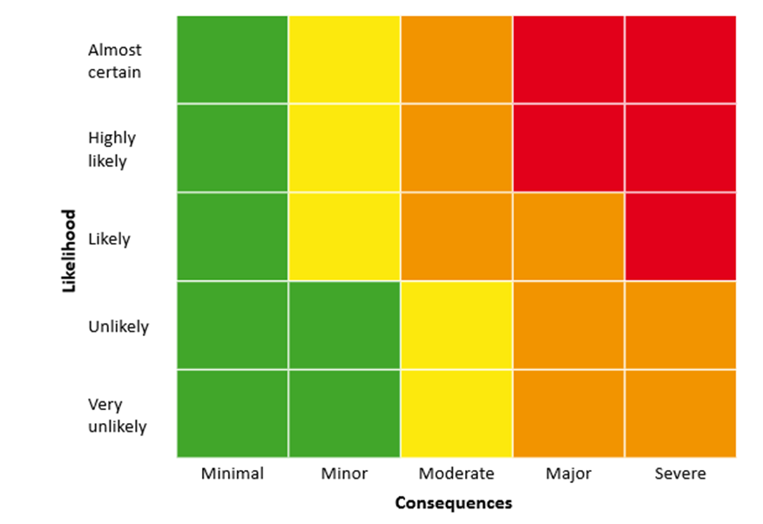
Discussion Question #3:
A cluster of 22 cases of severe respiratory disease with seven deaths in country x were admitted to hospital over the past 17 days
The event is occurring 8 km from the border and cases have been reported from three villages by a local health-care worker (HCW). The area is the poorest in country x and health infrastructure is limited
There are also strong beliefs that `strange diseases´ are caused by sorcery
Likelihood of spread?
Expected consequences?
Notes:
Facilitator notes: Take 5 minutes to lead a brief discussion with the entire group. Ask the participants to estimate the likelihood of further disease spread and the likelihood of severe consequences of the scenario shown.
Is the likelihood of further spread how or high?
Are the expected consequences mild or severe?
(Discussion from WHO document to guide discussion—if needed:
Information used to assess the likelihood of further spread:
• cases are still being reported 17 days after the first known cases were detected
• the specific hazard and mode(s) of transmission have not been identified
• it is also likely that some cases are not being detected (e.g. mild cases are less likely to seek care from health services and are therefore not included in the official reports).
Therefore it is highly likely that further cases will occur if nothing is done.
Information used to assess the consequences of further spread:
• the disease has a high case fatality ratio
• the health-care system is poor and the ability to treat the cases is already limited
• negative economic and social impact of the cases and deaths in the affected communities
• there is potential for unrest in communities because of cultural beliefs that sorcery is causing the deaths
• the event is occurring in a border area and could affect the neighbouring country.
Therefore the consequences if further cases occur will be severe.
Using the risk matrix to combine the estimate of the likelihood and the estimate of consequences leads to an estimate of the overall risk; in this case, the overall level of risk is high.
The confidence in the risk assessment is low-medium. Although the report is from a local HCW, the information is limited and it is not clear if the HCW has examined the suspect cases or is reporting a rumour.

Slide 40
EBS Step 6: Communicate Communicate
Operational communication: between risk assessment team and relevant stakeholders
Communication with the public: Communication to provide key findings from risk assessments at regular intervals
how the team will provide regular feedback on the risk assessment, and in what format;
clearly defined roles and responsibilities (e.g. focal points) for communications functions;
how and in what format the information should be presented to stakeholders and the public.
http://www.who.int/risk-communication/guidance
Notes:
Risk communication is an integral part of the risk management process
There are two equally important components to risk communication:
• Operational communication: The structured communication that organizations use to communicate internally and with people outside their organization.
• Communication with the public: Communication to provide key findings from risk assessments at regular intervals. Regular communication helps to ensure that the public is informed of the nature and level of risks and the desired behavioural changes that can minimize them.
At the start of the risk assessment, the team should identify stakeholders. The communication strategy for each public health event should be agreed as soon as possible to ensure that there is two-way communication between the risk management team and stakeholders.
The strategy should include:
• how the team will provide regular feedback on the risk assessment, and in what format;
• clearly defined roles and responsibilities (e.g. focal points) for communications functions;
• how and in what format the information should be presented to stakeholders and the public.

Slide 41
Feedback and Communication to Stakeholders
Relevant, periodic and useful feedback to stakeholders is critical to maintaining EBS
Format of feedback should be simple and appropriate to the audience
  Include updates on event confirmation, assessment, and response
  Include data on EBS in surveillance bulletins and consider publishing reviews and evaluations of the system
  Positive reinforcement for local workers
Notes:
Alternative to slide #35
Relevant, periodic and useful feedback is essential to maintaining EBS systems. Without relevant and useful feedback people will stop reporting events. The format should be simple, adapted to the audience, and include regular updates on confirmation, assessment and response. Consider providing extra data to the media who provide the initial report. Include data on event-based surveillance in surveillance bulletins and publish regular reviews and evaluations of the system.

Slide 42
EBS Step 7: Response
Response planning
  Scale guided by risk assessment and triage: partial or full-scale investigation
  Organized by local or national level
  Should follow clear procedures and include defined roles and responsibilities of responders
  May link with national Emergency Response Center
Notes:
Once an event is confirmed and is considered to be a potential risk to public health based on the risk assessment, the event should be triaged to determine if it warrants a partial or full-scale investigation; not all events will require a full scale investigation. Epidemiologists or public health experts with general expertise in public health should be engaged in the triage process. If an animal event is reported, public health veterinarians and veterinary specialists for the species in question should be engaged. A response can be organized from either the local or national level. There should be clear procedures for responding to an event, including definition of roles and responsibilities of key responders and other stakeholders. The response may also be linked with a national Emergency Response Center. The steps involved in assembling and deploying a rapid response team and in conducting a case and outbreak investigation will be covered in more detail during Modules 3 and 4.
When considering whether to do a partial or full-scale investigation, this is where countries need guidance on how to separate noise from real event signals quickly so that they are not “over responding” to small events and over committing human and laboratory resources.
I was thinking examples of events where you “stop” after an initial assessment and those where you “go” and do a more comprehensive investigation is what I was referring to.

Slide 43
Response
Institute control measures:
  Infection control (community and hospital)
  Social distancing
  Vaccines (in humans or animals)
  Antivirals/antibiotics as indicated
  Animal control and bio-containment strategies
Risk communication:
  the exchange of real-time information, advice and opinions between experts and people facing threats to their health, economic or social well-being.
  The ultimate purpose of risk communication is to enable people at risk to take informed decisions to protect themselves and their loved ones.
  www.who.int/risk-communication/background/en/
Notes:
The goal of instituting control measures is to mitigate the impact of the acute public health event and prevent further spread of the disease. The choice of control measures that are implemented should be guided by the likely effectiveness and consequences of the control measures. Control measures may include
infection control measures at the community and hospital levels,
implementing social distancing measures as indicated such as school closure and public health messaging to ill persons to stay at home while symptomatic,
use of vaccines if available and appropriate for the pathogen that has been identified
antiviral and antibiotics as indicated.
Control and biocontainment as well as vaccines may be applicable if an animal event is reported such as a poultry die-off and should follow the guidances of international organizations such as OIE and FAO as taught in the veterinary technical modules.
Infection control procedures for novel influenza viruses and other novel respiratory pathogens are covered in more detail in the clinical modules.
Risk communication is also a part of the response and requires timely and ongoing communication with the community and other stakeholders. Effective and clear communication is typically needed at various times during an outbreak investigation. If an animal outbreak is involved, risk communication should be coordinated between public health and animal health sectors.

Slide 44
Review Question #1
What are the 7 steps outlined as part of event-based surveillance?
Notes:
Facilitator Notes: These review questions may be included if appropriate for the audience
What are the 7 steps outlined as part of event-based surveillance?
Answer:
Define events of interest that should be reported
Generate health event report with basic initial information
Assess if a signal is an event of interest
Verify the event
Assess the risk posed by event
Communicate
Response (as indicated)

Slide 45
Discussion Question #4
In your country or specific location, which of the EBS steps present the most challenges?
Notes:
Facilitator notes: Take 5 minutes to lead a brief discussion with the entire group. Ask participants to volunteer to describe the challenges they might face in an EBS

Slide 46
Review Question #2
What are the goals and components of general risk assessment as outlined by the WHO?
Notes:
Facilitator Notes: These review questions may be included if appropriate for the audience
What are the goals and components of general risk assessment as outlined by WHO?
Answer:
Goal is to estimate the level of risk in order to develop the appropriate plans for control of the public health event.
Components of general risk assessment are hazard, exposure, and context assessment.

Slide 47
Review Question #3
What are some resources available from the WHO on public health risk assessment that you have used or know about?
Notes:
Facilitator Notes: These review questions may be included if appropriate for the audience
What are some resources available from WHO on public health risk assessment?
Answer:
Rapid Risk Assessment of Acute Public Health Events. (2012)
Early Detection, assessment and response to acute public health evets: Implementation of Early Warning and Response with a Focus on Event-Based Surveillance. (2014)
Other answers are also possible.
WHO also has a tool for specifically assessing an influenza virus’s risk of pandemic potential (Tool for influenza pandemic risk assessment (TIPRA). (2016) )

Slide 48
Monitoring and Evaluation for EBS
Timeliness
Positive predictive value
Representativeness
Usefulness
http://www.who.int/ihr/publications/WHO_HSE_GCR_LYO_2014.4/en/
Notes:
As with indicator-based surveillance, EBS systems need to be monitored and undergo periodic evaluation. Many (but not all) of the performance indicators used to evaluate IBS also apply in the evaluation of EBS. A full discussion of EBS evaluation is beyond the scope of this training. However, key performance indicators that should be assessed for an EBS system include those shown here and more detailed information is available in the WHO manual on early detection, assessment and response to acute public health events available at the link at the bottom of this slide.
Timeliness: Timeliness is a major objective of EBS, so it is important to assess the time interval between different phases of event detection and reporting. For example, assess the time interval between the onset of symptoms of the first case and detection through EBS.
PPV: Refers to the probability that a signal detected through EBS reflects a true health risk.
Representativeness: Evaluation of representativeness should consider both geographic representation and subject matter representation meaning that ideally EBS will detect all targeted health risks equally well.
Usefulness: One way to assess the usefulness of EBS is to determine the proportion of health risks that were detected primarily through EBS (as opposed to through other systems).

Slide 49
Elements of a Successful EBS System
Close links between all levels of response chain
Clear understanding of the roles at each level
Timely communication of information
Systematic collection of data
Regular monitoring and evaluation
Multi-sectoral approach involving human, animal, and environmental components
Notes:
Now that we have talked about the steps in EBS, key activities for setting up EBS, and important attributes of an EBS system that should be evaluated periodically, let’s review elements that are important to conducting successful EBS. These include:
1) Fostering close links between all levels of the response chain, including bidirectional flow of information that includes reporting and timely feedback to reporters and other stakeholders.
2) A clear understanding of roles at each level in the response chain.
3) Timely communication of information
4) Systematic collection of data
5) Regular monitoring and evaluation
6) Multisectoral approach involving human, animal, and environmental components.

Slide 50
Knowledge Check #2
Would you “stop” after an initial assessment or would you “go” and do a more comprehensive investigation?
Example: Two reported ILI cases in a house or school mates
Notes:
Facilitator notes: Take a minute to lead a brief discussion with the entire group. Ask participants to answer whether they would “stop” or “go” for each example.
Answer: No, “Stop”

Slide 51
Knowledge Check #3
Would you “stop” after an initial assessment or would you “go” and do a more comprehensive investigation?
Example: Two severe acute respiratory illness (SARI) cases in the same week who both work at a local poultry processing plant
Notes:
Facilitator notes: Take a minute to lead a brief discussion with the entire group. Ask participants to answer whether they would “stop” or “go” for each example.
Answer: Yes, “go”

Slide 52
Knowledge Check #4
Would you “stop” after an initial assessment or would you “go” and do a more comprehensive investigation?
Example: One ILI case who had a relative visit from China
Notes:
Facilitator notes: Take a minute to lead a brief discussion with the entire group. Ask participants to answer whether they would “stop” or “go” for each example.
Answer: No, “stop”

Slide 53
Knowledge Check #5
Would you “stop” after an initial assessment or would you “go” and do a more comprehensive investigation?
Example: One ILI case who helped remove dead chickens as part of a response operation in a district
Notes:
Facilitator notes: Take a minute to lead a brief discussion with the entire group. Ask participants to answer whether they would “stop” or “go” for each example.
Answer: Yes, “go”

Slide 54
Knowledge Check #6
Would you “stop” after an initial assessment or would you “go” and do a more comprehensive investigation?
Example: ILI case who visited a live bird market where routine surveillance detected H7N9
Notes:
Facilitator notes: Take a minute to lead a brief discussion with the entire group. Ask participants to answer whether they would “stop” or “go” for each example.
Answer: Yes, “go”

Slide 55
Knowledge Check #7
Would you “stop” after an initial assessment or would you “go” and do a more comprehensive investigation?
Example: A distraught midwife who had a mother die following birth complications and pre-eclampsia
Notes:
Facilitator notes: Take a minute to lead a brief discussion with the entire group. Ask participants to answer whether they would “stop” or “go” for each example.
Answer: No, “stop”

Slide 56
Knowledge Check #8
Would you “stop” after an initial assessment or would you “go” and do a more comprehensive investigation?
Example: Reported local culling of chickens in several backyard farms in a district, no human illness
Notes:
Facilitator notes: Take a minute to lead a brief discussion with the entire group. Ask participants to answer whether they would “stop” or “go” for each example.
Answer: Yes, “go”

Slide 57
Knowledge Check #9
Would you “stop” after an initial assessment or would you “go” and do a more comprehensive investigation?
Example: A health care worker that has severe acute respiratory illness (SARI)and who has been treating other pneumonia cases
Notes:
Facilitator notes: Take a minute to lead a brief discussion with the entire group. Ask participants to answer whether they would “stop” or “go” for each example.
Answer: Yes, “go”

Slide 58
Knowledge Check #10
Would you “stop” after an initial assessment or would you “go” and do a more comprehensive investigation?
Example: A strange community death reported by a person with altered mental status and no secondary confirmation
Notes:
Facilitator notes: Take a minute to lead a brief discussion with the entire group. Ask participants to answer whether they would “stop” or “go” for each example.
Answer: No, “stop”

Slide 59
Resources
Early Detection, assessment and response to acute public health evets: Implementation of Early Warning and Response with a Focus on Event-Based Surveillance. (2014)
  http://www.who.int/ihr/publications/WHO_HSE_GCR_LYO_2014.4/en/
International Health Regulations, 2nd edition. (2005)
  http://www.who.int/ihr/publications/9789241580496/en/
Rapid Risk Assessment of Acute Public Health Events. (2012)
  http://www.who.int/csr/resources/publications/HSE_GAR_ARO_2012_1/en/
Tool for influenza pandemic risk assessment (TIPRA) (2016)
  http://apps.who.int/iris/bitstream/10665/250130/1/WHO-OHE-PED-GIP-2016.2-eng.pdf?ua=1

Slide 61
What is Event-Based Surveillance (EBS)?
Organized and rapid capture of information
Of events that are a potential risk to public health
Obtained from official data or informal/unofficial sources such as rumors and other ad-hoc reports
Transmitted through formal channels
and informal channels
Notes:
Alternative to slide #7
Now let’s talk a bit more about EBS. As we already mentioned, EBS involves the organized and rapid capture of information with a focus on events that pose a potential risk to public health. Data can be obtained from official data as well as informal or unofficial sources. Examples of the latter include rumors and ad hoc reports. Data may be transmitted through formal channels and informal channels. Events can involve humans or animals.
EBS allows for reporting by healthcare personnel working at any hospital in the country. EBS usually does not utilize case definitions.

Slide 62
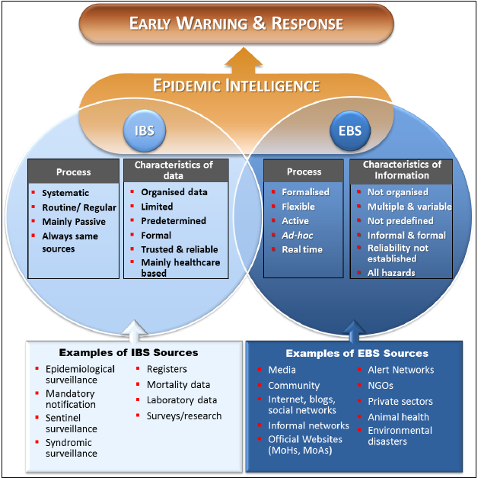
Notes:
From: World Health Organization. Early detection, assessment and response to acute public health events: implementation of early warning and response with a focus on event-based surveillance, 2014. Contract No.: WHO/GSE.GCR/LYO/2014.4.

Slide 64
A signal referring to a serious life-threatening disease or epidemic-prone disease does not necessarily mean that this event will be relevant for EBS in general and EWAR in particular. For example, a single case of meningitis in a well-known endemic area (covered by IBS) will not require immediate intervention.
A large number of cases does not mean that an event is necessarily “serious”, while a single case of a new disease could represent a genuine threat.
A sensationalist report in the press such as “A threefold increase of influenza cases was reported” may actually conform to the known seasonality trend.

