Slide 1
Surveillance in Humans After a Poultry Event Detection
Module E2

Slide 2
Goals
To detect novel influenza virus infections early
To respond quickly and contain novel influenza virus infections
To minimize human exposure to potentially infected poultry and humans

Slide 3
Learning Objectives
Define an outbreak of a novel influenza virus in poultry
Define stakeholders
Define the human population at risk
Describe the active surveillance process
Describe the risk assessment process
Describe the role of health communication

Slide 4
Presentation Outline
Defining a novel influenza virus outbreak in poultry
Conducting a risk assessment
Engaging stakeholders
Communication activities
Investigating humans at risk
  Surveillance
  Contact tracing
Ending surveillance activities
Summary
Notes:
Defining an outbreak of A(H7N9) in poultry
Engaging stakeholders
(Specific steps once an outbreak is detected for both animal and human health authorities)
Investigating humans at risk
Surveillance
Contact tracing
Ending response
Summary

Slide 5
Reminder: High vs. Low Pathogenicity Viruses
Avian influenza A viruses are designated as highly pathogenic avian influenza (HPAI) or low pathogenicity avian influenza (LPAI) based on
  molecular characteristics of the virus
  ability of the virus to cause disease and mortality in chickens in a laboratory
HPAI and LPAI do not refer to the severity of illness in human infection; both LPAI and HPAI viruses have caused severe illness in humans
HPAI can be detected because of poultry die off or human infection
LPAI is likely first identified because of a case of human illness that then triggers additional surveillance of poultry, or from a laboratory detection resulting from routine surveillance of seemingly healthy chickens.
Both HPAI and LPAI viruses can spread rapidly through poultry flocks

Slide 6
A(H7N9)
For this talk will use avian influenza A(H7N9) (Asian lineage) as a topical example of a novel influenza virus

Slide 7
Defining an Avian Influenza Outbreak in Poultry

Slide 8
Defining poultry outbreaks with relevance to humans
The threshold for detecting an outbreak varies by disease and setting.
In a country where an avian influenza virus in poultry that can cause human disease (e.g. A(H5N1) or A(H7N9)) is not endemic, it is likely a single case.

Slide 9
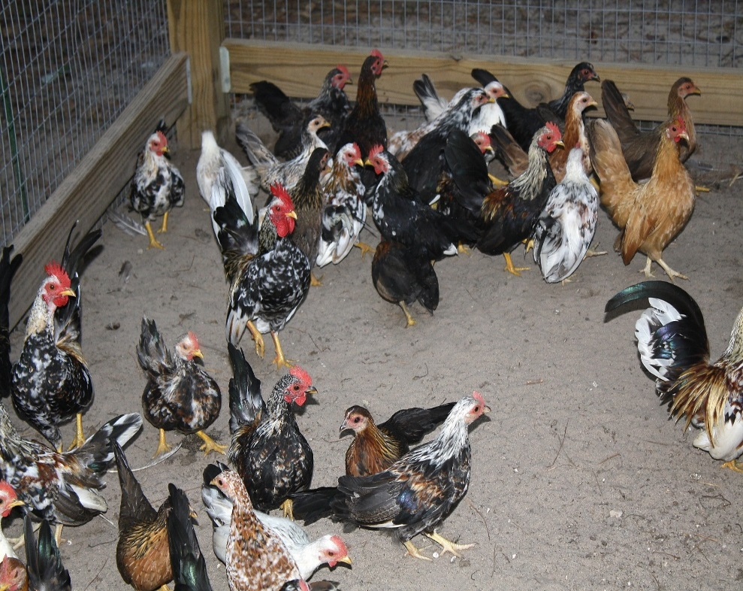
Outbreak of A(H7N9) in Poultry
Any asian lineage A(H7N9) detected in poultry in a country where it has not previously been detected constitutes an outbreak; a public health emergency of international concern
  HPAI (highly pathogenic avian influenza): relatively easy to detect as it causes overt disease in poultry
  LPAI (low pathogenicity avian influenza): difficult to detect as it causes no apparent illness or subtle signs/symptoms in poultry
Report to the International Health Regulations (IHR)
Surveillance key to detecting A(H7N9) in poultry
Must respond immediately to all A(H7N9) infections in poultry
See OIE standards for detection and reporting
http://www.oie.int/fileadmin/Home/eng/Health_standards/tahc/current/chapitre_avian_influenza_viruses.pdf
Notes:
Image: CDC/ Eric Grafman
Copy Restrictions: None - This image is in the public domain and thus free of any copyright restrictions. As a matter of courtesy we request that the content provider be credited and notified in any public or private usage of this image.

Slide 10
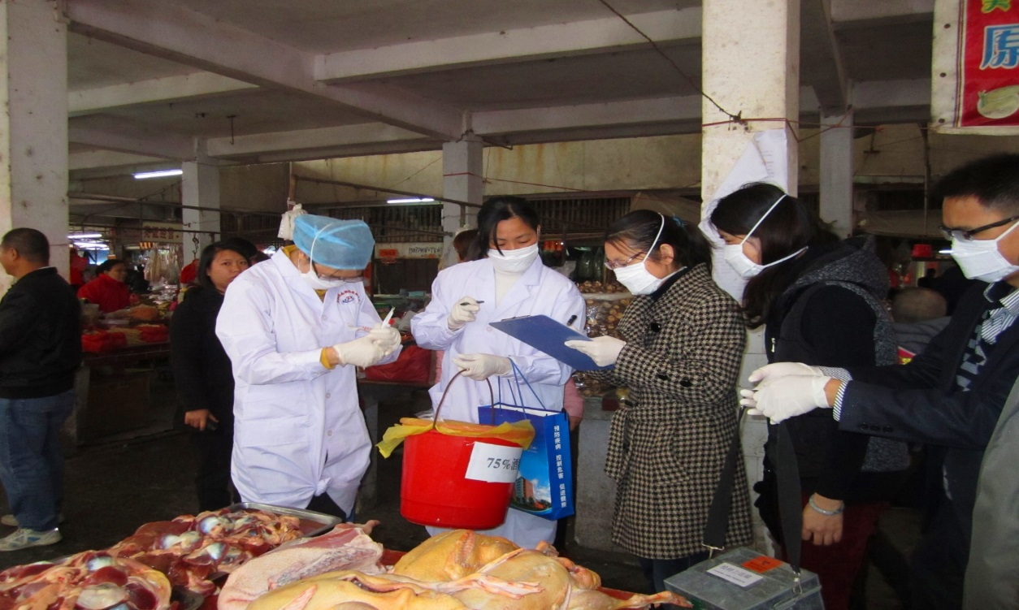
Enhanced Routine Surveillance
If influenza A(H7N9) is detected notify:
sentinel surveillance clinics / hospitals
live bird markets
the veterinary community
All should look for additional cases through their active, laboratory supported sentinel surveillance
Notes:
Image: CDC/ Shuqing Zhao, China
Copyright restrictions: None - This image is in the public domain and thus free of any copyright restrictions. As a matter of courtesy we request that the content provider be credited and notified in any public or private usage of this image.

Slide 11
Enhanced Routine Surveillance
In areas at risk for an A(H7N9) outbreak:
In the case of a LPAI A(H7N9) virus, a case of confirmed human infection is more likely to be the trigger for a potential poultry outbreak that should be investigated through enhanced poultry and environmental sampling of live bird markets
Active poultry surveillance in seemingly health birds may also detect this virus
Notes:
Image: CDC/ Shuqing Zhao, China
Copyright restrictions: None - This image is in the public domain and thus free of any copyright restrictions. As a matter of courtesy we request that the content provider be credited and notified in any public or private usage of this image.

Slide 12

Discussion Questions
In your country or specific location, how do Ministry of Health/human health authorities notify stakeholders about outbreaks of concern, including the following?
  Sentinel surveillance clinics
  Hospitals
  Veterinary hospitals
  Live bird markets
  Etc.
How straight-forward or difficult has it been to conduct these notifications in your country or specific location?
Notes:
Facilitator notes: Take 5 minutes to lead a brief discussion with the entire group. Ask participants to volunteer to describe how notification is done in their country/location. Note: The question is asking about how Ministry of Health/Human health authorities notify all stakeholders of outbreaks of concern such as a A(H7N9) detection in poultry (i.e. what are the communication channels that are in place).
If time allows, and depending on the audience, ask the 2nd question to the group

Slide 13
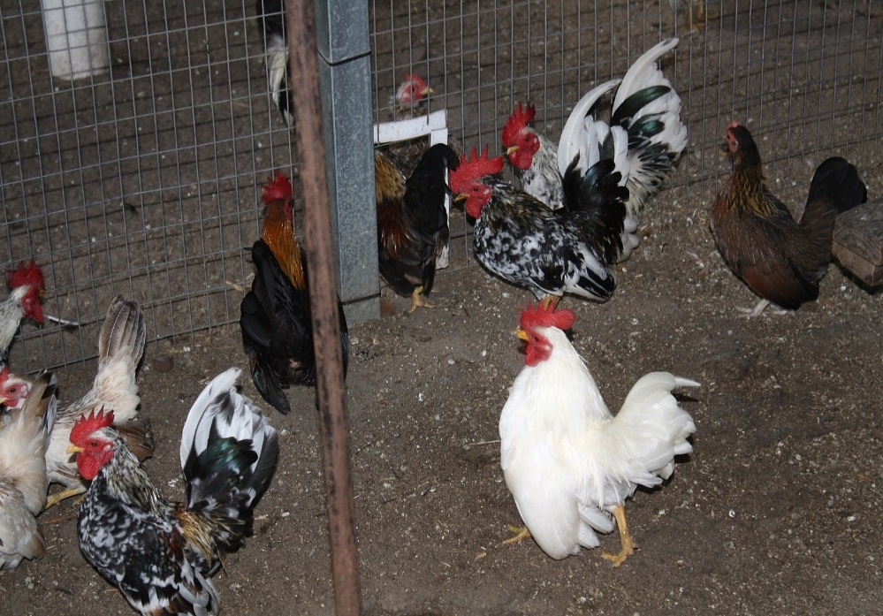
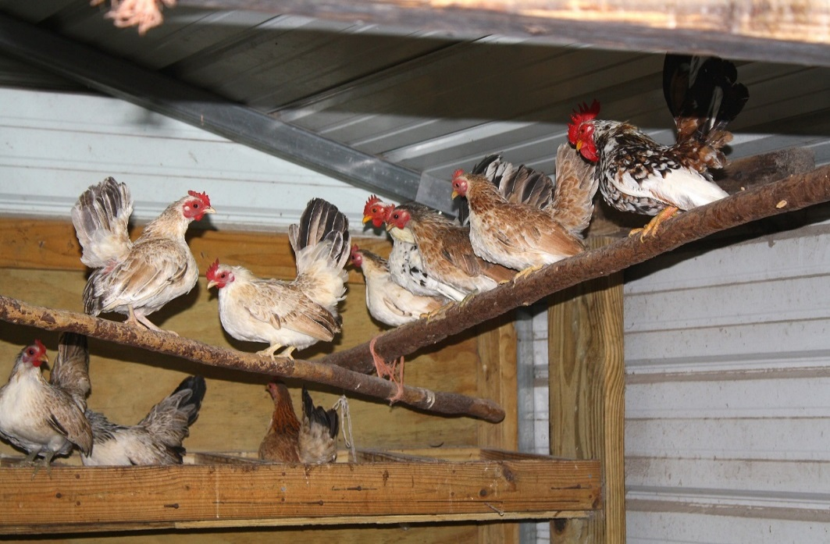
Spread of Poultry Outbreak
If the outbreak spreads to new flocks
more areas must be assessed for humans at risk
response surveillance protocols must be instituted to stop the outbreak in poultry (discussed further in veterinary surveillance and response modules)
Notes:
Image: CDC/ Eric Grafman
Copy Restrictions: None - This image is in the public domain and thus free of any copyright restrictions. As a matter of courtesy we request that the content provider be credited and notified in any public or private usage of this image.

Slide 14
Human Outbreak-Specific Factors
Geographic extent of human cases
  area small enough that containment would be logistically possible
  supply of food, shelter, medical care, etc. to affected area
Pandemic potential
  Presence of clusters of human cases in defined area over short period of time

Slide 15
Risk Assessment
WHO publication “Rapid Risk Assessment of Acute Public Health Events” *
Components:
  Hazard assessment: the virus’ characteristics and consequences of infection
  Exposure assessment: number exposed, number susceptible, likelihood of transmission, including both poultry and humans
  Content assessment: all factors (not just morbidity/mortality) that effect risk
    STEEEP: social, technical and scientific, economic, environmental, ethical, and policy and political
Results in an overall risk characterization
*http://www.who.int/influenza/human_animal_interface/influenza_A(H7N9)/Risk_Assessment/en/
Notes:
This is a simple mechanism to increase visibility of risks and assist management decision making.

Slide 16
Risk Assessment
Experts from the outbreak response team can conduct a series of risk assessments
Crucial to decide the key questions, and the data needed, which may change over time
  What are the virus characteristics? Has it changed?
  Is there evidence of human to human spread? Is it sustained?
  What is the spectrum of illness (from asymptomatic to very severe)?
  Who are most at risk for severe complications?
Notes:
TIPRA which is designed to prioritize pandemic preparedness activities.

Slide 17
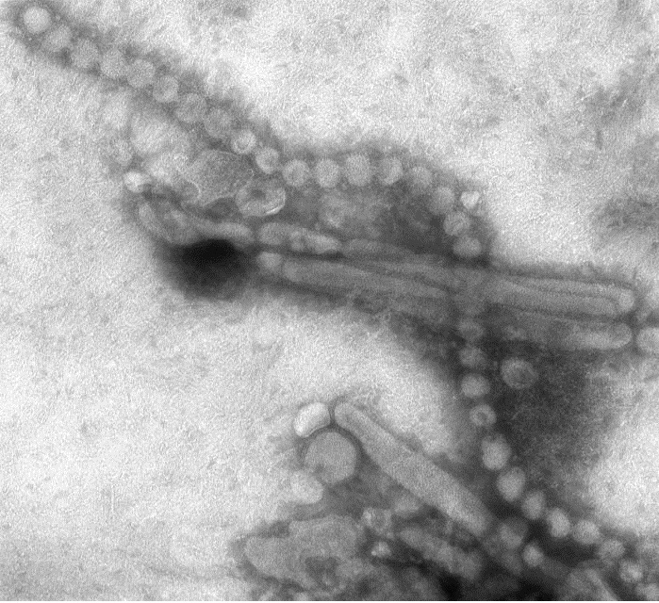
Low pathogenicity avian influenza can be detected by visually inspecting poultry.
True or False?
KNOWLEDGE CHECK
Notes:
Background Image:
ID: 15670
CDC/ Cynthia S. Goldsmith and Thomas Rowe
CDC - National Center for Immunization and Respiratory Diseases (NCIRD); Influenza (Flu): Images of Avian Influenza A
restrictions:
None - This image is in the public domain and thus free of any copyright restrictions. As a matter of courtesy we request that the content provider be credited and notified in any public or private usage of this image.

Slide 18
Low pathogenicity avian influenza can be detected by visually inspecting poultry.
False
KNOWLEDGE CHECK
Notes:
Background Image:
ID: 15670
CDC/ Cynthia S. Goldsmith and Thomas Rowe
CDC - National Center for Immunization and Respiratory Diseases (NCIRD); Influenza (Flu): Images of Avian Influenza A
restrictions:
None - This image is in the public domain and thus free of any copyright restrictions. As a matter of courtesy we request that the content provider be credited and notified in any public or private usage of this image.

Slide 19
KNOWLEDGE CHECK
____________ is key to detecting influenza A(H7N9) in poultry.
Notes:
Background Image:
ID: 15670
CDC/ Cynthia S. Goldsmith and Thomas Rowe
CDC - National Center for Immunization and Respiratory Diseases (NCIRD); Influenza (Flu): Images of Avian Influenza A
restrictions:
None - This image is in the public domain and thus free of any copyright restrictions. As a matter of courtesy we request that the content provider be credited and notified in any public or private usage of this image.

Slide 20
KNOWLEDGE CHECK
Surveillance with laboratory testing is key to detecting influenza A(H7N9) in poultry.
Notes:
Background Image:
ID: 15670
CDC/ Cynthia S. Goldsmith and Thomas Rowe
CDC - National Center for Immunization and Respiratory Diseases (NCIRD); Influenza (Flu): Images of Avian Influenza A
restrictions:
None - This image is in the public domain and thus free of any copyright restrictions. As a matter of courtesy we request that the content provider be credited and notified in any public or private usage of this image.

Slide 21
Engaging Stakeholders

Slide 22
General A(H7N9) Preparedness Recommendations
Establish laboratory supported active surveillance of poultry
Establish coordination of animal and human health authorities
  Routine, timely sharing of information
  Routine meetings
  Plan of Action for coordinated response to an outbreak of A(H7N9) in poultry
  Comprehensive and coordinated educational and communication materials

Slide 23
Discussion Question
How well have you been able to coordinate between human and animal health authorities in your country or specific location after a poultry event detection?
If coordination has been challenging, what were some of the main problems?
Notes:
Facilitator notes: Take 5 minutes to lead a brief discussion with the entire group. Ask participants to volunteer to describe how well coordination has workedin their country/location.
If time allows, and depending on the audience, ask the 2nd question to the group

Slide 24
Outbreak Plan of Action
Defines an outbreak of A(H7N9) in poultry
Defines roles and responsibilities for animal health and human health authorities
Schedule of routine coordination meetings
Education and communication strategy
Specific steps once an outbreak is detected for both animal and human health authorities
Defines the end of an outbreak

Slide 25
Plan of Action: Animal Health Authorities
Animal health authorities
  Confirm the diagnosis
  Contact human health authorities
  Go to the site
  Notify animal diagnostic laboratories
  Notify veterinary community
  Coordinate communications with human health authorities
  Review the Plan of Action with human health authorities
  Conduct the animal health investigation and control activities including culling
  Plan for disposal of dead birds plus disinfection of the premises (along with other control activities).

Slide 26
Plan of Action: Human Health Authorities
Human health authorities
  Review the Plan of Action with animal health authorities as soon as possible
  Notify relevant authorities at all levels
  Notify responsible laboratories, including the National Influenza Center laboratory
  Notify nearby clinical services
  Initiate communication strategy response
  Go to the site
  Identify the human population at risk

Slide 27
Routine Stakeholder Communication
Morning meeting with between human and animal health authorities to review new information and confirm activities for the day
Evening meeting with animal health authorities to review activities and results of the day and plan for tomorrow
Daily unified end of day report to leadership
Daily unified press release

Slide 28
Health Communication
Health communication is critical to an optimal outbreak response
Recommend a professional health communicator to ensure an optimal communication strategy and response
Purposes of communications
  To provide information
  To influence behavior
  To motivate action
Key factors to consider include the message, audience, medium, timing, and intended impact of the communication
A good message is clear, informative, concise, accurate, precise and timely

Slide 29
Health Communication
Daily unified press release is important
Can consider different media as appropriate
  Radio
  Television
  Posters
  Internet
  Text messages
Adjust target audiences and messages as needed

Slide 30
Health Communication: Examples
Overriding communication objective:
  To prevent human cases of A(H7N9) due to this outbreak
One of the goals:
  To decrease human exposure to infected poultry
Keep the information and advice simple and direct
  Contact with any infected live poultry, dead poultry and / or poultry parts can infect you with A(H7H9)
  Avoid contact, wash hands after any contact
  Use proper PPE (with examples) if contact with poultry is unavoidable
Tailor the media and the message to the target population, the general public or selected higher risk populations
Evaluate each media and message and modify to increase effectiveness

Slide 31
KNOWLEDGE CHECK
What actions are included in an outbreak action plan?
Notes:
Background Image:
ID: 15670
CDC/ Cynthia S. Goldsmith and Thomas Rowe
CDC - National Center for Immunization and Respiratory Diseases (NCIRD); Influenza (Flu): Images of Avian Influenza A
restrictions:
None - This image is in the public domain and thus free of any copyright restrictions. As a matter of courtesy we request that the content provider be credited and notified in any public or private usage of this image.

Slide 32
KNOWLEDGE CHECK
Which actions are included in an outbreak action plan?
Define roles and responsibilities for animal health and human health authorities
Schedule of routine coordination meetings
Define an outbreak of A(H7N9) in poultry
Education and communication strategy
Define the end of an outbreak
Notes:
Background Image:
ID: 15670
CDC/ Cynthia S. Goldsmith and Thomas Rowe
CDC - National Center for Immunization and Respiratory Diseases (NCIRD); Influenza (Flu): Images of Avian Influenza A
restrictions:
None - This image is in the public domain and thus free of any copyright restrictions. As a matter of courtesy we request that the content provider be credited and notified in any public or private usage of this image.

Slide 33
Investigating Humans at Risk

Slide 34
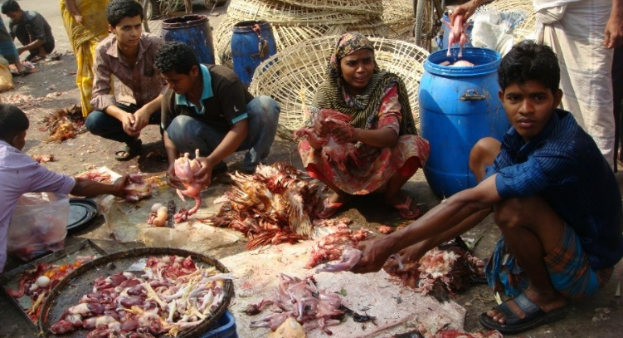
Human Population at Risk
Risk factors for exposure to infected birds:
  Keep live poultry in their backyards or homes, or purchase live poultry or birds at markets
  Slaughter, de-feather, or butcher poultry
  Handle and prepare raw poultry for further cooking and consumption
  Transport or sell live poultry or carcasses
Notes:
Image: CDC/ Sureyya Hornston, M.P.H., Ph.D., with the Division of STD Prevention, NCHHSTP
Copyright restrictions: None - This image is in the public domain and thus free of any copyright restrictions. As a matter of courtesy we request that the content provider be credited and notified in any public or private usage of this image.

Slide 35
Human Population at Risk
Risk factors for exposure to infected birds (continued):
  Are involved in culling/depopulating/disposing of poultry
  Work in the poultry industry, including farmers and veterinarians
  Have contact with poultry by-products (e.g. viscera, manure, feathers) or water contaminated with these by-products (e.g. waste water from a live bird market or a slaughtering facility)
  Consume raw poultry products

Slide 36
Prioritize Human Population at Risk
Not all people with possible exposure to infected birds have the same risk, so must prioritize and focus on higher risk groups
Theoretically, higher risk groups have longer and / or more intense exposure to poultry and include people who do the following:
  Poultry farmers
  Transport live poultry
  Sell live poultry
  Slaughter poultry
  Butcher poultry
  Defeather poultry
  Handle raw carcasses and meat

Slide 37
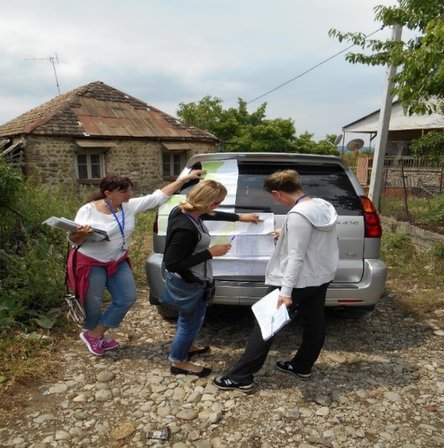
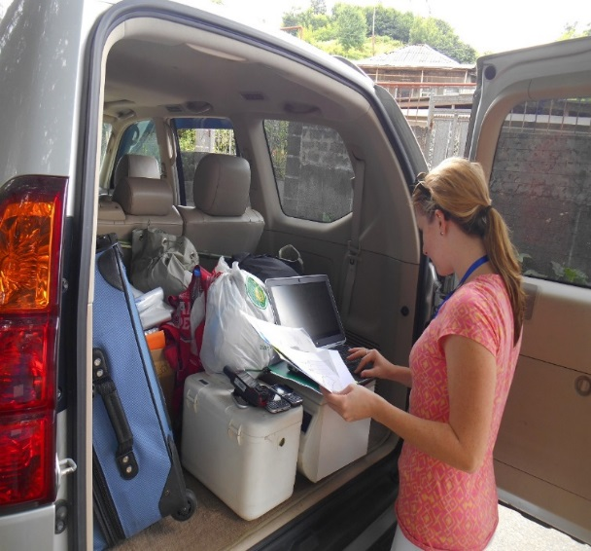
Investigation
Identify all households and work sites in the area
Visit all households and work sites and interview and observe adults for risk of exposure to live poultry
  In some rural villages this will be everyone
Record key demographic and contact information
Visit daily for a minimum of seven days since the last case in a human or bird
Monitor all staff
Notes:
Images: CDC/ Jessie Blount
Copyright restrictions: None - This image is in the public domain and thus free of any copyright restrictions. As a matter of courtesy we request that the content provider be credited and notified in any public or private usage of this image.

Slide 38
Discussion Question
When doing fieldwork in your country or specific location following a poultry event detection, what challenges have you faced when trying to identify, visit and interview at-risk persons?
Notes:
Facilitator notes: Take 5 minutes to lead a brief discussion with the entire group. Ask participants to volunteer to describe challenges they have encountered in their country/location when visiting and interviewing at-risk persons following a poultry event detection.

Slide 39
Monitor Exposed Persons
Ask and observe daily for signs and symptoms of respiratory illness or temperature > 38ºC
  If negative for fever and respiratory symptoms, then record and visit the next day
  If positive for fever or respiratory symptoms, then obtain combined nasopharyngeal and oropharyngeal swabs and
    Isolate the individual until laboratory results are available
    Consider immediate empiric antiviral treatment with a neuraminidase inhibitor (if available)
    Monitor individuals who have been in contact with this person since one day prior to symptom onset until lab results are available (if resources permit)

Slide 40
A Confirmed Human Case
Defined as a person with laboratory-confirmation of a recent infection with A(H7N9) virus
When first identified in a country considered a public health event of international concern and should be reported to WHO
Continue response surveillance efforts
Consider mandatory isolation
“Resets the clock”, must follow close contacts of this person for at least another seven days
  Reassess for persons at risk of exposure to this person and common sources of exposure (e.g. live bird markets)
  Interviews of newly identified people at risk
  Process continues until there is no new case for at least seven days

Slide 41
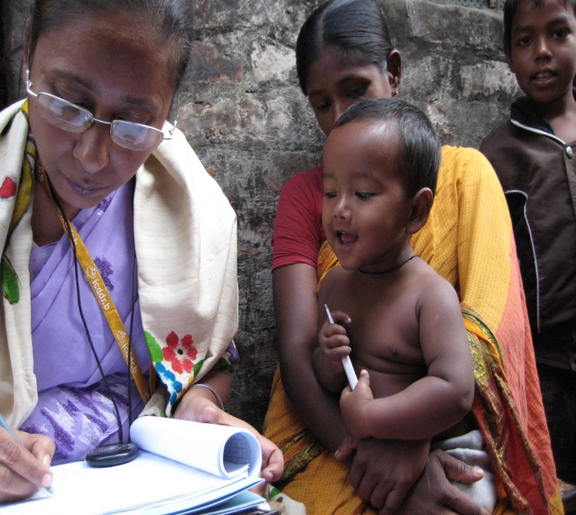
Contact Identification
  Interview and simple medical exam, including taking temperature
  Contact tracing and follow-up
  Becomes difficult as case load increases
  Essential during rapid response phase
Notes:
Image: CDC/ Alyson Rose-Wood
Copyright restrictions: None - This image is in the public domain and thus free of any copyright restrictions. As a matter of courtesy we request that the content provider be credited and notified in any public or private usage of this image.

Slide 42
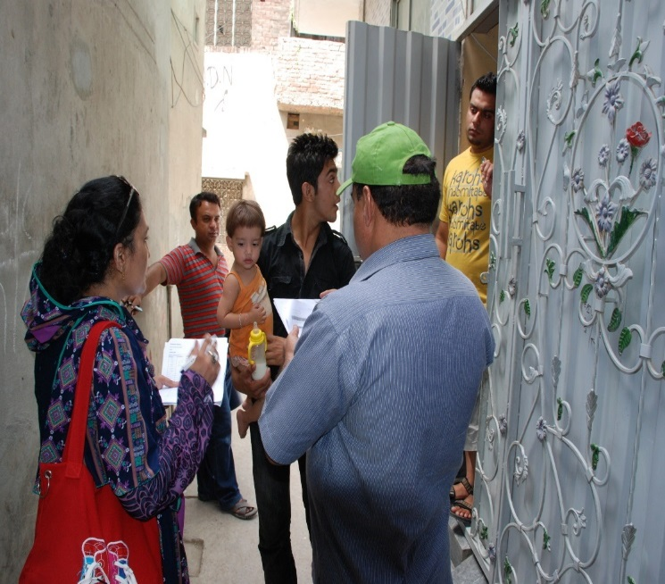
Contact Tracing
Contact tracing efforts should focus on persons who had close, unprotected contact with the case patient in the one day before through 14 days after the onset of the case patient’s illness
Information about close contacts can be obtained from interviews with:
  Patient
  Family members
  Workplace or school associates
  Others with knowledge about patient’s recent activities and travels
Notes:
Image: CDC/ Dr. Mirza Amir Baig, Pakistan
Copyright restrictions: None - This image is in the public domain and thus free of any copyright restrictions. As a matter of courtesy we request that the content provider be credited and notified in any public or private usage of this image.

Slide 43
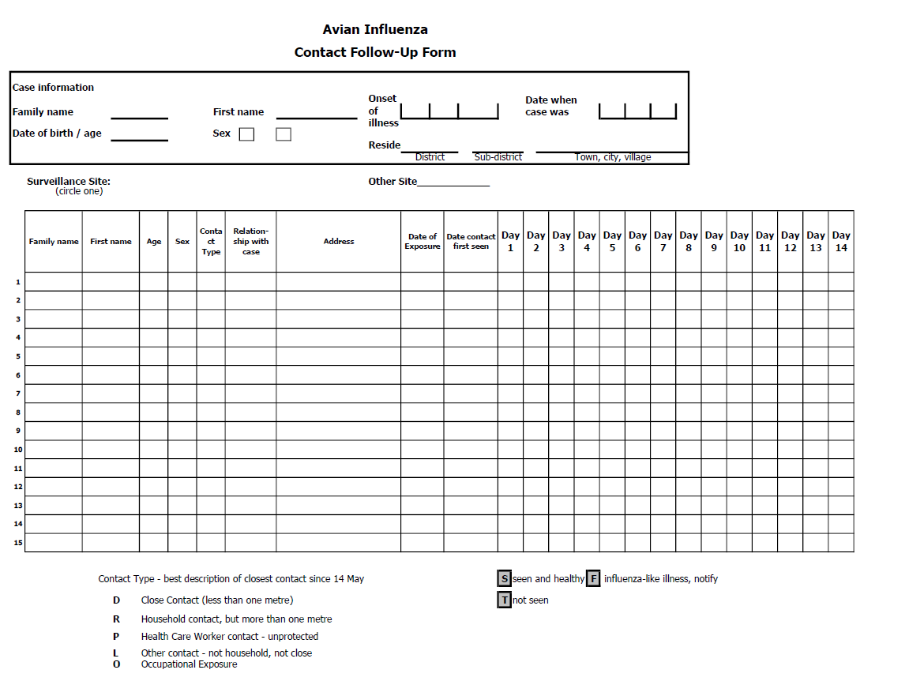
Contact Tracing: Contact Follow-Up Form Template
Notes:
Key points about the Contact Tracing form:
Simple, easy to fill out, easy to read.
Only includes useful information.
This is not a form for a research project. It is a form to facilitate contact tracing.
Keep it simple and easy to use.
This form achieves this.

Slide 44
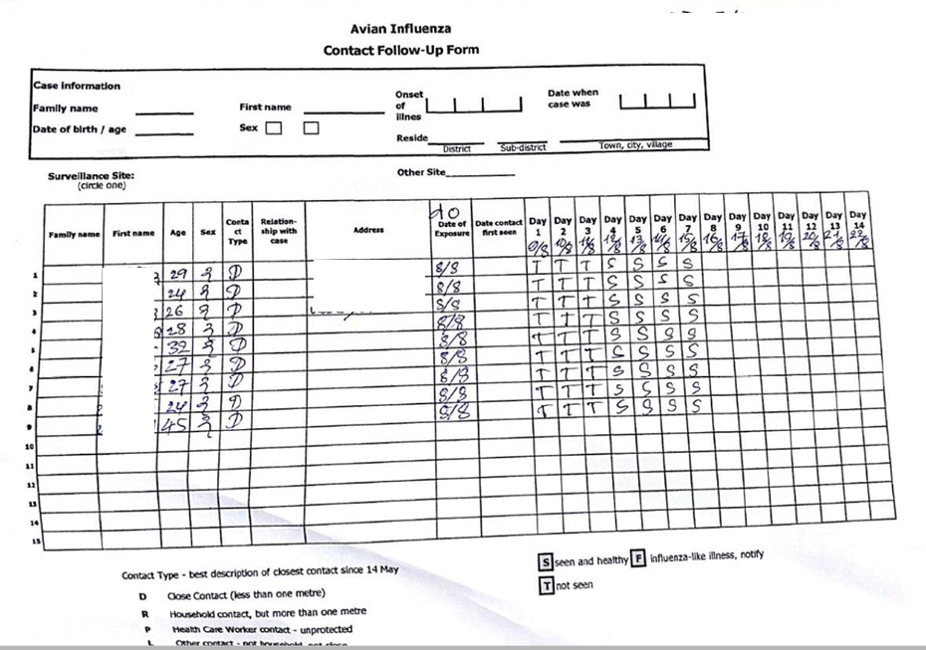
Contact Tracing: Contact Follow-Up Form Example
Notes:
In the box at the top is the information on the case, the person with confirmed or probable A(H7N9) infection. This will usually only be a confirmed case, but could be a probable case if the epidemiologic link were strong enough and the laboratory confirmation not available.
We see in the columns starting from the left, Family Name, First Name, Age, Sex, Contact Type, Relationship, Address, Date of Exposure, Date Contact First Seen and then columns to record the results of the daily screening.
The code for recording these data are recorded below --- codes for type of relationship, type of contact and the results of the daily assessment --- capital S for “seen and healthy”, capital F for “influenza-like illness, notify” and capital T for “not seen”.
Some places choose to also record the name of the health care worker doing the contact tracing. This form does not, but it does record the surveillance site and location of the people, so in practice it should be straightforward to determine who saw the contact on any given day.

Slide 45
KNOWLEDGE CHECK
Mr. Lee butchers poultry in a factory that recently had a confirmed case of A(H7N9) in its poultry. Is Mr. Lee at risk for developing A(H7N9) influenza?
Yes or No?
Notes:
Background Image:
ID: 15670
CDC/ Cynthia S. Goldsmith and Thomas Rowe
CDC - National Center for Immunization and Respiratory Diseases (NCIRD); Influenza (Flu): Images of Avian Influenza A
restrictions:
None - This image is in the public domain and thus free of any copyright restrictions. As a matter of courtesy we request that the content provider be credited and notified in any public or private usage of this image.

Slide 46
KNOWLEDGE CHECK
Mr. Lee butchers poultry in a factory that recently had a confirmed case of A(H7N9). Is Mr. Lee at risk for developing A(H7N9) influenza?
Yes
Notes:
Background Image:
ID: 15670
CDC/ Cynthia S. Goldsmith and Thomas Rowe
CDC - National Center for Immunization and Respiratory Diseases (NCIRD); Influenza (Flu): Images of Avian Influenza A
restrictions:
None - This image is in the public domain and thus free of any copyright restrictions. As a matter of courtesy we request that the content provider be credited and notified in any public or private usage of this image.

Slide 47
KNOWLEDGE CHECK
Dr. Patel is a veterinarian who recently visited a rural community to investigate a reported case of A(H7N9) in a small flock of chickens. The case was later laboratory confirmed as positive. Is Dr. Patel at risk for developing A(H7N9) influenza?
Yes or No?
Notes:
Background Image:
ID: 15670
CDC/ Cynthia S. Goldsmith and Thomas Rowe
CDC - National Center for Immunization and Respiratory Diseases (NCIRD); Influenza (Flu): Images of Avian Influenza A
restrictions:
None - This image is in the public domain and thus free of any copyright restrictions. As a matter of courtesy we request that the content provider be credited and notified in any public or private usage of this image.

Slide 48
KNOWLEDGE CHECK
Dr. Patel is a veterinarian who recently visited a rural community to investigate a reported case of A(H7N9) in a small flock of chickens. The case was later laboratory confirmed as positive. Is Dr. Patel at risk for developing A(H7N9) influenza?
Yes
Notes:
Background Image:
ID: 15670
CDC/ Cynthia S. Goldsmith and Thomas Rowe
CDC - National Center for Immunization and Respiratory Diseases (NCIRD); Influenza (Flu): Images of Avian Influenza A
restrictions:
None - This image is in the public domain and thus free of any copyright restrictions. As a matter of courtesy we request that the content provider be credited and notified in any public or private usage of this image.

Slide 49
KNOWLEDGE CHECK
How long should Dr. Patel be followed after her A(H7N9) exposure?
No follow up
At least 3 days
At least 5 days
At least 7 days
Notes:
Background Image:
ID: 15670
CDC/ Cynthia S. Goldsmith and Thomas Rowe
CDC - National Center for Immunization and Respiratory Diseases (NCIRD); Influenza (Flu): Images of Avian Influenza A
restrictions:
None - This image is in the public domain and thus free of any copyright restrictions. As a matter of courtesy we request that the content provider be credited and notified in any public or private usage of this image.

Slide 50
KNOWLEDGE CHECK
How long should Dr. Patel be followed after her A(H7N9) exposure?
No follow up
At least 3 days
At least 5 days
At least 7 days
Notes:
Background Image:
ID: 15670
CDC/ Cynthia S. Goldsmith and Thomas Rowe
CDC - National Center for Immunization and Respiratory Diseases (NCIRD); Influenza (Flu): Images of Avian Influenza A
restrictions:
None - This image is in the public domain and thus free of any copyright restrictions. As a matter of courtesy we request that the content provider be credited and notified in any public or private usage of this image.

Slide 51
KNOWLEDGE CHECK
On day 2 after her A(H7N9) exposure, Dr. Patel develops fever. What steps should be taken?
Notes:
Background Image:
ID: 15670
CDC/ Cynthia S. Goldsmith and Thomas Rowe
CDC - National Center for Immunization and Respiratory Diseases (NCIRD); Influenza (Flu): Images of Avian Influenza A
restrictions:
None - This image is in the public domain and thus free of any copyright restrictions. As a matter of courtesy we request that the content provider be credited and notified in any public or private usage of this image.

Slide 52
KNOWLEDGE CHECK
On day 2 after her A(H7N9) exposure, Dr. Patel develops fever. What steps should be taken?
Combined NP and OP swabs taken for testing for A/A(H7N9) by RT-PCR
Assure proper isolation per local guidelines
Ensure empiric antiviral treatment with a neuraminidase inhibitor (if available)
Initiate contact tracing for her contacts
Notes:
Background Image:
ID: 15670
CDC/ Cynthia S. Goldsmith and Thomas Rowe
CDC - National Center for Immunization and Respiratory Diseases (NCIRD); Influenza (Flu): Images of Avian Influenza A
restrictions:
None - This image is in the public domain and thus free of any copyright restrictions. As a matter of courtesy we request that the content provider be credited and notified in any public or private usage of this image.

Slide 53
Ending Surveillance Activities

Slide 54
Ending Human Surveillance Activities
Can end human surveillance after there has been no new cases in poultry or humans for two incubation periods (ie. 2 weeks)
  Surveillance can end only when there is excellent case finding and surveillance and subsequent risk assessment concludes the risk is low
This may be communicated to the public in the next daily press release

Slide 55
When can surveillance activities stop?
If all people with possible exposure have been identified
If all people with possible exposure have been followed for at least seven days and there are no more individuals with fever or respiratory symptoms
There are no additional bird cases, and a risk assessment in poultry populations has been completed and is determined to be low
Notes:
If negative laboratory results and no other ILI or bird cases, then can stop the response surveillance.
If positive laboratory results, then reset the clock and restart the response surveillance protocol.

Slide 56
Ending Surveillance Activities
If there is a human contact with respiratory symptoms or fever and/or a bird die-off, surveillance must continue until laboratory results are available
  Negative laboratory results → Stop
  Positive laboratory results → Continue
Notes:
If negative laboratory results and no other ILI or bird cases, then can stop the response surveillance.
If positive laboratory results, then reset the clock and restart the response surveillance protocol.

Slide 57
Ending Surveillance Activities
With each new laboratory-confirmed case the team must review the situation and modify plans as necessary
Large number of cases over large area |  | Consider that outbreak may not be able to be contained and consider changing response
Small number of cases over a contiguous area |  | Should probably continue response surveillance protocol
Isolated cases over a large area |  | Should probably continue response surveillance protocol
Requires regular coordination between animal and human health sectors through the response
Notes:
When number of cases in persons or birds are too large or over too large an area or both over a short time, must consider that the outbreak cannot be contained and consider changing the response.
When small number of cases over a contiguous area, probably should continue response surveillance protocol.
When many cases over a large area over a long time, but each case is isolated, probably should continue response surveillance protocol.

Slide 58
Ending Surveillance Activities
Findings and decisions should be included in the daily joint (animal and human officials) report
Conduct another risk assessment to ensure OIE recommendations for monitoring and controlling AIV in poultry populations have been in place before ending surveillance and response activities
When response surveillance is modified or discontinued, consider a joint summary report including findings, actions, plans and any recommendations to improve the response surveillance protocol

Slide 59
KNOWLEDGE CHECK
What are the criteria that should be satisfied in order to stop response surveillance activities?
Notes:
Background Image:
ID: 15670
CDC/ Cynthia S. Goldsmith and Thomas Rowe
CDC - National Center for Immunization and Respiratory Diseases (NCIRD); Influenza (Flu): Images of Avian Influenza A

Slide 60
KNOWLEDGE CHECK
What are the criteria that should be satisfied in order to stop response surveillance activities?
1) All people with possible exposure have been identified and followed for at least seven days
2) No more individuals with fever or respiratory symptoms for two incubation periods
3) No additional bird cases have been identified and proper monitoring and control strategies are in place
Notes:
Background Image:
ID: 15670
CDC/ Cynthia S. Goldsmith and Thomas Rowe
CDC - National Center for Immunization and Respiratory Diseases (NCIRD); Influenza (Flu): Images of Avian Influenza A

Slide 61
Summary

Slide 62
Summary (I)
An outbreak of A(H7N9) in poultry in an previously unaffected country is a public health emergency of international concern and must be reported immediately to the WHO and OIE.
Animal and human health authorities should prepare a plan of action for novel influenza within their broader response plans well in advance of an actual response to facilitate a coordinated and comprehensive response.
Responses to poultry outbreaks of avian influenza A(H7N9) are labor and resource intensive
  Require intensive investigation of the population to identify persons at risk of exposure, followed by daily monitoring

Slide 63
Summary (II)
Emphasis on daily planning and reporting sessions with animal and human health with daily written updates to higher authorities and daily press releases
Must coordinate with key laboratories (human and animal) and get results promptly
Repeat investigative processes until the outbreak is over or has spread too far to allow containment, including serial risk assessments

Slide 64
Summary (III)
With proper planning and implementation the impact of an outbreak of A(H7N9) in poultry on humans can be minimized
Surveillance should be coordinated across multi-sectoral human and animal health partners

Slide 65
Thank You

Slide 66
References
WHO Writing Group. Emerg Inf Dis 2006;12:88-94. WHO SEARO: Simple public health interventions for Avian Influenza
WHO WPRO: Advice for people living in areas affected by bird flu, 8 Nov 2004 http://www.wpro.who.int/NR/rdonlyres/04FA6993-8CD1-4B72-ACB9-EB0EBD3D0CB1/0/Advice10022004rev08112004.pdf
Flu Pandemic Mitigation: Social Distancing. GlobalSecurities.org, Sept 2005.
http://www.globalsecurity.org/security/ops/hsc-scen-3_flu-pandemic-distancing.htm
Centers for Disease Control and Prevention (2004). Fact Sheet: Isolation and Quarantine. Division of Global Migration and Quarantine, National Center for Infectious Diseases. http://www.cdc.gov/ncidod/dq/index.htm
Center for Law and the Public's Health (Dec. 2001). The Model State Emergency Health Powers Act.
http://www.publichealthlaw.net/MSEHPA/MSEHPA2.pdf
WHO: Rapid Risk Assessment of Acute Public Health Events, WHO/HSE/GAR/ARO/2012.1 http://www.who.int/influenza/human_animal_interface/influenza_A(H7N9)/Risk_Assessment/en/

