Slide 1
Module E4
Epidemiologic Case Investigation of Human Infections with HxNy

Slide 2
Learning Objectives
Know when and how to prepare for investigations of human cases of novel influenza virus
Understand the objectives of novel influenza virus outbreak investigations
Understand the steps and mechanics of novel influenza virus outbreak investigations
Describe how to analyze data and communicate findings from outbreak investigations
Understand the importance of multi-sectoral coordination while doing case investigation
Notes:
The objectives of this module are to:
Know when and how to prepare for the investigation of human cases of novel influenza virus infection.
Understand the objectives of novel influenza virus outbreak investigations.
Understand the mechanics of novel influenza virus outbreak investigations which includes activities such as creating case definitions, conducting case finding, interviewing cases, and contact tracing.
Describe how to analyze and communicate findings from novel influenza virus infections.
And to understand the importance of multi-sectoral involvement and coordination in case investigation
Although many of the concepts presented in this module can be applied to novel influenza viruses in general, the focus is on investigating a virus with characteristics similar to the avian influenza A(H7N9) virus unless otherwise specified.

Slide 3
Presentation Outline
Objectives and phases of case investigations
Steps of an outbreak investigation
Pre-investigation and response planning
Gathering evidence
Contact tracing
Managing and analyzing data
Implementing infection control measures
Reporting and evaluation
Influenza investigation resources
  Influenza A (H5N1) virus
  Influenza A (H7N9) virus
Notes:
In this session we will first talk about the objectives and phases of a case investigation and then walk through the steps of an outbreak investigation including
Pre-Investigation and Response Planning
Gathering Evidence
Contract Tracing
Managing and Analyzing Data
Implementing Infection Control Measures
Reporting and Evaluation
Lastly, additional resources on influenza investigations will be presented for A(H5N1) and A(H7N9)

Slide 4
Objectives of Case Investigation
Confirm or exclude novel human case of animal influenza virus infection
Reduce morbidity and mortality through rapid identification, isolation, treatment, and clinical management of cases and follow-up of contacts
Reduce further spread of novel influenza virus infection through identification of exposure sources and implementation of control measures
Determine if cases or a cluster of cases represent sustained human-to-human transmission of novel influenza virus
Notes:
Let’s begin by emphasizing why it is important to investigate cases of novel influenza virusases of animal influenza virus infection in humans.
The objectives of case investigation are to protect the health of the individual and the public, as follows:
To confirm, or exclude the diagnosis of novel influenza virus infection in the case. This is predominantly a laboratory determination.
To reduce morbidity and mortality by implementing public health measures. This is done through rapid identification, isolation, treatment, and clinical management of cases and follow-up of contacts of cases
To work closely with animal health authorities to reduce further spread of novel influenza virus infection in animals by identifying exposure sources and implementing control measures.
To determine if the case or case clusters being investigated suggest an increased threat of human-to-human transmission, which may signal the beginning of a potential pandemic

Slide 5
Objectives of Case Investigation (continued)
Gather data in order to:
  Identify key epidemiological and clinical characteristics of cases and virologic characteristics of viruses
  Inform current and future prevention and control efforts
  Enhance surveillance
  Ensure timely communication among stakeholders from all relevant sectors to facilitate informed decision-making
Notes:
The investigation of cases also gives us valuable information that can be used to better prepare for public health emergencies and to form a better understanding of the virus. Objectives include:
Identify key epidemiological and clinical characteristics of cases and virologic characteristics of viruses.
Analyzing these data collectively will inform current and future prevention and control efforts
Enhance surveillance to detect new cases and to facilitate rapid response
Communicate investigation findings in a timely manner to stakeholders to allow informed decision-making.

Slide 6
Phases of Case Investigation
Pre-Investigation
  Plan the investigation (e.g., objectives, studies, questions)
  Identify resource needs and stakeholders
Investigation
  Gather epidemiologic evidence
  Manage and analyze data, study epidemic curves and patterns
  Implement prevention and control activities
Post-Investigation
  Summary report and evaluation of performance
Notes:
Case investigation can be broken into three phases. HOWEVER, it is important to remember that many of these activities and steps will occur at the same time and may not follow a chronological order! In other words, you will likely be engaged in multiple steps or activities at the same time. But to present the material we have combined many of the activities into three phases and several steps.
The first phase is pre-investigation:
Following a request for assistance, a team needs to be assembled to plan the response before the actual investigation (on location) begins. Part of investigation planning includes an assessment of what resources are needed to conduct a successful investigation and which stakeholder should be engaged.
The next phase is the actual investigation:
The first step is to gather the existing epidemiologic evidence of novel influenza exposure and create a case definition.
Step two should occur throughout the investigation and includes ensuring that data collection occurs in a complete and accessible manner and is managed accordingly. Later on, the data need to be analyzed descriptively and studied using epidemic curves and other basic analytic tools.
Step three includes critical prevention and control activities
The last phase is Post-investigation which includes the activities that are completed after the investigation is over or winding down:
Although good communication should be a priority throughout the investigation, during this last phase communication and reporting may be prioritized.
A summary report should be drafted and the performance of the team should be evaluated to identify successes, challenges, and lessons learned during the investigation to improve future investigations.

Slide 7
Steps of an Outbreak Investigation
Prepare for field work
Evaluate existence of an outbreak
Determine the diagnosis
Identify and investigate cases
Describe the data
Develop hypotheses
Evaluate hypotheses
Refine hypotheses and conduct additional studies
Implement control and prevention measures
Communicate findings
http://www.cdc.gov/excite/classroom/outbreak/steps.htm
Notes:
The steps of an outbreak investigation are listed here. We will talk about each of these steps in detail during this module.

Slide 8

Discussion Questions
Who is responsible for and involved in novel human cases of avian influenza virus investigations in your location/country?
  (e.g., is it the rapid response team members or is the investigation team made up of different members?)
Notes:
Facilitator notes: Take 5 minutes to lead a brief discussion with the entire group. Ask participants to volunteer to who is responsible for leading and involved with case investigations in their location/country.
Note for facilitator:
Animal authorities *would not* engage in any seasonal human case investigation. Animal authorities and human health authorities would simply coordinate with one another and share information as needed.

Slide 9
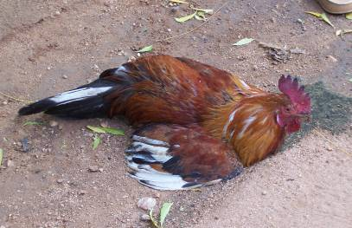
Triggers for an Outbreak Investigation
Triggers include multiple event types and should be adapted to the local context
Human cases of infection with an un-sub-typeable respiratory sample or any influenza virus not currently circulating in human populations
Severe respiratory illness in persons occupationally exposed to chickens or who have traveled to locations where zoonotic influenza viruses are known to be circulating (http://www.who.int/influenza/human_animal_interface/influenza_h7n9/Data_Reports/en/)
Respiratory disease in humans associated with illness in animals
Outbreaks of death or illness in fowl (e.g., poultry or ducks) or other animals
Photo: Diane Gross, CDC
Notes:
Triggers for a novel virus outbreak investigation may include multiple types of events and should be adapted to the local context.
Any human case of infection with a respiratory sample that is positive for influenza A but un-sub-typeable or is positive for an influenza virus not currently known to be circulating in human populations should be investigated. However, because collection, shipping, and testing of specimens can take several days if not longer, other events should also trigger investigation.
In addition, unusual events in animals or linked to animals or humans with novel influenza virus infection may represent emergence of a highly pathogenic virus or a virus that is more easily transmissible from animals to humans and should trigger an investigation. These include
severe respiratory illness in persons occupationally exposed to chickens or who have traveled to locations where novel influenza viruses are known to be circulating
respiratory disease in humans associated with illness in animals
outbreaks of death or respiratory illness in animals
Events without a clear novel influenza virus link may also represent potential human-to-human transmission of a novel virus and should be investigated. These include:
clusters of severe respiratory disease or pneumonia in families, work places, or social networks
unexpected patterns of respiratory illness or pneumonia
changes in treatment response or outcome of severe lower respiratory illness
severe lower respiratory illness that is unexplained in healthcare workers who care for patients with respiratory disease
An unexpected pattern of respiratory disease or pneumonia such as an increase in apparent mortality, a shift in the age group associated with severe influenza, or a change in the pattern of clinical presentation of influenza-associated disease
Severe acute respiratory infections or pneumonias in health care workers who care for patients with SARI or pneumonia. This is especially true in countries where hospital infection control practices are substandard.
Cases in health care workers may also serve as an important signal event that the virus has acquired the ability to spread to humans, as was seen with the SARS epidemic.
Other events that might signal human to human spread include clusters of SARI in people with social connections within a two week period, such as 2 members of the same family.
If changes are noted in the usual pattern of respiratory infections in a health care facility, such as a shift in the age distribution, an increase in mortality or an increase in the number of cases, these could also signal the start of a new pandemic.

Slide 10
Triggers for an Outbreak Investigation (part 2)
Clusters of severe respiratory disease or pneumonia in families, work places, or social networks
An unexpected pattern of respiratory disease or pneumonia such as an increase in apparent mortality, a shift in the age group associated with severe influenza, or a change in the pattern of clinical presentation of influenza-associated disease
Changes in treatment response or outcome of severe lower respiratory illness
Severe, unexplained lower respiratory illness occurring in healthcare workers who care for patients with respiratory disease
Notes:
Events without a clear novel influenza virus link may also represent potential human-to-human transmission of a novel virus and should be investigated. These include:
clusters of severe respiratory disease or pneumonia in families, work places, or social networks
unexpected patterns of respiratory illness or pneumonia such as an increase in apparent mortality, a shift in the age group associated with severe influenza, or a change in the pattern of clinical presentation of influenza-associated disease
changes in treatment response or outcome of severe lower respiratory illness
severe lower respiratory illness that is unexplained in healthcare workers who care for patients with respiratory disease. This is especially true in countries where hospital infection control practices are substandard. Cases in health care workers may also serve as an important signal event that the virus has acquired the ability to spread to humans, as was seen with the SARS epidemic. Other events that might signal human to human spread include clusters of SARI in people with social connections within a two week period, such as 2 members of the same family.

Slide 11
Pre-investigation and Response Planning
Information gathering
Assemble team
Planning
Identify resources
Identify documentation/supply needs
Identify and involve stakeholders
http://www.cdc.gov/excite/classroom/outbreak/steps.htm
Notes:
Now, let’s talk about the activities that should occur during pre-investigation planning.
Phase 1: includes what is done before you leave for a case investigation. This includes the information gathering and planning that must be done to prepare for the investigation.
First, an investigation team must be assembled. The team must then identify resources and documentation and supply needs and identify key stakeholders.

Slide 12
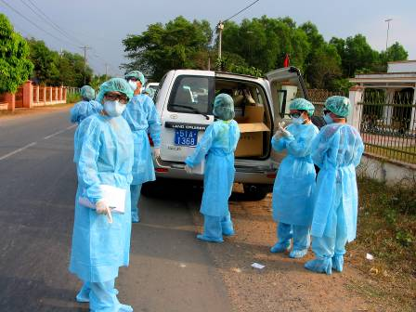
Suggested Rapid Response Team (RRT)
Core team members
  Team leader
  Epidemiologist or health officer
  Hospital clinical officer
  Senior laboratory technician/ scientist
  Veterinarian/ animal health specialist
  Communications specialist
Expanded team members
  Health promotion officer
  Infection control officer
  Logistician/administrators
  Interviewers
  Security officer
  Biosecurity officer
  One Health officer and/or environmental health officer
More details:
Epi Module 3: Forming a Rapid Response Team
Photo: Tim Uyeki, CDC
Notes:
The suggested composition of a rapid response team was covered earlier in module 3 and is shown again here as a reminder.

Slide 13
Investigation Resources
Local resources
  Physicians and nurses caring for case-patient(s)
  Agricultural and animal health workers, veterinarians, clinical and laboratory experts, support personnel
  Local district, city, and provincial public health and veterinary staff
National resources
  Ministry of Health and Ministry of Agriculture
  Epidemiologists/subject matter experts
  Nurse and veterinary consultants
  Disease investigation specialists
  Animal biologists and wildlife experts
International and other resources
  World Health Organization (WHO) (www.who.int)
  World Organization of Animal Health (OIE) (www.oie.int)
  Food and Agriculture Organization of the UN (www.fao.org)
  Centers for Disease Control and Prevention (www.cdc.gov)
  USAID Emerging Pandemic Threats Program (www.usaid.gov/ept2)
  Published scientific articles
Other
  People or agencies to advise on security concerns for an investigation location
Notes:
When preparing for an investigation, you should identify and locate the resources you will need to carry out the investigation. These include:
People, such as the physicians and nurses caring for the suspected novel influenza virus infection case patient. You will need contact information for these individuals.
Other resources include the national Ministry of Health and Ministry of Agriculture and epidemiologists and other subject matter experts that can advise you.
The World Health Organization (WHO) country office colleagues will be a valuable source of the latest information on the situation.
WHO has published guidance related to H5N1 case investigations and H7N9 surveillance. An important resource for H5N1 case investigations is the WHO guidelines for investigation of human cases of avian influenza A (H5N1) which can be accessed from the WHO website. In addition, the document Interim WHO surveillance recommendations for human infection with avian influenza A(H7N9) virus provides updated case definitions for probable and confirmed cases of A(H7N9). Much of the content of this presentation is adapted from these documents.
You should also gather articles on the epidemiology and clinical characteristics of human cases with novel influenza virus infection that have been published in scientific and medical journals if they are available.
Lastly, you should be aware of any specific safety and security risks in the areas where you may be working.
Although animal health authorities will not be directly involved in human case investigation, it is important to stay in touch with animal health authorities.

Slide 14
Items to take with you during an investigation
Proof of employment
Information on cases already gathered
List of important contacts or resources
  Local contacts as well as contacts from home agency
  Multi-sectoral contact information
Manuals or Standard Operating Procedures (SOPs)
  Case management
  Epidemiologic investigation (investigation questionnaires)
  Specimen collection and transport procedures
Local currency
Notes:
Next you must think about what documentation you will need to prepare and bring with you before leaving for the outbreak investigation. Some of the pre-documentation information may be country specific, so you have to consider carefully what documentation requirements will be necessary in the country in which you are conducting the case investigation.
Documentation that you should always bring with you is evidence that you & your team are employees of your institution – so evidence such as an identification badge, or an official letter from your institution or the country’s Ministry of Health that indicates that you are a member of the investigation team.
Other documentation or materials you might need includes:
Information on the cases that you have already gathered, such as their location, date(s) of illness onset, signs and symptoms, dates of hospital admission, discharge or death, and other clinical and exposure details. Be sure to get in touch with people who work in the animal/veterinary field so that you will also know where animal cases are occurring, if any. If animal cases are occurring, similar information on animal outbreaks in the region should also be collected.
Lists of important contacts or resources, including for other sectors such as animal health and environmental health
Standard operating procedures or SOPs to refer to for various aspects of the investigation, including but not limited to case management and laboratory specimen collection procedures, and specimen labels
And don’t forget to get local currency

Slide 15
Supplies
Epidemiological
  Case definitions, reporting forms, questionnaires, databases
Medical
  Antiviral medications, exam equipment (e.g. stethoscope)
Laboratory
  Specimen collection materials, transportation containers, labels, viral transport media
Personal Protective Equipment (PPE)
  Respirators, gloves, gown, goggles
  Be prepared with PPE for human cases
Decontamination
  Solution for homes, hospital rooms, farms, etc.
More details:
Lab Module 1: Sample collection, transport, and storage
More details:
Clinical Module 6: Infection prevention and control preparedness
Notes:
Finally, before you leave to begin the field investigation, you should gather supplies that you will need to carry out the investigation. These supplies may include items such as:
Epidemiological supplies such as copies of the case definition, multiple copies of case reporting forms, and standardized questionnaires for interviews (these will need to be modified in the field). Be sure to have any forms in all local languages that you may need.
Medical supplies, such as antiviral medications (oseltamivir) for treatment in the event that a member of the team becomes ill. Physicians who will be examining patients should bring exam equipment such as a stethoscope.
Laboratory supplies for collecting and storing samples for testing, such as sterile synthetic swabs, sterile tubes, sterile blood drawing equipment (needles, syringes, tubes), specimen labels, permanent marking pens, sterile cryovials for freezing sera, specimen collection bags, a cooler, cold packs for freezing, and sterile viral transport media.
Personal protective equipment, or PPE, to protect team members from novel influenza virus exposure. More details on appropriate PPE for different situations is provided in Clinical Module 6 on infection prevention and control preparedness.
A solution for decontamination of surfaces, boots, etc. in case it is needed during the course of your investigation. This may be obtained locally.

Slide 16
Supplies
Electronic equipment
  Cell phone
  GPS Unit
  Laptop (with “software for analyses”)
  Electrical adapters
  Camera
  Extra batteries or a way to re-charge batteries in the field
Educational materials
  Current brochures and posters for the novel virus
  Simple and culturally appropriate messages
  Guidelines for contacts, family members, and healthcare workers
  Guidelines for farmers, animal breeders, etc.
  Guidelines for clinical management of human illness
  Guidelines for control of the spread of influenza in animal populations or animal health contact information in case people who work with/have animals need this or ask for this
  Communication materials
Notes:
You also need to check your electronic equipment, cell phones, and laptops to make sure they will be in good working order in a field setting. Check that the laptops are equipped with the necessary and accessible software for data analyses, and that computer protection software (virus, firewall) are up-to-date.
You should be prepared to interact with the community and with healthcare practitioners during the investigation and bring supplies that can be distributed to partners and the community. This includes human clinical and guidelines for control of infection in animal populations, as well as educational materials about the novel influenza virus such as brochures and posters that can be distributed when interacting with the community and healthcare practitioners. These should be easy to read, and contain simple message and guidelines in the local language for contacts of cases, family members, or medical workers. If you do not already have materials such as this, you should think about developing them before an outbreak of novel influenza virus infection occurs. If appropriate, include messages about how to recognize, report, and control influenza virus in poultry and other animals. Also consider using any communications resources produced in the local language or culturally appropriate context. Be sure to have communications materials related to human cases as well as basic information about animal cases and agricultural issues, as needed.

Slide 17
Discussion Question
Do you already have all needed case investigation supplies and educational materials in place in your location/country?
  Guidelines
  Standard operating procedures
  Etc.
Notes:
Facilitator notes: Take 5 minutes to lead a brief discussion with the entire group. Ask participants to volunteer to state what educational and other materials (e.g. guidelines and SOPs) are available in their location/country.

Slide 18
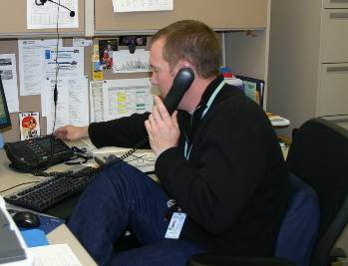
Identify Key Stakeholders
Government officials
Healthcare personnel
Community
Non-governmental organizations
Laboratory
Investigation participants
International partners
Veterinary health / wildlife authorities
Animal owners/breeders/handlers
Farm owners, etc.
Agriculture officials
Photo: Centers for Disease Control and Prevention
Notes:
There are a number of people or agencies that will be stakeholders in your investigation. There may already be terms of reference in place for what each person or agency’s responsibilities will be during an investigation of a novel influenza case. However the following are recommended when no terms of reference are in place:
Veterinary Health Authorities should be notified to conduct an evaluation of diseased poultry or other animals in the area where novel influenza cases are being investigated. Similarly, wildlife authorities should be notified to evaluate the presence or spread of the virus in wild birds.
Animal owners, breeders, and/or handlers should be notified so that you can ask about diseased animals they may have noticed.
Farm owners who may be aware of sick of dead birds or other animals should be notified so you can speak with them.
Government and agriculture officials in the relevant ministries should be kept informed of the situation, and officials in the Ministry of Health may have provide advice and direction that will be useful in your investigation.
Healthcare personnel caring for the hospitalized patients should know that you will be arriving to investigate. You may want to remind them how to limit exposure to visitors and other hospital workers, and offer information or resources about case management as necessary.
The communities you will visit will likely be very interested in a report about a possible case of novel influenza virus infection. Be prepared to answer questions, offer assurance that you and your RRT are handling the situation, and use the opportunity to educate them about how to prevent disease transmission.
Non-governmental organizations in the area could be a resource for medical staff, antiviral medications and PPE, transportation, or other needed resources. They may have very good relationships with people in the communities where you will be conducting your investigations, and may be able to assist with communication and coordination.
The key public health laboratories should know that clinical and possibly environmental samples will be sent from suspected novel influenza virus infection cases. If the hospital has already sent samples for testing, communicate with the laboratory staff about testing results. Be sure to keep any relevant animal veterinary hospitals and veterinary diagnostic laboratory staff informed as well.
Before you leave to the field, it is important that every RRT member understands their role: what their tasks are, who they report to, and where to go if they have questions. It is also important that the team understands the roles of other international partners who may be engaged in the response.

Slide 19
Collaborative Investigation
Public health investigators should work together with human, animal, and environmental health investigators
  Plan joint visits to affected areas
  Frequent communication
Animal health investigators help assess appearance and health of animals and surrounding environment
Ask questions about health of both humans and animals
  If animal health arrives first, also ask questions about the health of humans caring for the animals
  If human health team arrives first, also ask questions about ill animals in the area
  In a situation with a concern for low pathogenic influenza A(H7N9) communications should include the possibility of human illness even if poultry in the area are seemingly healthy
Coordinate and share test results and surveillance data
Notes:
As you plan and investigate, keep in mind that an effective rapid response to novel influenza virus infection should involve collaborative investigations between human, animal, and environmental/agricultural health officers. It is vitally important for:
Public health investigators to work together with animal health investigators to assess the role of the novel influenza virus in animal populations as possible sources of infection to humans
This involves conducting joint visits, if possible, to affected areas including: case homes, surroundings, local farms, live animal markets, places frequented by the animal populations in question, and places with animals visited by the case the week before illness
It is also important to assess the appearance of all the animals (both well-appearing, and sick or ill animals) in the case’s home, neighborhood, and surrounding areas, including birds, cats, dogs, and pigs
Depending on which investigation team, animal or human health, is in the field first, it is vitally important to ask questions about the health of both animals and humans.
Generally though, animal health investigators will collect animal and environmental specimens and human health investigators should collect specimens from humans.
In a situation with a concern for low pathogenic influenza A(H7N9) communications should include the possibility of human illness even if poultry in the area are seemingly healthy
* It is critical that animal and human health investigators coordinate and share all of the test results and surveillance data

Slide 20

Gathering Evidence
Establish existence of an outbreak
Verify the diagnosis
Define and identify cases
  Clusters
  Contact Tracing
Image: Centers for Disease Control and Prevention
Notes:
After preparations have been made, it is time to begin the investigation. The first step is to gather evidence - data and information - that allow you to begin assessing the situation.
Your team will need to gather evidence to establish whether an outbreak is occurring and verify the diagnosis using laboratory testing. Then, you will need to define cases to help with case and cluster identification and then perform contact tracing.

Slide 21
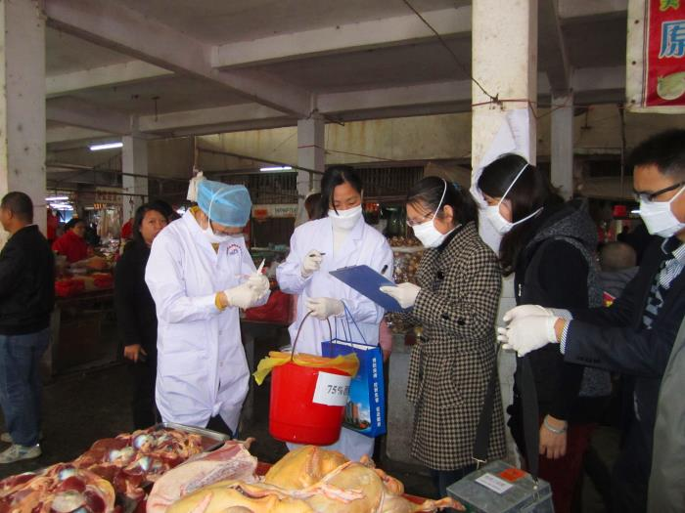
What is an Outbreak?
An increase in the occurrence of illness above what is expected in that population in that area during that specific time period
Photo: Centers for Disease Control and Prevention
Notes:
The basic definition of an outbreak is an increase in the occurrence of illness above what is expected in the population in that area during that specific time period. To determine whether an outbreak is occurring, you will need to examine any available historical and current surveillance data.
Photo: https://phil.cdc.gov/phil/details.asp Image ID# 19669

Slide 22
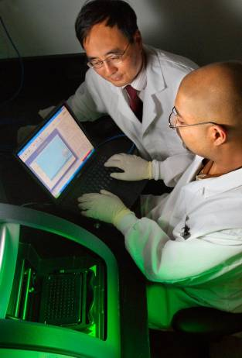
Verify Diagnosis
Obtain medical records and laboratory results
  Contact public health epidemiologists in hospitals, veterinary epidemiologists, and infection prevention staff
Conduct clinical testing if needed
  Contact reference laboratories to provide testing or training and necessary tools/kits to conduct testing at the local level
Photo: Centers for Disease Control and Prevention
Notes:
At the same time, you will need to verify the diagnosis. This is done by reviewing medical records and lab results for testing that may have been done as part of routine clinical care and by obtaining specimens for clinical testing.
If a case of novel influenza virus infection is suspected, specimen testing to confirm the novel virus infection will likely need to be done at a reference laboratory, especially early in the investigation. It is important to review the latest WHO guidance on specimen collection for investigation of the novel virus and to communicate early with the reference laboratory for guidance on specimen collection and testing. Also note that all positive but un-sub-typeable specimens of influenza A should be sent immediately to a WHO Collaborating Centre for further analysis. Be sure to coordinate with both human and veterinary laboratories. Human and animal laboratory workers should keep each other informed about testing of specimens and lab results.

Slide 23
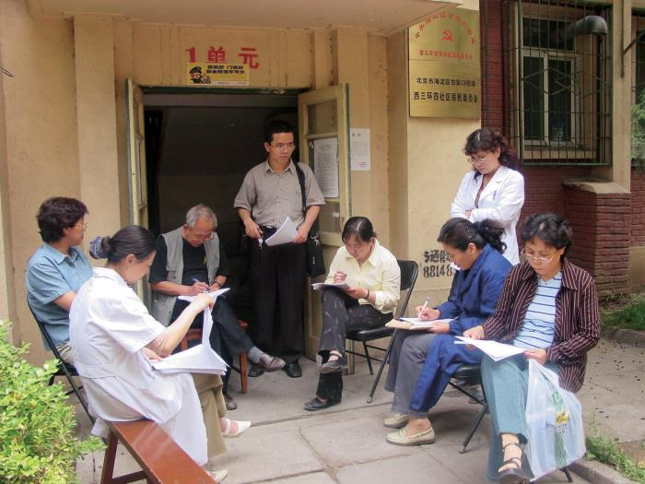
Human Case Finding
Attempt to identify additional cases
  Persons who may have been exposed to the same infection source as known case(s)
  Persons with exposures to potentially infected animals or healthcare workers caring for sick patients
  Persons with recent travel history to places that may be impacted by the outbreak
  Persons with unexplained acute lower respiratory infection with fever or persons who died of an unexplained acute respiratory illness
  Close contacts of case(s)
Photo: Centers for Disease Control and Prevention
Notes:
The objective of case finding is to identify any additional cases beyond the already identified cases and close contacts.
This is done by searching for:
Persons who may have been exposed to the same novel influenza virus source as the case patient
Persons with exposures to potentially infected animals or health care workers that cared for suspected/ probable or confirmed novel influenza virus cases
Persons with unexplained acute lower respiratory infection with fever or persons who died of an unexplained acute respiratory illness
Close contacts of the case
Persons exposed to potentially infected animals
This case finding can be done with both active and passive methods.
Photo: https://phil.cdc.gov/phil/details.asp Image ID# 20568

Slide 24
Methods of Human Case Finding
Active: Search effort by public health workers in an area where a case has occurred
  Interviews with known cases to identify contacts
  House-to-house searches
  Visits to health care facilities, private practitioners, traditional healers, pharmacies, laboratories
  Location of potential environmental exposure (i.e., poultry market, agricultural fair)
Passive: Suspected cases that are reported without active searching by public health staff
  Routine surveillance or enhanced surveillance
  Rumor hotlines
  Public information messages in the affected communities
Active vs. Passive approach depends on local resources and outbreak context
Once cases are identified, it is important to ensure that the appropriate respiratory specimens are collected and tested, and that suspected cases are referred for appropriate medical care
Notes:
Active Case finding refers to a search effort by public health workers or RRT members throughout the geographic area where a case has been identified and/or where animal outbreaks of novel influenza virus infection have been documented or are suspected. Depending on the circumstances, consider house-to-house searches, visits to health care facilities, private practitioners, traditional healers, pharmacies, laboratories.
Passive case finding refers to suspect/probable cases that are reported without active search efforts by public health staff.
Examples of passive case finding includes routine surveillance, rumor hotlines, and providing public information messages in the affected area which may encourage local communities to identify additional cases and report them through various mechanisms.
The decision to pursue active over passive case-finding depends on local resources as well as the context of the outbreak including how long the outbreak has been going on, the size of the outbreak, or the risk to other humans.
Regardless of how the new cases are found: Once cases meeting trigger criteria are identified through case finding, it is important to ensure that the appropriate respiratory specimens are collected and tested, and that suspected cases are referred for appropriate medical care.

Slide 25
Enhanced Surveillance
Implement in areas where novel influenza virus cases live or where animal outbreaks are occurring
May include multiple mechanisms:
  Active surveillance at healthcare facilities, traditional healers, pharmacies/medication dispensaries, private laboratories
  Engaging or establishing sentinel surveillance sites
  Active surveillance among health care workers
  Active surveillance among veterinarians and other persons exposed to potentially infected birds/animals
  Engage village leaders, traditional healers, religious leaders, farmers, fisher-people, etc. to notify authorities of trigger events
  Notify teachers and school administrators to report increases in student absenteeism
Continue for a minimum of 2 weeks after the last human case was identified
  2 weeks = 2 incubation periods for influenza viruses
  Maintain for longer periods if animal outbreaks are ongoing and not controlled
Notes:
In addition to active case finding activities, surveillance efforts should be enhanced in the area(s) where suspected/probable, or confirmed novel influenza virus cases live or where animal outbreaks of the novel influenza virus have been reported. As mentioned before, active surveillance should be implemented in hospitals, emergency departments, other places where patients access health care, and considered in places where people have occupational exposures to either human or animal cases of infection with the novel influenza virus, such as in health care workers and poultry workers.
Enhanced surveillance should be maintained for at least 2 weeks after the last human case of infection with the novel influenza virus has been identified AND local markets have been declared clean; however this should be extended longer if there are ongoing, uncontrolled animal outbreaks in the area.

Slide 26
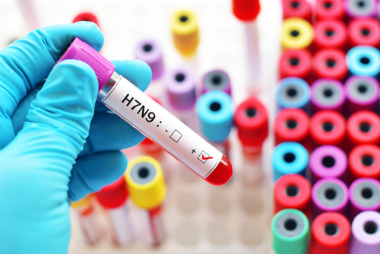
Specimen Collection During an Investigation
Collect specimens rapidly, safely and correctly
Specimens related to investigation should be prioritized for testing over sentinel or routine specimens
Information needed:
  Whom to collect from
  What samples to collect
  What to wear for protection
  How to properly label specimens
  How to transport specimens
  Where to send specimens for processing and testing
Notes:
If laboratory testing has not yet been performed for cases identified during an investigation, it is important to collect specimens rapidly, safely and correctly.
Specimens collected as part of the investigation, or specimens otherwise associated with the investigation, should be prioritized for testing over sentinel or routine specimens.
The information needed to safely perform specimen collection:
Whom to collect specimens from and what samples to collect, including from people and animals
What to wear to protect yourself and others
How to safely transport the materials in order to ensure that the sample arrives at the lab in an optimal state
And the appropriate procedures for diagnosis of the case in question.
All of this information is covered in detail in the laboratory diagnostics, specimen collection, and biosafety module.
The specimen collection guidance for chickens or other animals is not provided in this lecture but is in a veterinary module.
Photo: purchased from Shutterstock. Stock photo ID: 759724642

Slide 27
What to Collect to Confirm Human Novel Virus Infection
Upper respiratory tract specimens
  Nasopharyngeal swab or nasal aspirate/wash plus throat swab (ideal)
  Nasal swabs (may be collected in place of nasopharyngeal swab)
Lower respiratory tract specimens should also be collected
(if available in the course of clinical care)
  Endotracheal aspirates
  Bronchiolalveolar lavage (BAL)
  Pleural fluid from chest tubes
    BAL or pleural fluid should only be tested if they were collected for another purpose
Collect multiple specimens from different sites and at different time points. Collect the first respiratory specimen as early as possible during illness.
Ideally before antiviral administration
but do not withhold treatment for a specimen
Collection of acute and convalescent sera
More details:
Lab Module 1: Sample collection, transport, and storage
http://www.who.int/csr/resources/publications/surveillance/CDS_EPR_ARO_2006_1.pdf
https://www.cdc.gov/flu/avianflu/severe-potential.htm
Notes:
The optimal specimens for confirming infection may vary depending upon the novel influenza virus in question. Upper respiratory specimen collection options include nasopharyngeal swabs or nasal aspirates/washes (typically done in young infants), throat swabs, and nasal swabs. The WHO has not yet issued guidance on optimal specimens for detection of avian influenza A(H7N9) viruses in humans, but guidance for specimen collection confirmation of A(H5N1) emphasized collection of an oropharyngeal swab.
Currently, the US CDC recommends collecting paired specimens that include a nasopharyngeal swab or nasal aspirate/wash plus a throat swab for investigation of possible A(H7N9) cases. If a nasopharyngeal swab cannot be collected, a nasal swab may be taken in its place.
Lower respiratory tract specimens should additionally be collected for testing but are most likely only to be available from hospitalized and/or critically ill patients. These include endotracheal aspirates that can be collected from intubated patients, bronchoalveolar lavage specimens and pleural fluid collected by thoracentesis with or without a chest tube. Note that BAL or pleural fluid should only be tested if it is being collected for another purpose.
It is also recommended to collect multiple specimens from different sites and at different time points during the illness from persons with suspected infection, especially if the initial specimen is negative for novel influenza virus but novel influenza virus is highly suspected based on contact and/or clinical history.
The first respiratory specimen should be collected as early as possible during the illness episode.
Respiratory specimens should ideally be collected before starting antiviral treatment but treatment should not be withheld or delayed for a specimen.
You may also consider collecting acute and convalescent sera for novel influenza virus infection. The acute serum sample should be collected within 7 days of symptom onset and the convalescent serum sample should be collected 2-4 weeks later.
Veterinary/animal sample collection will not be discussed in this presentation.

Slide 28
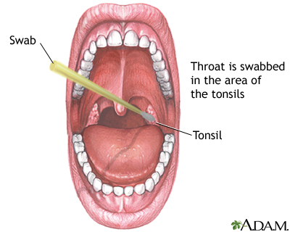
Oropharyngeal Swab Collection
Notes:
Now, let’s talk about how to obtain an oropharyngeal swab and a nasopharyngeal swab. Let’s start with oropharyngeal swabs.
First, it is important to use the correct swab type. Swabs should have synthetic tip (e.g., polyester or Dacron®) and an aluminum or plastic shaft. Swabs with cotton tips and wooden shafts are not recommended, and swabs made of calcium alginate are not acceptable. The swab specimen collection vials should contain 1-3ml of viral transport medium.
To obtain an oropharyngeal swab:
1) Tilt patient’s head back 70 degrees.
2) Insert the swab into the mouth, and swab the posterior pharynx and
tonsillar areas while avoiding the tongue.
3) Then place the tip of swab into the tube of VTM and cut-off the applicator tip at the level of the rim of the VTM tube. Be sure to use clean scissors to cut off the applicator tip for each swab to avoid cross contamination between swabs.
Image: A.D.A.M. http://aia5.adam.com/content.aspx?productId=117&pid=1&gid=003746

Slide 29
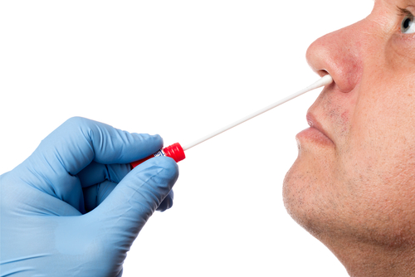
Nasopharyngeal Swab Collection
Nasopharyngeal swab collection video: https://www.youtube.com/watch?v=DVJNWefmHjE
Notes:
Now let’s talk about how to collect a nasopharyngeal swab. The same guidelines for swab type apply—you should use a swab with a synthetic tip.
Again, tilt the patient’s head back 70 degrees. This time, insert the swab into one nostril to a depth equal to the distance from the nostrils to the outer opening of the ear. Leave the swab in place for several seconds to absorb secretions. Then, slowly remove the swab while rotating it.
Swab both nostrils with the same swab. Then place the tip of the swab into the VTM and cut off the applicator stick. For paired specimens, the OP and NP swabs will be placed into the same tube of VTM. The link at the bottom of this slide provides a video demonstrating the current technique for obtaining an NP swab.
Remember to don and doff PPE before and after obtaining respiratory specimens and to wash your hands with soap and water before and after obtaining specimens.
Photo purchased from Shutterstock. Stock photo ID: 469573808

Slide 30
Components of a Human Case Definition
A case definition should be specific to the outbreak under investigation.
A case definition includes criteria for person, place, time, and clinical features.
  Person: includes key characteristics of affected persons, such as age, sex, race, occupation and exclusion criteria
  Place: typically describes a specific geographic location or facility associated with the outbreak
  Time: is used to delineate a period of time associated with illness onset for the cases under investigation
  Clinical information: is based on simple and objective measures
Notes:
Defining a standardized human case definition is a critical part of an outbreak investigation. The case definition should be specific to the outbreak under investigation.
The case definition includes criteria for person, place, time, and clinical features.
- The elements of defining person include key characteristics of affected persons. For example, a case definition might specify poultry workers or persons exposed to sick pigs at a livestock show.
- The elements of defining place typically describes a specific geographic location or facility or institution associated with the outbreak.
- Limiting the time period enables exclusion of similar illnesses which are unrelated to the outbreak of interest.
- Clinical criteria should be based on simple and objective measurements. There may be more than one case definition in an outbreak investigation. For example, there may be different case definitions for confirmed cases and probable cases.

Slide 31
Refining Case Definitions
May have more than one case definition
  Confirmed cases
  Probable cases
  Suspect cases
Case definitions may change as investigation progresses
  Early in investigation: the case definition may be broad
  Later in investigation: the case definition may be refined to be more specific to person, place, time, or clinical information that has been gained
There will be separate case definitions for human events and animal events
Notes:
You may have more than one case definition (for example, a case definition for a confirmed case, a probable case or a suspect case).
The case definition may change as the outbreak progresses. At the start of an investigation, the case definition might be broad to capture all as many events as possible. But as the investigation continues the case definition may become more specific to the people, place, time, or clinical information that is only known once several events have been investigated.
- There will be separate case definitions for animal events.

Slide 32
Example Case Definitions for Influenza A/H7N9 Virus Infection
Case definitions should be adapted to the local context during an outbreak investigation.
Below is a set of example case definitions for A(H7N9) virus infection:
Confirmed case: Influenza A(H7N9) virus infection in a person that is laboratory confirmed using methods in accordance with WHO-approved protocols for detection of avian influenza A(H7N9) virus
Probable case: Illness compatible with influenza in a person meeting exposure criteria * and for whom laboratory results were A/unsubtypeable (inf A pos, inf A(H1) neg, inf A(H3) neg by RT-PCR)
Suspect case: Illness compatible with influenza in a person meeting exposure criteria * and for whom confirmatory laboratory test results are not known or pending
* Example exposure criteria are outlined in the next slide
Notes:
Here are generic case definitions of A(H7N9). During an outbreak investigation, these should be adapted for use in the local context.
A confirmed case is A(H7N9) infection in a person where infection was laboratory confirmed using methods in accordance with WHO-approved protocols for detecting A(H7N9) viruses
A probable case is illness compatible with influenza in a person who meets exposure criteria (which we’ll go through on the next slide) and for whom laboratory results were indicative of influenza A infection but the infection was unsubtypeable.
A suspected case is illness compatible with influenza in a person who meets any of the exposure criteria and for whom lab test results are either not known or are pending.

Slide 33
Example Case Definitions for Influenza A/H7N9, continued…
Example exposure criteria for probable or suspected cases:
Recent exposure (e.g. within 14 days) to a market where animal/poultry illness has been reported or avian influenza A(H7N9) virus has been detected
Recent travel (within 14 days of illness onset) to areas where humans have become infected with avian influenza A(H7N9) virus or to areas where avian influenza A(H7N9) viruses are known to be circulating in animals (poultry)
Persons who have had recent close contact * (within 14 days of illness onset) with confirmed, probable, or suspected cases of human infection with avian influenza A(H7N9) virus
Unprotected exposure to live avian influenza A(H7N9) virus in a laboratory
* Close contact may be regarded as coming within about 3 feet (1 metre) of a confirmed or suspected case while the case was ill (beginning 1 day prior to illness onset and continuing until resolution of illness). This includes healthcare personnel providing care for a confirmed case without appropriate PPE use, family members of a confirmed case, persons who lived with or stayed overnight with a confirmed or suspected case, and others who have had similar close physical contact.
http://www.who.int/influenza/human_animal_interface/influenza_h7n9/InterimSurveillanceRecH7N9_10May13.pdf
Notes:
As part of this example case definition, certain exposure criteria would be considered. Again, during an outbreak investigation, these should be adapted for use in the local context.
In this example, for probable or suspected cases, exposure would be defined as exposure to a market where poultry illness has been reported or where influenza A(H7N9) viruses have been detected.
Recent travel would also be considered exposure if travel was to an area where infections have been infected with A(H7N9) or to an area where influenza A(H7N9) viruses are to know to be circulating in poultry.
Exposure would also be considered if the person had recent close contact with a confirmed, probable, or suspected case of human infection with influenza A(H7N9) virus infection.
Note here that this definition include close contact with a lab-confirmed case could include humans or animals. I would also add here that because A(H7N9) can have low pathogenicity in birds, surveillance in animals is even more important.
Finally, a person would be considered exposed if they had unprotected exposure to live virus in the laboratory.

Slide 34
e.g.: Chinese Case Definitions for Influenza A(H7N9) Virus Infection
Confirmed case: clinical symptoms consistent with acute influenza and a laboratory test positive for avian influenza A (H7N9) virus
Suspect case: clinical symptoms consistent with acute influenza, while no confirmed laboratory test result yet, and with below epidemiologic history
Epidemiologic history: Recorded exposure history to poultry and/or their blood and bodily fluids, or live poultry market, or persons confirmed with H7N9 infection in the preceding 14 days before onset
http://www.nhfpc.gov.cn/yzygj/s3593g/201701/2dbdbc6e82dd4fdfa57508499f61cdfc.shtml
Notes:
For the H7N9 outbreak in China, the Chinese National Health and Family Planning Commission developed the following case definitions.
A confirmed case is a person with clinical symptoms consistent with acute influenza and laboratory test positive for avian influenza A(H7N9) virus
A suspect case is a person with clinical symptoms consistent with acute influenza, while there is no confirmed laboratory test result yet, and the person has an epidemiologic history to H7N9.
This epidemiologic history includes recorded exposure to poultry or poultry blood or body fluids, live poultry market, or persons with confirmed H7N9 infection in the 14 days before illness onset in the case.

Slide 35
Discussion Questions
In your location/country, how would you adapt the example case definitions of influenza A(H7N9) virus infection during an outbreak investigation?
Notes:
Facilitator notes: Take 5 minutes to lead a brief discussion with the entire group. Ask participants to discuss to ways that they would need to adapt a case definition for their use in an outbreak of avian influenza A(H7N9).

Slide 36
Information for Human Case Investigation
Demographic data
  Age, sex, household members
Epidemiologic data
  Occupational exposures, animal exposures, environmental exposures during 14 days before illness onset plus type of exposure
  Contact with confirmed cases within 14 days prior to illness onset, type of exposure (speaking distance, slept in the same room, provided bedside care, etc.)
  Travel history
  Health seeking behaviors
Clinical data
  Illness onset date, signs & symptoms, underlying conditions, physical exam, vital signs
  Hospital admission dates, treatments, laboratory results, chest x-ray results, complications
  Outcome
Laboratory data (if samples already collected)
  Date of sampling, lab where specimen was sent, type of testing performed, test result
Notes:
Important types of information to collect include the following:
Demographic information, such as age, sex, race/ethnicity, household members, should be collected from every novel influenza virus case
Epidemiological data should be collected, including exposure information, such as work, home, or other exposures to birds and poultry in the 14 days before illness onset; information on any contact with confirmed or probable/suspected novel influenza virus cases in the 14 days before illness onset; and the patient’s or contact’s travel history
Clinical information such as date of onset of signs and symptoms, vital signs, underlying conditions, hospital admission history, and treatments (before admission and during hospitalization), complications, CXR findings, and outcomes, should be collected
Laboratory results (hospital diagnostics or any other specimens collected for confirmatory testing), if available, should be included

Slide 37
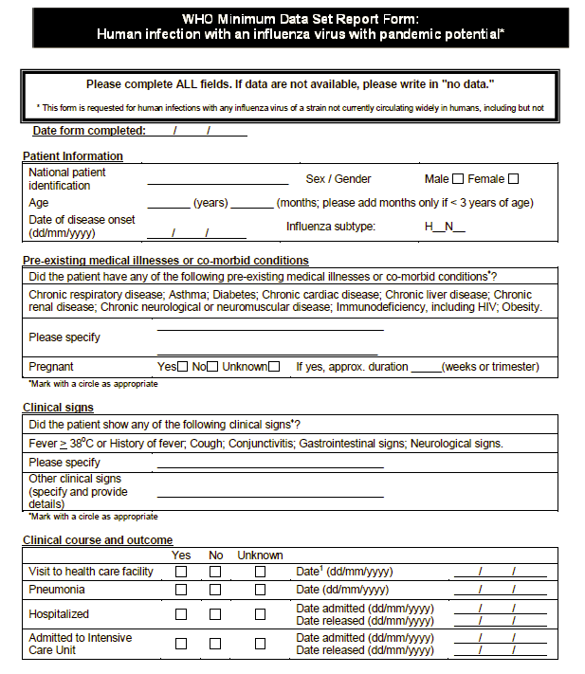
WHO Data Form for Human Infections
Interim WHO surveillance recommendations for human infection with avian influenza A(H7N9) virus. http://www.who.int/influenza/human_animal_interface/influenza_h7n9/InterimSurveillanceRecH7N9_10May13.pdf
Notes:
The WHO has developed a form for collection of detailed data on probable and confirmed cases of human infection with avian influenza A(H7N9). The form is shown here and on the next slide. National authorities are encouraged to share the information on this form with the WHO to inform guidance related to human infection with A(H7N9).

Slide 38
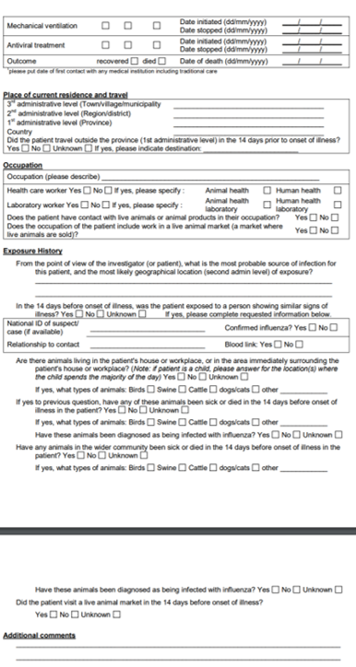
WHO Data Form for Human Infections
Interim WHO surveillance recommendations for human infection with avian influenza A(H7N9) virus. http://www.who.int/influenza/human_animal_interface/influenza_h7n9/InterimSurveillanceRecH7N9_10May13.pdf
Notes:
The WHO has developed a form for collection of detailed data on probable and confirmed cases of human infection with avian influenza A(H7N9).Just discuss major categories of data elements .

Slide 39
Counting and Tracking Human Cases
Generate a line list to capture information on cases:
  Identifying information: name, address, phone number
  Demographic information (age, sex, race, occupation, underlying health conditions)
  Clinical information: symptoms (type, duration), onset dates
  Exposure information (animal exposures, travel history, environmental exposures)
  Laboratory test results
  Case status (confirmed, probable, suspected)
Case # | Age | Sex | Status | Occupation | Difficulty breathing | Date of Onset | PCR result
1 | 5 | M | Confirmed | Child | Yes | 7 July | Positive
2 | 55 | F | Probable | Caretaker of case #1 | Yes | 9 July | Pending
3 | 48 | M | Probable | Poultry Farmer | No | 7 July | Pending
Notes:
A line list is an organized way to help you keep track of cases. Typically, a line list is produced by epidemiologists during outbreak investigations to keep track of person, place, and time information for different categories of cases and contacts. For example, cases can be entered into the line list as probable or confirmed. Contacts can also be included in the same or separate line lists. Line lists should be updated daily as the investigation progresses. Basic information in a line list includes demographic, epidemiological, clinical, case status, and laboratory testing results. The purpose of a line list is to provide quick summary data about cases and contacts under investigation; therefore your team should determine what data fields are appropriate for the purposes of your investigation. The list shown here is only a simplified example, and real line lists may include substantially more data.

Slide 40
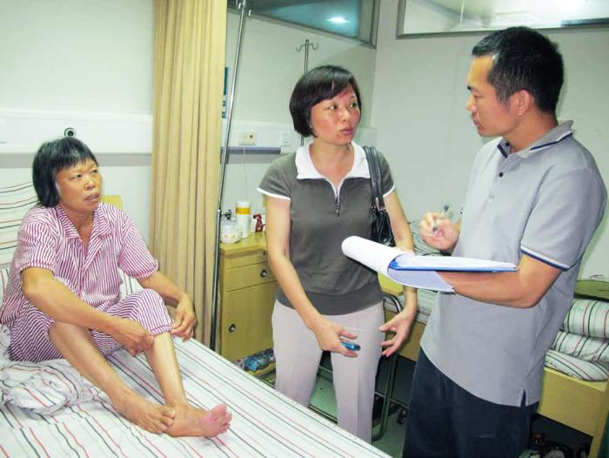
Definition of a Human Cluster
  A group of 2 or more persons with onset of symptoms meeting the case definition criteria
  Associated with a specific setting (e.g., health care workers, classroom, workplace, household, extended family, hospital, other residential institution, military barracks or recreational camp)
  With illness onset occurring within the same 14-day period
Photo: Centers for Disease Control and Prevention
Notes:
When trigger cases are identified, they should be immediately investigated for the possibility of a novel influenza A virus.
As mentioned earlier, clusters are defined as:
Two or more persons (one of which has moderate-to-severe acute respiratory illness, or who died of an acute respiratory illness) ), that is not explained by another diagnosis, with onset of illness within two weeks of each other
AND
With a history strongly suggesting potential exposure to a novel influenza virus.
Photo: https://phil.cdc.gov/phil/details.asp Image ID# 20576

Slide 41
Human-to-Human Transmission
More efficient and sustained (at least 2 generations) human-to-human transmission of a novel influenza virus may represent increased risk of a pandemic
Should be evaluated in early clusters of novel influenza virus infection
If human-to-human transmission is suspected: immediate collection of specimens
Notification of the WHO
Notes:
Human to human transmission should be evaluated in early clusters of novel influenza virus infection.
If human-to-human transmission is suspected, immediate collection of specimens for detailed genetic and antigenic characterization by a designated WHO Reference Laboratory is essential
The WHO should be notified if an investigation indicates that human-to-human transmission may be occurring

Slide 42
Identifying Possible Human-to-Human Transmission
Documented exposure to a confirmed or probable novel influenza virus case
AND
The time interval between contact with a probable or confirmed case and illness onset is 14 days or less
AND
Documented absence of other source of possible exposures:
  Such as exposures to animals (e.g., birds, feathers, droppings, fertilizers, live poultry markets, agricultural fairs, contaminated environments, or laboratory specimens) or travel history to a place where an outbreak is ongoing
Notes:
Possible human-to-human novel influenza virus transmission should be considered for:
Well documented exposure to a confirmed or suspect/probable case, AND
The time interval between contact with a suspected/probable or confirmed novel influenza virus case and illness onset is 14 days or less, AND
Documented absence of an alternative source of exposure such as exposures to potentially infected animals, or animal products, (such as feathers, droppings, fertilizers made from fresh bird droppings), visits to live poultry markets, agricultural fairs, or exposure to contaminated environments, or to laboratory specimens) or travel to a place where an outbreak is ongoing.

Slide 43

What is Human Contact Tracing?
The identification and diagnosis of persons who may have been in close contact with an infected individual during the infectious period
Notes:
Once a case of novel influenza is identified and interviewed, contact tracing is an important next step of the rapid response process.
Contact tracing can be defined as the identification and diagnosis of persons who may have been in close contact with an infected individual during the infectious period or in close contact with the same animal/environmental exposure(s) as the case.
Image: Icon by Eliricon, from thenounproject.com (attribution required)

Slide 44
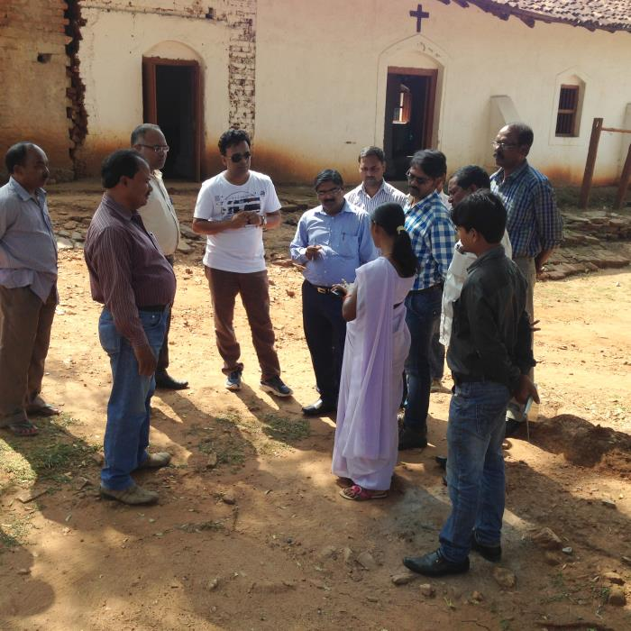
Purpose of Human Contact Tracing
Find new potential human cases of novel influenza virus infection
Provide interventions to decrease risk of illness and interrupt further transmission
  Active surveillance for illness
  Early treatment of ill persons
  Collection of specimens for novel virus testing
  Educational information to prevent transmission
Contact tracing should be a part of the investigation as long as new cases are occurring
Photo: Centers for Disease Control and Prevention
Notes:
The purpose of contact tracing is to:
Find new potential cases of novel influenza virus infection
Provide targeted interventions to decrease risk of illness complications and interrupt further transmission. This may include active surveillance for disease, monitoring contacts for symptoms of novel influenza virus infection, providing early empiric antiviral treatment to ill persons, collection of specimens from ill persons for novel influenza virus testing, and providing educational information on how novel influenza virus infection is spread.
Contact tracing should continue for cases as long as new cases are occurring. Contact tracing should occur among confirmed cases. Whether there is contact tracing for suspected or probable cases depends on local resources and where in the outbreak tracing is occurring. For example, during the beginning of an outbreak, a more aggressive approach may be taken to find contacts of all confirmed, probable, and suspect cases. And then, later on, this strategy could be relaxed to trace contacts of confirmed cases only – in order to spare resources.

Slide 45
How to Identify Human Contacts
Review the case patients’ activities 1 day before onset of symptoms through 14 days after onset of illness
Based on their activities, identify all close contacts
  A close contact includes anyone who provided care for the patient, including a health care worker or family member, or who had other similarly close physical contact; anyone who stayed at the same place (e.g., lived with, visited) as a probable or confirmed case while the case was symptomatic.
  This may include direct contact with the patient or unprotected exposure within 2 meters (6 feet) of the patient.
Identify additional individuals with exposure to potential source animals, or their environments, suspected of being infected or those with recent travel history to a location where cases are occurring
Verify all information collected
Notes:
To identify contacts of a suspect/probable or confirmed novel influenza virus case, there are several steps to follow:
First, review the case-patient’s activities during the period one day before illness onset through 14 days after illness
Next, identify all possible close contacts during that period based on the patient’s activities and dates of activities
Close contacts can be defined as anyone who provided care for the patient, including a health care worker or family member, or who had other similarly close physical contact or anyone who stayed at the same place (e.g. lived with, visited) as a probable or confirmed case while the case was symptomatic.
This may include direct contact with the patient or unprotected exposure within 2 meters (6 feet) of the patient.
You will also want to identify additional individuals with exposure to potential source animals or their environments or products.
Finally, verify all information collected. Verification of information should include multiple sources.

Slide 46
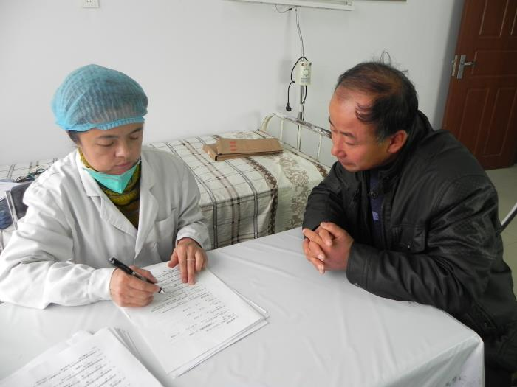
Prioritize Human Contact Identification
If the number of contacts is large, focus on those contacts with the highest risk of infection or exposure:
  Contacts of probable or laboratory-confirmed cases of novel influenza virus infection
  Contacts with prolonged close exposures to a suspected/probable case of novel influenza virus infection
  Household contacts sharing the same sleeping and eating space, persons providing bedside care, etc.
  Healthcare workers with prolonged contact with a suspected or probable case
Photo: Centers for Disease Control and Prevention
Notes:
In some cases, the number of contacts may be larger than the RRT’s ability to monitor each contact daily. In this situation, the team may want to confine active daily monitoring to high priority contacts such as:
Contacts of probable and confirmed novel influenza virus cases
Contacts with prolonged close exposures to a suspected/probable novel influenza virus cases – For example, household contacts sharing the same sleeping and eating space, persons providing bedside care, etc

Slide 47
Key Information for Human Contact Tracing
Who did the case come into close contact with?
What activities was case doing at the time?
Where did these activities take place?
When did case come into contact with this person?
Other key information to gather:
  Contact information, health status
Notes:
Key information to gather in the process of identifying potential contacts of the case include:
Who did the case come into close contact with during the case’s infectious period (1 day before and 14 days after illness onset)? Collect demographic information about these possible contacts.
What activities was the case doing at the time?
Where did these activities take place?
When did case come into contact with this person?
You will also need to collect contact information in order to find these potential contacts, especially to monitor their health status.

Slide 48
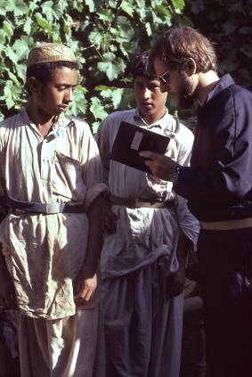
General Guidelines for Interviewing Contacts
Do not alarm contacts
Communicate how persons can protect themselves and their families
Refer symptomatic individuals to a designated healthcare facility
Consider if Personal Protective Equipment is necessary
Maintain a safe but effective distance from symptomatic individuals
Photo: Centers for Disease Control and Prevention
Notes:
Some general guidelines for contact tracing interviews include:
Avoid alarming contacts and unnecessarily causing fear that may preclude gathering key information
Communicate how persons can protect themselves and their families
Refer all symptomatic individuals to a designated healthcare facility
Depending on the situation, consider using Personal Protective Equipment such as a fit-tested N95 respirator, eye goggles, disposable gowns, disposable gloves if the contact appears to be symptomatic. If the contact is asymptomatic then you should not unnecessarily alarm the contact by wearing PPE.
Regardless of PPE, the interviewer should stay at a safe distance from symptomatic individuals but be close enough to conduct an effective interview.

Slide 49
Information from Human Contacts
Demographic and contact information
  Name, address, phone number
  Age, gender, relationship to the case, occupation
Exposure History
  Contact with case-patient
  Relevant animal (e.g., pigs, poultry, birds, wildlife) exposure
  Other high-risk exposures
Physical Exam and Clinical information
  Health status
  Temperature, other vital signs
  Presence of signs or symptoms of acute respiratory infection (feverishness, fever, sore throat, coughing)
  Empiric treatment status
Notes:
Information to gather from contacts includes demographic information, such as the individual’s name, address, occupation, age, gender, phone number, and relationship to the case.
You will also want to know about the contact’s exposure to the case, exposure to potentially infected poultry and wild birds, and any other possible novel influenza virus exposures (such as environmental exposures) they may have had.
Inquire about the contact’s current health. Clinical information to collect includes medical history, current signs and symptoms, and may involve obtaining vital signs and performing a physical exam. Take the contact’s temperature, check for the presence of a sore throat or coughing, and ask about any signs or symptoms that might indicate acute respiratory infection. Also ask if they have already received any neuraminidase inhibitors or other treatment.

Slide 50
Monitoring and Managing Contacts
Monitor contacts daily for signs of illness for at 14 days after exposure
  Encourage self-health monitoring
  Instruct to report onset of fever or respiratory symptoms
  Visit or phone daily to monitor for illness
  Refer contacts with fever or respiratory illness to medical care, isolation, treatment; and obtain respiratory specimens for testing
MOH may request (voluntary) home quarantine of all contacts for 14 days post exposure if human to human transmission is occurring
Consider immediate empiric antiviral treatment with a neuraminidase inhibitor (if available) for:
  Contacts who develop fever or any respiratory symptom
  Selected asymptomatic contacts with substantial unprotected or prolonged exposure to people or animals with novel influenza virus infection, with a focus on those at higher risk for complications
Notes:
Contacts should be actively monitored by public health staff each day for any signs of illness for 14 days after the last known exposure to a case of novel influenza virus infection or to animals suspected of being infected with the novel influenza virus.
Encourage contacts to self-monitor their health, for example, by checking their body temperature each day. Instruct them to immediately report onset of fever or respiratory symptoms to health authorities or the hospital.
Let the person know that they will be visited and/or telephoned daily by a member of the RRT to ascertain their clinical status. In remote areas, this may require establishing a special monitoring station to conduct daily monitoring of contacts.
It is important to remember that even if a patient tests positive for a different respiratory pathogen other than the novel influenza virus, they still should be followed for at 14 days to determine if there is a change in their condition as they still could develop novel influenza virus infection.
The Ministry of Health may ask that each contact remain at home for 14 days post-exposure to a case.
If antiviral medication is available, oseltamivir treatment should be provided to contacts who develop fever or any respiratory symptom and selected asymptomatic contacts with substantial unprotected or prolonged exposure to people or animals with novel influenza virus infection, with a focus on those at higher risk for complications
Note that antiviral treatment recommendations for avian influenza A(H7N9) differ from those for A(H5N1). The antiviral treatment recommendations on this slide are based on the interim guidance for antiviral treatment and post-exposure prophylaxis for A(H7N9).

Slide 51

Data Management and Analyzing Data: Record Keeping
Record keeping: systematically recoding data so that it is easily accessible and organized
Where will records be kept?
How will records be kept?
Who is assigned to record keeping?
How will records be available to people working in multiple-sectors?
Maintain confidentiality!
Examples of record keeping systems include EpiInfo, Excel, or Access
Notes:
Next, let’s move on to record keeping. Record keeping during a field investigation is critical. It can be defined as systematically recording data so that it is easily accessible and organized.
A record keeping system will help others understand what has been done and how it was done. It will also minimize any duplication of efforts. Some important record and data management issues to consider are:
Where will the records be kept?
How will they be kept?
Who will be assigned to record-keeping? Will it be only one person?
How will people working in different sectors have access to records from the other sectors?
IMPORTANTLY: the confidentiality of the records must be maintained to protect any personal information.
Some examples of software that can make record keeping simple are EpiInfo, Microsoft Excel, and Microsoft Access. The software you choose should allow for each entry, storage, and access of the data. Note, record keeping does not need to be fancy and can also be done using paper and a filing system.
Image: (no attribution required) https://pixabay.com/en/hanging-files-filing-cabinet-1920437/

Slide 52
Validation and Cross Checking
Check line lists against medical charts and interviews
Validation
  Ask the same question in different ways
  Ask the same question at different times
  Ensure answers are consistent
  Double-entry of data
Notes:
Your data should be cross-checked with other sources to ensure accuracy in recording data. When creating line lists you should ensure all the information has been recorded as it was in the medical chart or interview. It is very easy to make mistakes in recording data, especially when working quickly.
If possible, it is useful to validate your data. One way to do this is to ask the same questions in multiple ways or to ask the same question at different times to ensure the answers are consistent. Finally, entering your data twice—and correcting inconsistencies observed can be an excellent way to assure better data quality.

Slide 53
Describe and Orient Data
Characterize case data by time
  Generate an epidemic curve to track the occurrence of cases by date of onset of illness
Characterize case data by place
  Generate a map to geographically show where the cases are occurring
Characterize case data by person
  Generate tables or figures to describe key risk factors or exposures that appear to be linked to the occurrence of illness
  These may be demographic characteristics (age, gender, etc.) or exposure history (animal exposure or travel history)
Notes:
It is important to characterize your data by time, place and person. To characterize data by time, you would make an epidemic curve, which we will discuss on the next slide. A map can be used to characterize data by place. To characterize data by person tables or figures may be used.

Slide 54
Discussion Question
Do you have data management software in place and, if yes, what do you use?
Notes:
Facilitator notes: Take 5 minutes to lead a brief discussion with the entire group.
Ask participants what type of data management software they use. This question might stimulate discussion of the need for local RRT refreshers.

Slide 55
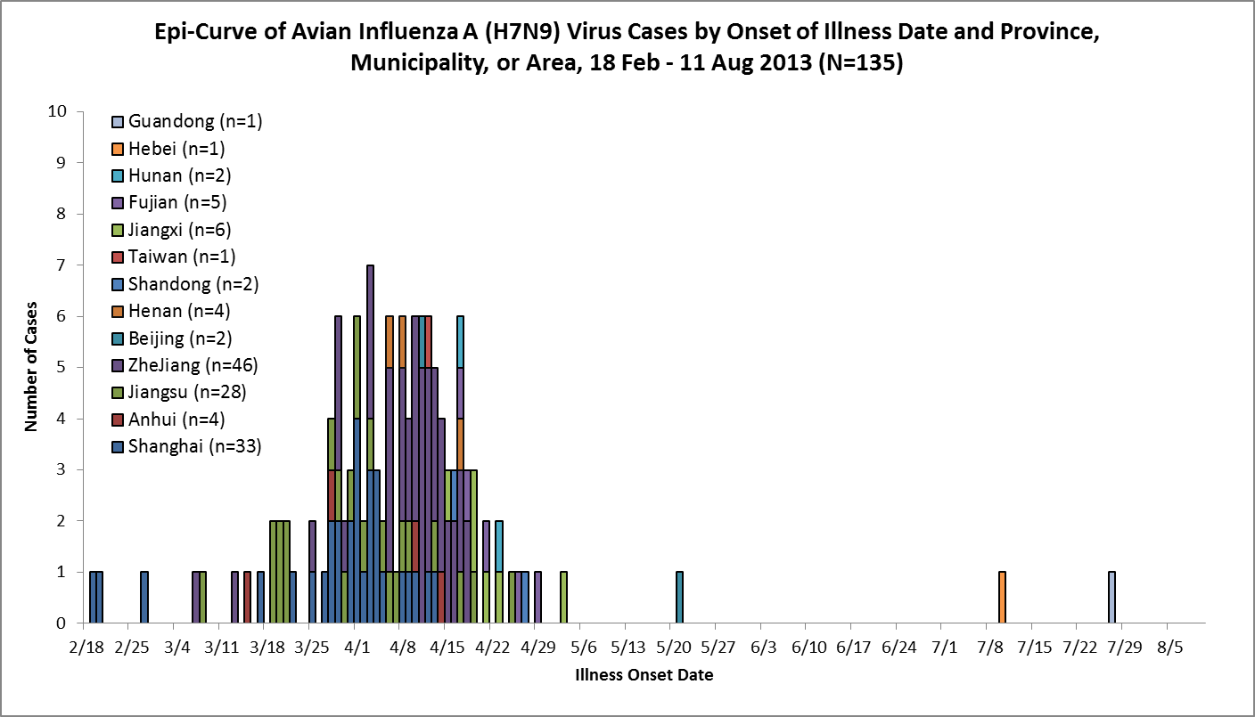
What is an Epidemic Curve
Notes:
Now that we have completed a line list to help organize the data collected in the course of a rapid response team investigation, we will analyze that data using a tool called an epidemic curve. With infectious diseases, once cases in an outbreak have been identified, the epidemic curve is a tool that can be used to help understand the epidemiology of the outbreak.
An epidemic curve (‘Epi’ curve) is a graph or histogram of the number of cases of illness on the Y axis by the date of illness onset on the X axis. This is an example of an epidemic curve of H7N9 cases in humans from February to August 2013.
If one knows dates of exposure, these data can help to ascertain the possible incubation period for the disease from exposure to illness onset. If you know the illness and its incubation period but you don’t know the source of exposure, an epidemic curve can provide clues about when an exposure may have occurred, and to help guide the investigation. The shape of the epidemic curve can provide clues about whether the outbreak may be more likely to be a common point source exposure, or whether there is a possibility of propagated human-human transmission.

Slide 56
How Can an Epidemic Curve Help?
Provides information on the characteristics of an outbreak
Pattern of spread or transmission pattern
Magnitude of epidemic
Outliers (case outside the expected time frame)
Time trend
Disease incubation period, possible timing of exposure
Notes:
Question: how can an epidemic curve assist in an outbreak investigation?
Answer: It is useful because it can provide information on various epidemiological characteristics of the outbreak, including:
Possible patterns of spread or transmission
The magnitude of the outbreak
Outliers, which are cases that occur outside the time frame of the majority of cases. Sometimes, investigating outlier cases can provide key insight to the cause of the outbreak.
Time trend of the epidemic, whether it starting, peaking, or waning
The disease incubation period. If you just know the disease, and its likely incubation period, you can even work backwards to understand possible times (and sources) of exposure.

Slide 57
Epidemic Curves and Transmission
Epidemic curves have different patterns depending on transmission
  Infectious agent transmitted between people
  Infectious agent transmitted from one source to multiple people
Can be used to assess whether human-to-human transmission is occurring
Can be used to see the effect of an intervention
Patterns easier to identify with larger number of cases
Notes:
Epidemic curves can be used to assess the type of transmission that is occurring. The curve will have a particular pattern depending on the type of transmission. Therefore epidemic curves are useful for detecting whether or not human to human transmission is occurring.
The curve will have a specific pattern if transmission of an infectious agent is occurring between people; or it will have a different pattern if people are all getting the infection from the same exposure source.
And curves can ben used to see the effect of an intervention.
These patterns of transmission are easy to see when there are lots of cases, but are more difficult to interpret if there is only a small cluster of cases.
Let’s look at some examples.

Slide 58
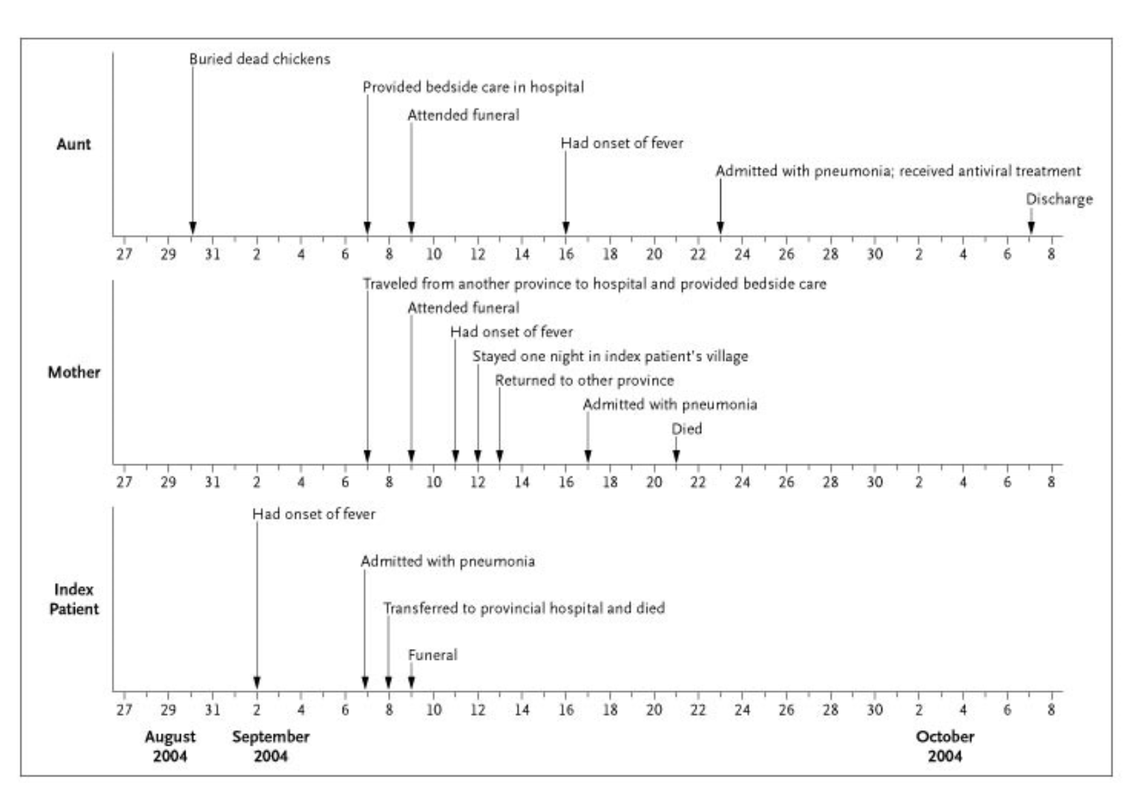
Investigating human-human tranmsission
An example of an investigation suggestive of
Human-to-Human Transmission
Source: http://www.nejm.org/doi/full/10.1056/NEJMoa044021)
Notes:
Timeline of Pertinent Exposures and Dates of Illness in the Three Patients. The index patient, who lived with her aunt, was not known to have had direct contact with the sick or dying chickens, but she played and slept in an area where the chickens were also often present. The mother lived and worked in a province four hours' drive from the index patient's village. The three-night funeral took place in a different, unaffected village.

Slide 59
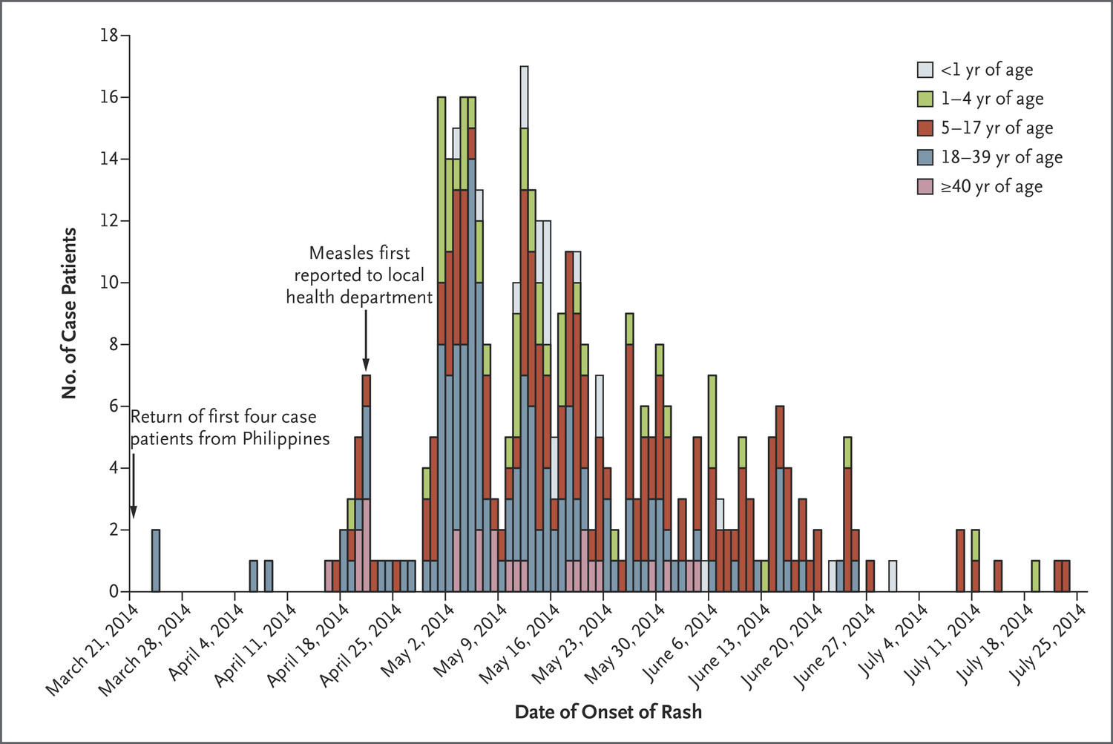
Epidemic Curve
Suggestive of Human-to-Human Transmission
incubation periods
Source: Gastañaduy PA et al. N Engl J Med 2016;375:1343-1354
Notes:
Here is another example of an epidemic curve, this time for measles, in which there is human-to-human spread. Here you can see that the pattern of human-to-human transmission is easier to see when there are lots of cases.

Slide 60
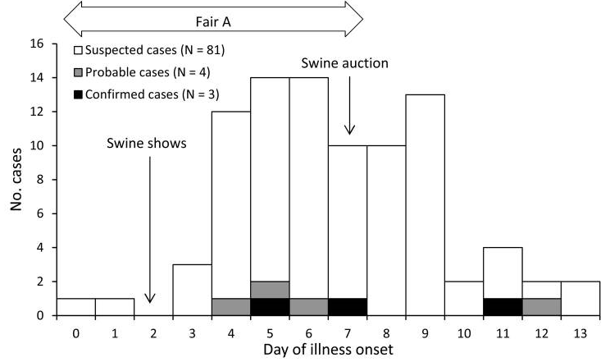
Epidemic Curve
An Epidemic Curve of an Ongoing Exposure to a Single Event
Source: Wong KK, et al., Emerg Inf Dis 2012;18 (12)
Notes:
This graph is an example of an epidemic curve of an H3N2 variant outbreak due to ongoing human exposure to a single event (a fair). This epidemic curve shows human H3N2 variant virus infections associated with swine shows. The cases accrue as the swine show is open and then end once the auction occurs and the show closes. Note how the graph shows a steep upslope and a comparatively gradual down slope.

Slide 61
Develop Hypotheses / Questions
Examples:
  Is exposure to animals linked to illness?
  Is travel history related to illness onset?
    Did cases travel to the same place?
  What is the severity of illness of the case(s)?
  Is there something about cases that makes them prone to more severe illness?
  Is the incubation period typical of similar diseases? Or is it shorter or longer?
  Has this area had a recent bird, poultry, swine, or other animal epizootic that could be linked to human illness (whether animals were ill or not)?
  Have the suspected cases had any relevant common exposures?
    What is the duration of exposure and is it related to severity of illness?
Notes:
The rapid response team can develop hypotheses and questions in order to further understand the outbreak and to understand how disease is being transmitted. It is important to develop hypotheses and questions with the input from people and agencies from different sectors.

Slide 62
Evaluate Hypotheses through Studies
  Cohort studies: useful in small outbreak and well defined population
    Example, Human-to-human transmission of H7N7 in Netherlands — 2003 (https://www.ncbi.nlm.nih.gov/pubmed/16371696)
  Case-control studies: ask both cases and controls about exposures to determine most likely source of infection
    Example, Case-control study of risk factors for H5N1 in Hong Kong — 1997 (https://www.ncbi.nlm.nih.gov/pubmed/10395870)
  Case series studies: follow cases to determine clinical course of infection and outcomes
    Usually a study of the first few hundred cases (http://www.hpa.org.uk/webc/HPAwebFile/HPAweb_C/1317139506255)
    Example, Epidemiology of H7N9 across five epidemic waves in China (https://www.ncbi.nlm.nih.gov/pubmed/28583578)
  Conduct cluster investigations to determine if human-to-human transmission is occurring
    Example, Clusters of human infection with H7N9 in China — 2013–2015 (https://www.ncbi.nlm.nih.gov/pubmed/28934462)
Notes:
Different types of studies can be conducted in order to examine the hypotheses or questions that the team came up with.

Slide 63
Discussion Questions
In your location/country, do you have a defined process for people from human health, animal health and wildlife sectors to come together to formulate hypotheses and develop investigations to test these?
Notes:
Facilitator notes: Take 5 minutes to lead a brief discussion with the entire group. Ask participants to discuss how people come up with hypotheses, questions, and studies to investigate these hypotheses in their location/country.

Slide 64
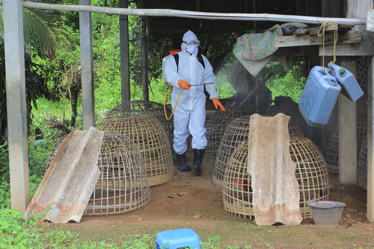
Implement Prevention and Control Measures
Prevention and control measures should be implemented as soon as possible
Empiric treatment may be guided by clinical presentation of cases
Control measures defined by WHO (human health) and DAO and OIE (animal health) can be implemented if the source of an outbreak is known and are used to mitigate further infection
Notes:
It is important to begin implementing prevention and control measures as soon as possible. The clinical features of a particular infection will inform which specific prevention and control measures are used. If the source of the outbreak is known, then control measures can be applied at the source.
Photo purchased from Shutterstock. Stock photo ID: 204254440

Slide 65
Prevention and Control Activities
Animal health and control measures (following specific requirements of FAO and OIE)
  Culling, disinfection, surveillance, vaccination
  Enhanced biosecurity
  Multi-sectoral cooperation is essential between the human, animal and agricultural sides
Infection control
  Isolation of suspected/probable and confirmed cases
  PPE, infection control precautions
Treatment of ill patients
Contact tracing & contact surveillance
  Voluntary quarantine of well contacts if human to human transmission is occurring
  Possible quarantine of farm, etc. if animal transmission is occurring
Enhanced (active) surveillance and case finding
Notes:
Some necessary prevention and control activities include the following:
Animal Control Measures--Animal health authorities may implement control strategies such as poultry culling, disinfection of poultry farms and other environments housing birds, enhanced biosecurity, active surveillance of poultry populations, poultry vaccination, and disinfection of or temporary closure of live poultry markets
Infection Control--Ensure isolation of suspected/probable and confirmed novel influenza virus cases. Ensure that team members, caregivers, family members of suspected/probable, and confirmed novel influenza virus cases are using proper PPE and are following proper infection control precautions.
Treatment—Ensure that oseltamivir treatment and necessary clinical case management is provided immediately to ill patients as soon as they are identified.
Contact Tracing—Active daily surveillance of case contacts may be conducted. If human to human transmission of the novel influenza virus is occurring, voluntary home quarantine may also be utilized to try to limit transmission.
Enhanced Surveillance and Active Case Finding--Implementation of active surveillance and enhanced case finding should be ongoing once the investigation has begun and should last at least 2 weeks after the last novel influenza virus case has been detected.

Slide 66
Communicate Findings from the Investigation
Share findings with key stakeholders
Oral briefing for local human health authorities, veterinary authorities and agricultural/environmental authorities
  Key objectives of the investigation
  Key findings
  Prevention and control measures implemented
  Thank everyone involved in the investigation
Written report of investigation
  Should follow a scientific paper format (e.g., introduction, outbreak summary, methods, results, discussion, lessons learned, recommendations, acknowledgments, and additional supporting documentation)
  Should involve authors from all sectors (human, animal, agricultural/environmental)
Notes:
It is important to communicate the findings of an investigation once the investigation has ended. Findings should be shared with key stakeholders from all sectors. Local health, veterinary and agricultural authorities should be briefed on the findings. A written report of the investigation should include input and authorship from all sectors and should follow a scientific paper format.

Slide 67
Multiple Levels of Communication
Local level: Who is responsible for submitting novel virus case reports for humans and for animals? When should this be done?
National level: Who needs to be updated on the investigation and receive the final number of novel virus cases? Who is responsible for assuring that this occurs?
International level: WHO should be notified immediately when there is a probable or confirmed case of novel influenza virus infection. The WHO IHR National Focal Point should be responsible for notifying WHO. Avian infections with highly pathogenic avian influenza viruses and all H5 and H7 subtypes (H5 or H7 low pathogenic or high pathogenic) are required to be reported to the OIE.
Multi-sectoral: Who is responsible for making sure authorities from all sectors are notified about cases?
Notes:
Information sharing about activities needs to occur at multiple levels including local, national, and international levels.
Throughout an investigation, and after the investigation is complete, it is important to update and inform key people and agencies about the outbreak.
At the local level: find out who is responsible for submitting novel influenza virus case reports for humans and for animals? When should this be done?
At the national level: determine who needs to be updated on the progress of the investigation and receive the final number of novel influenza virus cases by case definition? Who is responsible for assuring that this occurs?
At the international level: Probable, and confirmed novel influenza virus cases in humans should be reported immediately to the World Health Organization within 24 hours according to the International Health Regulations. The WHO IHR National Focal Point is responsible for notifying WHO. This may include notifying the WHO country office, the relevant WHO regional office, and WHO headquarters. Avian infections with highly pathogenic avian influenza viruses and all H5 and H7 subtypes (low or high pathogenic) are required to be reported to the OIE.
Communication needs to be multi-sectoral as well. Who is responsible for making sure authorities from all sectors are notified about cases?

Slide 68
Discussion Questions
In your location/country, are all levels of communication being covered?
  Local, national, international, multi-sectoral
If not, which levels are not being covered? What would be needed to provide training and a plan to implement reporting at all levels?
Notes:
Facilitator notes: Take 5 minutes to lead a brief discussion with the entire group. Ask participants to discuss if all levels of communication are being covered in their location/country.
If there is still time, also discuss the second question. (this question will be animated on the slide so the facilitator can show it only if there is time)

Slide 69
Why Communicate the Findings?
A document for action
  Control and prevention measures
To share new insights
To obtain national and international resources
Documents the investigation
To assist other districts or countries with investigation
Inform the public
Keep all sectors informed
Help prevent future outbreaks
Notes:
There are several reasons to communicate the findings of the outbreak investigation in a summary report.
First, the report serves as a document for action – outlining what control & prevention measures have taken place and are recommended.
Secondly, the report serves to share new information or insights about the outbreak, such as a newly discovered transmission mechanism and interventions that were successful.
Demonstrating that there is a problem can help you request needed resources (e.g. antivirals) from national and international partners.
The report also serves to documents the magnitude of the problem and justifies the team’s activities.
The publication of a report in one country may assist other nations with their own investigations. This may apply to countries that have not yet identified novel influenza virus cases or are just beginning to recognize cases.
Publishing a summary report also informs the public of what is going on with the outbreak and may help prevent future cases.

Slide 70
Evaluate How the Investigation Went
Summarize the events that occurred
Evaluate
  Timeliness of the response
  Completeness of the investigation
  Accuracy of the data
  Inter-agency coordination even within a sector
  Level of multi-sectoral involvement
Learn from experience
  Make recommendations for future investigations
  Take lessons from what worked well
  Take lessons from mistakes
Notes:
After an investigation has been completed, it is advisable to evaluate the team’s performance. This may be done before, during or after data analysis and may even occur before the report has been completed.
After an investigation has been completed, it is useful evaluate how well the investigation was done. We do this for several reasons:
To summarize the events that occurred, documenting what happened, how, and why
To learn from our experience
This experience allows us to make recommendations for future investigations, to take lessons from what worked well during the investigation, and from the mistakes that were made.
Basic aspects of the investigation that should be evaluated are:
The timeliness of all aspects of the response, including analysis and writing up the findings
The completeness of the investigation and the data gathered
The accuracy of the data
The coordination between partner agencies such as between human agencies/stakeholders as well as between animal and human health and agricultural ministries.

Slide 71
Discussion Question
What resources would you need in your country/location to procure additional needed supplies for case investigation?
Notes:
Facilitator notes: Take 5 minutes to lead a brief discussion with the entire group. Ask participants to volunteer to state what resources they think they would need in order to obtain any needed supplies for case investigation that they do not already have in their country/location.

Slide 72
Investigation Resources
WHO guidelines for investigation of human cases of avian influenza A(H5N1)
  http://www.who.int/csr/resources/publications/influenza/WHO_CDS_EPR_GIP_2006_4/en/
WHO case definitions for human infections with influenza A(H5N1) virus
  http://www.who.int/influenza/resources/documents/case_definition2006_08_29/en/index.html
WHO guidelines for global surveillance of influenza A(H5N1)
  http://www.who.int/influenza/surveillance_monitoring/global_surveillance_h5_guidelines_06_02_2004/en/index.html
Clinical management of human infection with avian influenza A (H5N1) virus
  http://www.who.int/influenza/resources/documents/clinical_management_h5n1_15_08_2007/en/index.html

Slide 73
Investigation Resources
Avian Influenza A(H7N9) virus
  http://www.who.int/influenza/human_animal_interface/influenza_h7n9/en/index.html
Interim WHO surveillance recommendations for human infection with avian influenza A(H7N9) virus
  http://www.who.int/influenza/human_animal_interface/influenza_h7n9/InterimSurveillanceRecH7N9_10May13.pdf
Post-exposure antiviral chemoprophylaxis of close contacts of a patient with confirmed H7N9 virus infection and/or high risk poultry/environmental exposures
  http://www.who.int/influenza/human_animal_interface/influenza_h7n9/13_January_2013_PEP_recs.pdf?ua=1
Tool for influenza pandemic risk assessment (TIPRA)
  http://apps.who.int/iris/bitstream/10665/250130/1/WHO-OHE-PED-GIP-2016.2-eng.pdf?ua=1

Slide 74
Glossary
Trigger
A series of events or cases which initiate an epidemiologic investigation. Diseases have different and specific triggers. For example, a single suspect case of human influenza A(H5N1) virus infection is a sufficient trigger for avian flu investigation.
Rapid Response Team (RRT)
A multi-disciplinary group of investigators and medical scientists who are quickly mobilized in response to a disease outbreak or adverse health event. Teams can consist of epidemiologists, medical providers, veterinarians, laboratory and communication specialists, data managers, infection control nurses, etc.

Slide 75
Glossary
Stakeholder
A person or group who is affected by, or involved in the investigation and its outcomes
Risk Stratification
Grouping individuals according to specific risk attributes such as degree of exposure or severity of illness
Case Finding
The concerted effort of public health professionals to search for and identify any potential cases of disease in order to treat or contain an illness

Slide 76
Glossary
Cluster
An unusual grouping, or excess number of disease cases in a geographical location or point in time
Case-patient
A person who meets the outbreak case definition
Line Listing
A way to organize and present important information that is collected about each potential case or contact

Slide 77

The findings and conclusions in this presentation are those of the authors and do not necessarily represent the official position of the Centers for Disease Control and Prevention.

