Slide 1
Introductory Training Module
The ABCs of Influenza
The findings and conclusions in this report are those of the authors and do not necessarily represent the official position of the Centers for Disease Control and Prevention.

Slide 2
Learning Objectives
Describe influenza epidemiology
Discuss novel influenza
Learn about current avian influenza threats

Slide 3
Themes
Influenza comes in many forms…
Animal influenza
Influenza viruses that live in animal species only (e.g. wild waterfowl)
Novel influenza
A zoonotic influenza virus that crosses species to humans, sometimes by way of other animals such as poultry or pigs
Pandemic influenza
A novel influenza virus that begins to spread and cause illness among humans, who have no or little natural immunity
Seasonal influenza
An influenza virus that has adapted to humans as a natural reservoir, often in the years following a pandemic. Humans can mount an immune response to seasonal viruses, which mutate over time requiring further human adaptation and the development of new vaccines
Systems to monitor, prevent, and control seasonal influenza
support detection and response to novel and pandemic influenza
Monitoring the interface between humans and animals is critical
Notes:
Image: CDC/Joshua Mott
There are a few recurring themes that you will encounter throughout this training.
First, there are different forms of influenza that you will learn about in this talk. First, there is animal influenza which lives naturally in animal species (often wild waterfowl as a natural reservoir) and mostly does not affect humans. Second there is novel influenza that is a zoonotic influenza virus that can transmit from animals to humans and cause illness in humans. Sometimes these viruses acquire the ability to transmit from animals to humans and cause disease in humans. These viruses are new to humans (who may not have much immunity to them) and are called “novel” or new viruses in humans. If these viruses can spread efficiently between humans they can cause global pandemics like those we experienced in 1918, 1957, 1968 and 2009. Over time viruses that once caused a pandemic can learn to live in human populations, and humans adapt to these viruses and start to gain an immunity to them. These viruses that have learned to live in humans are called seasonal influenza viruses and they often cause regular epidemic in humans every year, and through processes of mutation drift slightly over time changing our ability to mount immune responses, and also making us develop vaccines annual vaccines that match these circulating seasonal influenza viruses.
Given this ecology influenza is difficult to predict, and understanding influenza means understanding animal, novel/pandemic and seasonal influenza together. A strong seasonal influenza surveillance, vaccine delivery, and response system will also serve the purposes of pandemic preparedness, and vice-versa. The systems or platforms we have in place for seasonal influenza , including surveillance, research, respond and vaccine production, are important for monitoring and responding to pandemic influenza.
In addition, you will hear a lot about the interface between humans and animals. Surveillance (in human and animal populations) for novel influenza that can cause disease in humans is a critical component in detecting viruses with pandemic potential. As you will learn, viruses with pandemic potential may have virologic attributes of both seasonal and animal viruses. It is critically important to understand animal influenza in order to help understand and predict influenza in people. Agricultural preparedness (e.g. involving farmers, etc) for influenza outbreaks is therefore also important, as is regular communication systems between animal and human health sectors.

Slide 4
Influenza Epidemiology

Slide 5
Influenza
Contagious respiratory illness caused by influenza virus
Annual epidemics in temperate zones and cyclical epidemics in tropics and subtropics
Sporadic pandemics
  1918, 1957, 1968 and 2009
*Viboud C, Alonso W, Simonsen L.
PLoS Med (2006)

Slide 6

Significant Annual Burden of Influenza in Humans
Global Burden
Deaths
291,000-645,000
Severe Cases
Hospitalizations
3M to 5M
Cases
1.0 B
Global Burden http://www.who.int/immunization/topics/influenza/en/
Lancet. 2018 Mar 31;391(10127):1285-1300. doi: 10.1016/S0140-6736(17)33293-2. Epub 2017 Dec 14.
Notes:
Each year, seasonal influenza causes a significant annual burden of influenza in humans.
Globally, these numbers are staggering, with an estimated 1 billion cases, 3-5 million hospitalizations and 291,000-645,000 deaths. As you can appreciate from the range in the estimates, flu activity ranges from year to year and is difficult to predict, but understanding seasonal flu is necessary to understanding novel and pandemic influenza.

Slide 7
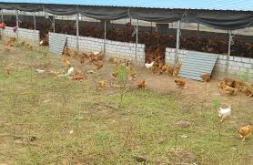
Influenza is also a Major Agricultural Problem
Avian influenza outbreaks in poultry can
  lead to huge economic losses
  overwhelm response capacity
Most influenza viruses live naturally in wild waterfowl
Risk to humans increases when domestic birds, pigs, and sometimes other animals are infected
Notes:
Image: free use from Wikimedia Commons https://www.google.com/search?q=poultry+farm+china&safe=active&rlz=1C1CHBF_enUS756US757&tbm=isch&source=lnt&tbs=sur:f&sa=X&ved=0ahUKEwisvobPtNLWAhWHhVQKHWEkAFcQpwUIHw&biw=1536&bih=735&dpr=1.25#imgrc=vEiEUB6iLyMImM:

Slide 8
Influenza Viruses
Orthomyxoviridae Family
RNA virus with 8 gene segments
Influenza types A, B, C and D
  A and B are major human pathogens
  Wild waterfowl are the natural host for most influenza A viruses
Notes:
Top Image: Trends in Molecular Medicine, Vol. 9, Issue 2, p46–52, DOI: http://dx.doi.org/10.1016/S1471-4914(02)00010-2
Surface proteins (major antigens)
Hemagglutinin (HA)
Site of attachment to host cells
Antibody to HA is protective
Neuraminadase (NA)
Helps release virions from cells
Antibody to NA can help modify disease severity
Wild birds are the natural host for all influenza A viruses. They are usually not clinically affected. The difference between human and avian-adapted viruses is in the HA receptor affinity.

Slide 9
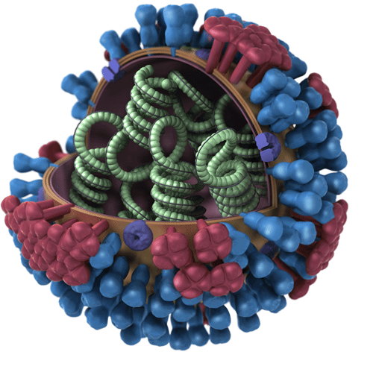
Surface Proteins (major antigens)
Hemagglutinin (HA)
  Site of attachment to host cells
  Antibody to HA is protective
  The difference between human and avian-adapted viruses is in the HA receptor affinity
Neuraminadase (NA)
  Helps release virions from cells
  Antibody to NA can help modify disease severity
Other genes responsible for virus replication and structure
HA
NA
Notes:
Image: https://www.cdc.gov/flu/about/qa/antiviralresistance.htm

Slide 10
Nomenclature
Virus type
Strain number
Virus subtype
A / Sydney / 05 / 97 (H3N2)
Place virus
isolated
Year isolated
Notes:
Influenza A viruses are named based on the type and the place that the sample originally came from. They are also labeled with a strain number by a reference laboratory, the year the virus was isolated, and the subtype of the virus. Viruses from animals would also include the type of animal.

Slide 11






H1
H2
H3
H4
H5
H6
H7
H8
H9
H10
H11
H12
H13
H14
H15
H16
H17
H18
N1
N2
N3
N4
N5
N6
N7
N8
N9
N10
N11
Influenza A HA and NA Subtypes
https://www.cdc.gov/flu/about/viruses/transmission.htm
Notes:
Influenza A viruses are divided into subtypes based on two proteins on the surface of the virus: the hemagglutinin (H) and the neuraminidase (N). There are 18 different hemagglutinin subtypes and 11 different neuraminidase subtypes. All known subtypes of influenza A viruses have been found among birds, except subtype H17N10 and H18N11 which have only been found in bats. This slides shows a table showing the different hemagglutinin and neuraminidase subtypes and the species in which they have been detected.

Slide 12
Why is Influenza a Major Public Health Problem?
Some people can develop severe complications of influenza virus infection
  Exacerbation of chronic underlying medical conditions (e.g., heart failure, lung disease, etc.)
  Viral and bacterial pneumonia
Complications can result in hospitalization/death
Substantial economic impact in humans
  Lost work / school days
Can overwhelm medical care systems during epidemics or pandemics
Substantial economic impact in agricultural industry
Avian influenza outbreaks lead to huge economic losses, and pose a public health risk to humans

Slide 13
Influenza Viral Pathogenesis
Acute febrile respiratory infection characterized by
  Abrupt onset fever, chills, muscle aches, headache, fatigue
  Cough, pharyngitis, rhinitis
  GI symptoms more common in children
  Sepsis-like syndrome in infants
  Elderly often without fever
Pronounced early systemic symptoms caused by cytokine response
Complications
  Primary viral pneumonia
  Secondary bacterial pneumonia
  Worsening of underlying illness (e.g., asthma, congestive heart failure)
Notes:
Image: http://slideplayer.es/slide/1672483/7/images/4/Diseminaci%C3%B3n+local+en+el+tracto+respiratorio+SNC+Compromiso+muscular.jpg

Slide 14
Influenza Clinical Diagnosis
Clinical diagnosis often non-specific
  Laboratory diagnosis important for assessing disease burden, infection control
  Even at peak influenza season in the United States about 30-40% of specimens tested for influenza are positive. This may be 10-20% in tropical areas where seasonality is less pronounced
  Infants can present with sepsis-like syndrome and fever may be absent, especially in elderly persons. Thus it is possible that influenza may be under-diagnosed in some age groups

Slide 15
Laboratory Testing for Influenza in People
Viral culture
  High specificity but results take 7+ days usually
  Influenza isolates for yearly vaccine development
RT-PCR
  Most sensitive and specific
  Becoming more widely available, but still expensive
Point-of-need tests
  Older rapid tests about 70% sensitive in children, lower in adults, 90+% specific
  Can provide results <30 minutes
  There are newer rapid molecular tests that have the potential to offer better performance
Immunofluorescence
  Requires intact cells and laboratory skill/experience
Serology
  Must used paired serum samples
  >2 week delay for results
Notes:
There will be much more detail on human and animal laboratory testing in other modules.

Slide 16
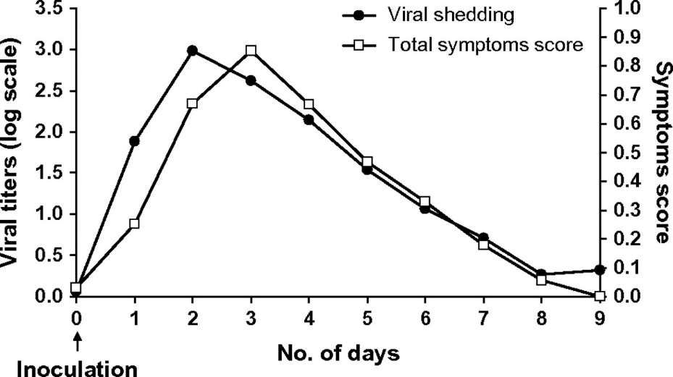
Viral Shedding and Incubation Period in People
Infect, replicate and shed in the upper respiratory tract
Incubation period: 1–4 days (typically 1–2 days)
  Virus shedding / contagious period:
  Starts before illness onset
  Peak shedding day 1–2 of illness
  Duration: 4–6 days, longer in children and immunocompromised
Am J Epidemiol. 2008 Apr 1;167(7):775-85.
Clinical Infectious Diseases 2011;52(S1):S123–S130
Notes:
Pathogenesis of influenza in animals will be discussed in other modules.

Slide 17
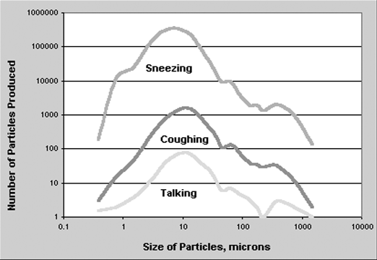
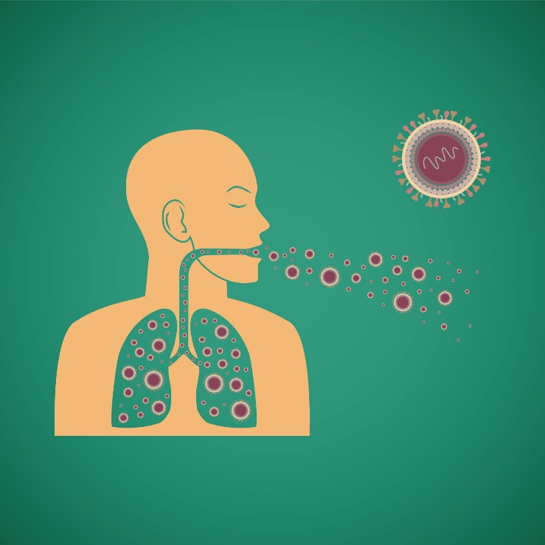
Transmission of Influenza
Contact, droplet, and airborne transmission may all occur
  Relative contribution of each unclear
    - Animals or human experiments under artificial conditions
  Droplet thought to be most important
    - Generated via coughing, sneezing, talking
Notes:
Image: Sneezing Man
Content provider: CDC/ Brian Judd
No copyright restrictions - This image is in the public domain and thus free of any copyright restrictions. As a matter of courtesy we request that the content provider be credited and notified in any public or private usage of this image.
Image: Sneezing/Coughing/Talking
Purchased from Shutterstock. Stock vector ID: 201932494

Slide 18

Prevention
Vaccination is primary prevention method
  Single best way to prevent flu
  Vaccination policies differ by country
  WHO recommendations (WER 2012;87:461-476)
    Pregnant women (highest priority)
    Children aged 6–59 months
    The elderly
    Individuals with specific chronic medical conditions
    Health-care workers
Good health habits
  Avoid close contact
  Stay home when you are sick
  Cover your mouth and nose
  Clean your hands
  Avoid touching your eyes, nose or mouth
  Practice other good health habits
Notes:
Image:
Content provider: CDC/ Judy Schmidt
No copyright restrictions - This image is in the public domain and thus free of any copyright restrictions. As a matter of courtesy we request that the content provider be credited and notified in any public or private usage of this image.

Slide 19
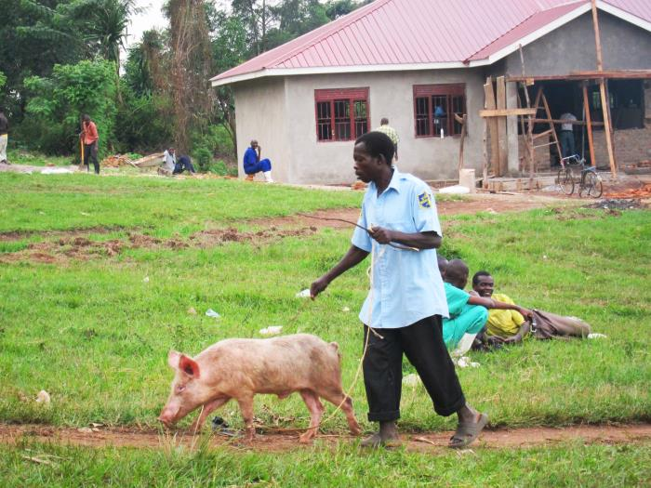
Prevention (continued)
Non-pharmaceutical interventions
  Social distancing, school closures, etc.
  These are not routine and only implemented under specific locally-defined circumstances
Risk education, especially for highest-risk populations
  Avoid swine/poultry barns and farms, etc.
  Avoid contact with live birds and bird markets
  Hand cleaning, if necessary to visit these sites or touch these animals
Biosecurity education and measures
  Animal owners, farmers, producers, etc.
Proper Infection Prevention and Control in
Health Care Settings
  PPE Use
  Appropriate use of standard, contact,
  droplet, and airborne precautions as necessary
Notes:
Photo: CDC image 19936, https://phil.cdc.gov/phil/details.asp

Slide 20
Treatment
Influenza antiviral agents can be used to treat or prevent flu
Neuraminidase inhibitors
  Oseltamivir (now generically available)
  Zanamivir
  Peramivir
Adamantanes (high resistance, not recommended)
  Amantadine
  Rimantadine
Notes:
Generic versions of oseltamivir phosphate (oseltamivir) are now becoming available following a settlement with the pharmaceutical company Roche. A generic drug is a drug which is equivalent to a brand-name product in dosage, route of administration, strength, quality, kinetics, and its intended use.
This means that oseltamivir may be produced and licensed in individual countries by generic drug manufacturers, and may become more widely available.
While this may have significant benefit to timely influenza treatment, this also can mean there are more opportunities for inappropriate use patterns, which can possibly lead to the development of drug resistance.
For this reason proper training on clinical management becomes even more important.
It is important to remember that oseltamivir does not treat or prevent illnesses caused by infections other than the influenza virus, and does not prevent bacterial infections that may happen with influenza.
It is also not a replacement for influenza vaccination.

Slide 21
Novel Influenza Viruses

Slide 22
Novel Influenza Virus
Influenza A virus that is different from influenza viruses currently circulating among humans
Novel viruses can occur in the following subtypes H5, H6, H7, H9, H10 (and more)
Novel H1 and H3 subtypes may originate from a non-human species or a include a genetic reassortment between animal and human viruses
Pandemics can occur when a novel influenza virus emerges in the human population and can be readily transmitted person to person
All of the seasonal influenza A viruses that are now adapted to circulate in humans (ie. A(H3N2), A(H1N1)pdm09) originally emerged into human populations as novel viruses, and caused pandemics.

Slide 23
Pandemic Basics
New (novel) influenza A virus
Easily infects humans
Spreads from person-to-person in an efficient and sustained way
It is likely that there will be
Little to no population immunity
No vaccine

Slide 24
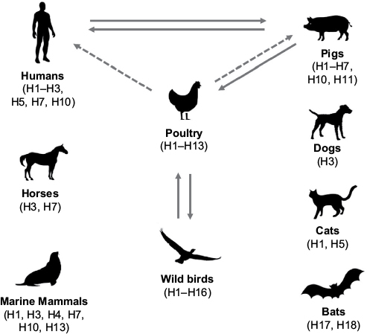
Influenza A Reservoirs - Interspecies Transmission
Drug resistance in influenza A virus: the epidemiology and management. Infection and Drug Resistance.(10): 2017
Notes:
Image: https://www.dovepress.com/drug-resistance-in-influenza-a-virus-the-epidemiology-and-management-peer-reviewed-fulltext-article-IDR

Slide 25


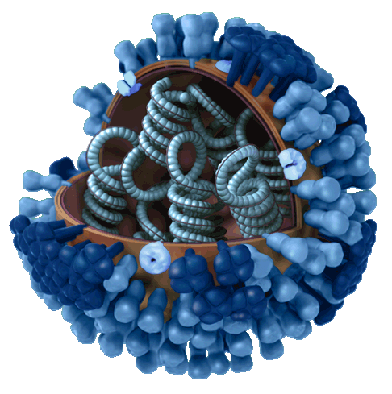
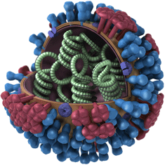

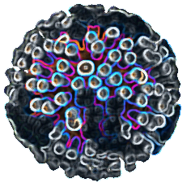
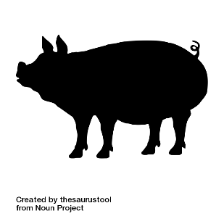

Influenza Viruses are Unpredictable
Influenza viruses are constantly changing through “antigenic drift” requiring year-round surveillance and frequent vaccine updates
Influenza viruses circulating in birds and swine can exchange genes and adapt to humans through “antigenic shift” generating new, and potentially pandemic viruses
Avian or Swine Influenza Virus
Human Influenza Virus
Reassorted Influenza Virus with Pandemic Potential
Notes:
Image: Avian or Swine Influenza Virus
Content Provider: CDC/ Doug Jordan, M.A.
No copyright restrictions - This image is in the public domain and thus free of any copyright restrictions. As a matter of courtesy we request that the content provider be credited and notified in any public or private usage of this image.
Image: Human Influenza Virus
Content Provider: CDC/ Doug Jordan, M.A.
No copyright restrictions - This image is in the public domain and thus free of any copyright restrictions. As a matter of courtesy we request that the content provider be credited and notified in any public or private usage of this image.
Black graphics
Flying Duck: https://thenounproject.com/search/?q=duck%20flying&i=214910 by Agne Alesiute (requires attribution)
Turkey: https://thenounproject.com/search/?q=turkey&i=37063 by Ealancheliyan (requires attribution)
Duck: https://thenounproject.com/search/?q=duck&i=1054313 by thesaurustool (requires attribution)
Pig: https://thenounproject.com/search/?q=pig&i=1054310 by thesaurustool (requires attribution)
Family: https://thenounproject.com/search/?q=family&i=955960 by Adrien Coquet (requires attribution)

Slide 26
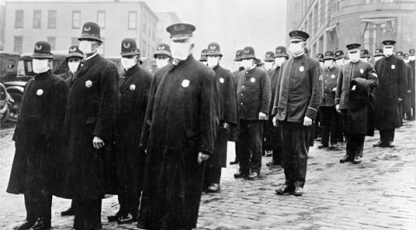
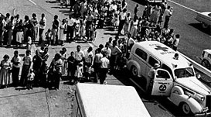
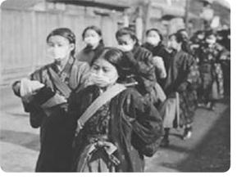
Influenza Pandemics in the 20th Century
1918 H1N1 Pandemic
  At least 50 million deaths globally
1957 H2N2 Pandemic
  Over a million deaths globally
1968 H3N2 Pandemic
  A million deaths globally
Notes:
Image: 1918 H1N1 Pandemic
http://www.illinoispandemicflu.org/flu-basics/pandemic-influenza/1918-pandemic
Image: 1957 H2N2 Pandemic
http://forum.prisonplanet.com/index.php?topic=128816.0
https://www.infowars.com/personal-recollections-of-the-1957-h2n2-flu-pandemic/
Image: 1968 H3N2 Pandemic
https://www.geni.com/projects/Influenza-1968-1969-Hong-Kong-Flu/28167

Slide 27
2009 H1N1 Pandemic
Emerged spring of 2009
Unique combination of influenza genes not previously identified in animals or people
Between 151,700 and 575,400 global deaths.
  80% of 2009 H1N1 deaths were in people younger than 65 years of age
  In typical seasonal influenza epidemics 70-90% of deaths are estimated to occur in people 65 years of age and older.
  Early surveillance in Mexico suggested the possibility of an even more severe pandemic
  We must be ready to rapidly estimate local burden of a full spectrum of illness if a new virus emerges.

Slide 28
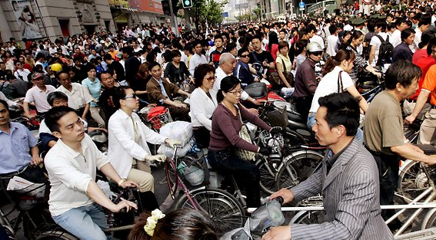
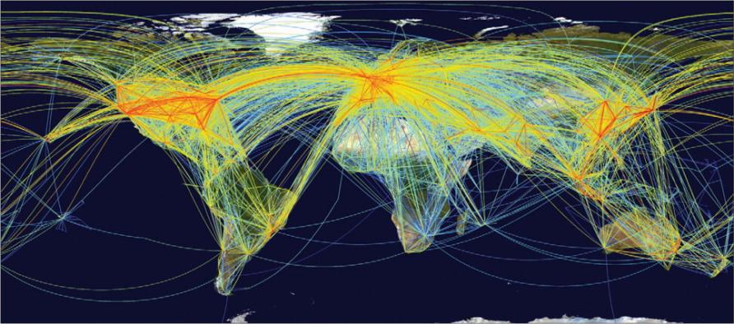
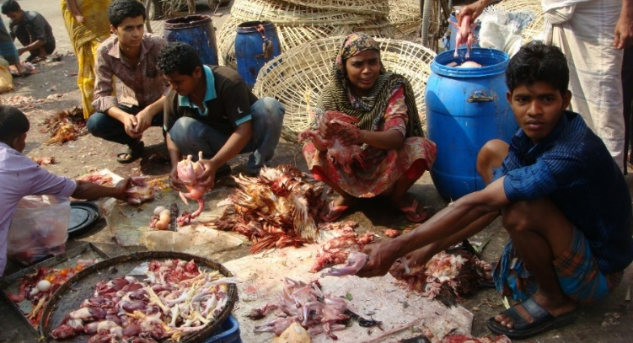
Emerging Novel Influenza Infections
The world is increasingly
  Crowded
  Connected
  Converging
Jernigan, Strausbaugh. Emerging Infections, Textbook of Infectious Diseases, 2004
Institute of Medicine, Emerging Infections, 1992
Jernigan, Cox. Textbook of Influenza. 2013
Notes:
Why are viruses emerging?
Mention: Including increasing animal-human interactions

Slide 29
Factors for Emerging Influenza Viruses
Factors for emerging influenza virus:
  People
  Poultry
  Pigs
  Passengers
Jernigan, Cox. Textbook of Influenza. 2013.
Notes:
This graph shows how the number of people, poultry and travel (measured in tourist arrivals) have drastically increased over the past 50+ years. The total number of pigs have stayed approximately the same during this time period.

Slide 30
Human Cases of Reported Novel Influenza A Infection, 1959-2017
Includes Avian H4, H5, H6, H7, H9, H10 & Swine H1, H3 (not H1N1pdm09)
Number of Human Cases
Year of Onset 1959 to 2017
>30 fold increase from 1990’s to 2000’s
Freidl G, Meijer A, de Bruin E, et al. Influenza at the animal-human interface: a review of the literature for virological evidence of human infection with swine or avian influenza viruses other than A(H5N1). Euro Surveill. 2014 May 8;19(18).
Cumulative cases of H5N1 and H7N9. WHO and Chinese provincial reports.
Notes:
This maybe be do to the growth of populations shown in the previous graph, but also probably has to do with improving surveillance and laboratory technologies,

Slide 31
Tool for Influenza Pandemic Risk Assessment (TIPRA)
Objectives:
support a timely and updatable hazard risk assessment for influenza viruses with pandemic potential;
transparently document features of the viruses and the infections they cause that might pose threats to a human population;
identify knowledge gaps and prompt further investigations including research and surveillance;
facilitate information sharing between scientists, policy-makers and other stakeholders.
http://www.who.int/influenza/areas_of_work/human_animal_interface/tipra/en/

Slide 32
Purpose of TIPRA
Prioritize and maximize investments in pandemic preparedness by helping to determine which novel influenza viruses to develop vaccines against and capitalizing on surveillance efforts and in-country capacity building activities
Identify key gaps in information and knowledge which can be the basis to prompt additional studies
Document in a transparent manner the data and scientific process used to inform management decisions associated with pandemic preparedness

Slide 33
Purpose of TIPRA (continued)
Provide a flexible means to easily and regularly update the risk assessment of novel influenza viruses as new information becomes available
Be an effective communications tool for policy makers and the influenza community
Provide a means to weigh the evaluation criteria differently depending on whether the intent of the risk assessment is to measure the ability of an influenza virus to “emerge” as a pandemic capable virus

Slide 34
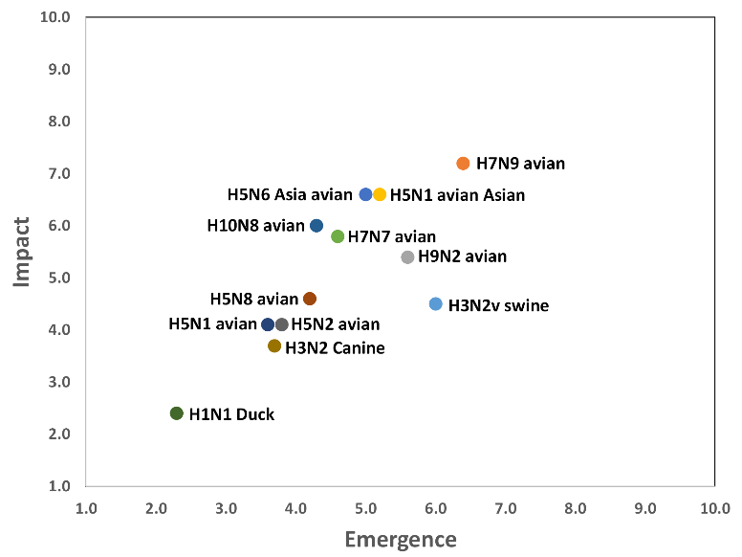
Influenza Risk Assessment – H7N9 Highest at the time
H7N9 in China has maintained the highest score since 2013
CDC. https://www.cdc.gov/flu/pandemic-resources/monitoring/irat-virus-summaries.htm
Notes:
This diagram lists viruses that have been evaluated and where they fall on the scale, with emergence on the x-axis and impact on the y-axis.

Slide 35
Highest Risk are:
  H7N9
  H5NX
H7N9 in China has maintained the highest score since 2013
CDC. https://www.cdc.gov/flu/pandemic-resources/monitoring/irat-virus-summaries.htm
Notes:
I just want to point out that the highest risk…

Slide 36
Avian Influenza A(H5N1) Virus

Slide 37
Avian Influenza Cases through May 2017
Confirmed Cases of Human Infection
Virus | 2017 Cases / Fatalities | Total Cases / Fatalities | First Report Date | Last Report Date
H7N9 | 735 / 251 | 1,533 / 575 (38%) | Mar 2013 | Jun 2017
H5N1 | 3 / 1 | 859 / 454 (53%) | 1997 | May 2017
H5N6 | 0 / 0 | 16 / 9 | May 2014 | Dec 2016
H6N1 | 0 / 0 | 1 / 0 | May 2013 | May 2013
H7N2 | 0 / 0 | 7 / 0 | 2002 | Dec 2016
H7N3 | 0 / 0 | 4 / 0 | Mar 2004 | Jul 2012
H7N7 | 0 / 0 | 93 / 1 | 1996 | Oct 2013
H9N2 | 2 / 0 | 31 / 1 | 1998 | May 2017
H10N7 | 0 / 0 | 4 / 0 | 2004 | Mar 2010
H10N8 | 0 / 0 | 3 / 2 | Dec 2013 | Feb 2014
2,551
Note: Case fatality proportions may be influenced by the focus of surveillance on more severe cases, and not reflect the full spectrum of illness.
Notes:
Avian influenza viruses are rare

Slide 38
High vs. Low Pathogenicity Viruses
Avian influenza A viruses are designated as highly pathogenic avian influenza (HPAI) or low pathogenicity avian influenza (LPAI) based on
  molecular characteristics of the virus
  ability of the virus to cause disease and mortality in chickens in a laboratory
HPAI and LPAI do not refer to the severity of illness in human infection; both LPAI and HPAI viruses have caused severe illness in humans
Poultry infected with
  LPAI viruses may show no signs of disease or only exhibit mild illness
  HPAI viruses can cause severe disease with high mortality
Both HPAI and LPAI viruses can spread rapidly through poultry flocks

Slide 39
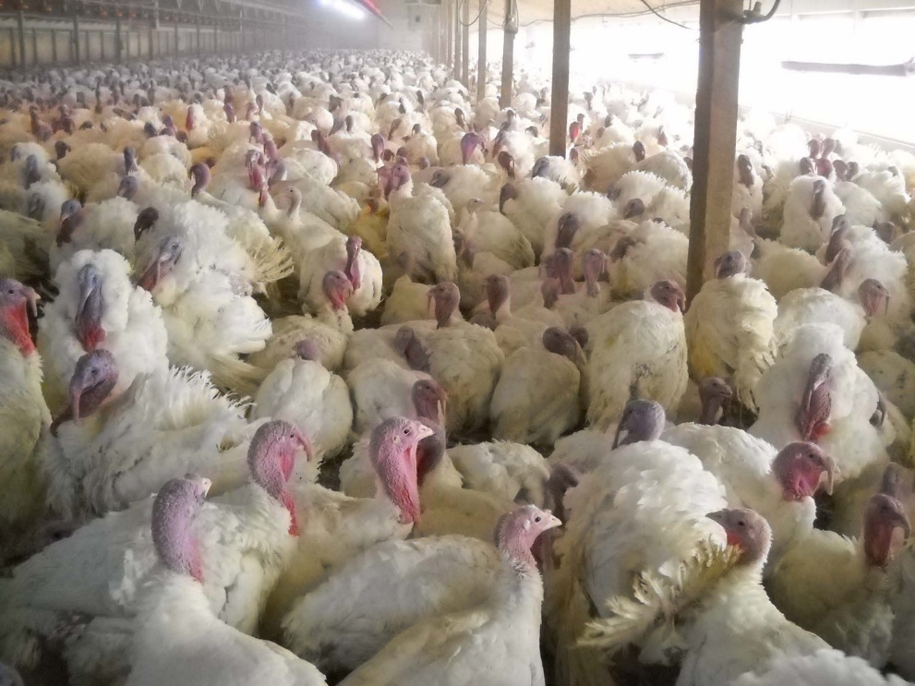
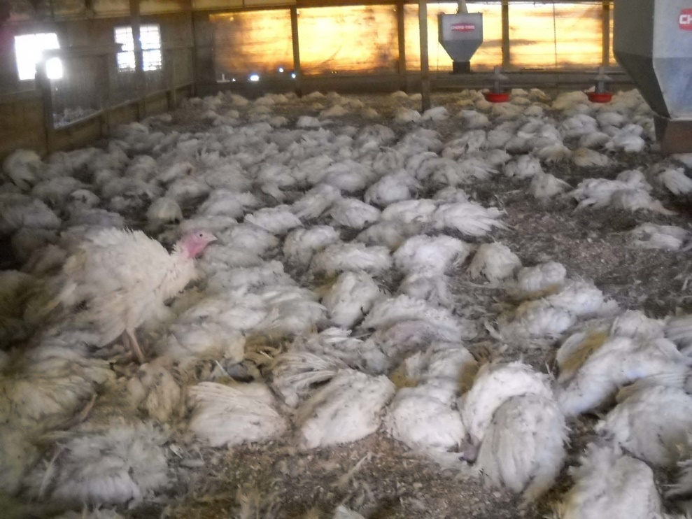
Low Pathogenicity vs High Pathogenicity in Poultry
24 hrs later
Low Pathogenicity Avian Influenza (LPAI)
  Poultry are generally asymptomatic, or there are mild respiratory signs, decreased egg production or fertility
Highly Pathogenic Avian Influenza (HPAI)
  High fatality cause of rapid flock die-off
Only H5 and H7 subtypes can be HPAI, and H5/H7 LPAI can spontaneously become HPAI
Minnesota turkey farm H5N1 die-off, via Indiana State Board of Animal Health

Slide 40
History of Avian Influenza A (H5N1) Virus
1996, virus first isolated from farmed goose in Guangdong Province, China (HPAI)
1997
  outbreaks in poultry in Hong Kong
  18 human infections, 6 deaths
  1.5 million birds culled (entire Hong Kong poultry population)
2003, reemergence and spread (poultry and human infections)
Sporadic infections with high mortality continue

Slide 41
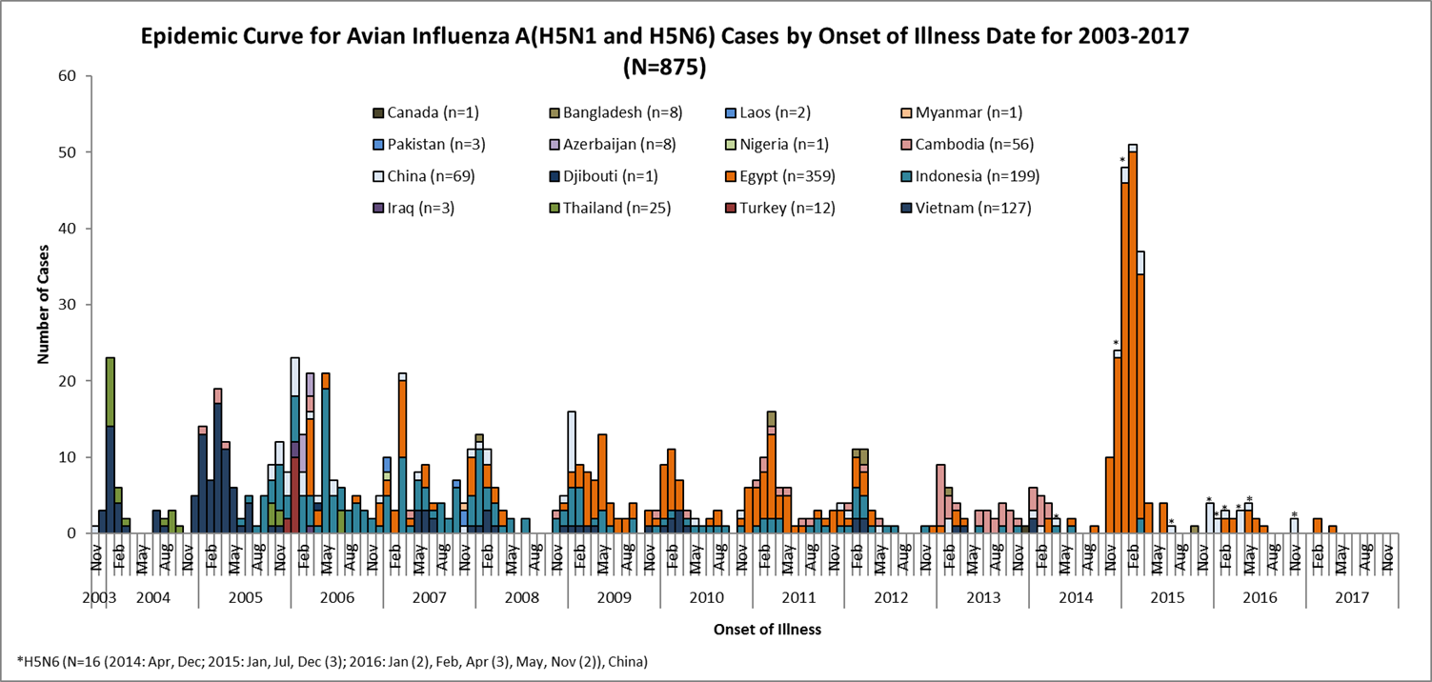
H5 infections in Humans
Notes:
This slides shows the number of H5 infections reported by country since 2003. Human infections have been detected in 16 countries.

Slide 42
H5N1 Infections in Humans
As of 16 May 2017, 859 infections and 453 (53%) deaths
Illness is often severe (e.g., pneumonia and respiratory failure)
Most cases occur from close contact with infected live or dead birds or A(H5N1) virus-contaminated environments
Human-to-human transmission is extremely rare
A(H5N1) viruses continue to evolve

Slide 43
Avian influenza A(H7N9) Virus

Slide 44
H7N9 Overtakes H5N1 Numbers in Five Years
Notes:
This slides shows the cumulative number of H5N1 and H7N9 infections by year. In five years, the number of H7N9 infections overtook the number of H5N1 infections.

Slide 45
H7 vs H5 Age Distribution

Slide 46
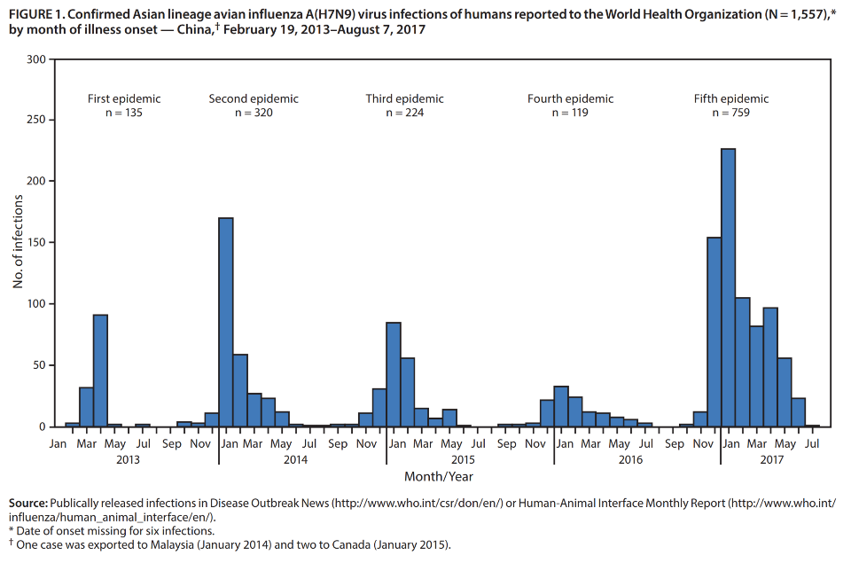
H7N9 – Five Epidemic Waves
https://www.cdc.gov/mmwr/volumes/66/wr/mm6635a2.htm
Notes:
There have only been three human influenza A(H7N9) cases in the “6th wave” in China, possibly related to a large scale poultry vaccination effort.

Slide 47
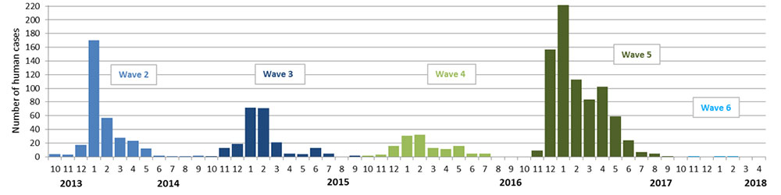
H7N9 – Five Epidemic Waves
Incidence of officially reported human cases by month, based on onset date from October 2013 (Beginning of wave 2) to 25 April 2018. Both high and low pathogenic H7N9 viruses are included.
http://www.fao.org/ag/againfo/programmes/en/empres/h7n9/situation_update.html
Notes:
There have only been three human influenza A(H7N9) cases in the “6th wave” in China, possibly related to a large scale poultry vaccination effort.

Slide 48
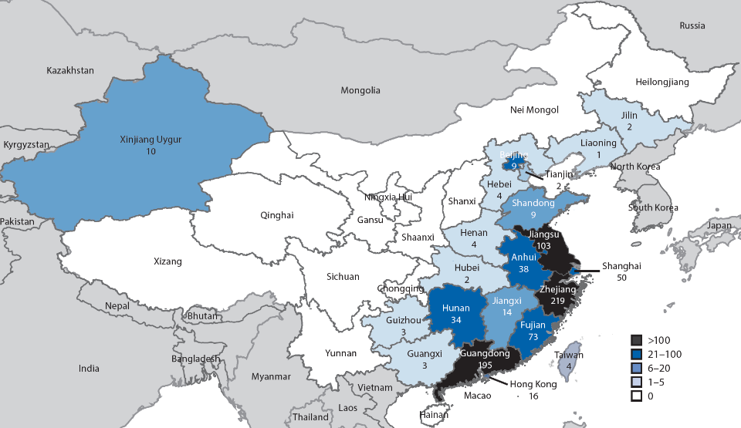
H7N9 – Epidemic Waves 1 to 4
Geographic distribution of Asian lineage avian influenza A(H7N9) virus infections of humans reported to the World Health Organization — China, epidemics 1–4 (March 2013–September 30, 2016)
https://www.cdc.gov/mmwr/volumes/66/wr/mm6635a2.htm

Slide 49
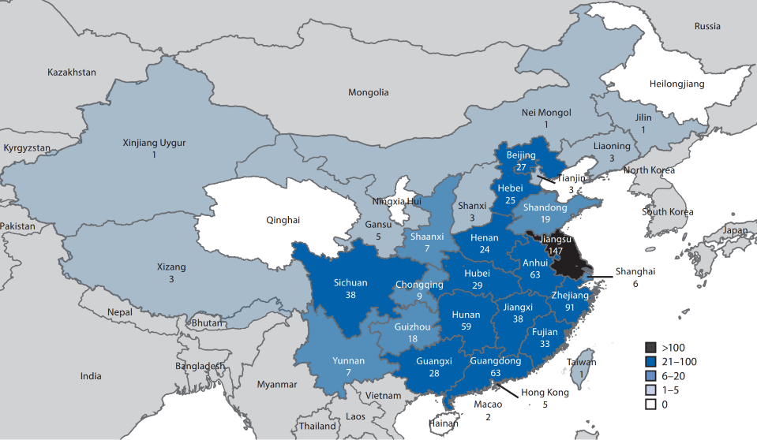
H7N9 – Epidemic Wave 5
Geographic distribution of Asian lineage avian influenza A(H7N9) virus infections of humans reported to the World Health Organization — China, epidemic 5 (October 1, 2016–August 7, 2017)
https://www.cdc.gov/mmwr/volumes/66/wr/mm6635a2.htm
Notes:
Prior to wave 5 the virus was mostly in the Eastern portion of China. With uncertain evolutionary pressures from the vaccine and westward expansion we do not know what to expect for the next wave.

Slide 50
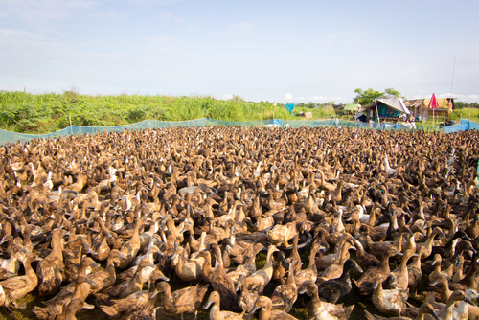
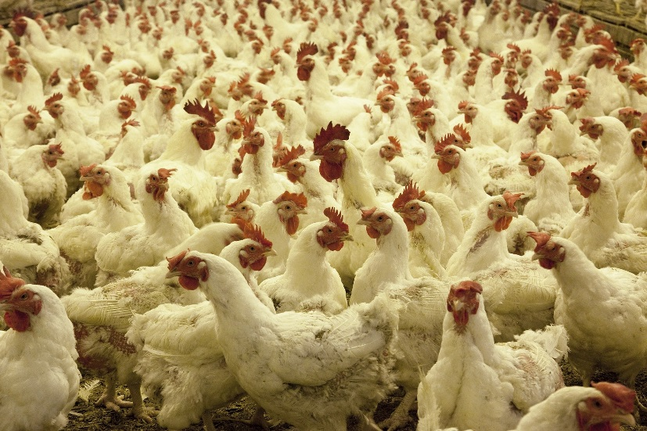
Characteristics of H7N9
Poultry exposure common in human infections
  85% exposure to live poultry
Birds show few or no symptoms
  For first 4 waves, all bird infections were low pathogenicity avian influenza (LPAI)
  Birds transmit without noticeable symptoms of illness
Notes:
Image 1: Purchased from Shutterstock. Stock photo ID: 142652188
Image 2: https://pixabay.com/en/poultry-farm-chickens-agriculture-1544654/ (no copyright restrictions)

Slide 51

H7N9 Characteristics
Severe human infections
  90% developed pneumonia
  70% admitted to ICU
  40% died
Clusters of infection
  40 reported but no sustained human-to-human transmission
5th wave viruses changed
  Increased cases and geographic spread
  Genetic drift requiring new vaccine development
  Subset of viruses now highly pathogenic in poultry
Notes:
Image: purchased from Shutterstock. Stock photo ID: 755082100

Slide 52

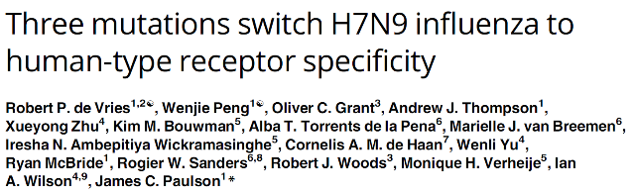
JUNE 15, 2017
H7N9 viruses have a mutation (Gln226Leu in HA) similar to progenitors of 1957 and 1968 pandemic
Three amino acid mutations conferred a switch in specificity for human-type receptors and promoted binding to human trachea epithelial cells
Notes:
This slide highlights a recent publication from June of this year in which the authors performed what is known as a “gain of function” study. The analyzed the A(H7N9) virus by forcing it to mutate to determine what, if any, changes were needed to make it more like a seasonal flu virus. They found that the virus already had a mutation which was similar to that found in the progenitor viruses for the 1957 (H2N2) and 1968 (H3N2) pandemic viruses. However, this mutation does not appear to be sufficient to make the virus more transmissible between humans. However, when they did their mutation analysis they found that it only took 3 amino acid mutations to confer a switch in specificity for human-type receptors and promote binding to human trachea epithelial cells.

Slide 53
H7N9 Conclusions
Risk Assessment
  Influenza Risk Assessment remains highest of evaluated novel viruses
  No sustained and efficient H-H transmission
Case Numbers Down
  Human case numbers significantly lower in Wave 6
  Possibly related to large scale poultry vaccination
  Uncertain evolutionary pressures being placed on the virus
  Possibility of other viruses evolving to occupy A(H7N9) niche
Virus is Changing
  Genetic changes indicate need for new vaccine viruses
  Most H7N9 viruses maintain genetic markers associated with transmission to humans
Potential New Impact from HPAI H7N9
  Emergence of HPAI H7N9 may impact poultry business and MoAg response
  HPAI H7N9 infections in humans may have higher severity similar to HPAI H5

Slide 54
Conclusions

Slide 55
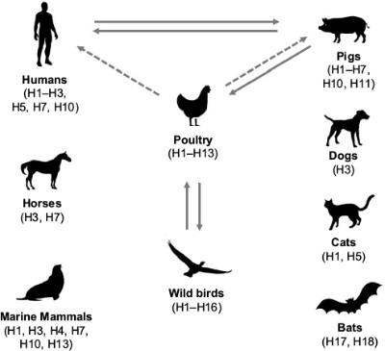
Conclusions
Influenza viruses are constantly changing, requiring ongoing surveillance and frequent vaccine virus changes
Path from novel to pandemic influenza is complex and often is the result of multiple virus changes in birds, swine, and humans
The number of emerging novel influenza viruses is increasing, requiring ongoing laboratory and epidemiologic investigations for risk assessments
Human and animal health are interrelated
Drug resistance in influenza A virus: the epidemiology and management. Infection and Drug Resistance.(10): 2017
Notes:
Last bullet - Heightened surveillance and disease control is needed in animals as well
Second image: https://www.dovepress.com/drug-resistance-in-influenza-a-virus-the-epidemiology-and-management-peer-reviewed-fulltext-article-IDR .
Drug resistance in influenza A virus: the epidemiology and management. Infection and Drug Resistance.(10): 2017

