Slide 1
Module L1
Human Specimen Collection,
Transport & Virus Sharing

Slide 2
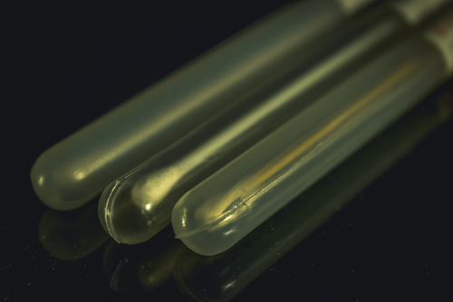
Learning Objectives
Describe specimens collection for influenza virus diagnosis
Understand specimen data collection and tracking
Understand specimen handling and storage for better diagnosis
Describe proper transport of influenza specimens
Understand virus sharing
Notes:
Image purchased from Shutterstock. Stock photo ID: 740774566

Slide 3
Influenza Virus Diagnosis
Successful influenza virus laboratory diagnosis depends largely upon:
  Quality of the specimen
  Storage and transport conditions
Pre-analytical phase of testing
Notes:
Quality of specimen
This is contingent on obtaining the appropriate specimen at the proper time during the illness and collecting the specimen, whichever it is properly
Storage and transport conditions
Once collected the specimen needs to be handled appropriately from the time of collection until delivery to the laboratory

Slide 4

Pre-analytical Phase
Often overlooked
Perhaps the most critical phase that
labs often have little direct control over
Key elements include:
  Specimen collection timing and technique
  Use of appropriate transport media
  Maintenance of cold-chain
  Accurate documentation
Rule of thumb: Garbage in = garbage out!
Notes:
No matter how good of an assay that you have in terms of sensitivity and specificity you CANNOT overcome the problems of a poorly collected or inappropriate specimen or poor handling of the specimen once it is collected and maintained.
Training to address the key elements listed is critical
Garbage in equals garbage out!!!
Image purchased from Shutterstock. Stock photo ID: 579791128

Slide 5
When to Collect the Specimen
1. For PCR, virus isolation or direct antigen detection:
  Within 3 days of onset of clinical symptoms is optimal
2. For serological testing:
  Acute-phase serum (<7 days after onset)
  Convalescent-phase serum (2-4 weeks later)
Notes:
A factor to consider for collecting the specimen is when to collect, e.g. at which stage of the illness.
For influenza virus diagnosis using virus isolation, PCR and antigen testing, it is best to collect respiratory specimens as soon as possible; within 3 days of onset of clinical symptoms is optimal
For serology studies, to understand the burden of infection, collect acute phase serum <7 days of onset and a convalescent phase serum (2-4 weeks after)

Slide 6
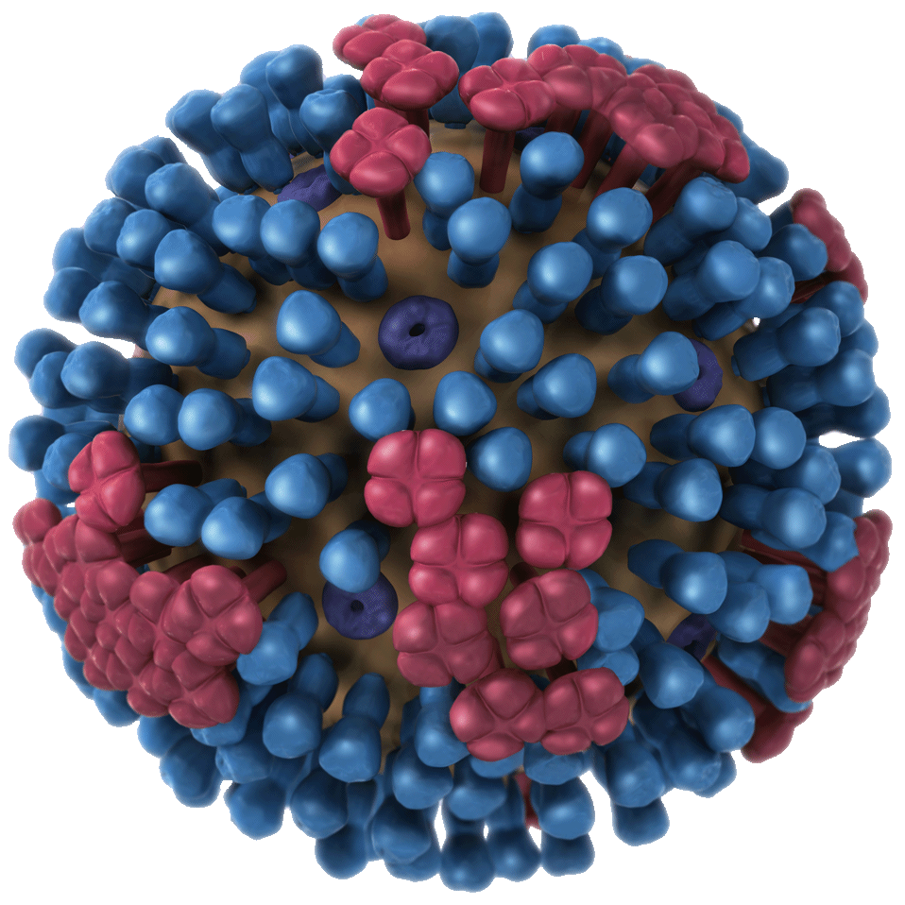
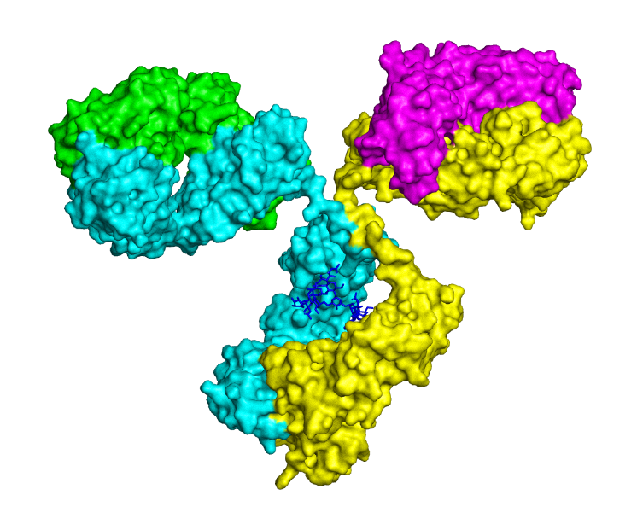
When to collect human specimens, and which specimens to collect
Incubation
Antibody detection
RT-PCR
Antigen detection/culture
Virus shedding
Antibody response
Days after onset of illness
Image created by James Stevens, CDC
Notes:
Knowledge about virus shedding and when anti-influenza antibodies are produced after infection is helpful to determine which specimen to collect and when to collect it.
Key point: If a delay in specimen collection is unavoidable (>3days from onset of virus detection), particularly with PCR, it is still advisable to collect a specimen.

Slide 7
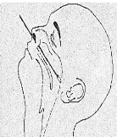

Type of Specimen - Human
Nasopharyngeal swabs or aspirates
Throat swab
Nasal wash or swab
Broncho-alveolar lavage (BAL)
Endotracheal aspirate
Serum
Images: http://www.who.int/csr/resources/publications/surveillance/WHO_CDS_EPR_ARO_2006_1/en/
Notes:
The best single specimen for influenza virus diagnosis in humans is a nasopharyngeal swab or aspirate. Optimally, this can be combined with an oropharyngeal swab which is put in the same viral transport media.
Collection of NP aspirates is most appropriate for the very young and in hospital setting
Other acceptable specimens are throat swabs and nasal wash or swab
For severely ill patients who are intubated, endotracheal aspirates and bronchoalveolar lavage (BAL) can be taken
These types of specimens are also appropriate for diagnosis of other respiratory pathogens
In avian influenza virus infections in humans, like H5N1, the virus has also been detected in serum by PCR.
Serum is also important for serology studies for a wide range of objectives: for example to determine if asymptomatic human infections occur with an AI virus such as H5N1 or H7N9
Optimal acquisition of any of these specimens requires good technique

Slide 8
When Novel Influenza is Suspected
Multiple specimen sampling strategy is optimal
Combined NP & OP swabs for routine diagnosis and addition of lower respiratory tract specimens such as BAL in more severe disease
Sampling on multiple days may be necessary
Novel influenza viruses may have not fully adapted to human cell receptors = low virus titers
Notes:
Employing a multiple specimen sampling strategy is optimal. Examples of such strategies are given on the slide

Slide 9
Swab Type

Slide 10
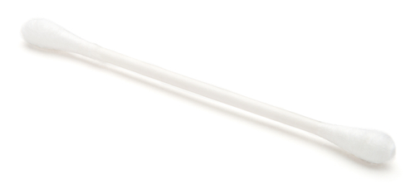
Are the type of swabs used for specimen collection important?
Notes:
There are different swab types (NP and TS), swab tip presentation (flocked vs fiber wad), swab tip material (synthetic tip such as nylon, Dacron, or cotton or calcium alginate) and swab shaft material (plastic, aluminum, wood)
What is the optimum swab? Next slide
Image purchased from Shutterstock. Stock photo ID: 155200598

Slide 11
Swab Type
Synthetic (nylon, Dacron®) tipped swabs
Plastic or aluminum shafts
Flocked swabs are optimal
  In the studies cited below, flocked NP swabs were found to be superior to nasal wash specimens and other types of upper respiratory specimens for detection of multiple respiratory viruses including influenza A and B
  In many studies, flocked swabs were superior to non-flocked TS and NPs
Avoid wooden-shaft, cotton and calcium alginate swabs
Munywoki et al., (2011) JCM; 45(9): 3365-3367
Li Li et al., BMC Infectious Diseases2013: 13,281
Notes:
This slide recommends the type of swab to use
Note: may want to find a new image that is free-use to show a flocked swab. Could not find an image of a flocked swab to use.

Slide 12
Collection Technique

Slide 13
Videos
Human:
  Joint Commission/SIRAS
    https://www.jointcommission.org/siras.aspx
  Nasopharyngeal swab technique: NEJM
    https://www.youtube.com/watch?v=DVJNWefmHjE
Animal:
  Sample collection from live birds: FAO
    https://www.youtube.com/watch?v=Jy0Dxiq2BnQ
Notes:
There are useful videos that you can access at the links provided that show how to collect specimens
Briefly describe these
Watching the videos can help you understand the collection technique, but practice is necessary
To clarify the collection of an NP swab, it is important to insert the swab straight into the nostril (don’t point swab upward) and insert the swab approximately the distance from the opening of the nostril to the opening of the ear
For collection of OP swabs, vigorously swab the posterior pharynx and tonsillar areas while avoiding the tongue (use of tongue depressor is useful). Collection of a good specimen will likely result in the patient gagging.

Slide 14
Human Specimen Collection Kit
Notes:
Ideally, the laboratory should provide collection kits for their users to ensure uniformity and to help ensure specimens will be optimally collected and handled properly. This will likely not be the case if each submitter assembles their own kits with different swabs, VTM, etc.

Slide 15
Reagents / Supplies
Viral transport medium (VTM)
Preparing the specimen collection kit
Managing the specimen collection kit
Notes:
The specimen collection kit contains the supplies you will need to safely collect samples from suspected cases of novel influenza. Specifically, we will talk about viral transport medium, preparing the specimen collection kit, and managing the specimen collection kit.
Image purchased from Shutterstock. Stock photo ID: 740774566

Slide 16
Why Viral Transport Medium?
For viral isolation and PCR testing
Prevents specimen from drying out
Prevents bacteria and fungi growth
Stabilizes virus to maximize chance of successful propagation
pH indicator
A recipe for VTM is available in the
Manual for the Lab Diagnosis and Virologic Surveillance of Influenza (WHO, 2011)
http://apps.who.int/iris/bitstream/handle/10665/44518/9789241548090_eng.pdf;jsessionid=42FAA549831EF3D9DB03E7A80A84DFFB?sequence=1
Notes:
Viral transport medium, abbreviated as VTM, is used in the collection of samples for viral isolation and PCR testing.
There are many types of VTM, but key constituents include
Balanced salt solution or medium with buffering capacity
Protein source
Antibacterial (gentamicin) and antifungal (Ampho B)
pH indicator
The value of VTM and its constituents are highlighted on this slide and include…
Image purchased from Shutterstock. Stock photo ID: 740774566

Slide 17
Viral Transport Medium Storage
VTM should be dispensed in sterile collection vials
Sterile glass beads should also be included in the vial
Optimally, provide a 3.0 ml volume of VTM to ensure adequate volume for complete characterization of the specimen
Ideally choose VTM that can be stored at room temperature
Otherwise, store VTM at -20°C and thaw when needed
Notes:
The inclusion of sterile glass beads helps homogenize any sputum in the specimen when specimen is vortexed
It is important to correctly store VTM. If VTM is made in the laboratory, place 2 to 3 milliliters of VTM into sterile collection vials. The vials can be stored in the freezer at -20 ºC until use. The vials can be stored for short periods of time at 2 - 8 ºC (refrigerator temperature).

Slide 18
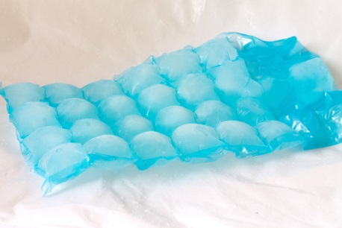
How to Prepare and Manage Kits
Specimen collection kits should be assembled and available for outbreak response activities
Store specimen collection kits in a dry, cool place
Include VTM, collection swabs (NP & throat), leak-proof bag with absorbent material and a reusable cold pack
Insulated cooler
Store specimen collection kit where it will be accessible after hours and on weekends
A specimen submission form should also be included with the kit
Notes:
The items in the specimen collection kit should be kept together, except for collection vials containing VTM. As much as possible, the specimen collection kit should be kept in a dry, cool place. In addition, it must be accessible after hours and on weekends, in case you need to leave for the field at these times.
A specimen submission form should also be included with the kit
Image purchased from Shutterstock. Stock photo ID: 481221127

Slide 19

Discussion Question
In your country or location, have you had any problems with having the materials you need on hand for specimen collection?
Notes:
Facilitator notes: Take 5 minutes to lead a brief discussion with the entire group.

Slide 20
Target Cases

Slide 21
Case Definitions
Symptomatic cases (seasonal flu)
  Follow case definition
  Symptoms consistent with influenza (ILI) or ARI
  Severe acute respiratory illness (SARI)
  http://www.who.int/influenza/surveillance_monitoring/ili_sari_surveillance_case_definition/en/
Zoonotic influenza
  Follow case definition
  Cases and symptomatic contacts (contact with suspected or probable cases)
  http://www.who.int/influenza/resources/documents/case_definition2006_08_29/en/
Notes:
When identifying cases for influenza viruses diagnosis, follow the case definitions, to increase chances of virus detection.
For zoonotic influenza suspect or probable cases, collect specimens from cases and symptomatic contacts. Latest case definitions can be accessed via the links provided on this slide.

Slide 22
When to Collect the Specimen?
As soon as possible after symptoms begin; within 3 days of illness onset is optimal
Before antiviral medications are administered
Even if symptoms began more than one week ago
Collect multiple specimens on multiple days when you have access to patient
Notes:
Influenza virus is most likely to be detected soon after symptoms begin. Therefore, in order to increase the chances that the laboratory can detect novel influenza virus, respiratory samples should be collected as soon as possible after symptoms begin and before antiviral medications are administered. However, it is not always logistically possible to collect respiratory samples early in the clinical course of disease. You can still collect specimens even if the symptoms began more than a week ago, as it is still possible to detect virus in these specimens.
It is best to collect multiple types of specimens on multiple days.

Slide 23
Safety

Slide 24
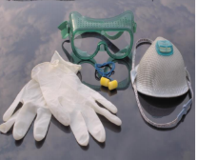
Infection Risk Mitigation
Do a proper risk assessment
Follow national or international Infection Prevention and Control (IPC) recommendations
Use appropriate PPE
  Masks (N-95 or N/P/R-100), gloves, eye protection (goggles) and a gown / apron
  Also hair cover and boot or shoe covers
http://www.who.int/csr/bioriskreduction/infection_control/publication/en/
Notes:
Regardless of the type of specimen that you collect—either respiratory or serological—when you collect clinical specimens from people who might have novel influenza, it is important to follow safety precautions. Be sure that you wear personal protective equipment such as N-95 or N/P/R-100 face masks, gloves, protective eye ware and a gown or apron. You should also wear hair covers and boot or shoe covers.
The same applies to sampling animals and contaminated environments. Aside from protecting yourself, it is critically important to avoid transporting the virus on your hands, clothes, shoes, or equipment.
You will learn more about personal protective equipment in the next module.

Slide 25
Laboratory Biosafety Recommendations (Avian Influenza)
BSL2 laboratory with BSL3 work practices is needed for:
  Processing and diluting specimens
  Nucleic acid extractions
  Diagnostic testing that does not involve culturing
Virus propagation procedures require the use of a BSL3 laboratory and BSL3 work practices
When the laboratory does not meet such (BSL2 or BSL3) requirements, then the specimens should be shipped to a WHO Collaborating Centre
Notes:
CC=Collaborating Center
Use of BSC, appropriate PPE
manipulation of all potentially infectious material should
be conducted within a biological safety cabinet or other primary containment device.

Slide 26
References
  Biosafety for AI (H5N1)
    http://www.who.int/influenza/resources/documents/guidelines_handling_specimens/en/
  WHO Laboratory Biosafety Manual
    http://www.who.int/csr/resources/publications/biosafety/WHO_CDS_CSR_LYO_2004_11/en/
Notes:
Excellent resources

Slide 27
Specimen Data Collection and Tracking

Slide 28
Specimen Collection Form--Important data to collect
Specimen Collection Form (Human Cases)
Name of person providing specimen: |  |  | Contact details for person who collected specimen (phone, email address):
Patient date of birth (dd/mm/yyyy): |  | Given name of patient: |  | Family name of patient:
Sex of patient: M F |  | Nationality of patient: |  | Occupation of patient:
Patient’s hospital/clinic number: |  | Patient’s address (sufficient to locate their specific house):
Place where specimen(s) were collected: Hospital Y N Clinic Y N Home Y N Other Y N Address (if different from above)
Unique ID number | Type of specimen | Date of collection | Clinical diagnosis | Health of patient when specimen collected | Antiviral treatment status and date antivirals received
Exposure history including timing and nature of possible influenza exposure:
Remarks:
Notes:
Here is an example of a field data collection form. The particular collection form used in your country might be different.
The tracking number (Unique identifying number)on the form should be the same number on the clinical samples taken from the patient. There should also be a form for animal and environmental samples – these must also be accurately identified.
Collect demographic information: the patient’s name, address, date of birth, sex, and occupation.
Information about the health status and clinical diagnoses is also collected as is illness onset date.
It is very important to provide information about when the type of specimen and when it was collected.
Finally collect information on antiviral treatment history and the details of the patient’s exposure, including specific timing.
Add any necessary remarks to understand the case as necessary.
The completed form should accompany the specimen when transported to the lab

Slide 29
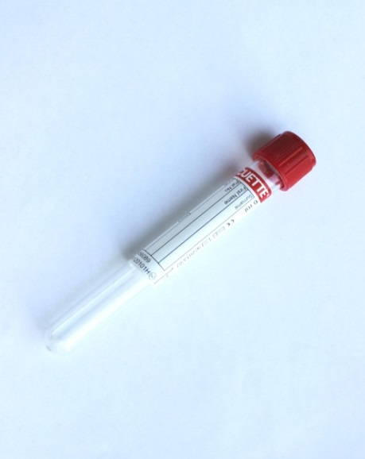
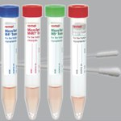
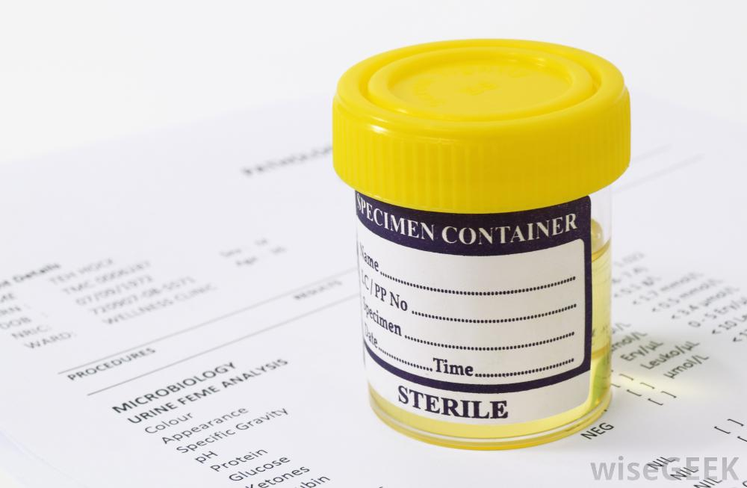
Specimen Labeling
Best practice is to consider having two unique identifiers
Standardized labeling practices
Labeling should be performed at the time of specimen collection!
Image source: www.remel.com
Notes:
The best practice is to have 2 unique identifiers.
Use proper ink on proper labels
Consider preparing labels for:
the specimen container
specimen collection form
the lab log book
The log book is where records of all procedures are kept, and should note that a specimen was collected from a particular patient (or animal/flock/facility), and the specimen was given a particular code. It may be useful to print additional labels for other documentation your team or the laboratory may require

Slide 30
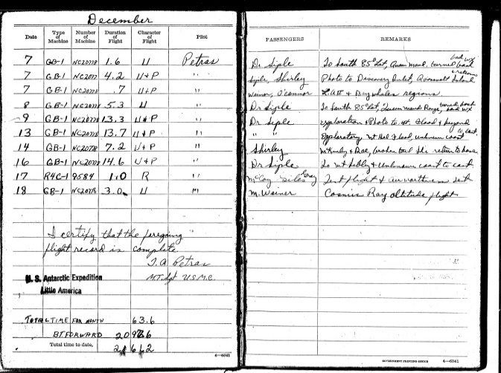
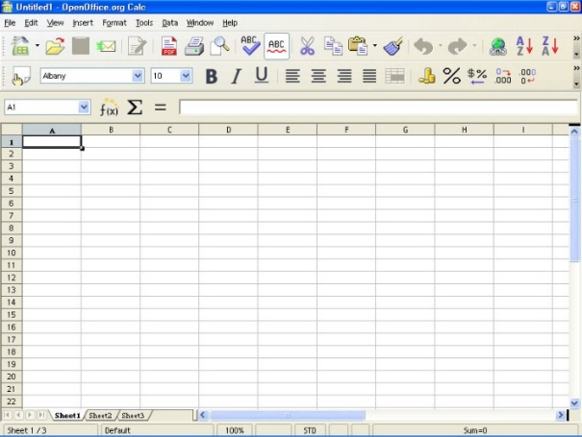
Specimen Tracking System
Maintain a database to track:
Identification number
Subject information
Specimen collection date and type
Specimen collection location
Diagnostic test results
Notes:
You will need to use a specimen tracking system to keep track of the specimens at all times. The particular specimen tracking system will vary by country. However, here are some guidelines. It is advisable to maintain a database that contains information about each sample, including the identification or tracking number as we just illustrated on the sample field data collection form, subject information, and when and where a sample was collected. Results from diagnostic testing should also be entered into the database.
Facilitator Note: Please adapt this content to your country.

Slide 31
Discussion Questions
In your country or location, do you have a database in place for specimen tracking?
In your country or location, have you had any problems with specimen tracking?
Notes:
Facilitator notes: Take 5 minutes to lead a brief discussion with the entire group.

Slide 32
Specimen Storage
Notes:
We are next going to discuss considerations for handling, storing and transporting the specimens that you collect.

Slide 33

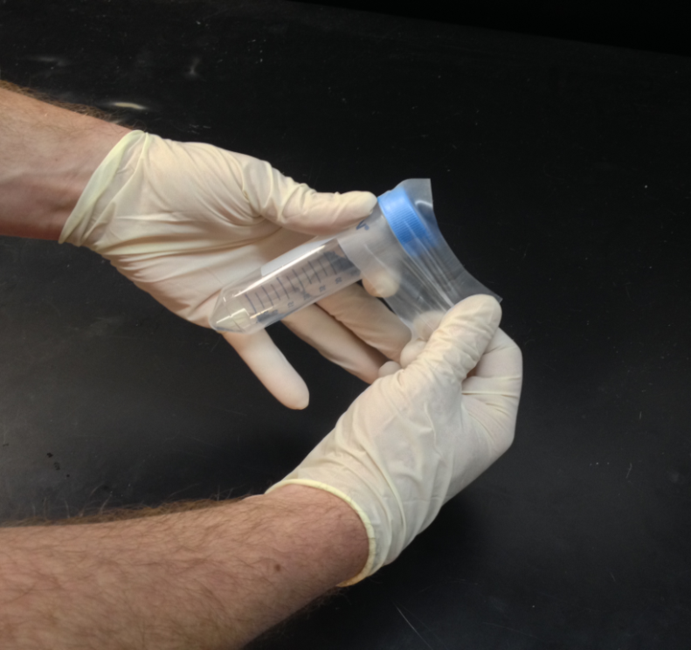
Specimen Packaging
Disinfect the outside of the specimen container
Use a sealable, leak-proof bag
Absorbent material
One specimen per bag
Do NOT leave swab shafts outside the cap
Consider using parafilm or similar sealer
Include specimen submission forms
Image source: http://www.gigayeast.com/wp-content/uploads/2015/03/wrap-film.jpg

Slide 34
Specimen Storage
Transport to laboratory as soon as possible
Store specimens at 4°C before and during transportation if within 48 hours
Store specimens at -70°C beyond 48 hours
Do not store in standard freezer – keep on ice or in refrigerator
  At -20°C ice crystals form that break the virus open and affect specimen quality
Avoid freeze-thaw cycles
  Better to keep on ice for a week than to have repeat freeze and thaw
Notes:
Although you should send specimens in Viral Transport Medium (VTM) to the laboratory as soon as possible, it is important to properly store them before you send them to a laboratory. If you will be transporting specimens within 48 hours, you can store them at 4 °C both before and during transportation. If you will not be able to transport the specimens to the laboratory within 2 days, you need to store them at -70 °C. If this can’t be done, keep the specimens on ice or in the refrigerator as long as necessary. DO NOT put specimens in a standard freezer, as this will damage them.
It is also very important to avoid freeze-thaw cycles. Do not freeze samples if they will thaw and be frozen again, as this will destroy the virus. It is better to keep a sample on ice even for a week, than to allow the sample to freeze and thaw multiple times.

Slide 35
Discussion Question
In your country or location, have you had any problems with specimen storage?
Notes:
Facilitator notes: Take 5 minutes to lead a brief discussion with the entire group.

Slide 36
Infectious Substance Transport

Slide 37
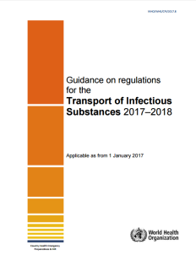
Infectious Substances Transport
Refer to WHO guidance for the safe transport of infectious substances:
http://www.who.int/ihr/publications/WHO-WHE-CPI-2017.8/en/
Follow national or international regulations on the transportation of infectious substance
Coordinate with the laboratory
Notes:
When you send any specimens from suspected or probable cases of novel influenza from the field to a laboratory, follow the WHO guidance on regulations for the transport of infectious substances. Link is provided on the slide.
In addition, you may need to follow national regulations for in-country transport, if exists. If not, follow the international regulations summarized in the WHO guidance.
Be sure to coordinate the shipment with the laboratory. Arrangements should be made so that the laboratory is prepared to receive the specimens when they arrive.

Slide 38
Infectious Substances Shipping Categories
International Air Transport Association(IATA) has classified packaging and shipping requirements as Category A, Category B and Exempt
Category A is an infectious substance that contains a highly pathogenic microorganism or cultures of other dangerous pathogens such as avian influenza
Category B substances includes diagnostic specimens from which an infectious agent has not been isolated, but may contain an infectious agent
Protect the environment, the carrier and the sample

Slide 39
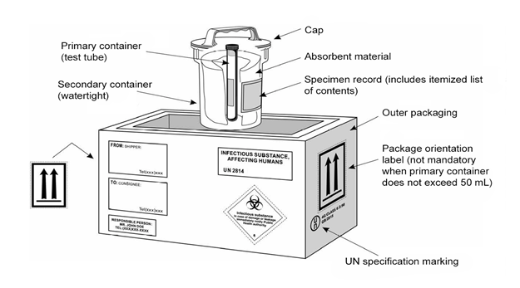
Infectious Substances Transport -Category A
Notes:
Here we will provide a high level comparison of Category A and Category B
DG Shippers – required to be trained on the class (Infectious Substances – Class 6.2)
Competency testing is required
Repeat training every two years (regulation revision cycle)
Records of training must be kept
Source of training: determined by national authorities of transport
Providers: IATA, ICAO and WHO ISST courses

Slide 40
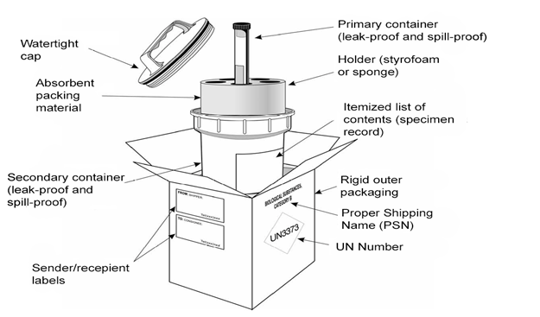
Infectious Substances Transport _Category B
Notes:
Here we will provide a high level comparison of Category A and Category B
DG Shippers – required to be trained on the class (Infectious Substances – Class 6.2)
Competency testing is required
Repeat training every two years (regulation revision cycle)
Records of training must be kept
Source of training: determined by national authorities of transport
Providers: IATA, ICAO and WHO ISST courses

Slide 41
Dangerous Goods Transport Regulations
United Nations Committee of Experts on the Transport of Dangerous Goods
Air
International Civil Aviation Organization (ICAO)
Rail
Regulations concerning the International Carriage of Dangerous Goods by Rail (RID)
Road
Convention on the Contract for the International Carriage of Goods by Road (CMR)
Sea
The International Maritime Dangerous Goods Code published by International Maritime Organization (IMO)
Notes:
Who regulates the transport of dangerous goods?
How often these regulations are revised?
Every two years. Current version is 19th.

Slide 42
Shippers’ (National Influenza Centre’s) Responsibility
Classify: Determine the classification of the dangerous goods
Identify: Properly identify the dangerous goods
Package: Pack according to packing instructions
Mark and label: Mark and label the package(s) in compliance with regulations
Document: Complete the Shipper’s Declaration for Dangerous Goods and Air Waybill
6. Contact carrier / authority and consignee: Make necessary arrangements

Slide 43
Virus Sharing

Slide 44
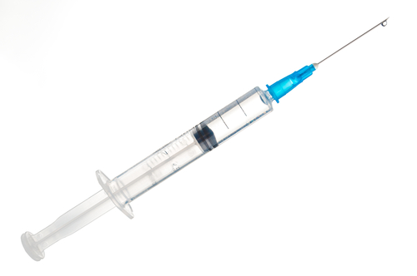
Seasonal Influenza
To update seasonal flu vaccines
Every year
Northern & Southern Hemispheres Vaccine Consultation Meetings (VCM)
Share representative isolates / samples
Timely and regularly
Timely deposit sequences in GISAID or other public database
Notes:
Sharing representative influenza viruses from the national influenza surveillance with WHO CCs is crucial for updating the vaccine every year.
Vaccine consultation meetings for the northern and southern hemispheres capture any antigenic drifts and propose new strains for the coming season.
NICs need to share viruses on regular and timely basis for that purpose.
Image purchased from Shutterstock. Stock photo ID: 526465792

Slide 45
Shipping Fund Project
Submission of influenza specimens from National Influenza Centres to a WHO Collaborating Centre
  Each NIC can make at least 4 shipments per year, to support the VCM risk assessment
  In situations where more shipments than 4 times in a year is needed, the laboratory should contact the WHO GISRS team
Notes:
Submission of influenza specimens from National Influenza Centres (NICs) to WHO CCs is a critical step of GISRS global surveillance. A lot of efforts have been / are being made including the WHO Shipping Fund Project (SFP), frequent communications directly between NICs and WHO CCs, and the reminder from the WHO CC CDC Atlanta recently on shipping additional packages to CDC from CDC CoAg countries.
In situations with more shipments than 4 times in a year needed, the laboratory should contact the WHO GISRS team at gisrs-whohq@who.int or Christian Fuster at fusterc@who.int , who will review the needs and financial situations and decide on a case-by-case basis.
*. The timing of the last two shipments is flexible e.g. early or late in the influenza season or after unusual events.
1. To re-emphasize: for each shipment it is recommended to randomly select, ideally, no more than 40 viruses per shipment. Four shipments per year would result in about 160 viruses being sent per year–representative virus specimens. ALL “Unsubtypeable” specimens must be sent immediately without any delay to a WHO CC.
2. Samples should be accompanied with all required information, properly labelled, sent in dry ice and packaged according to International Regulations for biological sample transportation (triple packaging system).

Slide 46
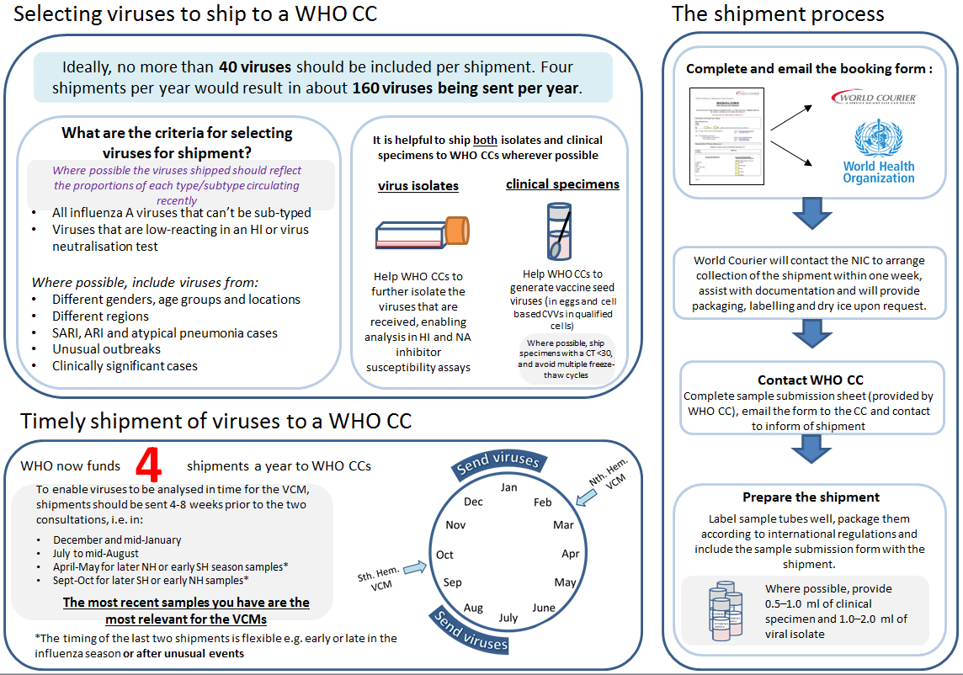
http://www.who.int/influenza/gisrs_laboratory/national_influenza_centres/NIC_virus_sharing_guidance_20171103.pdf

Slide 49
The Shipment Process

Slide 50
Zoonotic Influenza Viruses
Share as soon as possible
Share original specimen
Deposit virus sequences to GISAID or other public database
Share virus isolate, if available

Slide 51
PLEASE NOTE
Cost of extra shipments will only be covered by the WHO in some conditions
All NICs are encouraged to plan their shipments
The WHO Global Influenza Programme has launched an educational video on influenza, available in 6 languages:
  Arabic: https://www.youtube.com/watch?v=PxW6Pg1AnwI
  Chinese: https://www.youtube.com/watch?v=xW9gDKEPitQ
  English: https://www.youtube.com/watch?v=yhhJfT86Bgg
  French: https://www.youtube.com/watch?v=8mo8rWWJZkc
  Russian: https://www.youtube.com/watch?v=XQO6nbkKUWQ
  Spanish: https://www.youtube.com/watch?v=qXr75cKxwTY
Notes:
Cost of shipments will only be covered by WHO when done strictly in accordance with the above instructions.
* Payment can only be made by WHO directly to World Courier.
* WHO is not able to accept or reimburse costs or invoices from the NIC.
* If World Courier is not present in the country and NIC identify a Courier that can handling the shipment, GIP can cover the cost trough the Country Office but previous arrangement by the NIC with GIP need to be set.
All NICs are encouraged to plan their shipments of seasonal influenza samples, taking into consideration the timing of the WHO annual vaccine composition consultations and that WHOCCs require at least one month in advance in order to conduct the analysis of the virus isolates to be included in the WHO annual consultations.

Slide 52
Enquiries and Contact Information
For standard shipping arrangements, please contact World Courier at opsgva@worldcourier.ch or fax +41 22 8273070
For any specific queries surrounding logistics and shipping, please contact WHO Shipping and Logistics Support, Mr Christian Fuster, email: fusterc@who.int or +41 22 7912869 (indicating it is related to the WHO Influenza Shipment Fund Project in the subject heading.)

Slide 53
THANK YOU
http://www.who.int/influenza/gisrs_laboratory/en/

