Slide 1
Module L2
General Biorisk Management

Slide 2
Learning Objectives
Define Biorisk Management
Identify the key principles of biosafety
Explain the importance of a laboratory biosafety management structure and training program
Identify the key principles of biosecurity
Explain the biosafety risk assessment process
Notes:
By the end of this presentation the participants will be able to:
Define Biorisk Management
Identify the key principles of biosafety
Explain the importance of a laboratory biosafety management structure and training program
Identify the key principles of biosecurity
Explain the biosafety risk assessment process

Slide 3
Biosafety
Processes
Biosecurity
Processes
Biorisk Management
Risk
Assessment
Notes:
Biorisk management---effectively handle risks posed by working with infectious agents and toxins in laboratories
Requires understanding of biosafety and biosecurity principles, practices and procedures and understanding of the risk assessment process
Range of practices and procedures to ensure the biosecurity processes, ​biosafety processes, and biocontainment of those infectious agents and toxins.
The full spectrum of safety and security measures for laboratories, from Standard Operating Procedures (SOPs) to physical measures to individual practices in the laboratory.
(Image: Made in Power Point)

Slide 4
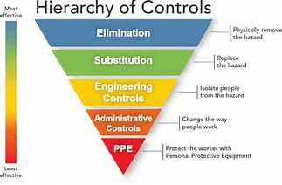
Biorisk Management fits within a Heirarchy of Controls
This is especially critical in low resource environments!
Notes:
Biorisk management fits within the broader safety hierarchy of controls. This figure is based on the NIOSH hierarchy. It is important for labs to consider elimination or substitution of hazards when they approach risk managements. There may be certain agents or procedures that simply can’t be done safely given the resources available to a lab, and shipping samples to another lab that can better handle them may be the remedy.
This is especially critical in low resource environments!

Slide 5
Biosafety
Notes:
The first element of Biorisk Management that we will discuss is Biosafety

Slide 6
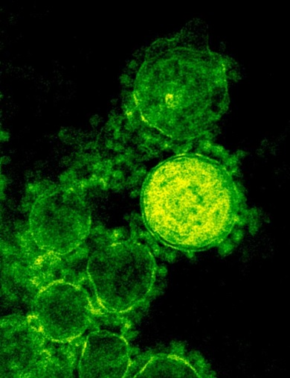
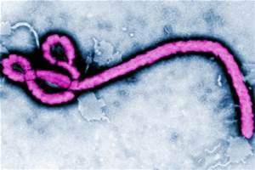
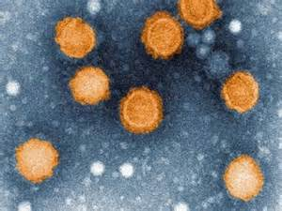
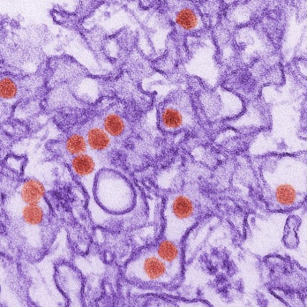
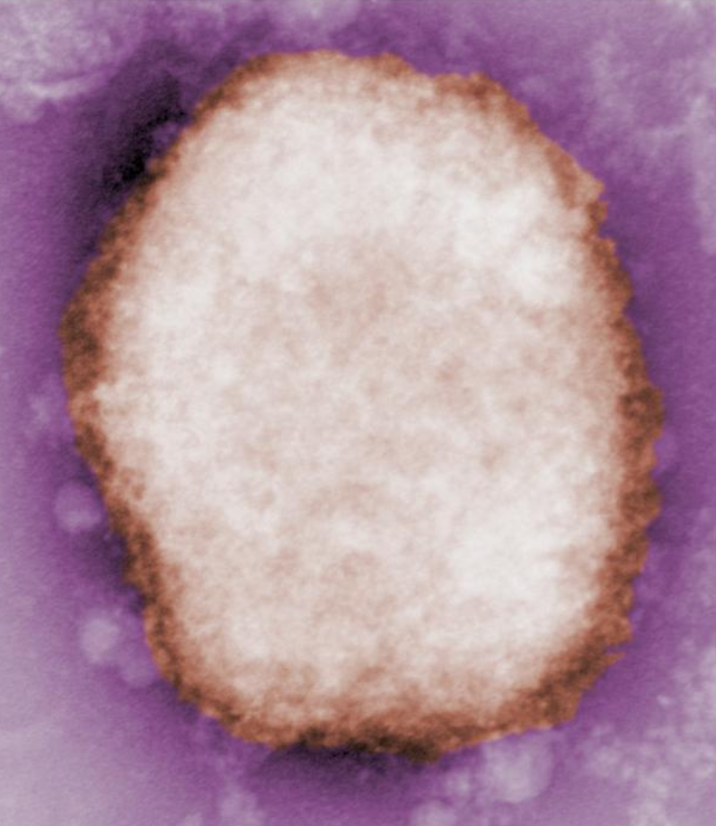
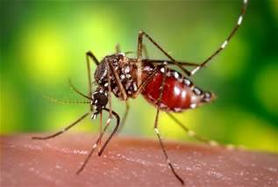
Emerging Diseases and Events of Concern
Events with lab impact
West Nile Virus
Anthrax attack
SARS / MERS-CoV
Monkeypox
Influenza A
  H1N1pdm09
  H5N1, H7N9
  H3N2v, H5Nx
Ebola
Zika virus
Unknown pathogen of concern
Images: CDC, NIAID and Institute Pasteur
Notes:
A number of major EID events , most notably Ebola, have highlighted the need for improvements in biosafety practices in the laboratory and health care settings. Some of these may begin as unknown pathogens of concern but must be handled with appropriate biorisk management practices.
Note:
SARS/MERS-CoV (severe acute respiratory syndrome (SARS) and the Middle East respiratory syndrome (MERS), Coronaviruses (CoVs)
Images;
Ebola Virus (Photo: CDC/ Frederick A. Murphy)
MERS-CoV (Photo: National Institute of Allergy and Infectious Diseases (NIAID))
Virus chikungunya (Photo: Marion Sourisseau, Marie-Christine Prévost, Olivier Schwartz, Institut Pasteur Paris).
Zika Virus (Photo: CDC/ Cynthia Goldsmith)
Monkey Pox virus (Photo: CDC/ Charles D. Humphrey; Tiara Morehead; and Russell Regnery)
Mosquito (Photo: CDC/ James Gathany)

Slide 7
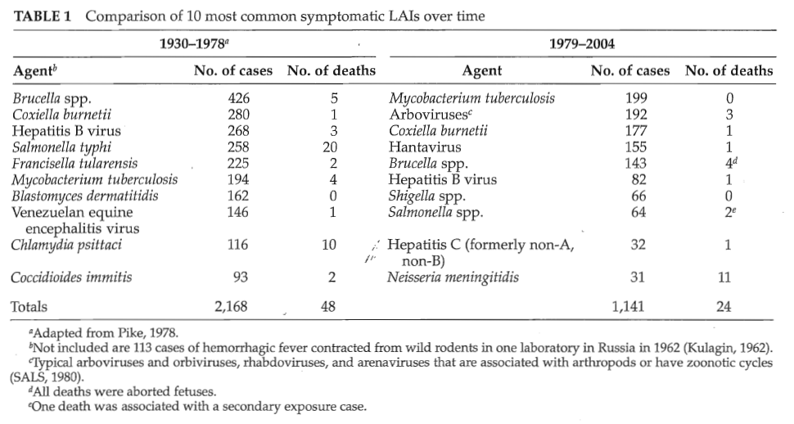
…and Don’t Forget about Other More Common Lab Infections
Harding and Byers (2006) Biological Safety Principles and Practices 4th Edition, ASM
Notes:
…we need to be reminded that laboratory acquired infections due to a number of known agents, both common and uncommon, continue to occur and not infrequently
These pose, not just a theoretical emerging risk, but rather a real day-to-day risk to all of us in the clinical laboratory

Slide 8
How do laboratorians get infected?
Needle stick / sharps
Inhalation of aerosols
Ingestion
Ocular / mucosal splash or contact
Lab animal / vector exposure
Persons affected in adjacent workspace
Unknown route
D. L. Sewell. 1995. Clinical Microbiology Reviews. 8: 389-405.
Note: These routes of infection may not all apply to influenza per se
Notes:
The risks posed to laboratorians come from a number of different sources. These may not all apply to influenza per se.
Here are some of the ways lab workers may be infected with disease agents…
We need to understand how we get infected in the lab setting in order to prevent exposures
Understanding these routes of exposure is a key part of performing a risk assessment (which we will talk about later.
https://my.absa.org/LAI

Slide 9
Need for a Culture of Biosafety in the Laboratory
Reduces exposures and injuries
Establishes team concept - all lab personnel share responsibility for maintaining a safe workplace
Ensures management’s commitment to safety
Ensures that staff are comfortable reporting incidents or near misses and when they occur recognize that they are opportunities for improvement
Improves compliance with safety practices and regulations
Notes:
In the face of the various threats we encounter in the diagnostic laboratory, there is the need to develop a Culture of Biosafety within the laboratory whereby we are constantly aware of the risks in the lab as well as how we can mitigate those risks
What are the advantages in developing this Culture of Biosafety
This goes beyond just memorizing things and enforcing non-compliance…it’s a way of doing things that is ingrained in our work
Safety is a critical component of a laboratory Quality Assurance (QA) program

Slide 10
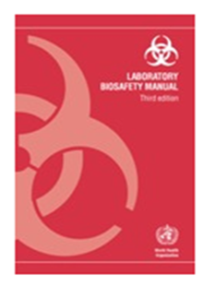

Key Biosafety Resources
WHO Laboratory Biosafety Manual,
3rd edition
http://www.who.int/csr/resources/publications/biosafety/WHO_CDS_CSR_LYO_2004_11/en/
Biosafety in Microbiological and Biomedical Laboratories (BMBL),
5th edition
https://www.cdc.gov/biosafety/publications/bmbl5/index.htm
Notes:
To help us in this effort, there are a number of valuable resources
These include general laboratory biosafety resources
WHO Biosafety Manual
BMBL (Biosafety in Microbiological and Biomedical Laboratories)

Slide 11
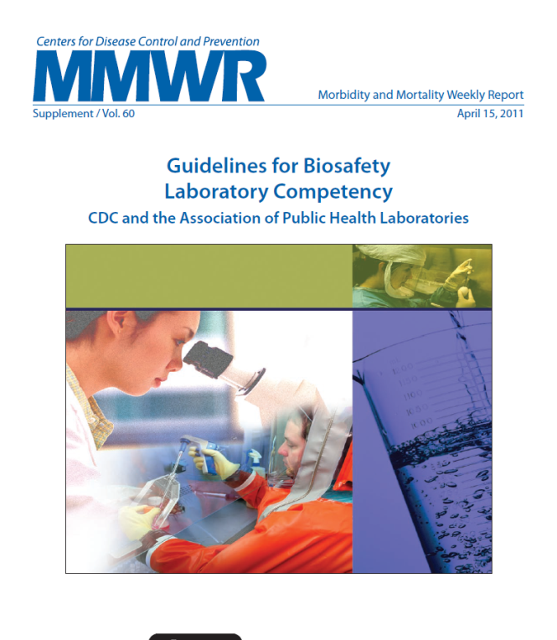
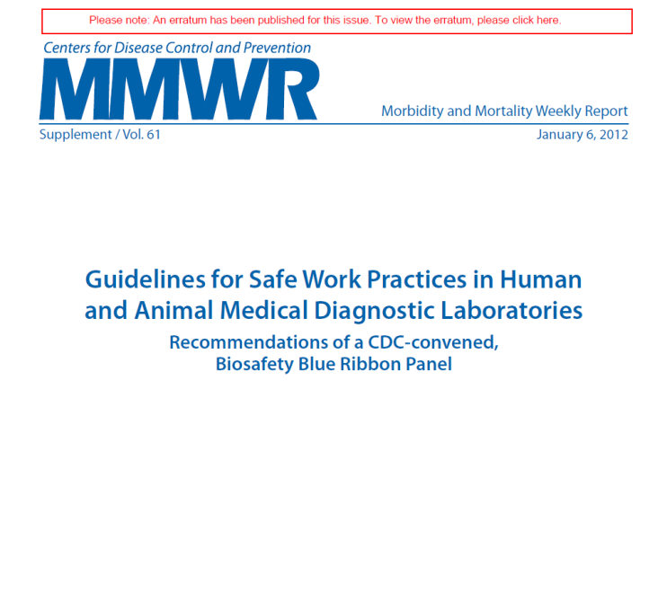
Biosafety Guidelines
https://www.cdc.gov/mmwr/preview/mmwrhtml/su6002a1.htm
https://www.cdc.gov/mmwr/pdf/other/su6101.pdf
Notes:
In addition, these resources provide more specific information, not just general principles

Slide 12
Laboratory Biosafety: Basics
Strict adherence to Standard Precautions is a basic starting point
Understand the basic Principles of Biosafety
Each laboratory needs to perform Risk Assessments to determine whether they can safely perform procedures with infectious materials
Notes:
Let’s look at the basics of laboratory safety
This is really Biosafety 101
Standard precautions are the most basic starting point
These Principles of Biosafety were first introduced in 1984 with publication of the 1st Ed. Of BMBL. Carry through to current edition.
Risk assessment is the process of evaluating the potential risks of lab procedures and applying the principles above to minimize the risks

Slide 13
Laboratory Biosafety: Standard Precautions
Strict adherence to Standard Precautions is the most basic starting point for laboratory biosafety
Notes:
I used this slide several times in making presentations on how the clinical lab needs to prepare for Ebola during the outbreak in 2014
We stated that strict adherence to Standard Precautions and practices designed for blood-borne pathogens is a basic starting point
Specifically because you may not know if you are handling a specimen from a suspect Ebola patient or a patient with any other high risk pathogen
Standard precautions are a set of infection control practices used to prevent transmission of diseases that can be acquired by contact with blood, body fluids, non-intact skin (including rashes), and mucous membranes. These measures are to be used when providing care to all individuals, whether or not they appear infectious or symptomatic
The philosophy and many of the key elements apply to the diagnostic lab as well: assume all blood, body fluids and tissues we work with are infectious
Key elements include…
Hand hygiene
PPE (gloves, protection of mucous membranes, skin/clothing protection)
Needle stick and sharps injury protection/safe injection practices
Cleaning and disinfection of environmental surfaces
Waste disposal
Respiratory protection and hygiene (cough etiquette)

Slide 14
Laboratory Biosafety: Principles of Biosafety
The primary objective of biosafety is the containment of potentially harmful biological agents
The purpose of containment is to protect
  Lab personnel and the immediate environment
  The environment external to the laboratory
Key elements of containment include
  Laboratory practice and technique
  Safety equipment (primary barriers and PPE)
  Facility design and construction (secondary barriers)
Notes:
Laboratory practice and technique
Arguably the most element of containment
Requires awareness of potential hazards and training and experience to minimize the hazard
Behavioral factors are critical
Clear focus on work
Eliminate bad habits
Maximize other containment elements
Safety equipment (for each route of exposure)
Aerosol: Biosafety Cabinets (BSCs), covered centrifuge carriers, loop incinerators or disposable loops, Personal protective equipment (PPE) (respirators, Powered Air Purifying Respirators (PAPRs)
Percutaneous: sharps disposal, retractable needles
Mucous membrane: goggles/safety glasses, face shields, gloves
Ingestion: auto-pipetting devices
Facility Design (contributes to laboratorian safety, but main role to protect outside of lab and community from accidental release
Appropriate Biological Safety Level (BSL)
Negative airflow
High efficiency particulate air (HEPA filtration)

Slide 15
Laboratory Practice and Technique
The most important element of containment
Requires constant awareness of potential hazards
  Pre-analytic, analytic and post-analytic processes
  What about non-traditional testing sites and personnel?
Involves a number of behavioral factors
  Need for complete focus on work
  Need to follow all biosafety practices / procedures
  Avoid bad habits and shortcuts
  Faithfully use safety equipment provided
Training and experience are critical
Notes:
The diagnostic testing process
Pre-analytical: Specimen collection, handling, shipping
Analytical: specimen processing and testing
Post-analytical: storage, disinfection, disposal of infectious waste
Complete focus on work needed no matter the level of experience
Each lab must have (adapt or develop) a laboratory-specific biosafety manual prepared and adopted as policy. This manual must be available and accessible. The biosafety manual should identify the hazards that may be encountered and that specifies practices and procedures designed to minimize or eliminate exposure to these hazards
Personnel should be advised of special hazards and be required to read, periodically review and follow required practices and procedures
The fact is lab practice and technique must be supplemented by the other containment elements

Slide 16

Discussion Questions
Does the laboratory in your country or specific location have a laboratory-specific biosafety manual prepared and adopted as policy?
How often are laboratory personnel in your country or location required to do refresher training on required practices and procedures?
Notes:
Facilitator notes: Take 5 minutes to lead a brief discussion with the entire group.
Key point refresher: Each laboratory should have a laboratory-specific biosafety manual prepared and adopted as policy. Personnel should be familiar with the contents of the manual.

Slide 17
Safety Equipment: Primary Barriers and PPE
Available for each possible route of exposure
  Respiratory tract (aerosols): Biosafety cabinets, covered centrifuge carriers, loop incinerators or disposable loops, respirators / powered air purifying respirators
  Skin: Gloves, gowns / lab coats
  Percutaneous: sharps disposal, retractable needles, gloves
  Mucous membranes: goggles or safety glasses, face shields, gloves
  GI tract: automatic pipetting devices, face shield
Notes:
Respiratory tract: protect from aerosols
Skin: protect from splash/splatter
Percutaneous: protect from puncture or entrance via broken skin
Mucous membranes: protect from splash/splatter
GI tract: protect from ingestion or splash splatter
Use of all of these require some level of skill and, therefore, training.
Maximum protection is offered by the use of one or more of these depending on need

Slide 18
The Biological Safety Cabinet
Arguably the single most important piece of safety equipment in the laboratory!
Information Resources
Importance of the Biological Safety Cabinet
  Provide containment of infectious splashes or aerosols
  Protects the laboratorian, the lab environment and work materials
Different classes of BSC provide different levels of protection
Notes:
Information resources: BMBL5, Appendix A and WHO Lab Biosafety Manual, Chap 10
Individuals need an understanding of those procedures that generate aerosols
Aerosol particles are created by
any activity that imparts energy into a liquid or semiliquid material, such as shaking,
pouring, stirring or dropping liquid onto a surface or into another liquid. Other
laboratory activities, such as streaking agar plates, inoculating cell culture flasks with
a pipette, using a multichannel pipette to dispense liquid suspensions of infectious
agents into microculture plates, homogenizing and vortexing infectious materials, and
centrifugation of infectious liquids, or working with animals, can generate infectious
Aerosols
High-Efficiency Particulate Air (HEPA) filter and airflow critical elements of the BSC

Slide 19
The Biological Safety Cabinet (continued)
Follow proper biosafety cabinet (BSC), work practices and procedures
  BMBL5, Appendix A
BSCs don’t work at all if you don’t use them!
Need a lab-specific plan for BSC use
  A policy issue
  Tie into risk assessment
Need a regular maintenance and annual certification plan
Notes:
Considerations (See BMBL5 and WHO document) for proper use of BSC in lab include:
Location
Operator
Material placement
Operation and maintenance
Avoid open flames
Certification
Cleaning and disinfection
Bleach solution or 70% alcohol followed by wiping with sterile distilled water
Use of UV lamp
Decontamination
Etc.
BSC usage policy
Tie into risk assessment (discussed below)
Organism-related
Patient-related
Enforcement
Need a regular maintenance and annual certification plan

Slide 20
Facility Design and Construction: Secondary Barriers
Contributes to laboratorian safety; however, primary role is to protect environment external to the lab from accidental release
Recommended secondary barriers depend on the risk of transmission of specific agents
  BSL-2 vs. BSL-3
Notes:
Examples of secondary barriers include: separation of lab from public access, availability of decontamination equipment (autoclave) and hand washing equipment. For containment of agent readily aerosolized, barriers include features of BSL-3 including specialized ventilation to ensure directional airflow (negative pressure), airlocks, controlled access points, HEPA filtration of exhaust air, separate modules/buildings to isolate the lab, etc.
Main exposure risk of BSL-1 and BSL-2 agents is direct contact with agent or inadvertent contact with contaminated wok environments (surfaces, etc.)
Main exposure risk of BSL-3 agent is infectious aerosol

Slide 21
Biosafety Containment Levels
Biosafety Containment Level
Safety Equipment
Laboratory Practices
Laboratory Facilities
Notes:
Biosafety level:
A specific combination of work practices, safety equipment, and facilities which are designed to minimize the exposure of workers and the environment to infectious agents
Image: Created by author in Power Point.

Slide 22
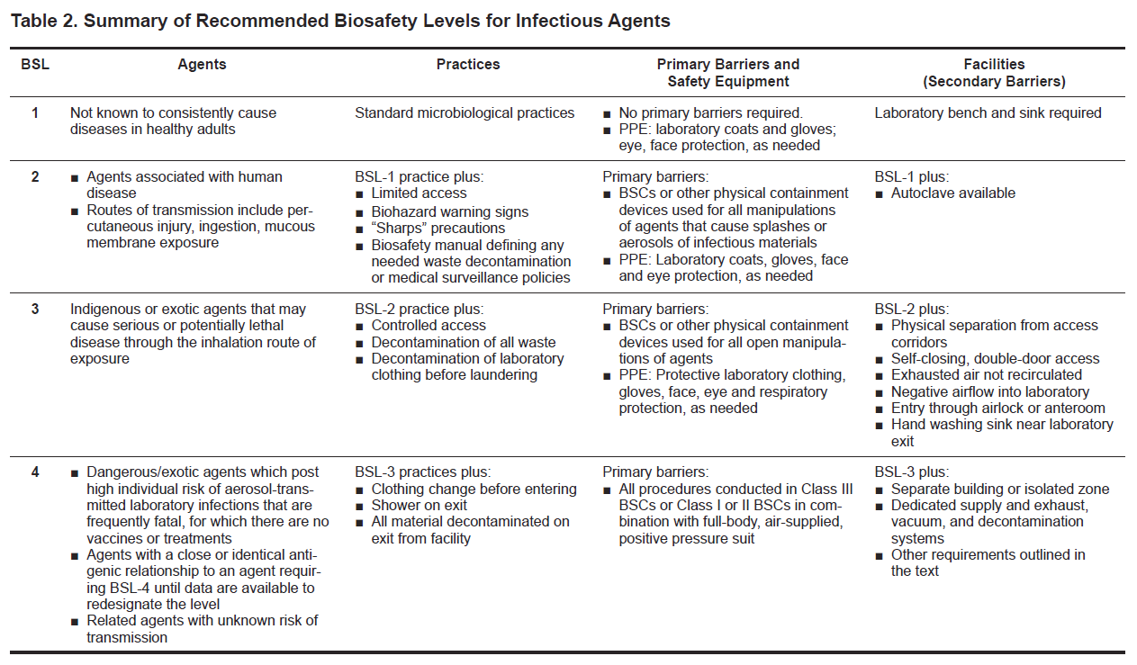
Recommended Biosafety Levels for Infectious Agents
Notes:
4 biosafety levels
Consist of combinations of lab practices and techniques, safety equipment and lab facilities
Purpose: To categorize risk associated with infectious agent and define the appropriate safety practices, equipment and facilities for handling the agent safely
Appropriate BSL determined by:
Microbiological agent Risk Group
Mode of transmission
Procedural protocols
Experience of staff
Likelihood of aerosol generation
Work involves use of amplified agent
Other?
Other characteristics to consider include: Infective dose
Stability in environment
Host range
Endemic nature
In total these characteristics determine the BSL under which the work should be conducted

Slide 23
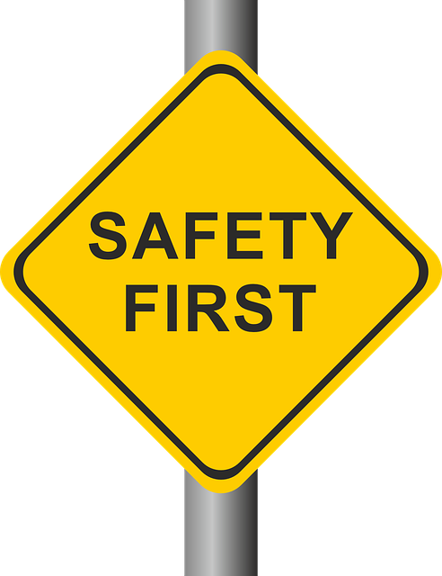
A Culture of Biosafety
Need for a management structure
Institutional commitment
Regular team meetings
Occupational health
  Immunizations, antivirals
  Medical surveillance
  Incident reporting
Biosafety Officer
Biosafety Committee
Biosafety Procedures Manual
Notes:
Understanding the basics of Biosafety that we just reviewed are critical to establishing a culture of biosafety (that I spoke about earlier) within our laboratories.
There are 2 other key elements in establishing this culture. The first of these is Need for a Management Structure that supports and enforces this culture
There should be established biosafety procedures which are described in a biosafety manual and mentioned in diagnostic SOPs
Validated
Clear, concise
Updated regularly
Accessible to lab staff
Reviewed regularly by staff
Image: Creative Commons, Free for commercial use, No attribution required

Slide 24
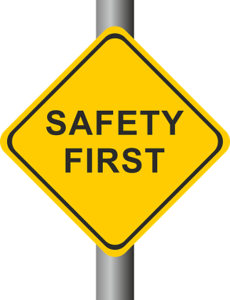
A Culture of Biosafety
Need for ongoing staff training
PPE selection and use
Don / doff
Best practices for handling infectious material
Use of laboratory equipment
Spill clean-up
Training records
Biosafety enhancements for processing suspected avian influenza or other novel pathogens.
Disposal—removal of contaminated materials
Clean-up following disposal
Notes:
There is also a need for ongoing staff training in areas such as…
Image: Creative Commons, Free for commercial use, No attribution required

Slide 25
Discussion Questions
Does the laboratory in your country or specific location require an annual laboratory safety training for laboratory personnel?
Does the laboratory in your country or specific location provide just-in-time training for laboratory personnel as the need arises?
Notes:
Facilitator notes: Take 5 minutes to lead a brief discussion with the entire group.
Key point refresher: There is a need for both annual and ongoing training of laboratory personnel.

Slide 26
Biosecurity
Notes:
Another key element of Biorisk Management is Biosecurity
I want to briefly highlight some of the important principles

Slide 27
Biosafety vs. Biosecurity
Biosafety: describes containment principles, technologies and practices implemented to prevent unintentional exposure to pathogens and toxins, or their accidental release
“Protect people from pathogens”
Biosecurity: protection, control and accountability for valuable biological materials (VBM), in order to prevent their unauthorized access, loss, theft, misuse, diversion or intentional release
“Protect pathogens from people”
Notes:
What is Biosecurity?

Slide 28
What is Biosecurity?
Protection of microbial agents from
  Theft
  Loss
  Diversion
  Intentional misuse
    Accomplished by limiting access to
  Facilities
  Clinical / research materials and information

Slide 29
Assess your Biological Agents
Determine what exists in your facility
  Inventory freezers, note locations and quantity
  Maintain an accurate inventory
Evaluate the potential for misuse
  Would the release of any of your biological agents cause harm in the community?
What are the consequences for misuse?
  Harm humans
  Potential pandemic
  Damage the food supply
Do any items require intellectual property protection?
Notes:
How could these items be misused?
Spiking public food or water sources; intentional life-threatening infections or chemical damage; mass bioterrorism
Do any items require intellectual property protection?
Proprietary agents such as vaccine candidates
unpublished research
lab-developed control material

Slide 30
Threat Assessment – Insider Threats
Insider threats
  Incompetence—even absentmindedness—can a threat. In a laboratory or medical facility, it can even be deadly.
    e.g. a preoccupied or inadequately trained employee walks into a freezer to retrieve vials of two. He or she leaves the freezer, takes one sample out for processing, and forgets the other one.
  An employee who isn’t well trained in SOPs can threaten lab security.
    E.g. a well-meaning employee can take supplies or ppe/clothing home to wash it—and endanger people.
  Staffers or other insiders who intend to do harm pose even more of a threat.
    Internal relations or employee with mal-intent
Notes:
Here are examples of insider threats, outsider threats, and environmental threats. It is important to assess the risk and possible impact of each for preparedness.

Slide 31
Threat Assessment – Outsider and Environmental Threats
Outsider threats
  Direct threats against employees or supervisors/institution
  Possible terrorism or theft
Environmental threats
  Hurricane, Tornado, Flood, Blizzard, Fire, Earthquake etc.
  Power /Outage or Shortage
Notes:
Here are examples of insider threats, outsider threats, and environmental threats. It is important to assess the risk and possible impact of each for preparedness.

Slide 32

Principles of a Biosecurity Plan
Physical security
Personnel security
Inventory management
Transport security
Information security
Program management practices
Biosecurity
Manual
Notes:
These are the principles of a biosecurity plan….
I have specific talking points for these if needed; however in the interest of time, I don’t have included here
Image: CC0 Creative Commons, Free for commercial use, No attribution required

Slide 33

Program Management Practices
Resources to implement a biosecurity plan
  Funding
  Dedicated personnel
Incident response plans
  Incorporate outside emergency responders
  Fire, police, medical, etc.
Training and Drills
  Tabletop drills
  Full-scale exercises
  Can be incorporated into existing drills
Re-evaluate on a regular basis
Periodic reviews of inventory and access records for any materials assessed as significant.
Notes:
Image purchased from Shutterstock. Stock vector ID: 533872648

Slide 34
Discussion Questions
Does the laboratory in your country or specific location have the resources / personnel to readily implement a biosecurity plan?
Is there regular coordination between the laboratory and emergency responders? Are joint exercises or drills conducted at least annually?
Notes:
Facilitator notes: Take 5 minutes to lead a brief discussion with the entire group.

Slide 35
Risk Assessment
Notes:
The final key and very important element of Risk Management is Risk Assessment

Slide 36

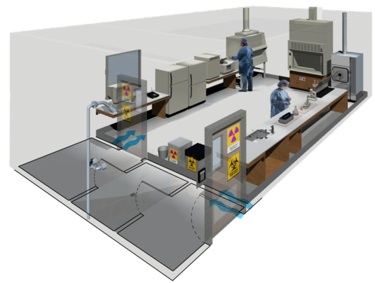
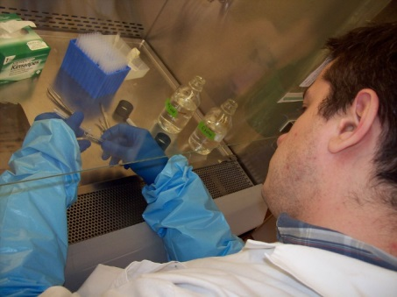
Risk Assessment: What is it?
Risk can be defined as the probability that a health effect will occur after an individual has been exposed to a specified amount of hazard
Risk assessment is a systematic process of evaluating the potential risks that may be involved in any process or procedure
Ultimate goal is to develop mitigation strategies necessary to provide protection
There is no one standard approach to the risk assessment process
Notes:
Risk assessment:
Structured approach for determining and prioritizing risks
Clearly delineates what is known and unknown about a potential risk
Ultimate goal is to determine mitigation strategies
A Risk Assessment of the work to be done with a specific agent or under specific circumstances determines the appropriate combination of the key elements of containment and thus should define the biosafety level needed that can prevent LAIs
Consult Section 2 of BMBL or Chapter 5 of Biological safety: Principles and Practice.
This is another critical element for the “culture of safety” in the laboratory
Why do we need to do RA?
Simply to prevent lab acquired infections to ourselves or exposure to those working around us to the outside environment
Images
Dictionary (Image: https://commons.wikimedia.org/wiki/File:Collegiate_Dictionary.jpg Noah1806) You are free: to share – to copy, distribute and transmit the work
Laboratory floor plan (Image: WHO Laboratory Biosafety Manual - Third Edition)
BSL worker (Image Flickr https://www.flickr.com/photos/jamesz_flickr/421863302 You are free to: Share — copy and redistribute the material in any medium or format )

Slide 37
Laboratory Safety Begins with a Risk Assessment
Assess biological risks
  Identify hazards associated with all procedures
  Consider the agent, the host, and the lab environment
  Estimate risk based on likelihood and severity of the occurrence…based on work being performed
Risk mitigation and exposure avoidance
  Identify and implement controls and work practices
Monitor effectiveness
  Review all accidents, exposures and near misses
  Review effectiveness of control measures
  Identify training needs
  Modify procedures
Notes:
This process is applicable to current laboratory practices dealing with the routine pathogens we encounter as well when a new pathogen emerges, which might impact the lab or when a new technology is incorporated into the laboratory
A little more about this later

Slide 38
What Procedures Should Laboratory Risk Assessment Cover?
Pre-analytic activities
  Specimen collection, transport, un-packaging, processing, movement through laboratory
Analytic activities
  Culture, serology, antigen detection, molecular methods
Post-analytic activities
  Clean up / disinfection of lab, destruction of clinical materials, specimen / isolate storage
  Sample inventory
Notes:
All activities along the laboratory diagnostic continuum
Also don’t forget about off-site specimen collection and transport and rapid test sites

Slide 39
When to Perform the Risk Assessment?
Before work begins
Whenever there is a laboratory move or renovation
Changes in personnel
New equipment, supplies, reagents, etc.
Recent accident
Regulatory changes
Changes to procedures
Emergence of a high consequence pathogen or any new pathogen
Notes:
Since the risk assessment is a critical tool to prevent LAI, it must be utilized before work begins and when changes in procedures, structure of the facility or other changes occur.
In the context of this workshop, emergence of a new infectious disease threat (Influenza A H7N9) is particularly relevant

Slide 40
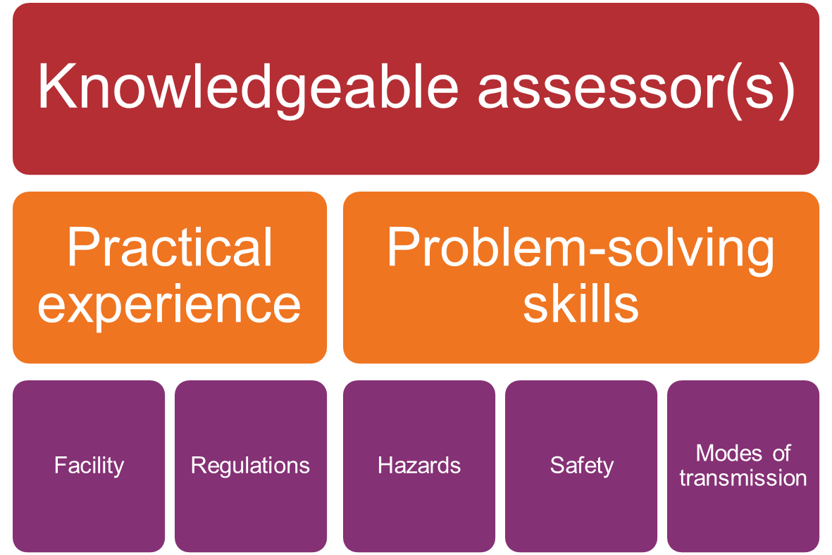
Who Performs the Risk Assessment?
Notes:
A knowledgeable assessor(s) is vital to a successful risk assessment.
Can be a team; want input from all staff not just upper management.
The assessor(s) ideally need a good deal of practical experience and good problem solving skills.
Familiar with facility, regs, hazards, safety, modes
However and importantly, ultimately bench staff need to be responsible as part of their day-to-day activities
Image: Made by author in PPT

Slide 41
Risk Assessment Considerations
People (Host)
Laboratory Environment
Biological Agent
Notes:
Image: Made by author in PPT

Slide 42
How Infections Spread
Biological
Agent
Agent
Susceptible Host
Reservoir
The Chain of Infection
Entry Site
Portal of Exit
Mode of Transmission
Notes:
The assessor keeps the chain of infection in mind while completing the assessment process.
Controlling the risk of infection in the laboratory is basically the implementation of tried and true infection control practices. A fundamental principle of infection control is breaking the chain of infection which can be applied to the risk of LAI. The chain of infection demonstrates that what is needed to acquire an infection is an infectious agent, a susceptible host, a site of entry, a means of spread to others, a site for the pathogen to exit and a reservoir for the infectious agent to thrive. The assessor keeps the chain of infection in mind while completing the assessment process.
A simple example of the chain of infection is a coworker who did not get vaccinated for influenza this year is working with a nasal wash specimen for influenza virus. The specimen accidentally splashes into the individual’s eye. The unvaccinated exposed worker becomes ill, but because the lab is short staffed, continues to work while infectious. The person talks on the phone while coughing and sneezing. The secretions, while mostly invisible, are on the phone and other surfaces. When another staff member, also unvaccinated, comes in contact with those surfaces, they acquire the infection.
Breaking any link of the chain can stop the transmission of infection
Image: Made by author in PPT

Slide 43
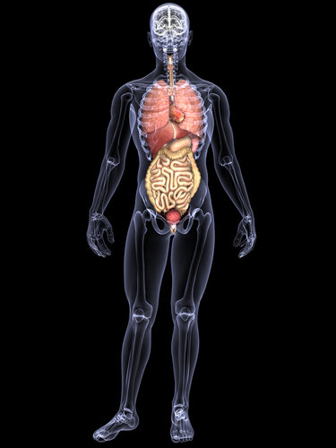
Portals of Entry of Biological Agents
MUCOUS MEMBRANES
Protect from
Splash / splatter
RESPIRATORY TRACT
(LUNGS)
Protect from Aerosols
GASTROINTESTINAL TRACT
Protect from
Splash / splatter /ingestion
SKIN
Protect from
Splash / splatter
Contact
Puncture
Notes:
43
43
In order to perform a risk assessment we have to understand how we are at risk. Humans have several portals of entry through which we are vulnerable to exposure to infectious agents. There are various routes of exposure.
Intact skin is an excellent barrier against nearly all agents, but mucous membranes, the eyes, nose and mouth, and breaks in the skin provide other portals of entry.
Remember, sharps are just as hazardous in the clinical lab as are aerosols.
As you can see protecting against splash and splatter will cover you for agents that infect through mucous membranes, the GI tract and through the skin (which of course can also convey these organisms to eyes, nose and mouth). One portal of entry that needs its own type of protection is the respiratory tract-you must protect against the inhalation of aerosols.
Image (person): Purchased from Shutterstock. Stock illustration ID: 84840628
CLICK for Each

Slide 44
Risk Assessment Considerations
Biological Agent
Laboratory Environment
People (Host)
Notes:
Biological Agent
Image: Made by author in PPT

Slide 45
Biological Agents Risk Determinants
Pathogenicity
Virulence
Transmissibility / communicability
Infectious dose
Stability in the environment
Incubation period
Infectious period
Modes of transmission
Availability of vaccine or treatment
Concentration of agent
Notes:
Because of the diversity of activities in an individual lab, every lab should do its own risk assessment. This entails, making a list a pathogens you commonly encounter in your lab. Consider the length of survival of pathogens if they were to get on surfaces. Are humans part of the host range for these pathogens (probably so for a clinical lab). What is the incidence that these pathogens are encountered. Are these pathogens a cause of LAI?
Remember to consider all organisms both routine and those rarely encountered. It is wise to expect the unexpected, so knowing what agents are emerging is very important.
Pathogenicity- the ability/capacity of an infectious agent to cause disease
Virulence- the quantitative ability of an agent to cause disease, the disease-evoking severity of a pathogen (virulent agents cause disease when introduced in small numbers)
Transmissibility/communicability- contagious, ease of spread between persons or species by contact with the sick or their fluids
Infectious dose- amount of pathogen required to cause an infection in the host.
Another important laboratory issue to consider is if you are working with an agent amplified by culture (therefore, having much higher titer)
Question : Ask about their particular lab and agents that are worked with

Slide 46
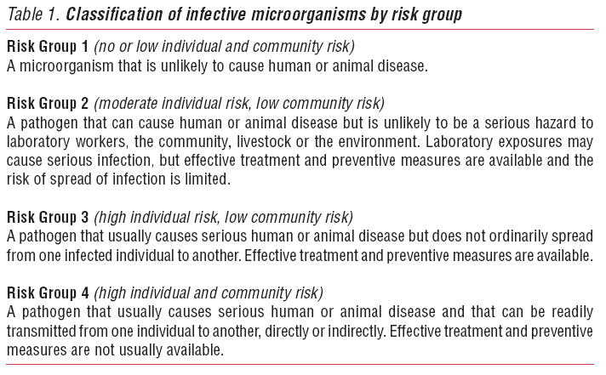
WHO Agent Risk Group Classification
From: WHO laboratory Biosafety Manual, 3rd Edition
Notes:
Microbiological agent risk groups are the result of classification of agents based on: Capability to infect and cause disease, severity of disease, availability of preventive measures and effective treatments
This Risk Group classification is described in the WHO Laboratory Biosafety manual
This risk group classification meant for laboratory work only
Similar risk groups described in NIH guideline as information for researchers and in BMBL
Risk group classification correlates with but does not equate to biosafety levels
A risk assessment will determine the degree of correlation between an agent’s risk group classification and biosafety level.
What risk group is flu? Different subtypes or strains?
What about novel viruses in humans or animals?

Slide 47
Risk Assessment Considerations
People (Host)
Laboratory Environment
Biological Agent
Notes:
The next Risk assessment consideration is People (host)
Image: Made by author in PPT

Slide 48
People (Host) Risk Determinants
Behavioral Factors
  Perception of risk
  Attitude toward safety; good habits
  Competency
  Stress, fatigue, etc.
Immune Status
  Pre-existing conditions / medical status
  Pregnancy
  Immunizations
Notes:
Tie back to an earlier slide where I state that Laboratory Practice and Technique is ultimately the most important element of microbial containment
Having a strong culture of biosafety hopefully ensures that all who work in the laboratory understand these risk determinants and how they apply to each of us.

Slide 49
Risk Assessment Considerations
People (Host)
Laboratory Environment
Biological Agent
Notes:
Finally, let’s consider the Lab Environment
Image: Made by author in PPT

Slide 50
Lab Environment Risk Determinants
Facility
Workflow
Equipment
Availability of PPE and primary barriers
Waste management
Procedures / protocols
NOTE: Greatest concern with aerosol-creating procedures
Notes:
The assessment of laboratory activities must be protocol driven. The lab activity drives the level of containment

Slide 51
Risk Assessment Process
Define the procedure
Define the risks within the procedure
  What can go wrong?
  What are the hazards?
Characterize the risks
  What are the consequences?
  How likely is it to happen?
Implement mitigation strategies
Review
Notes:
Mitigation strategies: Actions and control measures that are put into place to reduce or eliminate the risks associated with biological agents and toxins
Implement Controls (mitigation) entails identifying the key elements of containment which include:
Laboratory practice and technique
Safety equipment (primary barriers and PPE)
Facility design and construction (secondary barriers)
Much more detail of this process in the Appendix: Biosafety Risk Assessments, Tricia Blevins, 8/7/2017, Panama

Slide 52
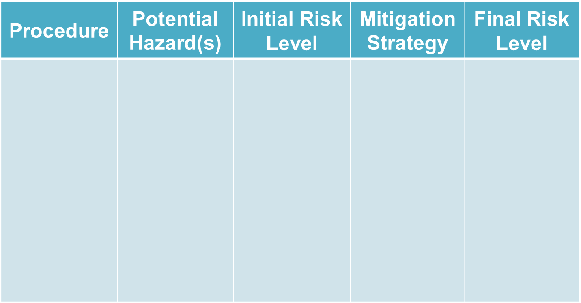
Risk Assessment Templates
Notes:
This is meant to be illustrative of a general RA template. The appendices provide examples of some templates that have been used
Refer the audience to WSLH, WCLN and APHL templates* which will be added as Appendices
If necessary, give some examples of RA Mitigation strategies
Risk of inhalational transmission: mitigation strategies include respiratory PPE, BSC , centrifuge safety cups
Risk of ingestion: mitigation strategies include no mouth pipetting, wearing gloves, face shield, wash hands
Risk of percutaneous transmission: mitigation strategies include sharps containers, safer sharps, cover compromised skin
Risk of contact with mucosal membranes: mitigation strategies include face shield, handwashing
* Appendices documents:
APHL: Template for Public Health Laboratory Risk Assessment for Ebola Virus Disease (EVD) Testing (ModuleL2_APHL_Ebola-risk-assessment.pdf)
WCLN: Laboratory Biosafety: Performing a Biosafety Risk Assessment (ModuleL2_WSLH-Risk-Assessment-Tool.pdf)

Slide 53
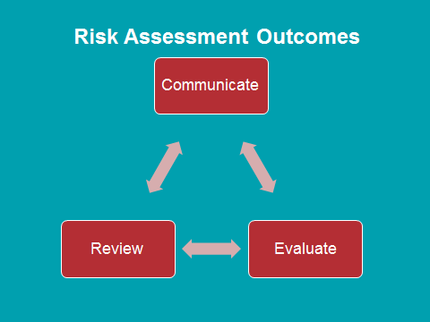
Risk Assessment: Final Steps
Communicate results of risk assessment to all stakeholders
Put preventative measures in place
  Personal Protective Equipment
  Develop safe work practice SOPs DOCUMENTATION
  Identify appropriate engineering controls
Develop Emergency Response Plans based on the risk assessment
  Include local emergency responders

Slide 54
Risk Assessment: Final Steps
Evaluate the effectiveness of the mitigation controls
Assess worker competency and understanding
Prioritize resources
  Identify the most important concerns
Perform ongoing review
  Goal is continuous improvement

Slide 55
Biosafety: An Inexact Science
Biosafety is an inexact science, and the interacting system of agents and activities and the people performing them are constantly changing.
Every etiologic agent is different
Every laboratory is different
Every person is different
From: Biological Safety: Principles and Practices, 4th Ed. Fleming DO, Hunt DL, eds., p. 81. Washington, DC. American Society for Microbiology, 2006
Notes:
Remember….

Slide 56

Balancing risk and work performance
Risk Assessment Goal
Mitigation
Strategies
Work Performance
Notes:
The expected outcomes from the performance of a risk assessment are twofold:
First, it should provide information regarding a particular risk.
Second, it should reduce the risk to an acceptable level.
Risk cannot be completely eliminated in a laboratory
Even if every available protection is taken the risk will never be zero, there is always the potential for human error, or that exposure may occur to someone who was not considered to be at risk.
Image made by author in PPT

