Slide 1
Module L3
Overview of Molecular and Serological Diagnostics for Influenza A(H7N9)

Slide 2
Learning Objectives
Describe the primary methods for detection and characterization of influenza virus
Summarize antigen detection methods used to detect influenza virus
Describe the challenges and benefits of molecular detection methods for influenza virus
Give examples of antibody detection methods used for influenza virus

Slide 3
Strategies for Detection and Characterization of Influenza Virus
Detection
  Viral antigen – inactivated or live virus
  Viral nucleic acid – inactivated or live virus
  Immune response to the virus – antibodies (from host)
Characterization
  Virus isolation – need specimen with live virus
  Typing and subtyping – inactivated or live virus
  Antiviral sensitivity – live virus
Notes:
These are 2 strategies for detection and characterization of influenza virus…

Slide 4


Required Clinical Specimens
Collection
  Who?
    Influenza-like illness (ILI)
    SARI
  When?
    Close to illness onset (< 10 days)
  What?
    Respiratory Specimens: Nasopharyngeal swabs, nasal swabs, NP aspirates, nasal aspirates, throat swabs, BAL samples
Transport
Storage
Notes:
When thinking about clinical specimens you will need to think about collection, transport and storage.
Photos purchased from Shutterstock.
Top: Stock photo ID: 87998860
Bottom: Stock vector ID: 201932494

Slide 5

Influenza Antigen Detection
Rapid tests (RIDT)
Immunofluoresence (IFA)
Enzyme Linked Immunosorbent Assay (ELISA)
Hemagglutination (HA)
Notes:
There are several methods for influenza antigen detection….
Image purchased from Shutterstock. Stock photo ID: 403291384

Slide 6

Influenza Antigen Detection
Rapid tests (RIDT)
Advantages
Can be used on-site
Rapid
Simple – low user expertise
Test specimens directly from patient
Disadvantages
Less sensitive than virus culture or PCR
Some cannot type (A/B) or subtype (H3, H1 etc.)
Cost – expensive per test (USD $12-$25)
Notes:
The advantages and disadvantages for rapid tests for influenza antigen detection are…
Image purchased from Shutterstock. Stock photo ID: 516741178

Slide 7
Influenza Antigen Detection
Immunofluoresence assay (IFA)
Notes:
Immunofluoresence assay can be direct or indirect….
No citation for this image.

Slide 8
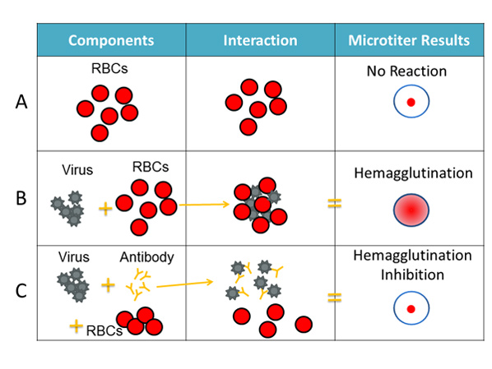
Hemagglutination Assay
Determine virus titre
Notes:
No citation for this image.

Slide 9
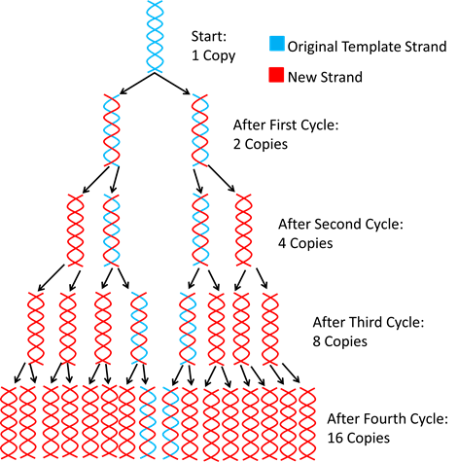
Molecular Detection
Conventional PCR
Real-time PCR
  SYBR green
  Taqman probe
Notes:
No citation for this image.

Slide 10
Laboratory Workflow
Molecular testing requires:
  Well organized laboratory
  Unidirectional workflow to avoid cross-contamination of samples and/or positive controls (if used)
    Laboratory should have:
      RNA extraction procedure room
      Clean procedure room (no RNA/DNA/sample) for reagent/master mix and plate preparation
      Separate procedure room for adding RNA to plate prior to running RRT-PCR
  Quality management plan to control for contamination and allow troubleshooting
    Negative Template Controls (NTCs) must always be used
Reagent storage must be monitored to ensure proper temperatures/storage conditions are maintained
  System to track reagent expiration
  System to ensure reagent/consumable availability
  Positive controls may be needed to control for degradation of primers/probes

Slide 11
Conventional PCR Output
Detection of H5N1 avian influenza A virus by one-step RT-PCR
A. Amplification of serially diluted in vitro-transcribed single-stranded RNA (lanes 2 to 11) measured by RiboGreen RNA quantitation reagent and H5N1 RNA extracted from allantoic fluid of infected egg (lane 19). Viral RNA extracted from human specimens that were previously confirmed with other respiratory viruses (lanes 12 to 17).
B. Specific detection of H5N1 avian influenza A virus.
From: Ng L et al. Specific detection of H5N1 avian influenza A virus in field specimens by a one-step RT-PCR assay. BMC Infectious Diseases 6(1):40. 2006.

Slide 12
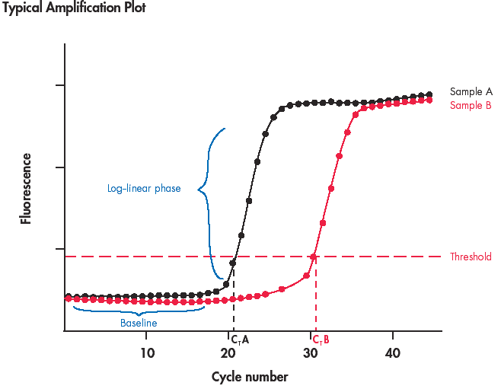
Real-Time PCR Output
Notes:
No citation for this image.

Slide 13
Routine Influenza Testing Algorithm
Routine Surveillance
No known risk for avian influenza
Perform RT-PCR testing for seasonal human influenza A and influenza B viruses
Negative
InfA (+)
InfB (+)
Report Results
Test for H3, pdm H1, pdmInfA
Test for YAM, VIC
InfA unsubtypable – possible novel influenza
  Based on risk assessment, test for H5, H7 and/or other novel strains w/RT-PCR
InfA inconclusive samples with possible swine origin influenza virus
Inconclusive samples with possible coinfection/LAIV
InfA (+)
H3 or pdm H1 (+)
InfB (+)
YAM or VIC (+)
Report Results
Report Results

Slide 14
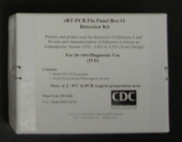
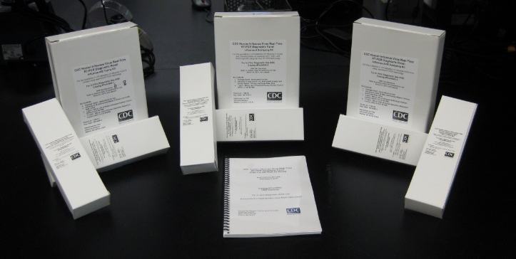
CDC/WHO Influenza Virus Real-time RT-PCR Reagent Kit
Influenza A/B Typing Panel
  (InfA, Inf B, RNasP)
Influenza A Subtyping Panel
(InfA, H3, pdmInfA, pdmH1)
Influenza B Genotyping Panel
(InfB, Yam, Vic, RNasP)
Influenza A H5 (Asian lineage) Subtyping Panel
(InfA, H5a, H5b, RNasP)
Influenza A
EuH7 Assay
(EuH7)
CDC’s real-time RT-PCR kits and reagents can be obtained from the International Reagent Resource (IRR)
IRR website https://www.internationalreagentresource.org/)
SOPs for real-time RT-PCR can be found at CDC Laboratory Support for Influenza Surveillance (CLSIS); https://partner.cdc.gov/Sites/NCIRD/clsis/SitePages/default.aspx.
Contact Steven Lindstrom (sql5@cdc.gov) for additional information and questions
Notes:
The RNasP primer and probe set targets the human RnasP gene and serves as an internal positive control for detection of human nucleic acid.

Slide 15
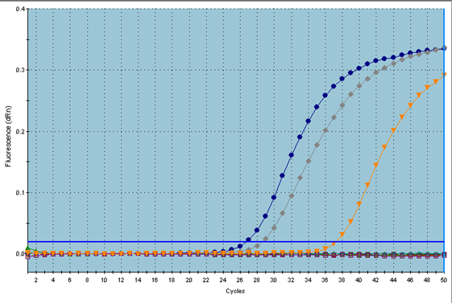
Interpretation of Real-time PCR Results for suspect variant viruses
InfA
pdmInfA
RNP
H3, pdmH1, H5, H7
Example for variant viruses detected in USA
InfA | H3 | pdmInfA | pdmH1 | EuH7 | H5 | RP | Result
+ | - | + | - | - | - | + | Suspect Influenza A variant virus; Send sample to WHO CC for confirmation; Perform sequence analysis to confirm result
Considerable genetic variation among influenza A viruses exist in swine populations across the world
rRT-PCR using CDC’s kit can facilitate detection based on specific results (as above) but requires sequence confirmation for conclusive interpretation
Recent variant viruses detected in the USA, for example, are closely related to seasonal viruses that were circulating in humans several years ago and must be analyzed in the context of known swine influenza A viruses for confirmation of a variant case
History of exposure of the patient to swine may inform laboratory interpretation
Notes:
No citation for this image.

Slide 16
Interpretation of CDC Real-time PCR Results: Influenza A(H7N9)
InfA
EuH7
RNP
H3, pdmInfA, pdmH1
InfA | H3 | pdmInfA | pdmH1 | EuH7 | RP | Result
+ | - | - | - | + | + | Influenza A Eurasian avian H7
Notes:
No citation for this image.

Slide 17
OFFLU Contributing Laboratories – A(H7N9) Real-time RT-PCR Detection
H7 HA Real-time RT-PCR Assay | A(H7N9) Detection | Developed by
CNIC H7(N9) rRT-PCR | Detection of novel A(H7N9), highly specific detection | CNIC, China
rRT-PCR H7.2-FLI | Detection of novel A(H7N9) and of other H7Nx viruses Used as standard A(H7) RT-qPCR Validated with AgPAth reagents | FLI, Germany
rRT_PCR_CODA | Detection of novel A(H7N9) and of other H7Nx viruses | CODA-CERVA, Belgium
rRT-PCR_IZSVe | Monne et al., 2008 - modified probe. Detection of novel A(H7N9) | IZSVe, Italy
Eurasian H7 HA2 rRT-PCR-AHVLA | Detection of novel H7N9 and of other H7Nx viruses | APHA, UK
Eurasian H7rRT-PCR assay2-HKU | Detects Eurasian A(H7) strains (J Clin Microbiol 48:4275-4278) | HKU, HK SAR
H7 CS rRT-PCR-AHVLA | Discriminates between LPAI and HPAI Advantage when molecular pathotyping may be required | APHA, UK
N9 NA Real-time RT-PCR Assay | H7N9 Detection | Developed by
CNIC (H7)N9 rRT-PCR | Sensitive detection of the N9 of novel A(H7N9) Detection of other HxN9 viruses | CNIC, China
Eurasian N9 rRT-PCR-­SEPRL | Sensitive detection of the N9 of novel A(H7N9) virus | USDA, USA
http://www.offlu.net/fileadmin/home/en/guidance/pdf/OFFLU_real-time_diagnostics_of_H7N9

Slide 18
Advantages of PCR
Rapid - < 24h for result
Sensitive
Specific
BSL-3 not required
High throughput
Can test clinical material or cultured virus

Slide 19
Challenges of PCR
Interpretation of results (conventional and real-time)
False positives
Contamination
Non-specific amplification
False negatives
Poor sample quality
Inefficient extraction of nucleic acid
Reaction failure
Presence of inhibitors in the sample

Slide 20
Considerations for Influenza Diagnosis
Laboratory infrastructure
Equipment availability / support / maintenance
Training / expertise
Reagent / stock availability
Specimen management
Data management
Laboratory information management system

Slide 21

Influenza Serology - Influenza Antibody Detection
Serological confirmation of influenza infection
  Estimate disease burden
  Outbreak investigations
  Influenza surveillance; e.g., animal-human interfaces
  Serology
  Captures cases missed by molecular diagnosis of respiratory specimen (PCR, etc.)
  Has wider sampling window than PCR
  Captures non-symptomatic cases and subclinical infections
Notes:
Image purchased from Shutterstock. Stock vector ID: 201932494

Slide 22
Influenza Serology - Influenza Antibody Detection
Characterize immune responses to influenza infection and vaccination in humans
  Vaccine development and evaluation
  Estimate population immunity for risk assessment
  Identify immune markers and correlates of protection for influenza
Notes:
No citation for image.

Slide 23
Classical Influenza Serological Methods
Hemagglutination inhibition assays
Virus neutralization assays
Single Radial Hemolysis (SRH)
Western Blot
ELISA

Slide 24
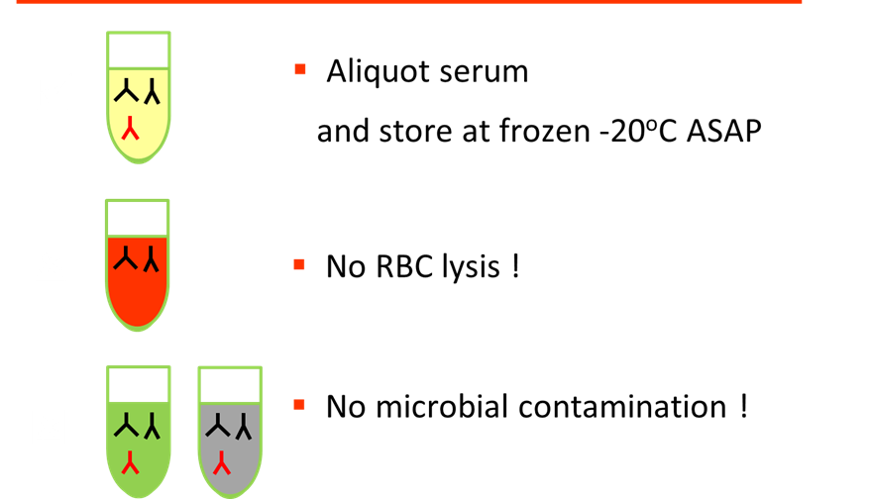
Quality Serum Specimen is Essential
Notes:
No citation for image.

Slide 25
Sera Collection Guidelines for Influenza Serology
Follow CDC sera collection guideline / SOP
  Contact Min Levine (mwl2@cdc.gov) for questions
Collect sera, not plasma
Suggested vacutainer tubes
  Glass red top vacutainer tubes
  Plastic red top vacutainer tubes with clot activator
  Plastic gold top serum separator tubes (SST) with clot activator and gel

Slide 26
Paired Sera Collection
Paired sera collection is always recommended when possible
  S1/Acute (within 7 days from symptom onset)
  The timing of the acute serum collection is important
  S2/Convalescent (2-3 weeks later)
Notes:
No citation for image.

Slide 27
Hemagglutination-Inhibition (HI) Assay
Most commonly used
A surrogate assay, simpler to perform than neutralization assays
Detects Ab that bind around receptor-binding site in globular head of hemagglutinin and block agglutination
Choice of RBC depends on the types of viruses, receptor binding specificity: human SA (2-6) Gal, avian SA(2,3) Gal
Notes:
No citation for image.

Slide 28
Serological Diagnosis of influenza A(H7N9)
The CDC recommends using CDC modified horse RBC HI assay for detection of A(H7N9) Antibodies in human sera.
The receptor specificity of influenza virus HA correlates with their ability to agglutinate RBCs from different animal species:
Avian viruses: SA α-2, 3
Human viruses: SA α-2, 6
Horse RBCs express a high proportion of SA α-2, 3 -gal linkages compared with turkey RBCs
With H7 influenza subtype viruses, improved sensitivity using horse RBCs for detecting HI antibodies in human sera than using turkey RBCs

Slide 29
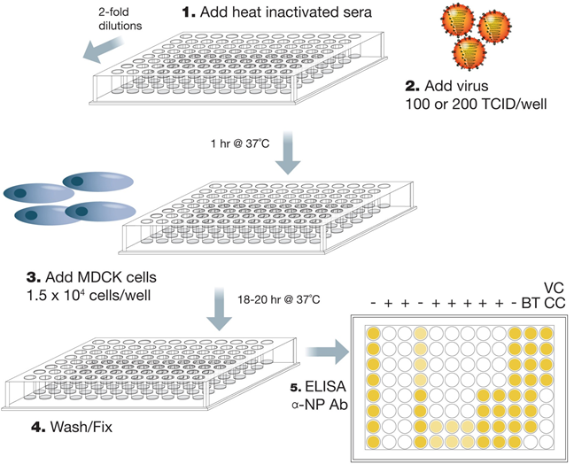
Microneutralization Assays
Neutralization assays detect antibodies that can block influenza virus replication cycle
Notes:
No citation for image.

Slide 30
Microneutralization Assays
CDC / WHO Microneutralization (MN) Assay
Widely used for influenza human serology
Utilize MDCK cell line or derivatives, readout of virus replication by NP ELISA, 2 day assay
Directly measure antibodies that neutralizes influenza virus, but more difficult to perform than HI
Primarily detects Ab that bind around globular head and block virus attachment / entry into cell; may also detect broader range of antibodies that bind elsewhere on HA

Slide 31
Considerations for Influenza Serology
For sero-diagnosis, viruses that antigenically match the local circulating viruses where the sera were collected should be used
Reference regional influenza surveillance data to determine the appropriate viruses to use for serology
Timing of paired sera collection
Prior exposure / vaccination history
Understand consistent / discordant results between serology versus PCR

Slide 32
Influenza Serology for Influenza A(H7N9)
When handling A(H7N9) viruses or antigens for serology, always follow appropriate biological safety regulations
Interpret serological results in the context of clinical and epidemiology background
Questions? Contact influenza division, CDC: Dr Min Levine mwl2@cdc.gov

Slide 33

Discussion Questions
Given the resources and laboratory capacity in your country or location, what diagnostic method(s) would you recommend for routine influenza diagnosis?
How might a large burden of cases, in the event of an influenza epidemic / pandemic, affect your recommendations for diagnostic methods in your country or location?
Notes:
Facilitator notes: Take 5 minutes to lead a brief discussion with the entire group. Ask participants to volunteer to share their recommendation for diagnostic methods for routine influenza diagnosis. Answers will likely vary by location, given the availability of resources and laboratory capacity.
If there is still time, also discuss the second question. (this question will be animated on the slide so the facilitator can show it only if there is time)

