Slide 1
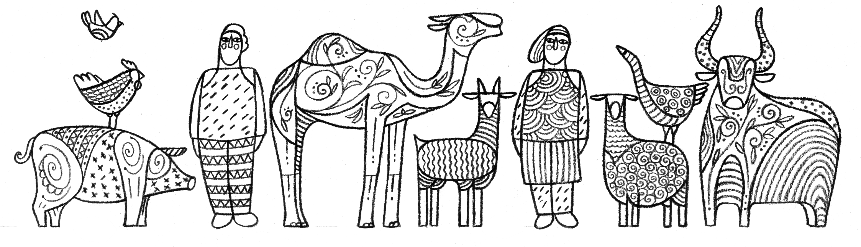

Slide 2
Module V1
Value Chain Analysis as a Basis for Animal Disease Surveillance and Response
Notes:
Value chain definition
FAO's definition ("Designing and implementing livestock value chain studies'):
Value chains are the linked groups of people and processes by which a specific commodity is supplied to the final consumer. These chains have inputs that are used to produce and transport a commodity towards a consumer; this is the supply chain. The value chain encompasses more than the production process; value chain as a term implies a flow of information and incentives between the people involved. Money is sent from the consumer to the different people in the chains to complete the value chain.

Slide 3
Learning Objectives
Understand Value Chain Analysis
Learn about data collection
Learn about data analysis
  Mapping: animal and animal product movements
  Value Chain diagram: risk pathways
Understand utilization
  Surveillance
  Response

Slide 4
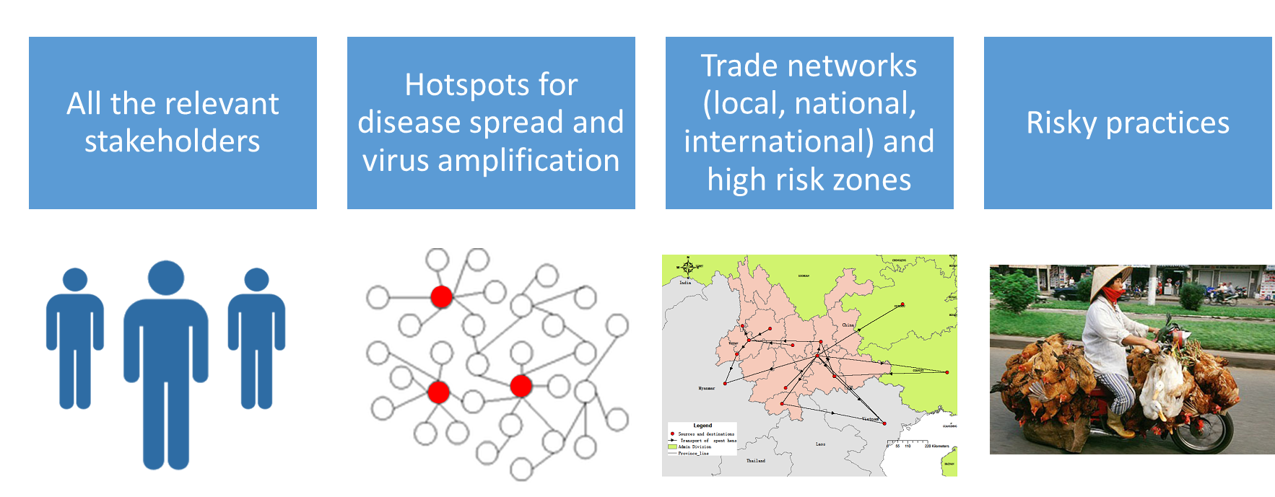
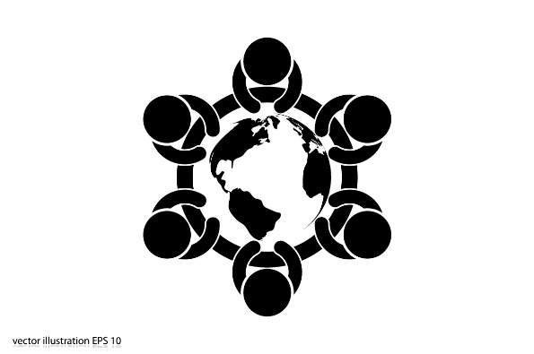
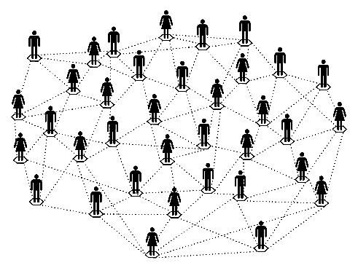
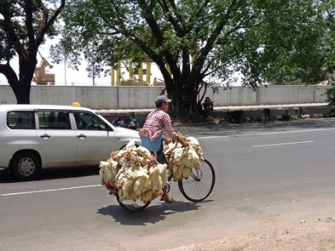

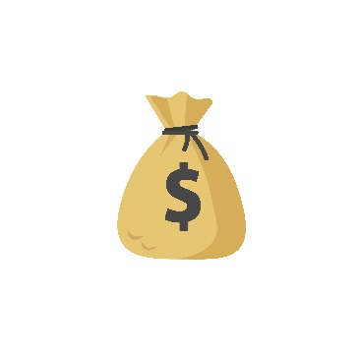
Introduction
VC ARE NOT MECHANISTIC
Individual and social drivers for animal movements
Notes:
Why we used the value chain approach for disease risk management?
Identify relevant stakeholders and understand the role they played
Identify hotspots for disease introduction/spread
Understand trade networks and identify high risk zones (based on risk factors and commercial links)
Understand risky practices and the drivers
*Note: Ideally, VC analysis should be performed before an emergency so critical points are identified and the analysis and the data can be quickly pulled out and be useful during the emergency.
Governance - refers to the relationships among the buyers, sellers, service providers and regulatory institutions that operate within or influence the range of activities required to bring a product or service from inception to its end use.
Response to temporal supply-demand imbalances or Profit-seeking
VC= value chains
Top row images from left to right:
1 Purchased from Shutterstock. Stock vector ID: 533872648
2 Purchased from Shutterstock. Stock illustration ID: 160106708
3 FAO ECTAD (2015). Report on poultry value chain investigation and enhancing biosecurity measures of poultry markets in Guangxi, Hunan and Yunnan (unpublished)
4 Purchased from Shutterstock. Stock photo ID: 397870375 (non-commercial use)
Bottom photo left (scale). Purchased from Shutterstock. Stock vector ID: 747610414
Bottom photo right (money). Purchased from Shutterstock. Stock vector ID: 747610414

Slide 5
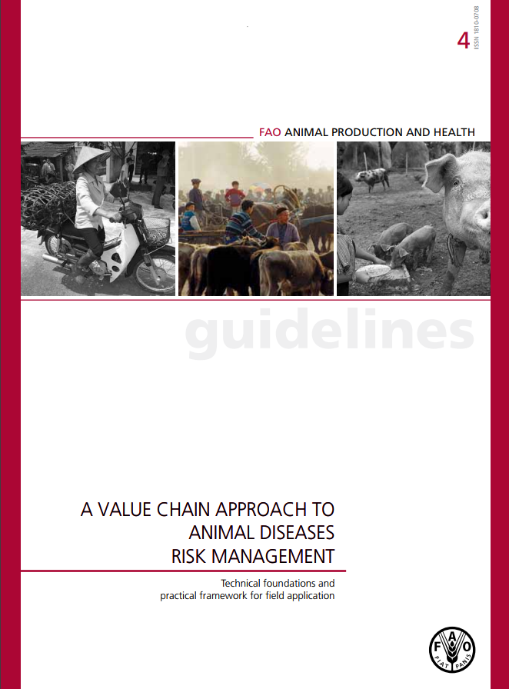
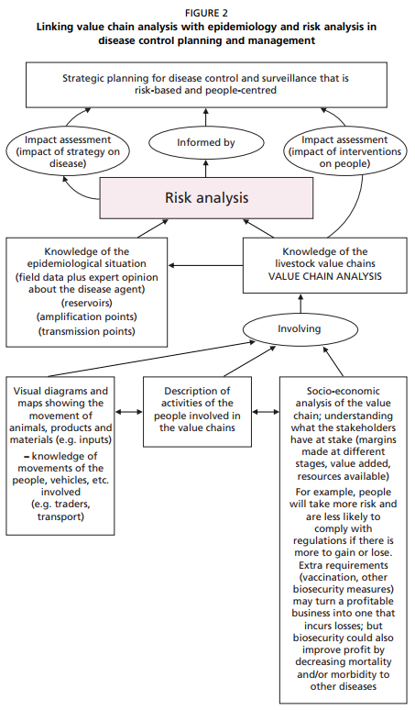
http://www.fao.org/docrep/014/i2198e/i2198e00.htm
Notes:
A general book that explains how to apply the value chain approach into animal diseases risk management and the link with risk analysis.

Slide 6
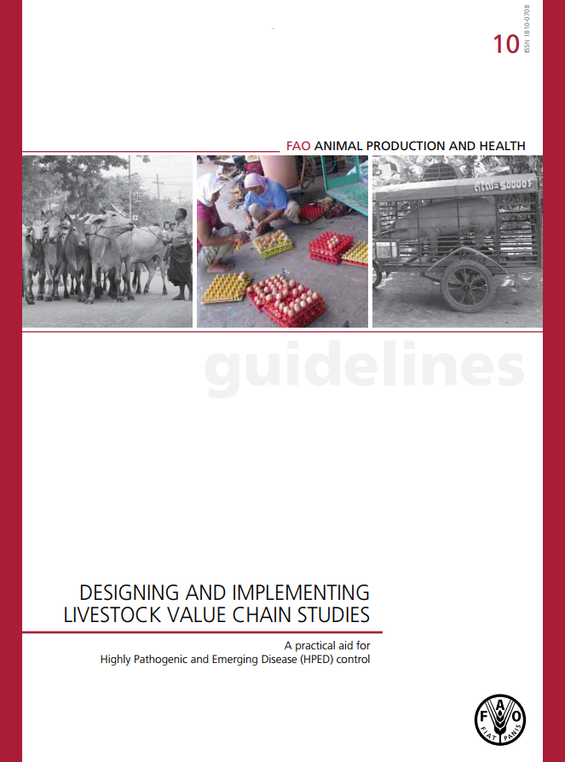
Content
Overview: context of value chain studies
Designing and implementing value chain studies
Some examples of successful application of tools
Final words
http://www.fao.org/docrep/015/i2583e/i2583e00.pdf
Notes:
Short guidelines on how to implement livestock value chain studies, including tools to collect and analyze data

Slide 7
Data collection
Origin & Destination
(Pathway)
Volume
Drivers
How much?
Why?
Seasonality
Species and products
Where?
When?
Practices
What?
How?
Data Collection
Questionnaires
Semi-structured interviews
Focus group discussions
Participatory workshop
Direct observation
Closed & open
Key informants & snowballing sampling
Notes:
The Why? And How? are usually overlooked and they deserve more attention. Challenge: Field of social sciences, which usually is absent in veterinary services.
Why? – Drivers -
at the individual level (why the stakeholders behave as they do?)
at the system level (why are Day Old Chicks (DOC) imported and not locally purchased? (price differentials)
why are animals moved long distances? (availability/scarcity of feed)

Slide 8
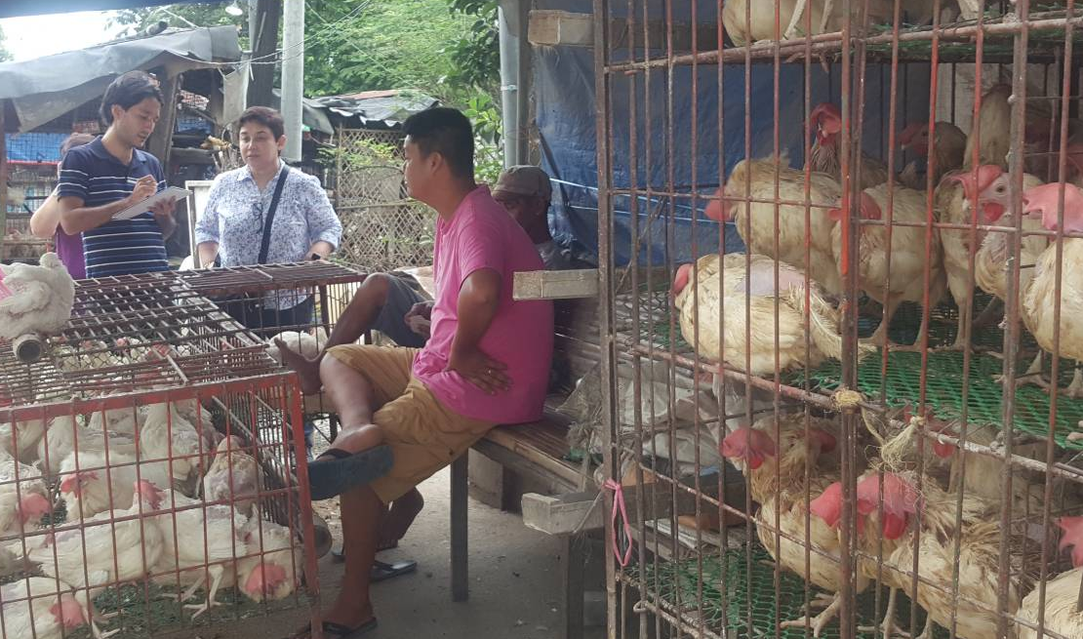
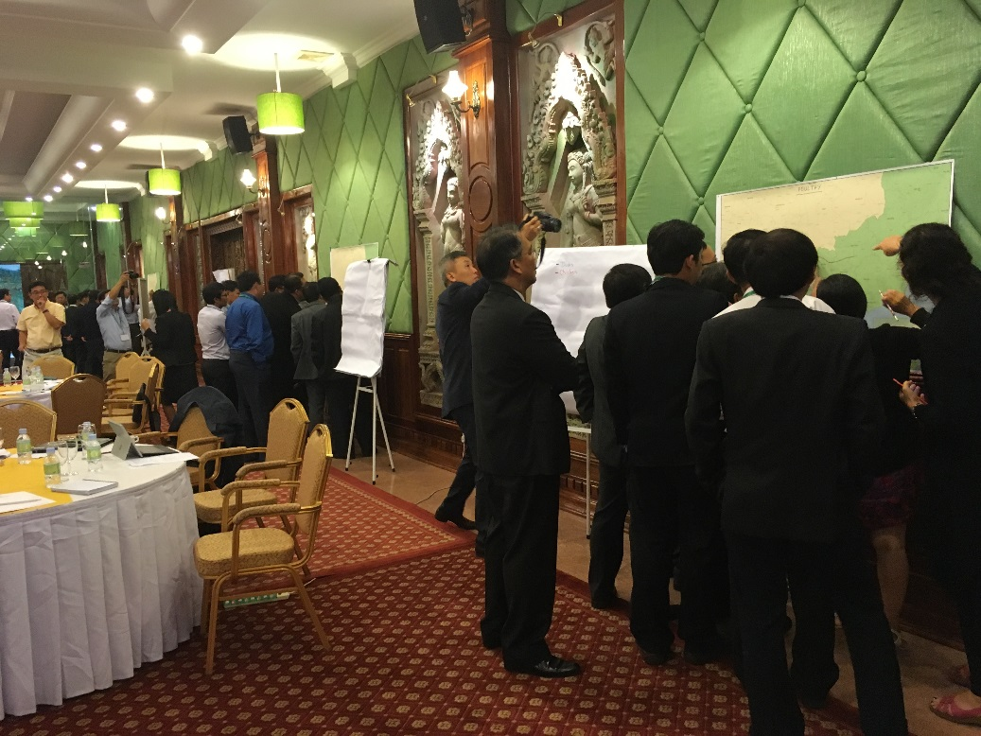
Semi-structured interview (Philippines 2017)
Participatory workshop (Cambodia 2017)
Notes:
Images from left to right:
1 FAO ECTAD (2017). Photo taken while interviewing a poultry trader in Nueva Ecija
2 FAO ECTAD (2017). Photo taken at the 5th Cambodia – Viet Nam cross-border meeting

Slide 9

Discussion Questions
  Do you currently have the information and data required to conduct Value Chain Analysis to improve animal disease outbreak detection and response in your country?
  If not, what data do you need to collect?
Notes:
Facilitator notes: Take 5 minutes to lead a brief discussion with the entire group. Ask participants to volunteer to describe what resources they would need to utilize a value chain analysis.
*Note: Provide some examples if participants do not respond or do not understand the question.
Examples:
Only data on distribution of farms is available but not about their connectivity
Density of animals is only know at the provincial level but not at district or commune level – Need higher resolution of data
No information on live poultry selling points – Need a census or registration system for selling points

Slide 10
Challenges
Language barrier: Hard to collect some valuable information through translators (perceptions / reactions)
  Train local people to collect data
Unofficial movements of animals / animal products (sensitive information)
  Build trust and ensure confidentiality
  “What do your neighbors do?”
Hard to get in touch with all the relevant stakeholders, especially traders (mobility)
  Local authorities usually know who the key players are
Time-frame: Recall bias

Slide 11
Discussion Question
  Are there any other challenges you have faced in your country / location when doing a value chain analysis?
Notes:
Facilitator notes: Take 5 minutes to lead a brief discussion with the entire group. Ask participants to volunteer to describe challenges they have faced when doing a value chain analysis.
Examples: Actors unwilling to participate in surveys; Sensitive information (illegal trade) hard to collect; Too many actors (do not know where to start)

Slide 12
Data Analysis
Mapping
Objective: Identify the pathways for movements of animals and animal products
Sometimes identifying the pathway can be very challenging, so in practice we focus on the origin and destination of such movements
Very powerful tool to:
  Identify high-risk areas
  Identify information gaps
  Communicate (some of) the results of VC studies

Slide 13
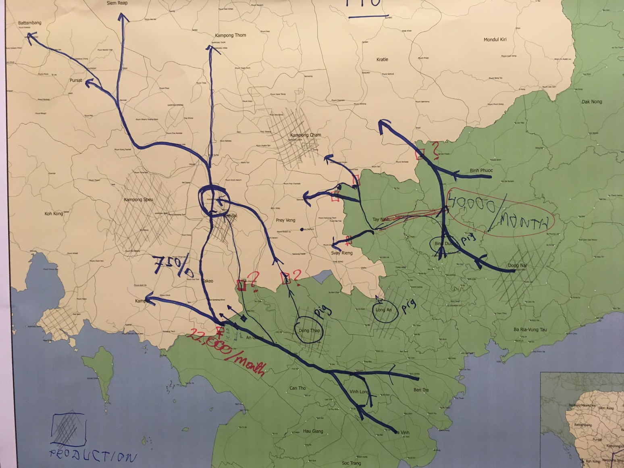
Notes:
Pieces of information: Routes for animal movements, production areas, crossing points, volume moved, + information gaps.
In the map:
Pig movements in the Northern part ~ 40,000 per month
Pig movements on the Southern part ~ 22,000 per month (75% travels farther away into central Cambodia)
Image: FAO ECTAD (2017). 5th Cambodia – Vietnam cross-border meeting (October), output of group exercise on mapping pig cross-border movements

Slide 14
Data Analysis
Value Chain Diagram
Objective: Identify the connections between different stakeholders and how animal disease risk spreads along the value chain
It is very useful to identify critical control points where interventions can be targeted
Spatial information is not reflected
  Spatial information is possible but can over-complicate the diagram

Slide 15
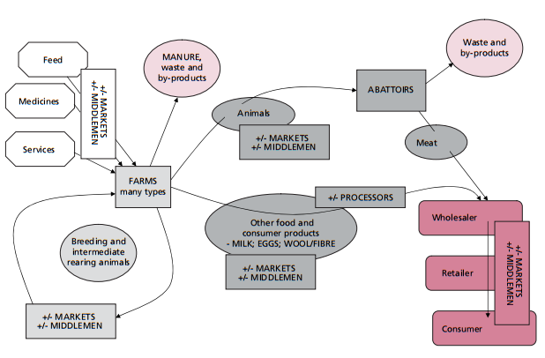
Example 1. Generic framework for livestock value chain
Notes:
Rectangles represent stakeholders
Circles represent products being moved (inanimate inputs in hexagons)
Farms obtain inputs (feed, medicines, services and live animals) through markets and middlemen. They produce manure and other by-products (whose VC is not further explored in this diagram).
Farms sell livestock through markets and middlemen, and their final destination is the slaughterhouse. Slaughterhouse sell their meat to wholesalers
Farms sell livestock products (milk, eggs, wool) through markets and middlemen to processors, who then sell final products to wholesalers.
The final products flow from wholesalers to retailers to the final consumer via middlemen and markets.
Image: in FAO (2011). A value chain approach to animal diseases risk management. Pp. 10

Slide 16
Example 2. Generic value chain for smallholder chicken production
Smallholder farmer
Resell
Sell
Trader
!
Export
Wholesale LBM
Legal
Domestic Processing, Sale and Consumption
Retail LBM +/- slaughter
Illegal
Consumer +/- slaughter
Transboundary Movement
Notes:
Farmers sell their birds to traders. Part of these birds are resold to other smallholder farmers, and the rest is split to meet local and foreign demand.
Chicken destined to other countries are moved through legal and illegal channels.
The birds destined to local consumption are sold by traders to wholesale LBM vendors. Traders can also buy live birds from wholesale LBM when needed.
From wholesale LBM, chickens are moved to retail markets. Some of these chickens are slaughtered and sold as meat, but some others are sold alive to consumers, who slaughter them by themselves.
Traders usually play a very important role in the spread of diseases since they create bottlenecks where poultry from different sources are gathered. They are the bridge between producers and consumers and there is a relatively small number of traders (compared with consumers or producers), so they are an interesting stakeholder to target risk mitigation measures, including awareness campaigns and trainings.
Image: FAO ECTAD (2017). Example developed for a FETPV lecture.

Slide 17
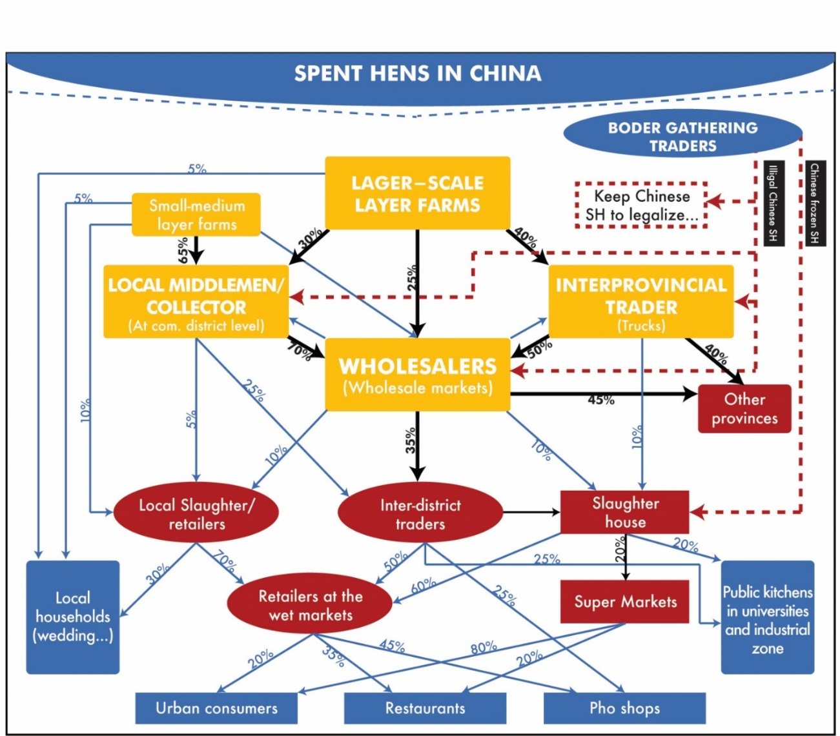
Example 3. Spent hens value chain in Vietnam (2013)
BORDER GATHERING TRADERS
LARGER - SCALE
Notes:
Spent hens smuggled from China are the point of entry for infectious pathogens.
- According to this diagram, the spent hens put other poultry at risk when they get mixed together by middlemen, traders or at the wholesale market
- Producers (large scale and small-medium layer farms) can be at risk when traders or middlemen collect their spent hens if they do not clean/disinfect their vehicles properly and no biosecurity is in place at the farm to avoid any contamination through fomites.
Stakeholders of other provinces are put at risk through wholesale markets and interprovincial traders
The final consumers of spent hens are local (rural) households, urban consumers, restaurants, pho shops (street food vendors) and public kitchens. While some of these consumers buy chicken meat, others prefer to buy live chickens (e.g. Pho shops owners buying spent-hens from inter-district traders).
Facilitator note: Spent hens are old laying hens: a by-product of egg and hatching egg production. While broiler chickens are raised for meat consumption, spent hens are raised to lay eggs, and when their productivity declines, they are processed for their meat.
Image: FAO ECTAD (2010). Unpublished data

Slide 18
Utilization
Prevention:
  Risk-based surveillance – identify hotspots for disease introduction in order to rapidly detect through active surveillance
  Target interventions – campaigns to raise awareness, trainings
Rapid response to an outbreak:
  Trace-back the origin of the outbreak (outbreak investigation)
  Send early alerts to areas that are at high-risk – avoid spreading
  Implement animal movement controls (where to locate the checkpoints?), and intensify surveillance in high-risk areas
Notes:
This slide discusses how value chain data can be utilized.
Remember that for LPAI viruses such as Asian lineage A(H7N9), human infections may serve as sentinels for poultry outbreaks. Coordination between human and animal health authorities is critical.

Slide 19
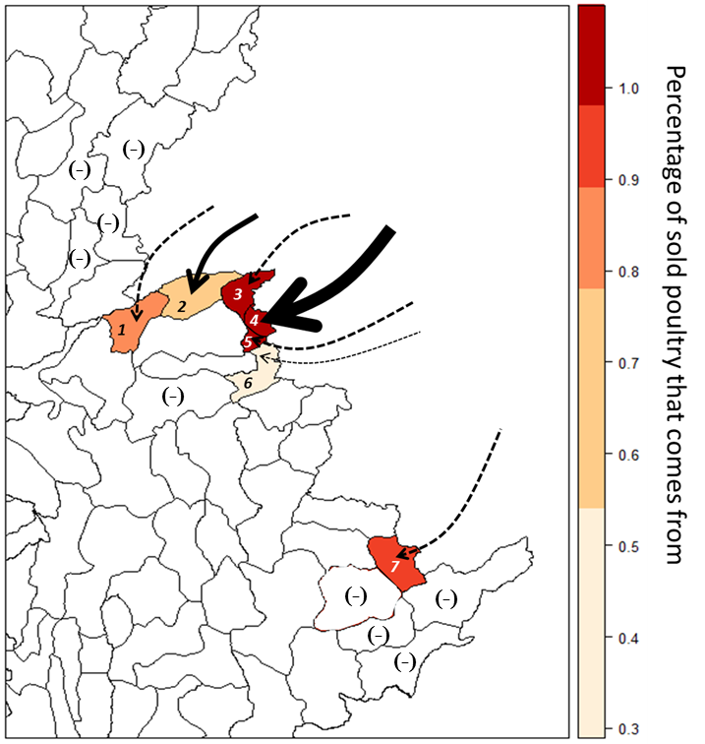
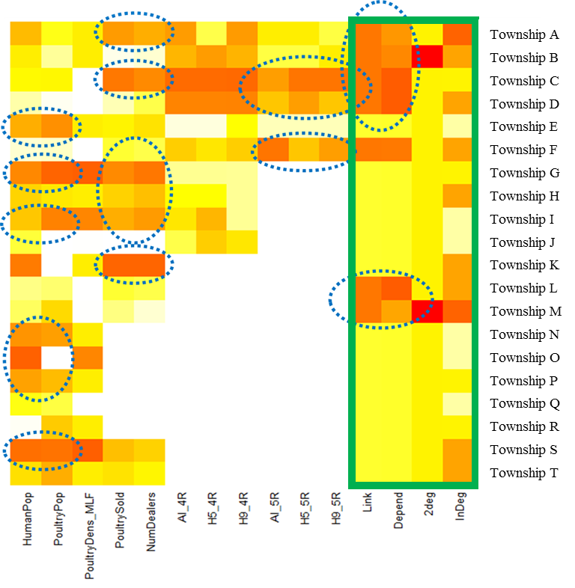
No evidence of poultry travelling to further townships
Notes:
Real example of how to use value chain data to design surveillance systems
Left hand side: Arrows represent incoming poultry from neighboring infected country. The width of the arrow represents the volume and the color of the township/district represents the share of poultry sold in that township/district that is coming from the neighboring country. Additionally, from the value chain study, there is no evidence of poultry travelling farther away, i.e. the imported poultry is to meet local demand. Townships/districts with “(-)” are those where value chain information was collected but there is no evidence of poultry being imported. According to this information, township/district #4 should be targeted for surveillance, followed by 3, 5, and 2.
Right hand side: Value chain information should be complemented with information on other risk factors, such as human population, poultry density, number of dealers and/or markets and previous surveillance results. In the green box at the right of the heat map we have the variables related to the value chain: Link (binary variable = 1 if there is a trade link with neighboring country), Depend (numeric variable - reliance on imported poultry), 2deg (binary variable = 1 if the corresponding township is connected to neighboring country by 2nd degree), InDeg = Indegree (Social Networks) of the corresponding township.
Images from left to right:
1 FAO ECTAD (2017). Internal report (unpublished data)
2 FAO ECTAD (2017). Internal report (unpublished data)

Slide 20



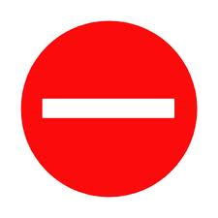
Rapid response to an outbreak:
Trace back the origin
Village C
Send early alerts
Target interventions
!
!
Village D
Market 2
Young birds
!
Village B
Village A
Notes:
The virus is detected in a market and the market is closed
Using VC data we can quickly identify which villages source the infected market, which facilitates the outbreak investigation to trace back the origin of the infection.
Using VC data we can send early alerts (exclamation marks) to villages or market that are at risk due to their commercial connection with infected premises.
Finally, interventions can be targeted at high-risk areas (due to their connection through the VC) to avoid further spread of the disease (exa. checkpoints between village A and D to enforce movement restrictions).
Image: FAO ECTAD (2018). Unpublished image.

Slide 21
Thank You

