Slide 1


Slide 2
Module V2
FAO Guidelines for comprehensive avian influenza active surveillance in Asia

Slide 3
Learning Objectives
Understand the objectives and the guiding principles and recommendations for the development of active, comprehensive, risk-based avian influenza surveillance
Describe the criteria for selecting areas, sites, target species /animals, and sample types for active avian influenza surveillance
Learn about avian influenza surveillance sample sensitivity, frequency of sampling, reporting of results, and risk communication

Slide 4
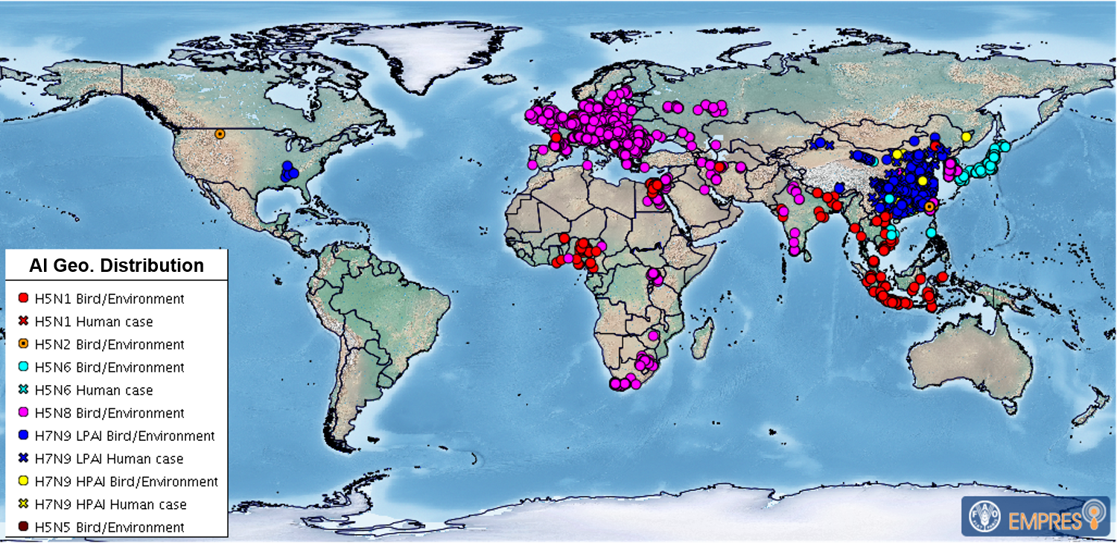
Geographical Distribution of Main Avian Influenza viruses
October 2016 – October 2017

Slide 5
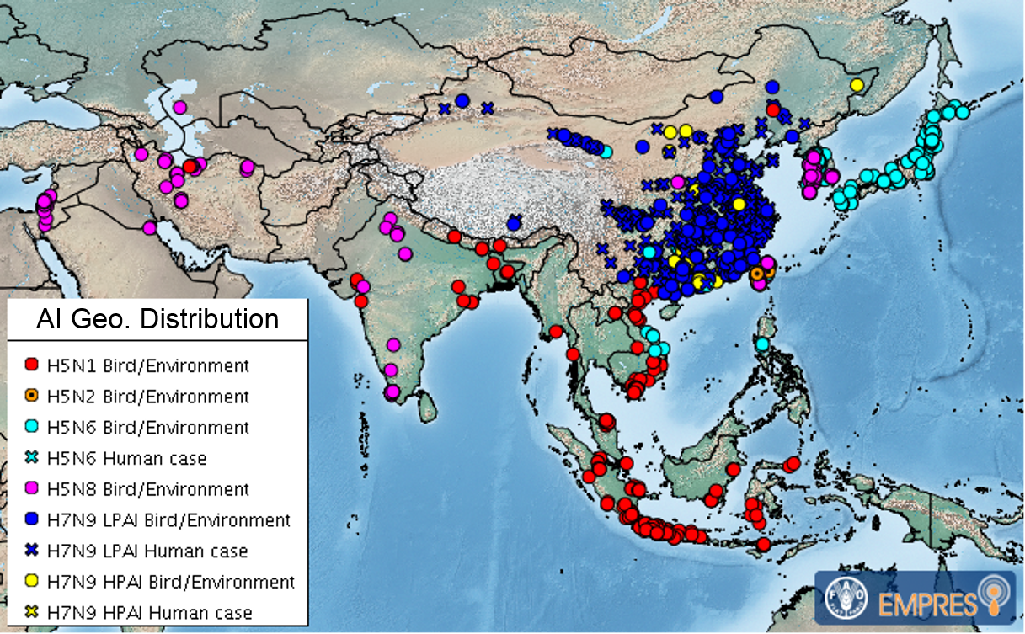
Geographical Distribution of Main Avian Influenza viruses
October 2016 – October 2017

Slide 6
Avian Influenza Active Surveillance: Need for a Comprehensive Approach
Emergence of new strains of avian influenza (AI) viruses over the past few years, in particular a LPAI strain (H7N9) as a public health pathogen of concern
Need for a more comprehensive approach and to expand the scope of the previous strategies to HxNy sub-types and in particular to sub-types of interest in the region: H5Ny, H7N9 and H9N2
Build on lessons learned and expertise from subtype-specific surveillance projects (H5N1, H1N1, H7N9)

Slide 7
Avian Influenza Active Surveillance in Asia
Regional approach:
  Active surveillance
  Risk-based approach
  Comprehensive
  Aim for cost-effectiveness

Slide 8
Surveillance
Data from:
Poultry population, production and value chain analysis, historical outbreaks, outbreaks in neighboring countries
Surveillance objectives
Action for risk reduction
Surveillance Results
Incl. sequencing
Surveillance Design
Positive
Negative
Surveillance
Cycle
Risk
Assessment
Data on: Production and marketing practices; behaviour
Surveillance Implementation
Notes:
Planning for surveillance is an iterative process. The first step is to define and agree on objectives of surveillance, i.e. specific questions that surveillance results should help answering. All relevant data already available (e.g. poultry population, production and value chain analysis, historical outbreaks) must be used for risk assessment to determine risk factors that will help in targeting the surveillance design and optimizing sample collection for a cost-effective approach (e.g. focusing on certain animal species or production systems, targeting geographic areas of higher risk, etc.). Results obtained from surveillance (negative results can be as important as positive results), including sequences, analysed together with data on production and marketing practices or people’s behaviour can be used to devise actions for reducing exposure risks and contain disease spread (risk reduction). Thus, surveillance is key to timely response as well as efficient disease prevention and control. The questions and objectives of surveillance must be periodically revised and the design may need to be adapted in order to fit the constantly changing avian influenza situation in a country or region.

Slide 9
Comprehensive AI Active Surveillance: Objectives
Assess whether and where AI viruses of interest (H5Nx, H7N9, H9N2) are circulating in poultry value chains to inform risk management
Early detection of incursion of new viruses (e.g. H7N9) in non-endemic countries for rapid and efficient containment
Monitor effectiveness of control programs, including decision making on vaccination strategy
Provide genetic information on circulating strains for molecular epidemiological analysis as well as vaccine matching in vaccinating countries
Raise awareness among different actors along the poultry value-chain
Notes:
AI surveillance is for early detection of H7N9 introduction but it is not only this – it is a comprehensive approach.

Slide 10
Comprehensive AI Active Surveillance: Design
No “one fits all” approach
Country specificities to take into account
Balance between costs and benefits/outputs
Attempt to harmonize surveillance programmes within the region to generate data that are meaningful and comparable at a regional level

Slide 11
AI Active Surveillance: Area Selection
Key criteria for area selection:
- Introduction of poultry from known infected areas
- Geographically close to a known infected area
- High poultry density
- High importance for poultry production
- High number and frequency of poultry movements
- Intense trade
- History of AI outbreaks
- Already known to have different AI viruses circulating
- Vicinity to wild bird congregation sites or major flyways
Value
Chain
Analysis
Notes:
This slide presents suggested criteria for selecting areas for active avian influenza surveillance.
The choice of criteria to use for area selection is country specific (some countries may not have regular introduction of poultry from known infected area; some may not have wild bird major flyways; value chain data might not be available and/or up-to-date…).
If several criteria are to be used, a prioritization approach can be taken with in-country subject matter experts scoring each of the criteria and have a final score of the sum of the independent scores, to cite an example.

Slide 12
AI Active Surveillance: Site Selection
Key criteria for sampling site selection
  Live bird markets (LBMs)
    - Strong connections to the national market network
    - Large throughput of poultry
    - Large number of traders from different origins
    - Poor biosecurity
  Farms, villages or poultry gathering sites with imports from known infected areas
  Slaughterhouses / slaughter points
Notes:
Most countries target their risk-based surveillance system at LBMs. These are the criteria for site selection for active avian influenza surveillance.

Slide 13
Discussion Questions
If you were tasked with building a new active surveillance program for AI in your country / region, where would you start (i.e. what areas or types of facilities would you focus on initially) and why?
What are the likely barriers (if any) to establishing or continuing a comprehensive active surveillance system for AI in your country / region?
Notes:
Facilitator: please take 5 or more minutes to go through these questions with participants.

Slide 14
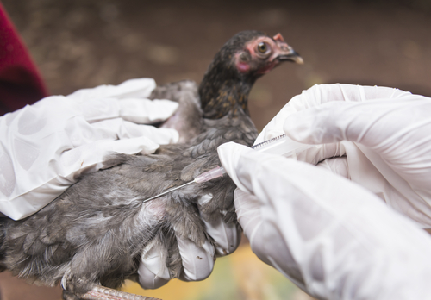
AI Active Surveillance: Sampling Target
Species
Chickens, ducks, turkey, quail, pigeons and farmed waterfowl (representative of the sampled site)
Prioritized sampling
Dead birds or those showing clinical signs
Notes:
These are the criteria for selecting target species or animals for avian influenza active surveillance.
Image: Purchased from Shutterstock. Stock photo ID: 694360045

Slide 15
AI Active Surveillance: Sample Types
Virological surveillance
  Samples (poultry)
    Oro-pharyngeal swabs
    Pools of 5 samples (same species, same stall / barn / yard) to be pooled at the laboratory
  Samples (environment)
    Swabs of cages, waste water, bins, faeces, display tables, cutting boards...
    Pools of 5 samples (from same area) to be pooled in the field
Notes:
These are the criteria for selecting sample types for active avian influenza virological surveillance….

Slide 16
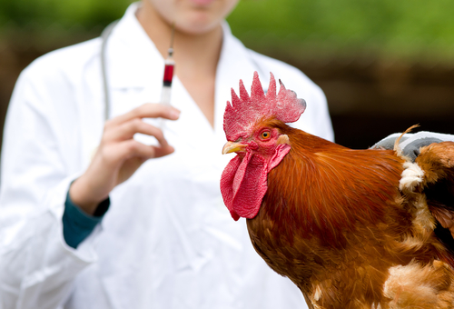
AI Active Surveillance: Sample Types
Serological surveillance
  Samples (blood)
    e.g. in slaughterhouses or farms (for unvaccinated populations)
    Limited value for H7 (with vaccination now ongoing in China)
  >> Not recommended in LBMs - high turn-over of poultry and lack of efficient traceability
Notes:
These are the criteria for selecting sample types for active avian influenza serological surveillance….
Image: Purchased from Shutterstock. Stock photo ID: 273937919

Slide 17
AI Active Surveillance: Sample Size
Herd sensitivity according to real virus prevalence and sample size
Test sensitivity: 98%, pool size: 5, total population unknown (Ref: Epitools® - http://epitools.ausvet.com.au )
True prevalence of infection in the sampled site |  | 10% | 5% | 2%
Probability of detecting infection (at least 1 positive test) | 12 pools (60 samples) | >99% | 95% | 69%
 | 10 pools (50 samples) | >99% | 91% | 62%
 | 6 pools (30 samples) | 95% | 77% | 44%
Note: If we double the information sources by taking poultry and environmental samples → herd sensitivity increases
Notes:
The sensitivity of a surveillance system increases as the number of sampled animals increases, but so do costs as well as the human/logistical resources needed to undertake it. A good surveillance system must be cost effective and practicality should always be considered when designing the sampling scheme.
The sample size depends mainly on the prevalence we wish to be able to detect, the desired herd-sensitivity (i.e. the confidence index we want to reach to make sure the infection has not been missed, usually equal to 95%) and the sampling design. The lower the expected prevalence, the higher the number of samples required and therefore the higher the cost.
Increasing herd-sensitivity also implies an increased sample size. Therefore, a certain balance has to be found between the aimed prevalence, the desired herd sensitivity and the resources and capacities available to collect and test the samples.
This table shows the herd sensitivity for detecting avian influenza in the selected sampled site based on the true prevalence of infection at the site and the number of sample pools taken.
For a good cost-effectiveness ratio, a minimum of 30 oropharyngeal samples [6 pools of 5 samples] from each poultry species at the selected sampling site shall be collected. At a 10 percent infection rate there would be a 95 percent chance of detecting the virus. At a 2 percent infection rate, there would only be a 44 percent chance of detecting the virus.

Slide 18
AI Active Surveillance: Sampling Frequency
Depends on several factors, mainly:
Risk level: Season, holidays / cultural events
Resources available: Funds, human resources
Field access: For sampling team, for sample transport to the lab
Laboratory capacity: To receive and test samples in a reasonable time frame (ideally less than 72 hours after sampling)
Example for a country at high-risk of AI virus presence:
High risk season: once every two weeks
Low risk season: once a month
>> Country-specific: what is feasible?
Notes:
Sampling frequency for avian influenza active surveillance will depend on several factors.

Slide 19
AI Active Surveillance: Data collection
Data collection concerning the selected site, the poultry populations tested and the samples taken shall include:
Site information | Type of site (LBM, slaughterhouse, production farm, parent stock/breeding farm, hatchery...)
 | Name and Location of the site (City, County, Province)
 | GPS coordinates
 | Name, address, telephone number and email of the site manager
 | Date of the sampling
 | Total number of samples collected
 | Name and contact (phone) of the sampler
Epidemiology information | Total poultry population at the site
 | Poultry species present at the site (type and number)
 | Are species mixed or segregated?
 | List sources of poultry, together with movement frequency
 | List destinations of poultry, together with movement frequency
 | List biosecurity measures in place
 | Is poultry slaughtered on-site?
Sample information | Poultry samples: Species, breed, type and age of the animal
 | Environmental samples: which type? Cages, baskets, processing table...
 | Traceability, number of animals or farm/location of origin (if available)
Case information | Case history, if known (clinical signs, ...)
 | Overall morbidity and mortality
For farms (in addition to the above) | Production type
 | AI vaccination status
Notes:
When conducting sampling in the field, accurate data should be collected concerning the selected site, the poultry populations tested and the samples taken.

Slide 20
AI Active Surveillance: Sample collection
Samples collected in the field must be clearly labelled on the tube/vial with a unique number that can be traced to the minimum following information:
Species
Type of sample
If a pooled sample, the number of individual samples inside the pool
Sampling date
Sample site location

Slide 21
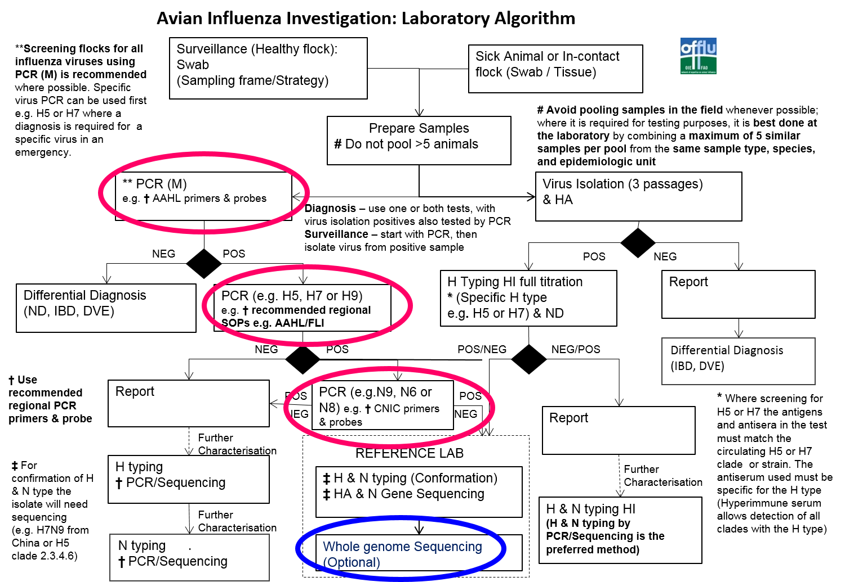
AI Active Surveillance: Laboratory Testing
or environmental samples

Slide 22
AI Active Surveillance: Results
Surveillance results to be:
Summarized on a regular basis
Shared and discussed with all stakeholders (multi-sectoral)
Interpreted in the national and local context (e.g. LBM or farm management) in a multi-sectoral process
Useful for decision makers
>> Any actions that would be implemented following the detection of positive results should be discussed and agreed with concerned stakeholders in advance.
Notes:
These factors are important to consider when looking at avian influenza active surveillance results….

Slide 23
AI Active Surveillance: Risk Communication
Continuous risk communication (before, during and after surveillance activities)
Stakeholder ownership and involvement
Raise awareness about
  Risks posed by avian influenza to stakeholder livelihoods
  Measures people can take to reduce those risks via clear information on the disease and risk mitigation measures, including biosecurity

Slide 24
Discussion Questions
  In your country or region, which key groups or stakeholders should be involved in active avian influenza surveillance: planning and implementation, reporting of results, and risk communication?
  In your country or region, how might you get key multi-sectoral stakeholders more involved in active avian influenza surveillance?
  In your country or region, how have you communicated effectively with multi-sectoral stakeholders about active avian influenza surveillance?
Notes:
Facilitator: please take 5 or more minutes to go through these questions with participants.

Slide 25
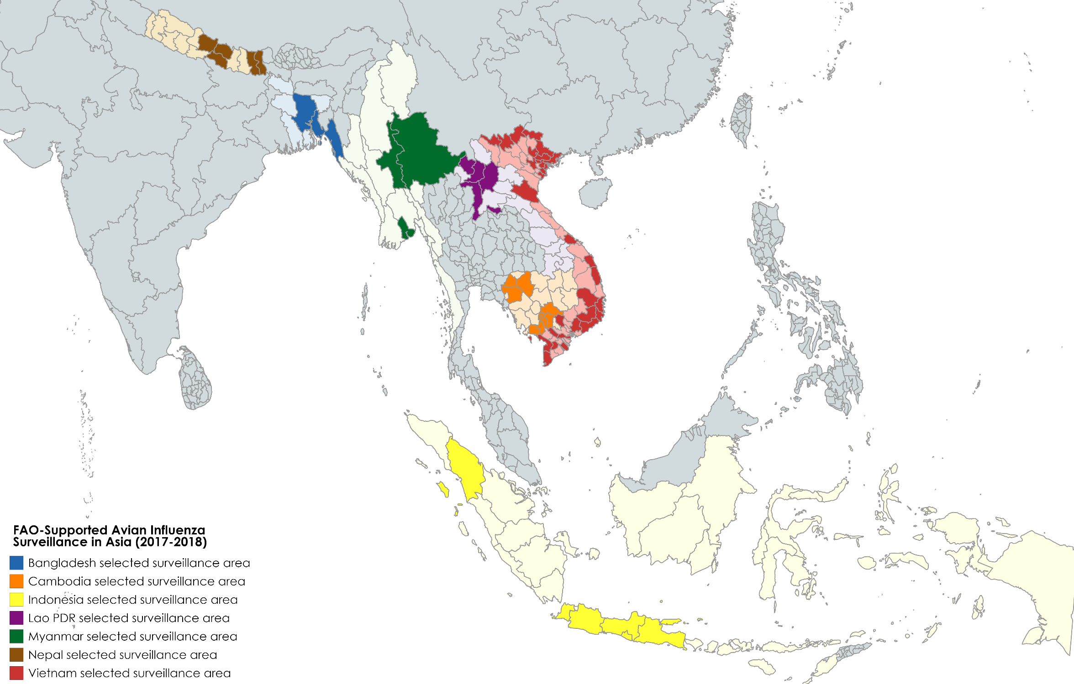
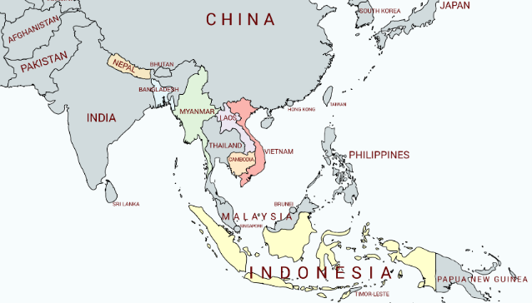
FAO-Supported Active AI Surveillance in Asia
Notes:
FAO is providing support to countries of the region in designing and implementing AI active surveillance, following these guiding principles and recommendations. Maps show areas targeted for active AI surveillance in these countries over the past few years (2015/17).

Slide 26
Examples of FAO-Supported Active AI Surveillance in Asia
Country | Target Areas | Target Sites | Type of samples | Sampling Frequency
Bangladesh | 2 Cities: - Dhaka - Chittagong | - Live Bird Markets (LBMs) | - Environmental swabs (3 pools of 6 samples from 3 market zones) | Once a month
Cambodia | - 6 provinces (NAHPRI): Battambang, Kampong Cham, Kampot, Phnom Penh, Prey Veng and Siem Reap - 3 provinces (IPC): Banteay Meanchey, Kandal and Takeo | - LBMs | - Chicken Oro-pharyngeal (20) + Cloacal swabs (20) - Duck Oro-pharyngeal (20) + Cloacal swabs (20) | - Low risk season: once a month - High risk season: up to 3 times a month during temporal peaks in HP H5N1 corresponding with national festivals
Indonesia | - Greater Jakarta (JABODETABEK) West Java; Banten; DKI Jakarta; - Surabaya-East Java - Medan-North Sumatra - Other DICs also started LBM surveillance with their own budget | - LBMs | - Environmental swabs | - Monthly LBM sampling in Greater Jakarta - Quarterly in other areas
Lao PDR | 5 provinces: - Luang Namtha, - Oudomxay, - Luang prabang - Xayabouly - Vientiane | - LBMs - Village - Collection point - Check point - Farm | - Chicken Oro-pharyngeal swabs (30) - Duck Oro-pharyngeal swabs (30) - Environmental swabs (5) | - Low risk season: once a month - High risk season: twice a month
Myanmar | - 6 border township areas: Kengtung, Mongla, Muse, Laukkaing, Namhkan and Chin Shwe Haw - 2 Inland sites: Yangon LBM, Mandalay LBM | - LBMs - City market - Live poultry collecting point - Poultry processing place | - Chicken Oro-pharyngeal swabs (30) - Duck Oro-pharyngeal swabs (30) - Environmental swabs (30) | Once a month
Nepal | 7 Districts : Jhapa, Chitwan, Kathmandu, Bhaktapur, Lalitpur, Kaski, Sunsari | LBMs Hatch./ Com. Layer Farm, Pig Farms Wild bird interface | - Chicken Oro-pharyngeal swabs - Duck Cloacal swabs - Poultry serum - Environmental swabs | Once a month during High Risk Periods only
Viet Nam | 31 provinces in northern, central and southern Viet Nam including six provinces bordering China | - LBMs | - Chicken Oro-pharyngeal swabs (30) - Duck Oro-pharyngeal swabs (30) - Environmental swabs (40) | Once a month for baseline surveillance during low risk season and twice a month for enhanced surveillance during high risk season
Notes:
Examples of surveillance approaches adopted by some countries in the region

Slide 27
Comprehensive AI Active Surveillance: Conclusion
Extremely active influenza season with co-circulation of different subtypes in the region
>> Countries on alert and maintain ongoing surveillance activities
AI surveillance design to be regularly reviewed to adapt to:
  Evolving disease situation
  Value chain dynamics
  Vaccination strategies (e.g. H7N9 vaccination in China)

Slide 28
Thank you

