Slide 1
Module V3 Avian Influenza and the OIE

Slide 2
Learning Objectives
Learn about avian influenza viruses (AIVs), their transmission factors, and their impact
Learn about the World Organisation for Animal Health (OIE)
Understand the role of the OIE in AIV monitoring, surveillance, detection, prevention and response
Describe the OIE-FAO Global Network OFFLU
Describe key biosecurity recommendations
Notes:
The learning objectives for this module are….

Slide 3
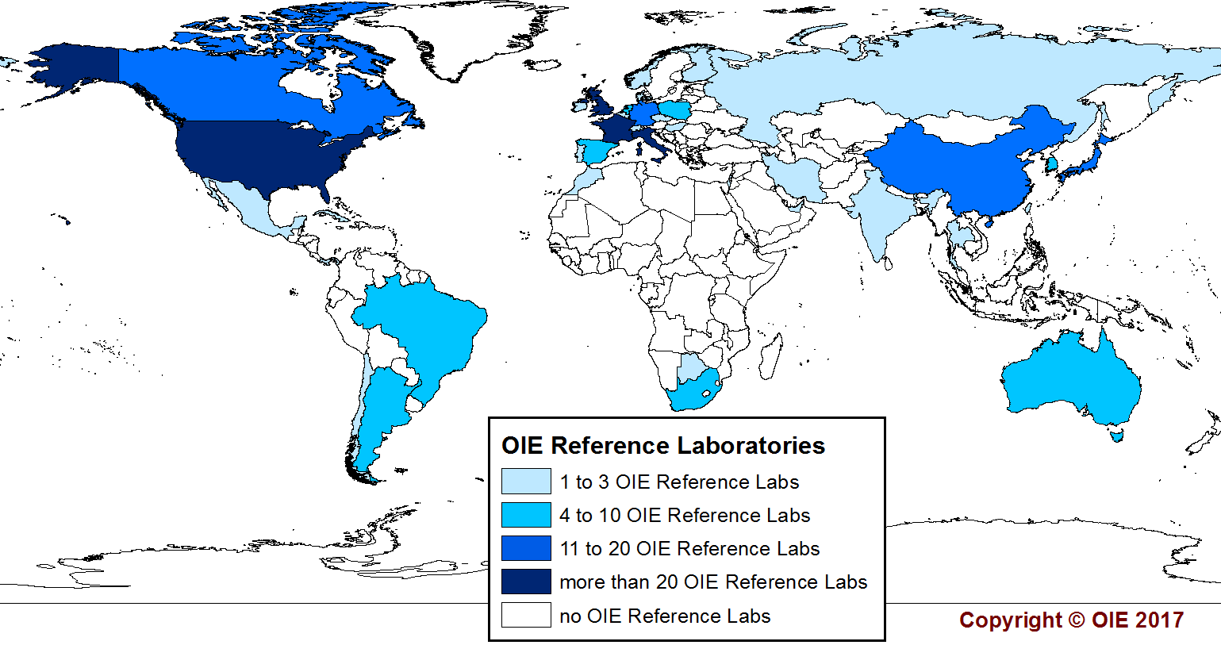
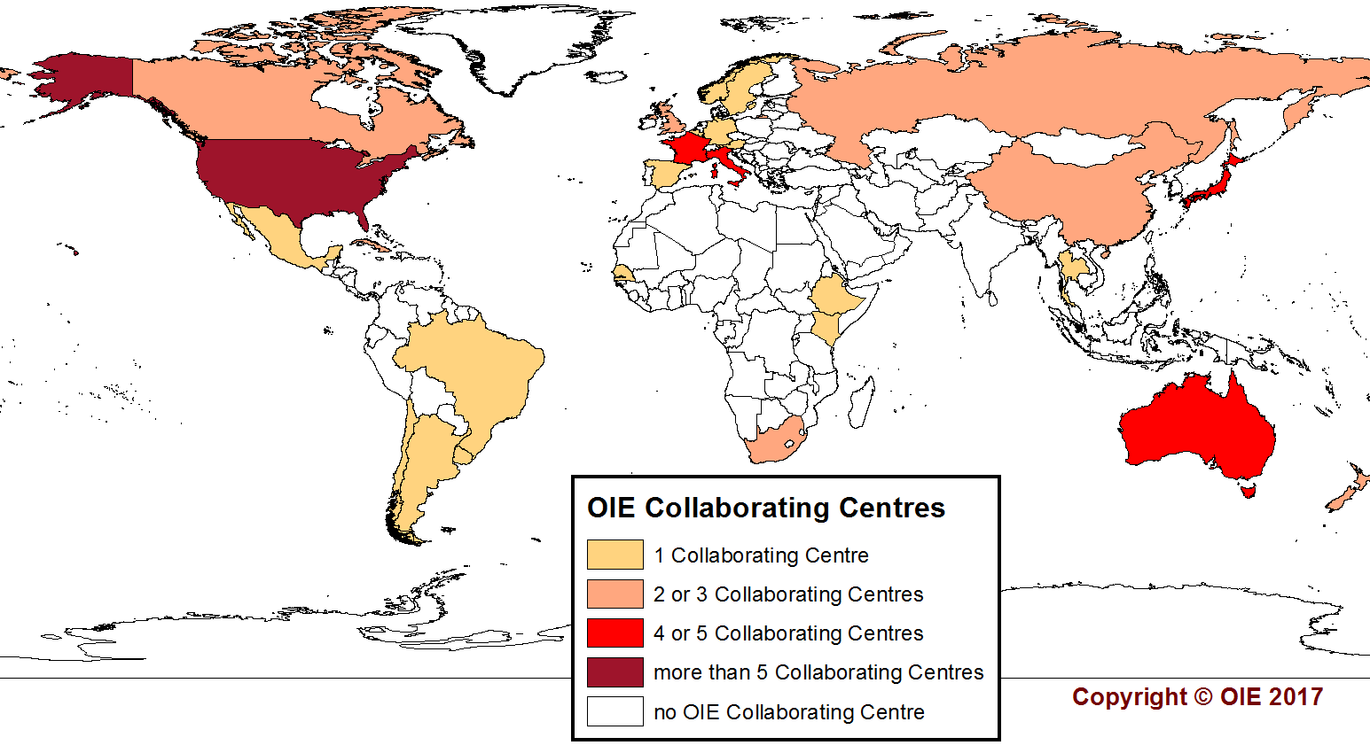
General Mandate
World Organisation for Animal Health (OIE)
To improve animal health and welfare and veterinary public health worldwide
One of OIE’s Main Objectives
To ensure transparency in the global animal disease situation, including for zoonoses
Reference Laboratories
Expert Centres for animal diseases
Collaborating Centres
Centres of excellence on horizontal topics
267 Reference laboratories in 38 countries
118 diseases
55 Collaborating Centres in 29 countries
49 topics
Notes:
It is OIE’s priority to promote transparency and understanding of the global animal disease situation in order to protect public health, and ensure safety of world trade in animals and animal products.
Reference labs and collaborating centers provide policy advice, strategy design and technical assistance for virus control and eradication
Reference Labs: Under the responsibility of an expert
Develop, perform and validate diagnostic tests
Store and distribute reference reagents
Conduct laboratory proficiency tests of samples from other Members’ laboratories
Coordinate technical and scientific studies
Organise technical and scientific training for Member Countries
List of Reference Laboratories validated annually by the World Assembly of Delegates
Support other countries
Specific OIE listed disease
Rapid and accurate diagnosis and agent characterisation
The first to know the cause and source of an outbreak
Collaborating Centres: Contribute to the development of procedures to update and promote OIE international standards and guidelines
Coordinate scientific studies
Provide technical training
Organise and host scientific meetings in collaboration with the OIE
Support other countries
Designated sphere of competence
Technical support, workshops, trainings

Slide 4
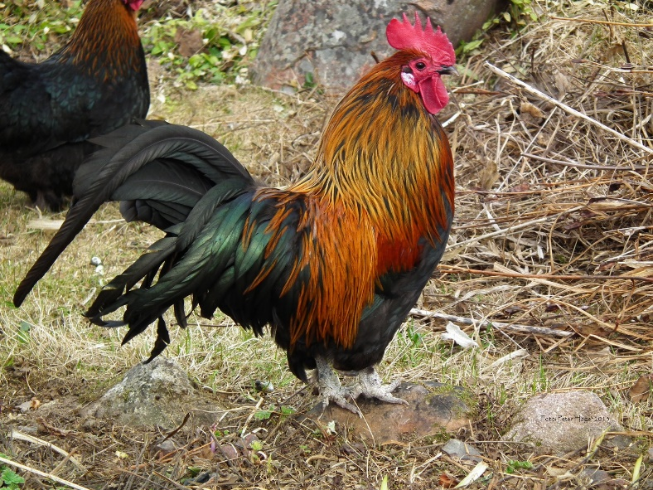
Avian Influenza Viruses
Two categories of viruses:
Low pathogenic (LPAI)
Highly pathogenic (HPAI)
  To date: economically important acute clinical disease has been associated with H5 and H7 subtypes
  Global circulation of strains resulting in ongoing outbreaks
  Some have the capacity to infect humans and other mammals
Notes:
Ongoing outbreaks of AI continue to be a global public health concern- H5N1, H5N2, H5N8, H7N8, etc…
Recombination of an AIV with a human influenza virus could potentially result in a pandemic strain.
Photo source: http://www.publicdomainpictures.net/view-image.php?image=40828&picture=rooster

Slide 5
Avian Influenza Viruses
AI is a notifiable disease listed by the OIE, Member Countries must report:
All HPAI viruses, irrespective of strain, detected in birds (domestic and wild)
All LPAI viruses of subtypes H5 and H7 detected in poultry
Any unusual mortality of wild birds, through OIE WAHIS
Surveillance & reporting
Early detection of disease outbreaks followed by a rapid response.
High level of awareness among veterinarians and animal owners, and high quality Veterinary Services are key
Accurate early warning systems and preventive measures are an essential part of an effective strategy to prevent and control avian influenza
Prevention & control
Biosecurity to prevent introduction from wild birds and to limit the risk of human infection with AI strains that have zoonotic potential
Monitoring and controlling AI at its poultry source is essential to decrease the virus load in susceptible avian species and environment

Slide 6

What Is Reportable?
Any Influenza A virus with IVPI greater than 1.2 (or as an alternative at least 75% mortality)
  Poultry and other birds, including wild birds
All influenza A viruses of H5 and H7 subtypes with low pathogenicity when detected in poultry
Should also report unusual mortality among wild birds
Report through World Animal Health
Information System (WAHIS)
Notes:
LPAI H5 and H7 reportable in poultry because of risk to become highly pathogenic by mutation
Any info on WAHIS?
Photo source: https://pixabay.com/en/telephone-phone-old-ringing-red-158190/

Slide 7
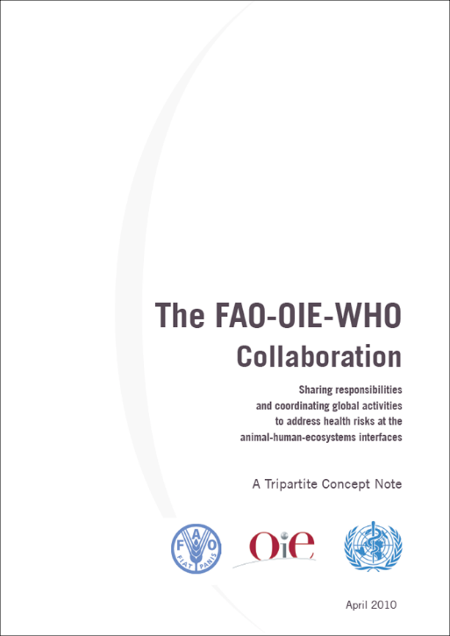
OIE Role in AIV Prevention, Detection & Response
Set internationally recognized, science-based standards, guidelines and recommendations
Reference laboratory network
Collaborating centers
International coordination (Tripartite)
  Food and Agriculture Organization (FAO)
  World Organisation for Animal Health (OIE)
  World Health Organization (WHO)
Notes:
Ongoing outbreaks of avian influenza viruses continue to be a global public health concern- for example: H5N1, H5N2, H5N8, H7N8, etc…
Photo source: http://farm9.staticflickr.com/8152/7602874630_0bcbff70c0_z.jpg

Slide 8
Consequences of AI Outbreaks
High mortality in flocks (often ~50%)
Job losses, especially in developing countries
Risks to animal and human welfare from culling healthy birds
HPAI restricts international trade
Damage to public opinion
Potential for infections in humans
Notes:
Outbreaks of AIVs can have devastating consequences for industry and at a national level. Farmers see high levels of mortality in flocks (often ~50%)
Job losses are an important impact, especially in developing countries. The poultry industry is labor intensive, so fewer birds means fewer jobs. Risks to animal and human welfare may result from culling healthy birds to contain outbreaks. Additional concerns exist regarding protein wastage and economic impacts. HPAI presence restricts international trade and causes damage to public opinion – it can reduce travel and tourism in affected areas. AIV infections in humans sometimes cause severe disease and death.

Slide 9
Monitoring and Surveillance
Southern and Estaern Title

Slide 10
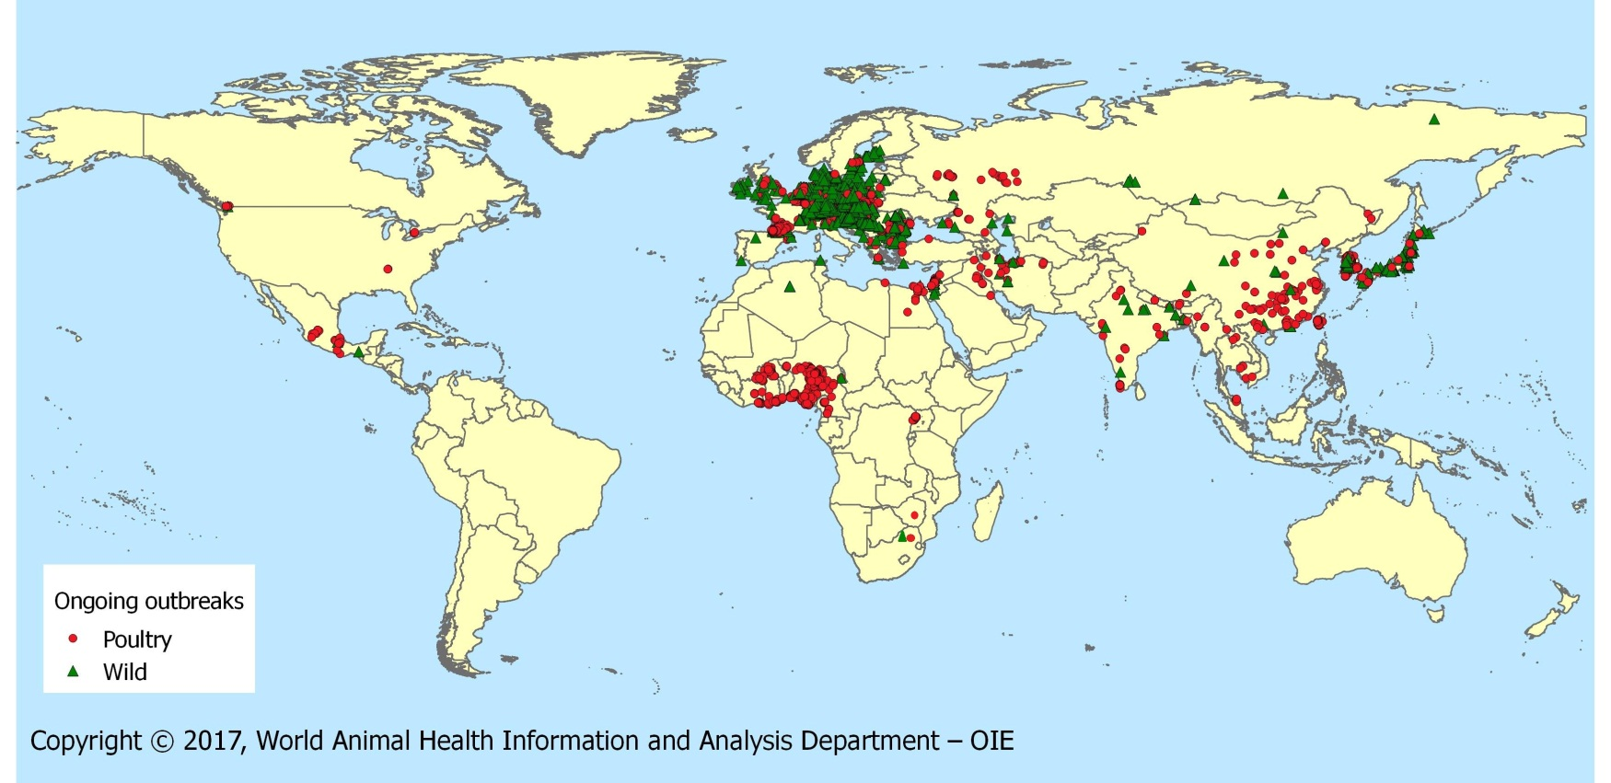
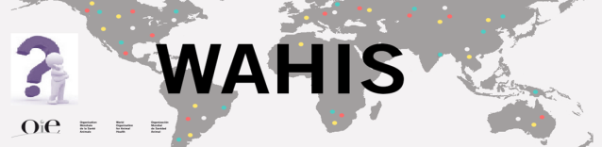
HPAI Outbreaks 2016/2017
05/09/2017
OIE Global Situation Report for Avian Influenza
http://www.oie.int/en/animal-health-in-the-world/update-on-avian-influenza/

Slide 11
HPAI in Asia (2017)
H5N1 – China, Laos, Myanmar, Nepal, Bangladesh, Cambodia, India, Malaysia, Vietnam
H5N2 – Chinese Taipei (since 2015)
H5N6 – Philippines (Aug 2017), Vietnam (Sept 2017), China, Chinese Taipei, Hong Kong, Japan, R. Korea, Laos, Myanmar
H5N8 – Russia, R. Korea, India, Nepal, China, Chinese Taipei
H7N9 – China
Notes:
DONE:

Slide 12
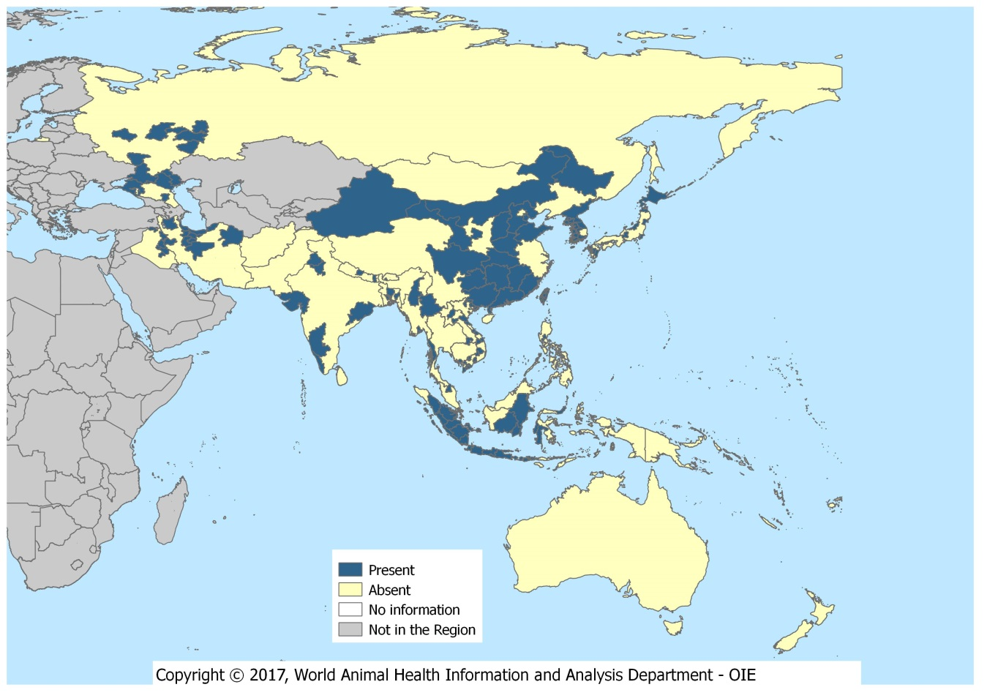
Distribution of HPAI in Asia, the Far East, & Oceania in 2016/2017
(Poultry)
01/10/2017
Notes:
DONE:

Slide 13
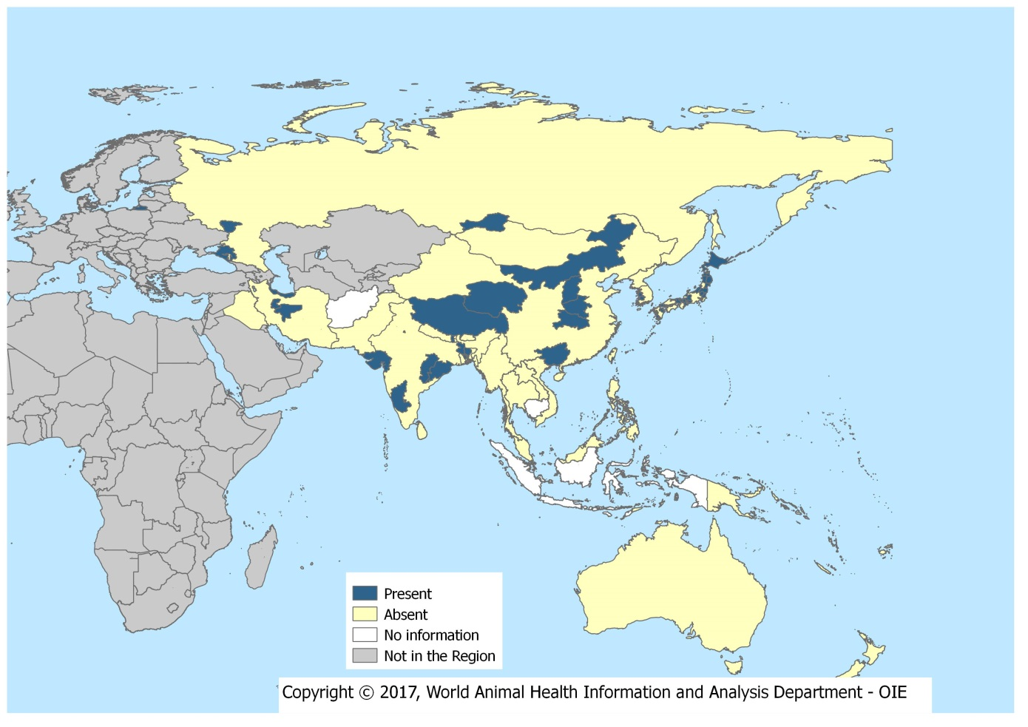
Distribution of HPAI in Asia, the Far East, & Oceania in 2016/2017
(Wild Birds)
01/10/2017
Notes:
DONE:

Slide 14
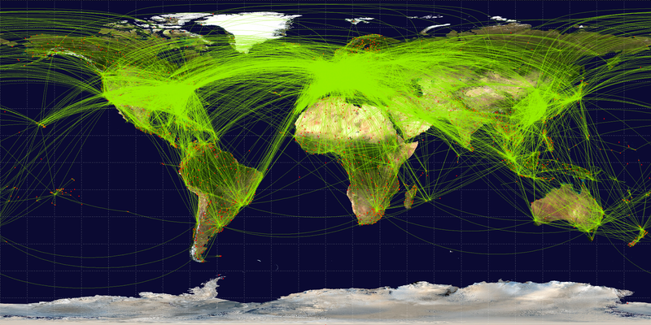
Avian Influenza Virus Transmission Factors
Globalization
International trade
Farming and commerce
(live bird markets)
Wild birds, migratory routes
Poor biosecurity
Notes:
Some of the factors associated with AIV transmission are….
Image source: https://commons.wikimedia.org/wiki/File:World-airline-routemap-2009.png by Wikipedia user Jpatokal

Slide 15

OIE-FAO Global Network: OFFLU
Global network of expertise on animal influenza
Reduce negative impacts of animal influenza viruses
Promote effective collaboration between animal health experts and the human health sector
The WHO participates as observer
Notes:
Image: Purchased from Shutterstock. Stock vector ID: 350819573

Slide 16
OFFLU Objectives
Exchange scientific data and biological materials, share information with the wider scientific community
Share and offer technical advice and veterinary expertise for prevention, diagnosis, surveillance and control of AIV
Collaborate with the WHO to contribute to preparation of human vaccines
Highlight and promote AIV research needs and ensure coordination
Notes:
The objectives of OFFLU are as follows:
To share and offer technical advice, training and veterinary expertise to international organisations and Member Countries to assist in the prevention, diagnosis, surveillance and control of animal influenza.
Exchange scientific data and biological materials (including virus strains) within the network, and to share such information with the wider scientific community.
Offer technical advice and veterinary expertise to Member Countries to assist in the prevention, diagnosis, surveillance and control of avian influenza.
Collaborate with the WHO to contribute to the early preparation of human vaccines.
Highlight avian influenza research needs, promote their development and ensure coordination.

Slide 17
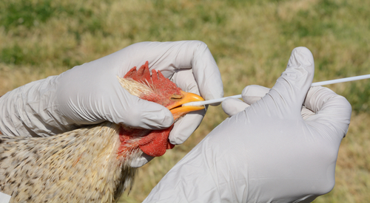
Avian Influenza Monitoring & Surveillance
Early warning system throughout production, marketing and processing for reporting suspicious cases
Regular and frequent clinical inspection
Regular and frequent serological and virological testing of high risk groups of animals
Notes:
Early detection is first line of defense in stopping a potential outbreak.
Image purchased from Shutterstock. Stock photo ID: 438928612

Slide 18
AIV Monitoring & Surveillance Strategies
Cover all susceptible poultry species within country, zone or compartment
Random and targeted approaches using molecular, virological, serological and clinical methods
Active and passive ongoing surveillance
Design programs through competent multi-sectoral professionals and according to the prevailing epidemiological situation
Notes:
Early detection is first line of defense in stopping a potential outbreak.
Image source: http://www.cidrap.umn.edu/sites/default/files/public/styles/ss_media_popup/public/media/article/chicken_being_swabbed.jpg?itok=xGiohBw5

Slide 19
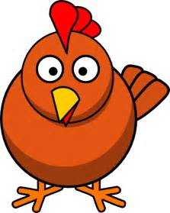

Serologic Virus Detection - Antibody Detection Tests
Nonstructural proteins (NSPs)*
Haemagglutinin (HA)
Haemagglutination inhibition (HI)
ELISA
Neutralisation (SN)
Neuraminidase (NA)
Neuraminidase inhibition (NI)
Indirect fluorescent antibody
Direct and blocking ELISA
Nucleoprotein/matrix (NP/M)
Polymerase complex proteins*
Direct and blocking ELISA
Agar gel immunodiffusion (AGID)
*detection of these antibodies not covered
Notes:
Once a bird is infected it produces antibodies against HA, NA, NSPs, NP/Ms, and PCP’s.
In diagram, orange arrows point to these viral proteins/enzymes that antibodies are produced against.
The green arrows point to specific available antibody detection tests (in darker orange).
Caveats:
HI test – reliable in avian species but not in mammals
SN test – can detect subtype specific antibodies against HA, preferred for mammals and some avian species
AGID test – reliable for NP/M in chickens and turkeys, but not other avian species
What if they are vaccinated?
Poultry can be vaccinated with a variety of Influenza A vaccines, strategies to differentiate vaccinated from unvaccinated include:
Serosurveillance in unvaccinated sentinel birds
Specific serological tests in the vaccinated birds
Images:
http://www.clipartmasters.com/cartoon-chicken-clip-art-free-clipart-1AbhNp.html
http://www.freepngimg.com/miscellaneous/virus

Slide 20
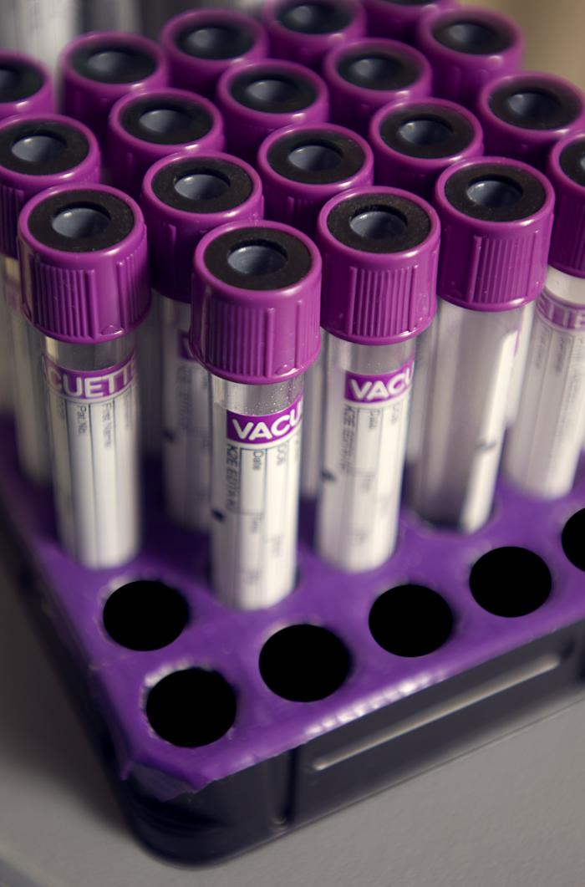
What If a Flock Is Positive?
Any flock with seropositive results = investigate
Epidemiological investigation
Supplementary laboratory investigation
  Confirmatory testing
    > specificity than screening test
    >/= sensitivity than screening test
Document the status of AIV infection for each positive flock
Notes:
OIE Source: http://www.oie.int/en/animal-health-in-the-world/web-portal-on-avian-influenza/early-detection-warning-diagnostic-confirmation/
If the infection is detected in animals, a policy of culling [depopulation] infected and contact animas is normally used in an effort to rapidly contain, control and eradicate the disease. Requirements include (and are described in the OIE Terrestrial Animal Health Code):
humane destruction of all infected and exposed animals (according to OIE animal welfare standards);
appropriate disposal of carcasses, litter and all animal products;
surveillance and tracing of potentially infected or exposed poultry;
strict quarantine and controls on movement of poultry and any potentially contaminated vehicles and personnel;
thorough cleaning and decontamination of infected premises;
a period of at least 21 days before restocking.
When outbreaks are detected, stamping out [depopulation] is generally applied at the level of the infected farm or within a short radius around the infected premises in conjunction with active surveillance.
Image source: https://phil.cdc.gov/Details.aspx?pid=13536

Slide 21


Influenza Status
Criteria to determine the status of a country, zone
or compartment:
AI is notifiable, an ongoing AI awareness program is in place, and all suspected occurrences of AI are investigated
Appropriate surveillance is in place for poultry and other birds
Consideration of all epidemiological factors
Articles 10.4.30 to 10.4.32
Notes:
Level of surveillance in place determines status.
Criteria used to determine the influenza status of a country, zone, or compartment:
AI is notifiable in the whole country, an ongoing AI awareness program is in place, and all notified suspected occurrences of AI are subject to field and (where applicable) laboratory investigations
Appropriate surveillance is in place to demonstrate the presence of infection in the absence of clinical signs in poultry, and the risk posed by birds other than poultry
Consideration of all epidemiological factors for AI occurrence and their historical perspective
Images:
http://www.clipartlord.com/wp-content/uploads/2013/04/stethoscope2.png
http://wikiclipart.com/earth-clip-art_19158/

Slide 22

Discussion Questions
What avian influenza virus monitoring and surveillance strategies are in place in your country / region?
What key challenges have you faced with these strategies?
Notes:
Facilitator notes: Take 5 minutes to lead a brief discussion with the entire group.

Slide 23
Epidemiology and Traceability
Southern and Estaern Title

Slide 24
Transmission of Avian Influenza Viruses
AI viruses are shed in feces and respiratory secretions
Potential routes of transmission:
  Direct contact
    Infected feces, secretions, contaminated feed or water
  Fomites
    Virus survives long periods at low temperatures
  Wild birds
    Most likely transmit to poultry via direct exposure
Notes:
There are 3 possible transmission routes.
Fomites - AI viruses can be carried on farm equipment and spread easily from farm to farm.

Slide 25
Knowledge Check
What are some examples of fomites?
Notes:
Fomites - feed, farm equipment, clothing…

Slide 26
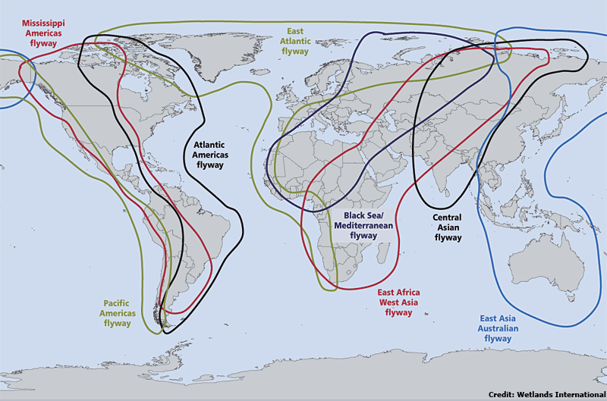
AIV Epidemiology & Traceability: Wild Birds
Natural hosts / reservoir
Incidence of infection appears seasonal (Fall)
Major role in evolution, maintenance and spread of virus
Main species
  Waterfowl
  Gulls
  Shorebirds
Notes:
OIE Source: http://www.oie.int/en/animal-health-in-the-world/web-portal-on-avian-influenza/about-ai/
Wild birds, as natural host and reservoir for all types of avian influenza viruses, play a major role in the evolution, maintenance, and spread of these viruses.
The main wild species involved have proved to be waterfowls, gulls, and shorebirds, however the virus seem to pass easily between different bird species.
The incidence of infection appears to be seasonal, with the highest isolation rate being in juvenile birds in the fall of the year.
Several routes of exposure of wild bird viruses to poultry have been documented or suspected of being the origins of outbreaks. Direct exposure to wild birds is the most likely transmission factor.
AIVs pass easily between avian species.
This image shows the overlap in flyway routes for migratory birds.
Image source: http://www.fao.org/avianflu/en/wildlife/sat_telemetry.htm

Slide 27
Discussion Questions
What are some ways that have been used in your country / region to reduce direct contact between wild birds and domestic poultry?
What challenges have you faced when trying to reduce this contact?
Notes:
Facilitator notes: Take 5 minutes to lead a brief discussion with the entire group.

Slide 28
Prevention and Control
Southern and Estaern Title

Slide 29
Monitoring & Controlling AIV in Poultry
Essential to decrease virus load in birds and environment
Biosecurity measures are key
  Secure the production sector and trade
  Safeguard food security and the livelihoods of farmers, particularly in developing countries
  Limit the risk of human infection with AIV strains that have zoonotic potential
Notes:
Monitoring and controlling avian influenza virus at its poultry source is essential to decrease the virus load in susceptible avian species and the environment.
Implementation of biosecurity measures, in line with OIE International Standards, are key.
Secure the production sector and trade.
Safeguard food security and the livelihoods of farmers, particularly in developing countries.
Limit the risk of human infection with AIV strains that have zoonotic potential through biosecurity, personal protective equipment and sanitation.
Data for AI outbreaks – economic losses and # human cases of H7N9 and H5N1 influenza
As of 27 September 2017 WHO reported a cumulative total (since 2003) of 860 confirmed cases of H5N1 infection in humans, with 454 deaths.
As of 25 October 2017 FAO reported 1622 cumulative cases (since 2013) of H7N9 infection in humans, with 619 deaths.
According to the UN, the estimated economic losses in China in 2013 alone from H7N9 was USD 6.5 billion.
According to an FAO report on H5N1: “Preliminary estimates in 2004 of impacts on South East Asian economies suggested that a single large outbreak could result in a reduction of up to 1.5% of GDP growth. http://www.fao.org/avianflu/documents/Economic-and-social-impacts-of-avian-influenza-Geneva.pdf

Slide 30
Controlling Infections: Culling
Rapidly contain, control and eradicate AIV
Humane destruction of all infected and exposed animals
Appropriate disposal of carcasses, litter and all animal products
Surveillance and tracing of potentially infected or exposed poultry
Strict quarantine and controls on movement of poultry and any potentially contaminated vehicles and personnel
Thorough cleaning and decontamination of infected premises
A period of at least 21 days before restocking
Notes:
When outbreaks are detected, stamping out is generally applied at the level of the infected farm or within a short radius around the infected premises in conjunction with active surveillance.
Controlled elimination of infected and exposed poultry (according to OIE animal welfare standards), movement restrictions, improved hygiene and biosecurity, and appropriate surveillance should result in a significant decrease of viral contamination of the environment. These measures should be taken whether or not vaccination is part of the overall strategy.

Slide 31
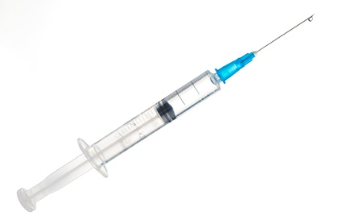
Avian Influenza Virus Vaccination
Must include an exit strategy
  Conditions to be met in order to stop vaccination
  http://www.oie.int/en/animal-health-in-the-world/web-portal-on-avian-influenza/early-detection-warning-diagnostic-confirmation/
Strategies to differentiate vaccinated from unvaccinated
  Sero-surveillance in unvaccinated sentinel birds
  Specific serological tests in vaccinated birds
Vaccination alone not the solution to control AI if eradication is desired
Notes:
Vaccination should be implemented for a limited duration when culling policies cannot be applied because either the disease has become endemic and therefore widespread, or the infection in affected animals is too difficult to detect. When appropriate vaccines complying with OIE quality standards are available, vaccination is used to protect susceptible poultry populations from potential infection. Vaccination strategies can be effective as an emergency measure in an outbreak or as a routine measure in an endemic area.
Poultry can be vaccinated with a variety of Influenza A vaccines.
Strategies to differentiate vaccinated from unvaccinated:
Serosurveillance in unvaccinated sentinel birds
Specific serological tests in the vaccinated birds
Vaccination alone should not be considered the solution to the control of AI if eradication is the desired result. Without monitoring systems, strict biosecurity, and depopulation in the face of infection, viruses may become endemic in vaccinated poultry populations. Long-term circulation of virus in a vaccinated population may result in antigenic or genetic changes in the virus – both of which have been reported in several countries.
Image purchased from Shutterstock. Stock photo ID: 526465792

Slide 32
Avian Influenza Virus Transmission
People in close contact with infected birds are at risk for acquiring AIV
Many human cases are limited to conjunctivitis or mild respiratory disease but some viruses can cause severe illness
No evidence to suggest consumption of eggs or poultry that are fit for human consumption can transmit AIV to humans
Culled animals due to AIV controls or outbreaks should not enter the human or animal food chains
Notes:
Image source: http://ucanr.edu/sites/poultry/files/182660display.jpg

Slide 33
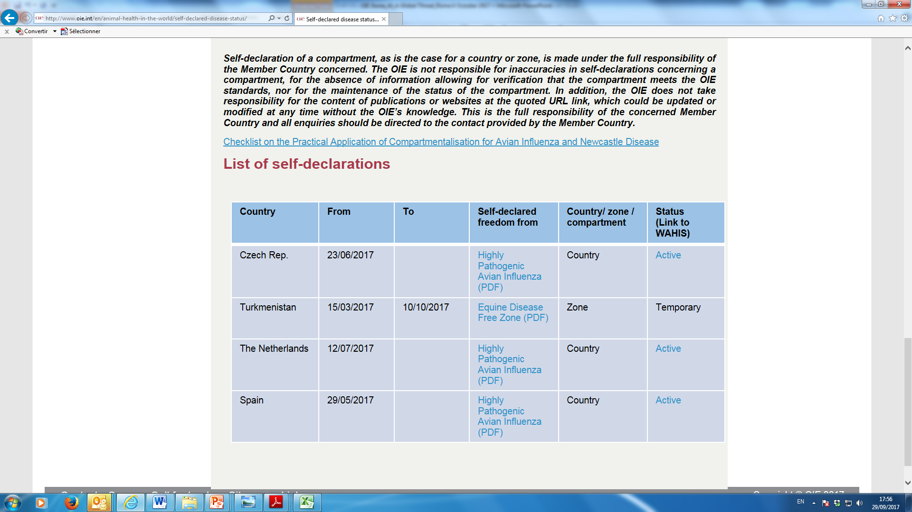
Self-declaration of Freedom Following Outbreaks
    Chapter 1.6: Self-declaration

Slide 34
Knowledge Check
What multi-sectoral steps can be taken to prevent or limit an outbreak of AIV?
Notes:
Fomites - feed, farm equipment, clothing…

Slide 35
Biosecurity
Southern and Estaern Title

Slide 36
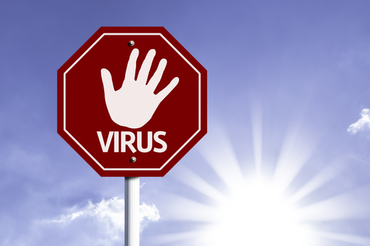
Biosecurity Recommendations
Keep poultry away from areas frequented by wild fowl
Do not keep elements that may attract wild birds on the premises, including poultry feed outside of buildings
Maintain strict control over access to flocks by people, equipment and vehicles
Notes:
Photo purchased from Shutterstock. Stock illustration ID: 214081507

Slide 37
Biosecurity Recommendations - Continued
Good sanitation on the property, poultry houses and equipment
Avoid introduction of birds with unknown disease status
Report suspicious bird illnesses and deaths to Veterinary Services
Dispose of manure, litter and dead birds appropriately
Vaccinate animals where appropriate

Slide 38
Discussion Questions
Which biosecurity measures and/or hygiene practices to protect against AIV outbreaks have been used in your country / region?
Are there any biosecurity measures and/or hygiene practices to protect against AIV outbreaks that have been difficult to use in your country or that you think would be difficult to implement in your country in a future outbreak?
Notes:
Facilitator notes: Take 5 minutes to lead a brief discussion with the entire group.

Slide 39



Thank you for your attention!!

Slide 40
Extra Slides: Resource and Reference Information
Southern and Estaern Title

Slide 41
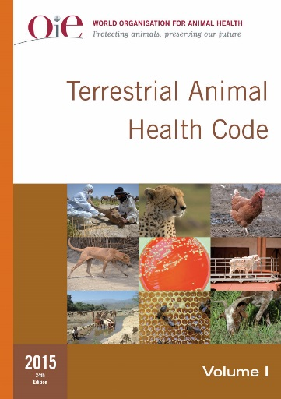
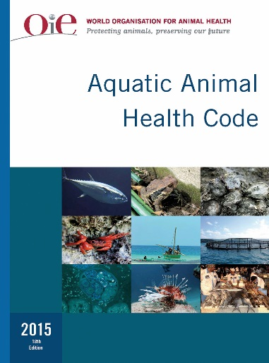
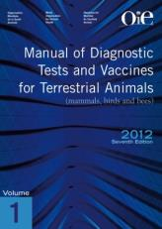
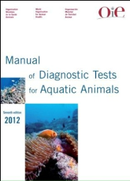
OIE Standards
CODES
MANUALS
Terrestrial
Aquatic
Terrestrial
Aquatic
Codes and Manuals available on the OIE website www.oie.int

Slide 42
Reference Centres for Avian Influenza
10 Reference Laboratories and 1 Collaborating Centre specifically for avian influenza
OIE reference laboratories provide scientific and technical assistance and expert advice on topics linked to surveillance and control of avian influenza

Slide 43
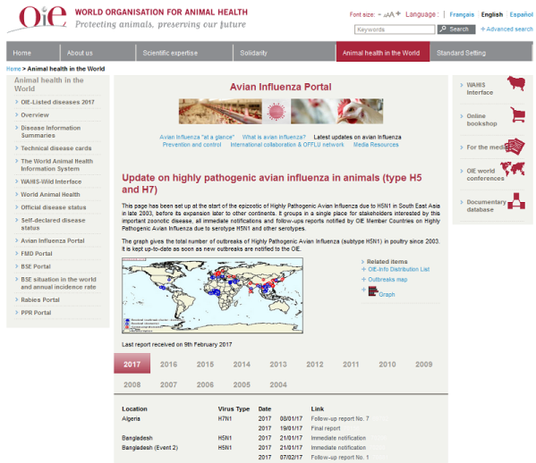
Avian Influenza Portal
Avian Influenza Portal on the OIE website:
http://www.oie.int/en/animal-health-in-the-world/update-on-avian-influenza/2016/

Slide 44
Resources & References
What OIE online AIV resources are available for Member Countries to use?
  OIE Code AIV: http://www.oie.int/en/international-standard-setting/terrestrial-code/access-online/?htmfile=chapitre_avian_influenza_viruses.htm
  OIE Manual AIV: http://www.oie.int/fileadmin/Home/eng/Health_standards/tahm/2.03.04_AI.pdf
  OIE Avian Influenza Portal: http://www.oie.int/en/animal-health-in-the-world/web-portal-on-avian-influenza/
  OIE Questions and Answers on Avian Influenza; http://www.oie.int/fileadmin/Home/eng/Media_Center/docs/pdf/PortailAI/EN_QA%20Jan2017.pdf
  OIE/FAO global network of expertise on animal influenza (OFFLU): www.offlu.net
  OIE Technical Disease Cards (HPAI): http://www.oie.int/animal-health-in-the-world/technical-disease-cards/
  World Animal Health Information System (WAHIS): http://www.oie.int/animal-health-in-the-world/the-world-animal-health-information-system/the-oie-data-system/
What OIE regional resources are available for Member Countries?
  OIE Regional Resources: http://www.oie.int/en/about-us/wo/regional-representations/
Notes:
OIE Code AIV: http://www.oie.int/en/international-standard-setting/terrestrial-code/access-online/?htmfile=chapitre_avian_influenza_viruses.htm
OIE Manual AIV: http://www.oie.int/fileadmin/Home/eng/Health_standards/tahm/2.03.04_AI.pdf
OIE (World Organization for Animal Health) Avian Influenza Portal; http://www.oie.int/en/animal-health-in-the-world/web-portal-on-avian-influenza/
OIE/FAO global network of expertise on animal influenza (OFFLU): www.offlu.net
OIE Regional Resources: http://www.oie.int/en/about-us/wo/regional-representations/
OIE Technical Disease Cards (HPAI): http://www.oie.int/animal-health-in-the-world/technical-disease-cards/
WAHIS: http://www.oie.int/animal-health-in-the-world/the-world-animal-health-information-system/the-oie-data-system/

