Slide 1
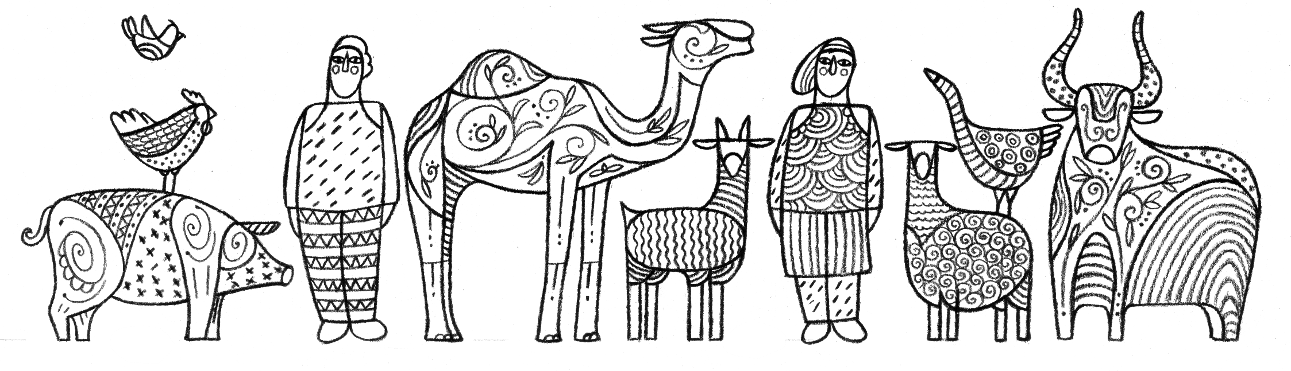

Slide 2
Module V4
Control Strategies for HPAI and LPAI in Poultry Populations

Slide 3
Learning Objectives
Learn about control strategies for HPAI and LPAI in poultry
Define stamping out
Describe challenges to stamping out
Define compensation
Understand why compensation is used
Learn about what types of compensation are available
Describe what would be too much versus too little compensation
Understand the use of market closures and key considerations for market closures

Slide 4
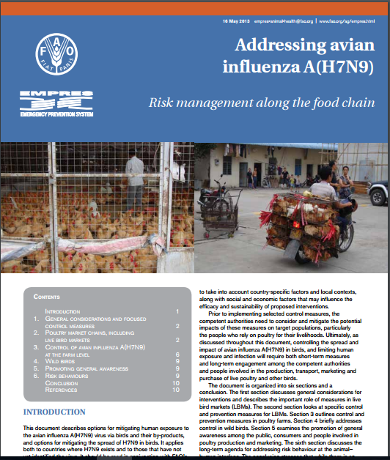
Control Strategies
Measures to prevent / reduce risk of infection in farms and markets
Measures to minimize infection / impacts once already occurring in farms or markets
Stamping out and compensation
Live-bird market management
Biosecurity improvement
Movement management (quarantine and isolation)
Vaccination
http://www.fao.org/docrep/018/i3609e/i3609e.pdf
Notes:
Control strategies for HPAI and LPAI in poultry populations include…
This publication discussed risk management along the food chain…

Slide 5
Stamping Out

Slide 6
Why use Stamping Out?
Reduce # of infected and at-risk populations once exposed
Stamp out only infected premises: most “resource-challenged” countries
Stamp out also at-risk population
  By geography
  By epidemiological link

Slide 7
Day 1
Resolved
Infected
At risk
Unaffected (yet)
Notes:
Comparing different stamping out approaches: only infected farm vs geographical vs epidemiological link

Slide 8
Day 5
Resolved
Infected
At risk
Unaffected (yet)
Notes:
Comparing different stamping out approaches: only infected farm vs geographical vs epidemiological link

Slide 9
Day 10
Resolved
Infected
At risk
Unaffected (yet)
Notes:
Comparing different stamping out approaches: only infected farm vs geographical vs epidemiological link

Slide 10
Challenges to Stamping Out
How to manage stamping out that is:
  Efficient (timely with effective coverage)
  Humane
  Safe for people involved
  Environmentally friendly
Resources (human, financial, equipment, facility)
Different types of productions pose different challenges

Slide 11
Stamping Out: Key Messages
Method of choice for virus elimination in newly infected places
Will not eliminate virus in places where case detection is weak and incomplete
Should be part of a package that includes:
  Investigation (tracing backward and forward)
  Effective movement control
  Compensation
  Communication
Time from infection to detection to reporting
Birds / flocks found positive may represent only a small percentage of the total infected
Notes:
The key points related to stamping out are….

Slide 12

Discussion Question
In your country / region, what challenges have you faced when using stamping out?
Notes:
Facilitator: spend 5 or more minutes discussing these questions with participants.

Slide 13
Compensation

Slide 14
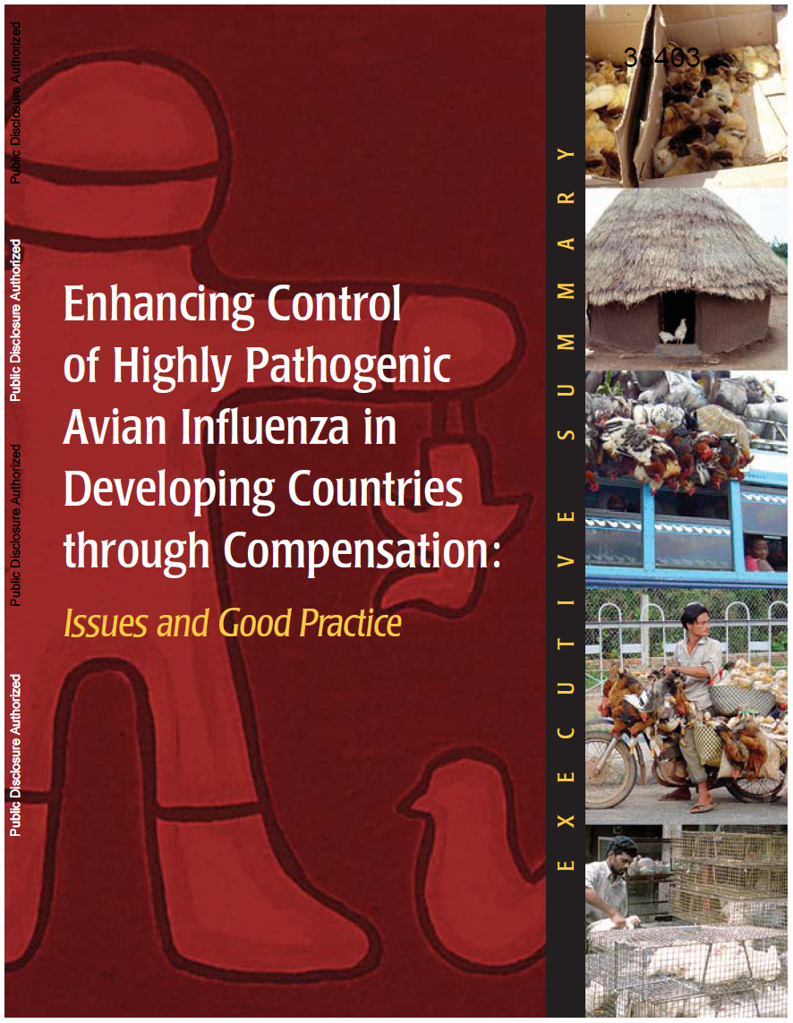
Compensation
Indemnification of private actors for losses incurred as a result of public action undertaken to promote the public good¹
Balance of private losses for public benefits
http://www.fao.org/docs/eims/upload/217838/gui_hpai_compensationsumm_en.pdf
¹ Enhancing control of highly pathogenic avian influenza in developing countries through compensation: issues and good practices, The World Bank, 2006
Notes:
Compensation is defined as…..

Slide 15
Why Compensate?
Provide incentives to:
  Report outbreaks (penalizing behaviors leading to disease spread)
  Comply with control strategies – get cooperation and avoid illegal movements
A measure for equity when private property is destroyed by the government for the public good
Protect farmers’ livelihood and food security
Notes:
There are several reasons why compensation may be used….

Slide 16
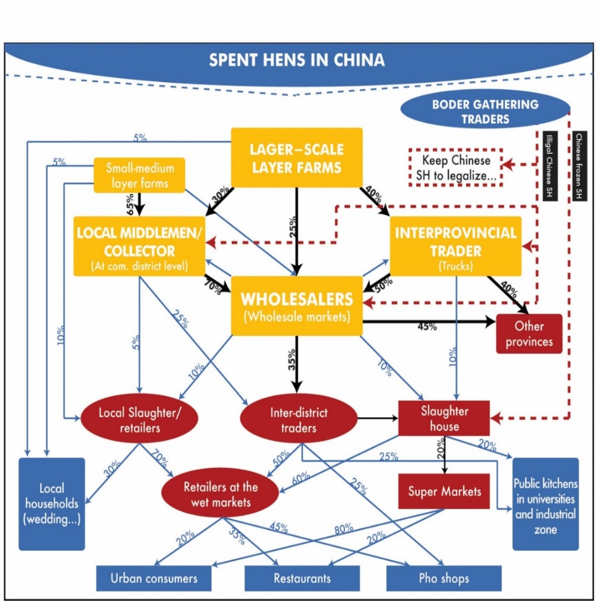
Who Should we Compensate?
BORDER GATHERING TRADERS
Direct / consequential / indirect impacts
  Farmers / traders / market operators
Types of investments made
  Owners of birds / laborers, feeds, and facilities
Notes:
Image: FAO ECTAD (2010). Unpublished data

Slide 17
What should
Compensation
be?
Notes:
Graphic explains different needs for compensation among different types of poultry production system (sectors)
Source: The World Bank (2006). Enhancing control of highly pathogenic avian influenza in developing countries through compensation:
issues and good practices.

Slide 18
What Should Compensation Be?
Cash – not necessarily all from public sector (but need to harmonize)
Access to (soft) credits / loans (opportunity to reinforce good biosecurity practices)
Incentivize through implementation of other control measures, i.e. movement restrictions
Rehabilitation, including replacement birds
Improved veterinary services
Assistance for alternative forms of livelihoods, e.g. training

Slide 19
19
Not too much but not too little
If too much:
Seek infection in the short-term
No effort to avoid the next epidemic
At expense of public finances
SHOULD BE LOWER THAN MARKET PRICE BEFORE THE OUTBREAK STARTED
If too little:
Encourage illegal movements
Discourage reporting new cases
Generate mistrust with private sector
SHOULD BE CLOSE TO MARKET PRICE AT AFFECTED & SURROUNDING (NOT-AFFECTED) AREAS

Slide 20
20
Discussion Questions
Other than cash payments, what types of compensation may be especially valuable or desirable for poultry producers and other involved parties in your country / region?
In your country / region, what types or levels of compensation have ended up being problematic? What types of problems arose?
Notes:
Facilitator: spend 5 or more minutes discussing these questions with participants.

Slide 21




21
Coverage
Destroyed livestock and property plus dead animals that would have been destroyed
Destroyed livestock and culling and disposal costs
Destroyed livestock (including fetuses) and destroyed contaminated products and material
Destroyed livestock
Notes:
Consequential losses: Derived from animal movement restrictions and market disruption
Capped market value recommended: 75-90% of pre-outbreak market value at the farm-gate

Slide 22
22
Level of Compensation
Farm-gate value of restocking
Capped market value – 50% if dead before notification of disease
Determined by an evaluation team – reduced in case of delayed notification
70% of ex ante market value – no payment if dead before official culling approval
Notes:
Consequential losses: Derived from animal movement restrictions and market disruption
Capped market value recommended: 75-90% of pre-outbreak market value at the farm-gate

Slide 23
23
Compensation: Key Messages
Compensation schemes should be developed in advance
  Beneficiaries and contributors identified
  Types and scope of compensation determined
  Mechanism for compensation agreed (rates, timeliness, accountability)
  Pre-requisite established (farm registration, values)
Incentivize early reporting by penalizing the compensation of sick or dead birds
  Not zero if dead birds have a market value
  Compensate dead birds at market value if the response to farmers’ report cannot be done in a prompt manner (less than 72 hours?)

Slide 24
24
Compensation: Key Messages (continued)
Closely monitor market values in affected and surrounding provinces and evaluate the possibility of adjusting
  Very complicated in reality and need a system in place
Different types of birds may require different compensation
  Quails vs chickens vs ducks
  Broilers vs layers
  Young layers vs old layers (spent hens)
  High-valued birds (can be subjective)
  HOWEVER, simpler can be better if good movement control is in place

Slide 25
25
Compensation: Key Messages (continued)
For the longer term:
  It is all about planning – expect the next animal disease outbreak
  Allocate resources (~ 5% of poultry industry value)
  Explore cost-sharing opportunities with the commercial sector

Slide 26
26
Recommendations for Management of Market Closures

Slide 27
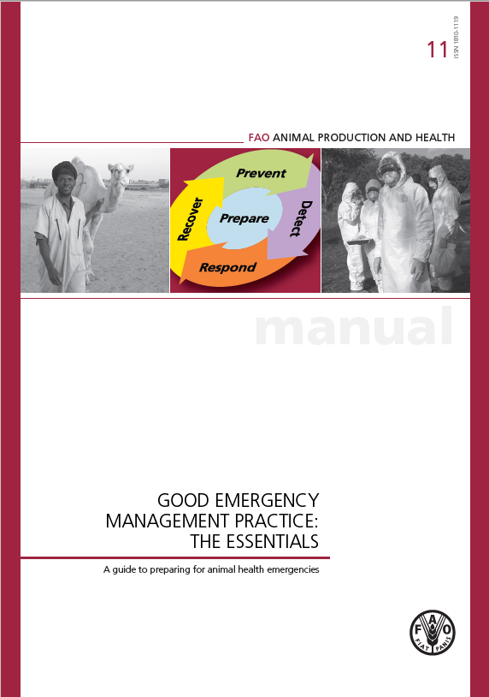
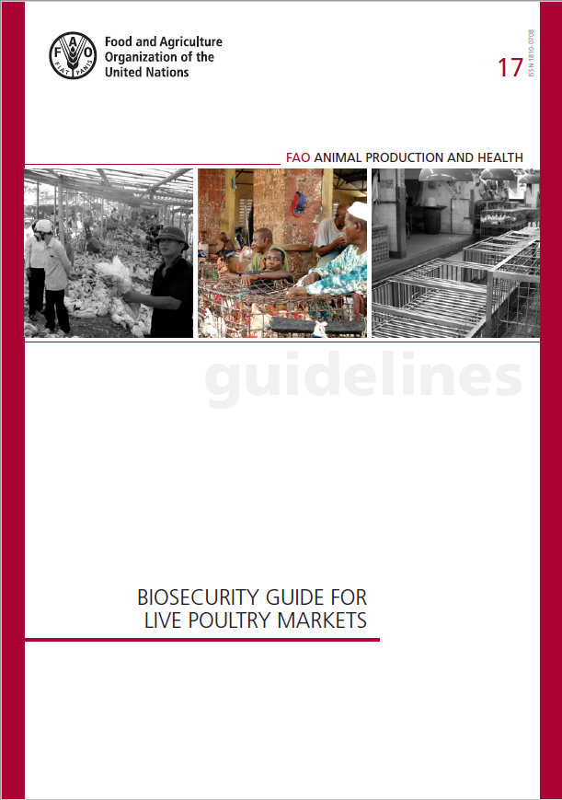
27
Notes:
These 2 books provide helpful resources.
Book 17:
The larger the market, the greater the consequences if a zoonotic agent is detected resulting in temporary market closure. Therefore, it is preferable to have multiple smaller and structured markets than one very large market trading more than 100 000 heads of poultry per day.
Any market closures will be in vain unless authorities have appropriate powers and resources to prevent the development of illegal parallel markets.

Slide 28
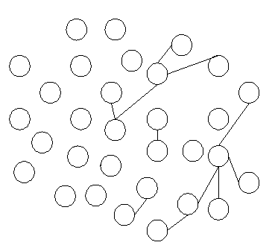
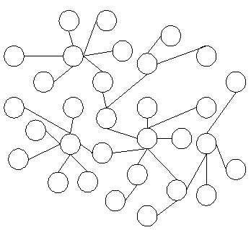
28
28
Rationale Behind Market Closures
Live bird markets act as hubs in the poultry network
Remove the hub = Stop the spread
Reduce human exposure to poultry
Notes:
Image source unknown. Need to provide citation.

Slide 29





29
Challenges for Closing Markets
Emergency slaughtering
Village C
Understand your value chain
  Trace back the origin of the infection
    Village A
  Early warnings
    Market 2
    Village B
What are the effects of such closures?
  Areas with excess poultry stock
    Emergency slaughtering and processing – Village C
  Adjustment of value chains
    Increase in poultry supply in other markets – Market 3
!
Market 2
Market 3
Market closure
!
Village B
Village A
Notes:
Image source unknown. Need to provide citation.

Slide 30
30
Key Messages: Market Closures
Market closures will be in vain unless authorities are able to implement strict movement controls (power & resources)
  Otherwise, animals will be moved illegally and unofficial parallel markets will appear
Anticipate the effects of the market closures
  The larger the market, the greater the consequences
  If possible, re-establish the markets as soon as possible after eliminating the virus
Important differences between different production systems
  Commercial vs backyard
  Broilers vs layers

Slide 31
31
Discussion Questions
Who has the authority in your country / region to implement AI control activities (stamping out, compensation, market closures, movement restrictions, etc.)?
What are some barriers in your country / region to effective implementation of any or all of these measures?
If there are different authorities involved in AI control measures, how well do they communicate with each other and coordinate their activities in a multi-sectoral way?
Notes:
Facilitator: spend 5 or more minutes (based on the remaining time in your session) to discuss these questions with participants.

Slide 32
32
Communications
Before an outbreak occurs, you can prepare:
Forming an Avian Influenza Communication Task Force
Gathering Information Resources
Identifying Partners and Alliances
Working with the Community

Slide 33
33
Communications
Communication materials can be adapted from materials already developed by international organizations (WHO, FAO, OIE, USDA, etc):
Messages or talking points addressing prevention and control of avian influenza for animals and humans
Frequently Asked Questions and Fact Sheets about avian influenza
Posters
Radio public service announcements
Television public service announcements
Live-read scripts that can be used for radio, television or loudspeaker
Leaflets and job aids for health care providers, community workers, veterinary workers, teachers and others
Brochures/booklets for farmers, veterinary workers, and members of the general population
Among others

Slide 34
34
Communications
Identify partners and alliances:
Government partners
Donor organizations
International nongovernmental organizations
Private/Civil Society/Religious groups
Business and media
Community leaders/authorities

Slide 35
35
Communications
Be prepared, the following questions can be anticipated:
What is H5N1 or bird flu?
Am I or is my family at risk?
What can I do to protect myself and my family?
What can I do to protect my animals?
What do I do if I think my birds or other flocks are sick?
What will happen to me if I report the sickness?
Will I or my family be in trouble?
What should I do?
Will I be compensated if my animals are culled?
Can you stop it from spreading?
Who is in charge, at the local and central level?
Has this outbreak been contained?
What can we expect, right now and later?
Are there any human victims?
Who is responsible for this?
How will you know if more outbreaks occur?
Notes:
Source: http://pdf.usaid.gov/pdf_docs/Pnadu055.pdf

Slide 36
36
Discussion Questions
Have you formed an avian influenza communication task force in your country? What was their experience working with different partners?
Have you prepared communication materials in advance of facing a potential avian influenza outbreak? Or during and avian influenza outbreak?
What kind of materials have you prepared?
Notes:
Facilitator: spend 5 or more minutes (based on the remaining time in your session) to discuss these questions with participants.

Slide 37
37
Thank you

