Slide 1
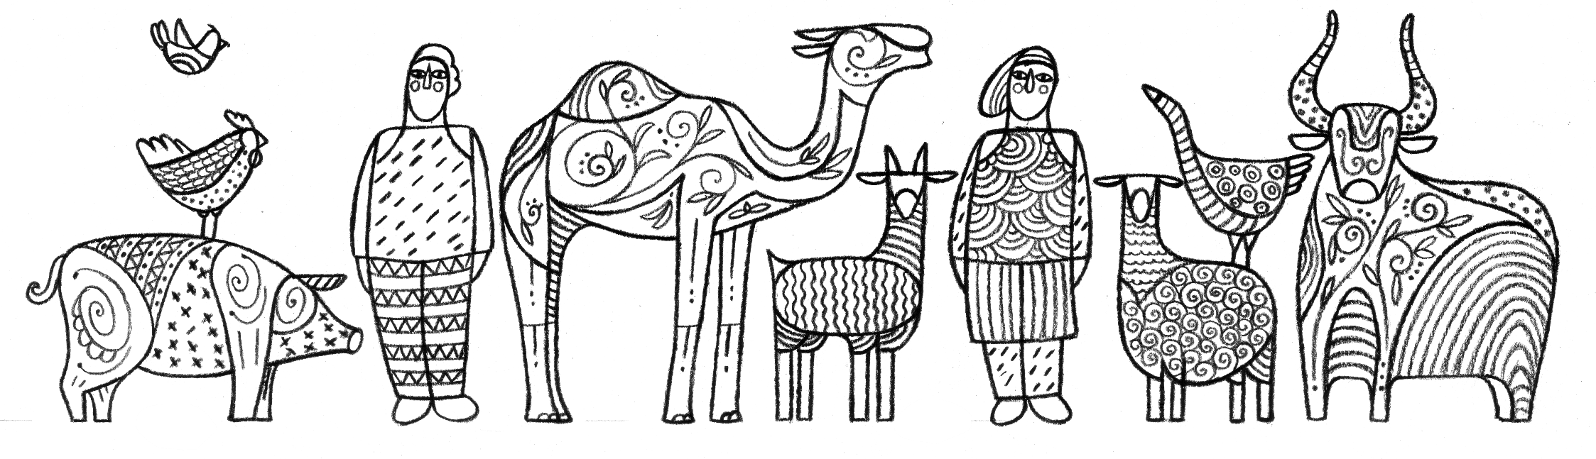

Slide 2
Module V5
Laboratory Algorithms for Comprehensive Influenza A Surveillance
Food and Agriculture Organization of the United Nations

Slide 3
Learning Objectives
Understand the regional diagnostic algorithm for influenza A detection
Describe virology/PCR flow charts per species
  Sample collection (species, pooling issues, environmental)
  Chickens and ducks
  Environment
Describe recommended regional protocols for HA and NA detection
  H5, H7, H9
  N1, N6, N8, N9
Learn about virus isolation
Discuss laboratory needs (capacity)
Notes:
The learning objectives for this module are…

Slide 4
Background
Diagnostic algorithms:
  Guidelines to assist the laboratory on procedures to follow to diagnose a certain disease (and/or make a differential diagnosis)
  Developed by subject matter experts in consultative way
  Evaluated annually or when needed to reflect ongoing regional situation
  In ASEAN: endorsed by ASEAN Laboratory Directors Forum
Virology / PCR flow charts:
  Practical procedure to implement the diagnostic algorithm in laboratory
  Adds additional details and priorities per species
  Some viruses are higher priority in a certain species based on biological parameters (e.g. H7N9 mainly infects chickens and not ducks)
Recommended regional protocols:
  Practical bench procedures to use in the laboratory
  Validated by reference laboratories before implementation
  Practical and short
Notes:
Explanation of the main components of the talk
Key target audience:
Algorithms : Lab directors, lab managers, heads of units
Flow charts: head of units and lab technicians (those who develop/design the work in the lab and those who need to perform testing)
Protocols: lab technicians/vets who carry out the testing

Slide 5
THE REGIONAL DIAGNOSTIC ALGORITHM FOR INFLUENZA A DETECTION
IN ANIMALS
(endorsed by ASEAN)
Notes:
The Association of Southeast Asian Nations (ASEAN)

Slide 6
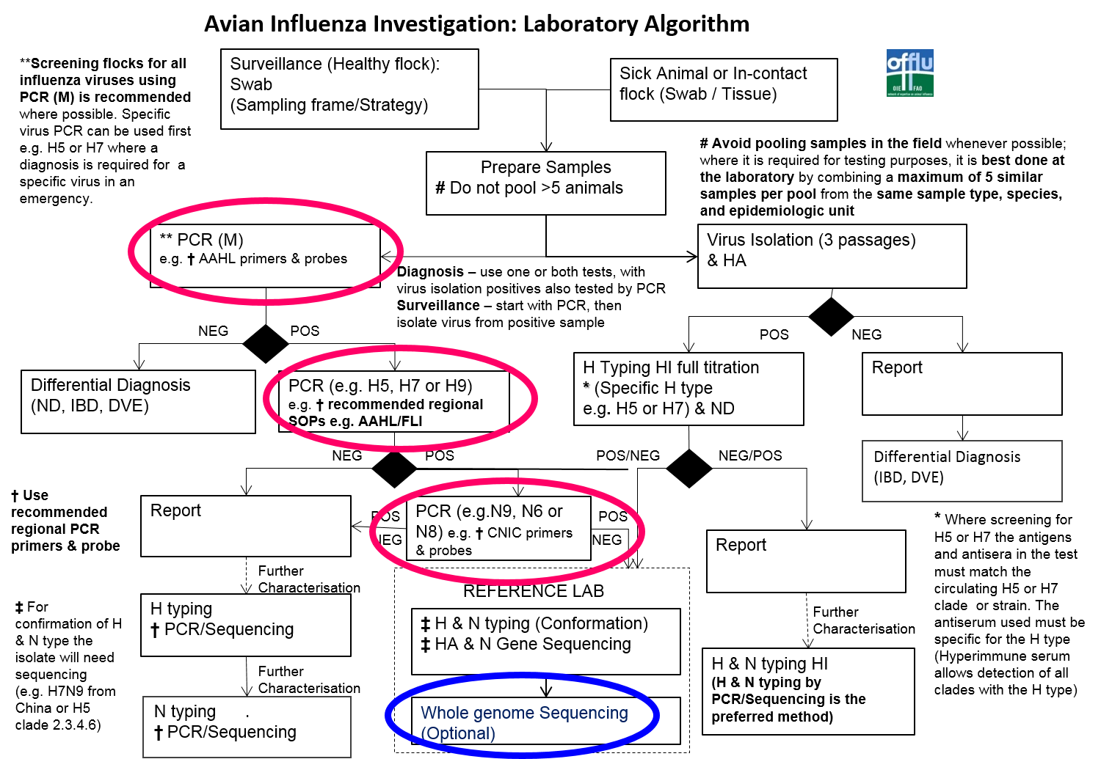
or environmental samples
Regional Bioinformatics
Notes:
OFFLU Algorithm: this is the current regional algorithm. During LAB-TAG we proposed to update the algorithm to include an arrow directly from M-GENE to SEQUENCING in case funds/mechanisms are available (this would be for surveillance acitvities – not for outbreak investigation)

Slide 7
Laboratory Testing Algorithm
Sample
Neg
Flu A (M gene)
Positive
H5, H7 wide, H9
Neg
HA subtyping
by sequencing
H5 +
H7 wide +
H9 +
Neg
N1, N6, (N8)
H7CN, N9
Neg
NA subtyping
Positive
Positive
H5N1
H5N6
H5N8
H7
H9
Hx
H5Nx
CN
H7N9
Full genome sequencing / HA & NA sequencing
Notes:
Full genome sequencing: “Subtyping of the unknown samples” or “genome sequencing for further characterization would be ideal since the purpose of sequencing (full or partial of HA or NA) is
to identify the subtype of the Flu A positive samples, or
to identify whether they are novel virus with new combination of internal genes, or
to see they are HPAI by sequencing at several important sites including HA cleavage site
Full genome sequencing is ideal but partial sequencing could also identify subtypes of samples and be more practical.

Slide 8
DETAILED VIROLOGY / PCR FLOW CHARTS
PER SPECIES

Slide 9




VIROLOGY: STEP 1. Sample Collection from Surveillance
Chickens
Ducks
Environment
1x OP swab
1x CL swab
1x OP swab
1x CL swab
1x different surfaces*
Pool FIVE (5) of the same samples from same sample site
(e.g. 5 OP swabs from chickens from same LBM)
Animal samples: Pool in LAB ; ENV samples: pool on site
Keep them at 4C for max 72 hours
Keep the individual samples at 4C in case they need further testing
Notes:
This slide describes step 1, sample collection from surveillance for chickens, ducks and the environment.
*Note: ANIMAL SAMPLES SHOULD BE COLLECTED INDIVIDUALLY and taken to the lab for further pooling.
Environmental samples can be pooled on site.
Chicken image: http://www.clipartmasters.com/cartoon-chicken-clip-art-free-clipart-1AbhNp.html
Duck image: https://openclipart.org/detail/170850/cartoon-duck
Food stand image: https://www.shareicon.net/fast-food-hot-dog-architecture-and-city-food-commerce-stand-street-810764

Slide 10
Testing of Pools
Pools can contain multiple viruses
M-gene testing is mainly to reduce the number of INDIVIDUAL samples to be tested
HA and NA testing of pools is not recommended since no conclusion on the correct HA-NA combination can be made
Avoid pooling samples in the field, best done at the laboratory
Combine a maximum of 5 similar samples per pool from the same sample type, species, and epidemiologic unit
Keep pooled samples for a maximum of 72 hours at 4C before testing in M-gene PCR
Notes:
This slide describes key guidelines for testing pools of samples.

Slide 11
Environmental Samples
Pool on site
5-6 swabs per site
Different targets: cage swabs, drinking water, cutting boards, defeathering machine, etc.
Depends on local situation
Notes:
This slide describes key guidelines for environmental sampling…

Slide 12

VIROLOGY: STEP 2. PCR Analysis of POOLED Samples from Surveillance
POOLED SAMPLE
RNA extraction
M-GENE PCR
NEGATIVE
POSITIVE
POOL is Flu A NEGATIVE
POOL is Flu A POSITIVE
Differential Diagnosis
(NDV, IBR, DVE)
Go back to INDIVIDUAL samples for further testing
Notes:
This slide describes step 2, PCR analysis of pooled samples from surveillance…

Slide 13

VIROLOGY: STEP 3- Chickens. M and HA-PCR Analysis
of INDIVIDUAL Samples from POSITIVE Pools
INDIVIDUAL CHICKEN SAMPLE
RNA extraction
M-GENE PCR
NEGATIVE
POSITIVE
Sample is Flu A NEGATIVE
Sample is Flu A POSITIVE
Differential Diagnosis
(NDV, IBR, DVE)
Perform 3 HA-GENE PCRs
(H5, H7, H9)
Send for full genome sequencing
Sample is Flu A POSITIVE
But NOT H5, H7, H9
Sample is H5 or H7 or H9 POSITIVE
Notes:
This slide describes step 3, PCR analysis of individual samples from positive pools from chickens…
Send for full genome sequencing: same as slide 3
Different PCR targets in different species: depends on the occurrence of the virus in these species, based on scientific knowledge.
For chickens, main targets are H5N1/N6/N8, H7N9 and H9N2 as those are the viruses of concern in chickens
Chicken image: http://www.clipartmasters.com/cartoon-chicken-clip-art-free-clipart-1AbhNp.html

Slide 14

VIROLOGY: STEP 4-Chickens. NA-PCR Analysis of H5, H7, H9 Positive Samples
Sample is H5 POSITIVE
Sample is H7 POSITIVE
Sample is H9 POSITIVE
NA-GENE PCR
(N1, N6, N8)
NA-GENE PCR
(N9)
NA-GENE PCR
(N2)
NEG
POS
NEG
POS
NEG
POS
Sample is H5Nx
Sample is H5N1, H5N6, or H5N8
Sample is H7Nx
Sample is H7N9
Sample is H9Nx
Sample is H9N2
Further NA typing required
If not possible in lab, send samples to reference laboratory
Notes:
This slide describes step 4, PCR analysis of H5, H7, H9 positive samples from surveillance for chickens…
Chicken image: http://www.clipartmasters.com/cartoon-chicken-clip-art-free-clipart-1AbhNp.html

Slide 15

VIROLOGY: STEP 3-Ducks. M and HA PCR Analysis of INDIVIDUAL Samples from POSITIVE Pools
INDIVIDUAL DUCK SAMPLE
RNA extraction
M-GENE PCR
NEGATIVE
POSITIVE
Sample is Flu A NEGATIVE
Sample is Flu A POSITIVE
Differential Diagnosis
(NDV, IBR, DVE)
Perform 2 HA-GENE PCRs
(H5, H9)
NEGATIVE
POSITIVE
Send for full genome sequencing
Sample is Flu A POSITIVE
But NOT H5, H9
Sample is H5 or H9 POSITIVE
Notes:
This slide describes step 3, PCR analysis of individual samples from positive pools from ducks…
Full genome sequencing: same as slide 3
Duck image: https://openclipart.org/detail/170850/cartoon-duck

Slide 16
VIROLOGY: STEP 4-Ducks. NA PCR Analysis of H5, and H9 Positive Samples
Sample is H5 POSITIVE
Sample is H9 POSITIVE
NA-GENE PCR
(N1, N6, N8)
NA-GENE PCR
(N2)
NEG
POS
NEG
POS
Sample is H5Nx
Sample is H5N1, H5N6, or H5N8
Sample is H9Nx
Sample is H9N2
Further NA typing required
If not possible in lab, send samples to reference laboratory
Notes:
This slide describes step 4, PCR analysis of H5, H7, H9 positive samples from surveillance for ducks…
For ducks we do NOT target H7 as from scientific knowledge it is shown that H7N9 is not highly prevalent in ducks
Duck image: https://openclipart.org/detail/170850/cartoon-duck

Slide 17
VIROLOGY: STEP 5. Further Characterization
(together with reference labs)
Sample is H5Nx
Sample is H5N1, H5N6, or H5N8
Sample is H7Nx
Sample is H7N9
Sample is H9Nx
Sample is H9N2
Reference Laboratory
Full genome sequencing to analyze the internal genes
Produce reference reagents, positive controls
Validate diagnostics tests

Slide 18
Discussion Questions
Given the HR and technical capacity in your laboratory:
Do you only perform M-gene (flu A) testing?
Do you do HA / NA subtyping?
Do you work on pools or individual samples?
Can you sequence full genomes?
Notes:
Facilitator: please take 5 or more minutes to go through these questions with participants.

Slide 19
LIST OF AVAILABLE RECOMMENDED REGIONAL PCR PROTOCOLS
Notes:
Regional protocol in ASEAN is currently focuses on detection using PCR (molecular diagnosis of viruses)
So, the aim of the regional protocols is to detect the presence of RNA of viruses in the sample

Slide 20
Recommended Laboratory Protocols
RNA Extraction
For automated extraction (magnetic beads)
  MagMax, Taco or similar
  For details see providers protocols
For manual extraction (column extraction)
  QIAgen RNEasy, Qiagen Viral RNA kit
  For details see providers protocols
Notes:
There are many products available for RNA extraction with similar performance.

Slide 21
Recommended Laboratory Protocols for Detection of Influenza A Virus
The regional Australian Animal Health Laboratory (AAHL) primers and probes are recommended
  Detailed protocols: see AAHL working protocols
Alternatively, reference laboratories’ primers and probes can be used
  Detailed protocol: e.g. CDC, FLI, APHA protocols
Notes:
In ASEAN most laboratories follow the protocols by AAHL, as this is the main OIE/FAO reference laboratory in this region. However, protocols by other reference laboratories (IZSVe in Italy, APHA in the UK, SEPRL in the USA, FLI in Germany) are also valid and can be used as an alternative method.
For AAHL working protocols: please contact AAHL representatives (Gemma Carlile) directly via email – not posted on website as they keep being validated and AAHL does not want to post to avoid ‘old’ version to circulate on web

Slide 22
Recommended Laboratory Protocols
H5-gene
The regional AAHL primers and probes are recommended
  Detailed protocol: see AAHL working protocols
Alternatively, following protocols (primers and probes) can be used
  Modified Spackman
  CODA
  FLI

Slide 23
Recommended Laboratory Protocols
H7-gene
The FLI AIV-H7.2 protocol has been chosen in SEA as the regional protocol: http://www.fao.org/docrep/019/i3596e/i3596e.pdf
Other protocols can also be used (Details in the above document)
For HPAI versus LPAI testing: OIE ref lab in Harbin (China) developed primers/probes to distinguish HPAI from LPAI (cleavage site)

Slide 24
Recommended Laboratory Protocols
H9-gene
AAHL provides regional primers and probes

Slide 25
Recommended Laboratory Protocols
N1-gene
The regional AAHL primers and probes are recommended
  Detailed protocol see AAHL working protocols
Alternatively, other reference lab protocols (primers and probes) can be used – as long as they are validated

Slide 26
Recommended Laboratory Protocols
N6-gene
No real-time PCR protocol has been validated
A conventional PCR is available
  For details see AAHL protocols
Alternatively NA sequencing can be performed using a generic protocol

Slide 27
Recommended Laboratory Protocols
N8-gene
FLI real-time PCR protocol has been validated
Also conventional PCR is available
Alternatively, NA sequencing can be performed using a generic protocol

Slide 28
Recommended Laboratory Protocols
N9-gene
The China CDC (WHO collaborating Centre in Beijing) has been chosen as the SEA regional protocol for the N9 gene
  For details see: http://www.who.int/influenza/gisrs_laboratory/cnic_realtime_rt_pcr_protocol_a_h7n9.pdf

Slide 29
Discussion Questions
Does your country / region have regional protocols in place and easily accessible?
If yes, how often does your country / region provide training on these protocols to the people who work in this area?
Notes:
Facilitator: please take 5 or more minutes to go through these questions with participants.

Slide 30
Virus Isolation (VI)
As an alternative to PCR methodology, VI can be used according to a regional algorithm
Follow OIE recommended protocols
  OIE Manual
  OFFLU website
Only to be used in biosafe laboratories with appropriate biosafety levels
Only by laboratory staff with sufficient expertise

Slide 31
Critical Laboratory Needs for Early Diagnosis
Hardware
Equipment
Reagents
Staff
Enabling Environment
Management commitment
Laboratory policy
Quality Assurance
Biosafety
Network
National lab network
Regional/global lab network
Field-lab linkages

Slide 32
Discussion Questions
Does your country / region have all the critical laboratory needs for early diagnosis (hardware, enabling environment, network)?
If not, how does your country / region outsource this laboratory work and where are samples sent to?
Notes:
Facilitator: please take 5 or more minutes to go through these questions with participants.

Slide 33
Resources
OFFLU website:
  www.offlu.net
AAHL detailed protocols:
  gemma.carlile@csiro.au
FAO H7N9 resources:
  http://www.fao.org/ag/againfo/programmes/en/empres/H7N9/
FAO Lab related questions:
  Filip.claes@fao.org

Slide 34
Acknowledgements
USAID
OFFLU
OIE reference laboratories, especially the Australian Animal Health Laboratories (AAHL)
  Chris Morrissy
  Gemma Carlile
  Frank Wong

Slide 35
Thank You

