Slide 1
Module V6
Avian Influenza Virus Poultry Vaccines and Their Use
Influenza Division
Centers for Disease Control and Prevention

Slide 2
Learning Objectives
Learn about avian influenza virus vaccines for poultry
Understand the 3 situations in which to consider AIV vaccination
Understand key considerations when using AIV vaccination
List the types of vaccines available
Learn about protection from AIV vaccination
Learn about the DIVA approach
Describe factors related to a vaccination exit strategy
Notes:
The learning objectives for this module are…
differentiating infected from vaccinated animals (DIVA)

Slide 3
Avian Influenza Virus (AIV) Vaccination
AIV vaccination considered?
Yes
No
Approval, action plan and supervision
Other control measures
Exit strategy
Notes:
Other control measures should also be considered in conjunction with vaccines as vaccination cannot work alone, they are complementary. Other controls measures include disinfection, biosecurity, monitoring, depopulation etc
This diagram shows key parts of the process when deciding whether or not to consider AIV vaccination….

Slide 4
Background
VACCINATION CANNOT WORK ALONE
Vaccination of poultry can be a supplementary control measure in some situations
Increases resistance to infection
  Reduces illness and death
  Reduces viral replication
  Reduces environmental contamination
Control of influenza in animals, Chapter 22. Textbook of Influenza. Wiley Blackwell Ed. 502p.
Swayne ED, 2009. Avian influenza vaccines and therapies for poultry. Comp Immunol Microbiol Infect Dis. 32:351-363
Notes:
Vaccination against AIV in poultry can be considered as a supplementary control measure in some situations. AIV vaccination increases resistance to infection and reduces illness and death among infected birds. AIV vaccination also reduces viral replication in the respiratory and gastrointestinal tracts, thus reducing environmental contamination and subsequent exposure and infection of other birds.

Slide 5
Use of AIV Vaccine Worldwide
From 2002 to 2010, over 113 billion doses of AIV vaccine have been used worldwide
  15 countries, combined poultry population of 131 billion birds
Between 1959 - 2011, 29 HPAI epizootics reported
  24 (83%) controlled without vaccination
Vaccination implemented when other control measures alone could not control or eradicate AIV
Swayne DE, et al K. 2011. assessment of national strategies for control of high-pathogenicity avian influenza and low-pathogenicity notifiable avian influenza in poultry, with emphasis on vaccines and vaccination. Rev Sci tech Off Int Epiz. 30 (3): 839-870
Notes:
Over 113 billion doses of AIV vaccine have been used worldwide (15 countries, with a combined poultry population of 131 billion birds).
>90% of AIV vaccine has been used in China
Also Egypt, Indonesia, Vietnam had significant use of the vaccine
Mainly against H5, but a small proportion against H7
Between 1959 and 2011, 29 HPAI epizootic outbreaks were reported; 24 (83%) were controlled without vaccination. Vaccination has been implemented in cases where stamping out measures alone could not control or eradicate the virus. In Italy, AIV vaccination was used together with other control measures, including differentiating infected from vaccinated animals (DIVA), to successfully control AIV outbreaks. In Mexico, vaccination against HPAIV H5N2 successfully eradicated the HPAI virus, but a LPAI H5N2 virus continued circulating.

Slide 6
Situations to Consider AIV Vaccines
AIV vaccination used in 3 contexts
Routine
Preventive
Emergency
Control of influenza in animals, Chapter 22. Textbook of Influenza. Wiley Blackwell Ed. 502p.
OIE http://www.oie.int/downld/AVIAN%20INFLUENZA/Guidelines%20on%20AI%20vaccination.pdf
Notes:
AIV vaccination may be considered in 3 situations….

Slide 7
Situations to Consider AIV Vaccines
Routine
AIV vaccination has been used routinely in endemic countries
If vaccination is not maintained, or does not remain well-matched to circulating virus strains, the virus may remain endemic if other control measures are not also used
  Disinfection, strict biosecurity, monitoring and depopulation
Notes:
Routine AIV vaccination is one possible use….

Slide 8
Situations to Consider AIV Vaccines
Preventive
Usually applied when there is a threat of introduction or transmission and, based on past experience, other control measures are not likely to be successful
Careful monitoring (DIVA*) must accompany vaccination to achieve eradication
*Differentiating Infected from Vaccinated Animals
Notes:
Preventive use of AIV vaccination is sometimes used…

Slide 9
Situations to Consider AIV Vaccines
Emergency
Once an outbreak has occurred, vaccination can be implemented in addition to other control measures. For example:
Strict differentiation of infected from vaccinated animals (DIVA)
Culling can be considered
  humane destruction of all infected and exposed animals
  appropriate disposal of carcasses and all animal products
Surveillance and tracing of potentially infected or exposed poultry;
Strict quarantine and controls on movement of poultry and any at-risk vehicles
Thorough decontamination of infected premises
A period at least 21 days before restocking.
OIE Terrestrial Animal health Code https://www.oie.int/doc/ged/D10905.PDF
Notes:
AIV vaccination may also be used in emergency situations during an outbreak….
(http://www.oie.int/en/animal-health-in-the-world/web-portal-on-avian-influenza/early-detection-warning-diagnostic-confirmation/)
Vaccination strategies can be effective as an emergency measure in an outbreak or as a routine measure in an endemic area.
It is important that vaccination alone is not considered the solution to the control of avian influenza if eradication is the desired result.
Without the application of monitoring systems, strict biosecurity and depopulation in the face of infection, there is the possibility that these viruses could become endemic in vaccinated poultry populations.
Long-term circulation of the virus in a vaccinated population may result in both genetic and antigenic changes in the virus as has been reported in several countries.
Vaccination should be implemented for a limited duration when culling policies cannot be applied because either the disease has become endemic and therefore widespread, or the infection in affected animals is too difficult to detect.
When appropriate vaccines complying with OIE quality standards are available, vaccination is used to protect susceptible poultry populations from potential infection.
DIVA= Differentiating Infected from Vaccinated Animals

Slide 10
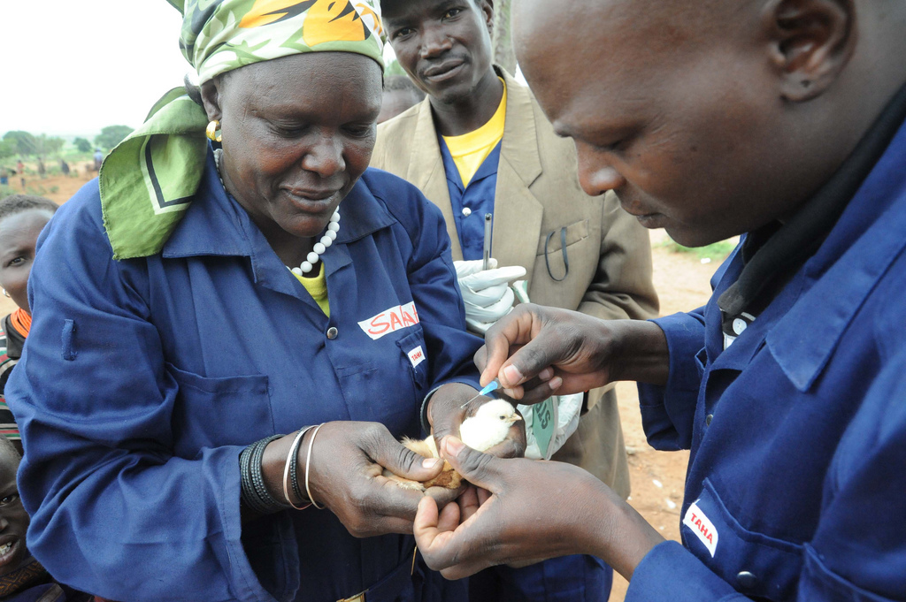
Use of AIV Vaccines - Considerations
Vaccination alone cannot eradicate the virus
Use in conjunction with stamping out measures (mentioned on previous slide)
Must be approved by government authorities
Emergency programs need advanced planning, including exit strategy
U.S. Air Force photo by Senior Airman Kaitlyn Johnson
Notes:
Vaccination should be used in conjunction with stamping out measures. Use must be approved by government authorities - only under Veterinary Services/Animal Health Department/Ministry of Agriculture supervision, as part of an official animal disease control program. Emergency programs need advanced planning, plans and logistics, including an exit strategy. Plans should include the number of doses required/route of administration/availability.
Photo source: https://www.flickr.com/photos/usarmyafrica/6191855646/
USDA Policy and Approach to HPAI Vaccination https://www.aphis.usda.gov/animal_health/animal_dis_spec/poultry/downloads/hpai_policy.pdf
OIE http://www.oie.int/downld/AVIAN%20INFLUENZA/Guidelines%20on%20AI%20vaccination.pdf; FAO http://www.fao.org/3/a-i5625e.pdf

Slide 11
Use of AIV Vaccines - Considerations
Identify financial resources
Laboratory capacity for monitoring circulating viruses
Restricted movement of vaccinated birds
Trade implications
Prioritize resources for populations at highest risk
Plan for post-vaccination immunity studies
Potential for viral spread by vaccination teams
USDA Policy and Approach to HPAI Vaccination https://www.aphis.usda.gov/animal_health/animal_dis_spec/poultry/downloads/hpai_policy.pdf
OIE http://www.oie.int/downld/AVIAN%20INFLUENZA/Guidelines%20on%20AI%20vaccination.pdf; FAO http://www.fao.org/3/a-i5625e.pdf
Notes:
Several things should be considered when using AIV vaccines:
Identify financial resources (plan for cost of vaccine purchase and of vaccination administration)
Assess laboratory capacity for monitoring circulating viruses
Plan for restricted movement of vaccinated birds
Consider trade implications
Prioritize vaccination and resources for populations at highest risk
Plan for statistically-sound post-vaccination immunity studies
Consider the potential for viral spread by vaccination teams

Slide 12

Discussion Question
Has your country had experience successfully controlling an AIV outbreak without AIV vaccination?
Notes:
Facilitator notes: Take 5 minutes to lead a brief discussion with the entire group.
-Has your country had experience successfully controlling an avian influenza virus (AIV) outbreak without vaccination?
+If so, what were the measures in place to control the outbreak? Please describe. How quickly was the outbreak controlled?

Slide 13
Discussion Questions
Has your country had any experience with AIV vaccination?
If yes, describe the vaccination plan challenges and successes.
Would your country consider AIV vaccination in the face of a future AIV outbreak? Why or why not?
Notes:
Facilitator notes: Take 5 minutes to lead a brief discussion with the entire group.
-Has your country had any experience with AIV vaccination?
+If so, were other measures in conjunction with vaccination applied? Please describe.
+Describe the vaccination plan, challenges and successes.
-Would your country consider AIV vaccination in face of an AIV outbreak? Why?/Why not?
+What are the main reasons for not considering vaccination?

Slide 14
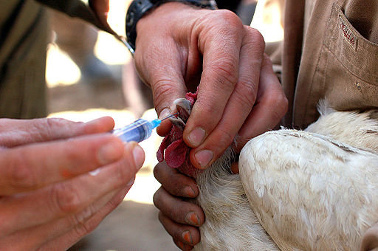
Types of Vaccines Available
Globally, licensed vaccines against AIV H5 and H7 are available in a number of countries
Inactivated AIV vaccines
Live vector / recombinant vaccines
  Avian paramyxovirus type 1
  Fowlpox virus
  Herpesvirus turkey
Swayne DE, Spackman E, Pantin-Jackwood M. 2014. Success factors for avian influenza vaccine use in poultry and potential impact at the wild bird-agricultural interface. EcoHealth 11, 94-108
Notes:
There are several types of vaccines available…
Photo source: https://upload.wikimedia.org/wikipedia/commons/thumb/6/6d/Chicken_vaccination.jpg/512px-Chicken_vaccination.jpg

Slide 15
Types of AIV Vaccines Available
Four countries have used the majority of influenza poultry vaccines during various HPAI epizootics in that country. 10 other countries have used poultry vaccination in focused manner during outbreaks.
Inactivated
Includes H5 and H7 HPAIV and LPAIV
Can be used in poultry and zoo birds
IM, SQ or in ovo
Live vector
Mexico and China (Avian paramyxovirus type 1) for chicken
US and Mexico and limited use in China (Fowlpox virus) for chicken, goose and Muscovy duck
US and Egypt (Herpesvirus Turkey) for chicken
Swayne DE, Spackman E, Pantin-Jackwood M. 2014. Success factors for avian influenza vaccine use in poultry and potential impact at the wild bird-agricultural interface. EcoHealth 11, 94-108
Notes:
Inactivated AIV vaccine
Produced with adjuvanted whole AIV
Can be applied in chicken, turkey, duck, goose, other poultry and zoo birds
Application route is IM, SQ or in ovo
Includes H5 and H7 HPAIV and LPAIV.
Live vector vaccine
Mexico and China (Avian paramyxovirus type 1) for chicken
US and Mexico and limited use in China (Fowlpox virus) for chicken, goose and Muscovy ducks
US and Egypt (Herpesvirus Turkey) for chicken

Slide 16
Discussion Questions
Does your country currently have a licensed AIV vaccine?
If yes, does the license need to be renewed after a certain period of time?
Notes:
Facilitator notes: Take 5 minutes to lead a brief discussion with the entire group.
Does your country currently have a licensed AIV vaccine?
+If so, please describe. Does license need to be renewed after certain period of time?

Slide 17
Vaccine Protection
AIV vaccines, including bivalent vaccines, are subtype-specific
Immunity mainly from antibodies against the surface glycoprotein hemagglutinin (HA)
Efficacy demonstrated through challenge models and vaccine protection measured by
  Prevention of clinical signs and death
  Prevention of drop in egg production
  Reduction in virus shedding
  Prevention of contact transmission
Swayne ED, 2009. Avian influenza vaccines and therapies for poultry. Comp Immunol Microbiol Infect Dis. 32:351-363
Notes:
The immunity provided by AIV vaccines comes mainly from antibodies against the surface glycoprotein hemagglutinin (HA). AIV vaccines are subtype-specific. AIV vaccine efficacy has been demonstrated through low pathogenicity (LP) or high pathogenicity (HP) AIV challenge models.
Vaccine protection has been measured by the following:
Prevention of clinical signs and death (HPAIV challenge)
Prevention of egg production drops (LP and HPAIV challenge)
Quantitative reduction in shedding of challenge virus from respiratory and gastrointestinal tracts (LP and HPAIV challenge)
Prevention of contact transmission (LP and HPAIV challenge)*
*Other factors including bird density, sanitation and ventilation standards may affect this outcome

Slide 18
Vaccine Protection
Other attributes of AIV vaccines
  Protect against high dose challenge
  Minimum 6-12 months protection
  Minimal number of doses required
  Protection in multiple species
  Vaccines are not 100% effective in preventing viral shedding after a field challenge with AIV
  Vaccinated birds or their products can only be exported if proven that the flock has not been exposed to AIV, and this can affect trade which may limit their use
Swayne ED, 2009. Avian influenza vaccines and therapies for poultry. Comp Immunol Microbiol Infect Dis. 32:351-363
Notes:
Other attributes of AIV vaccines:
Protect against high dose challenge
Long periods of protection, minimum 6-12 months
A defined route of administration (subcutaneous injection, wing web administration, spray, etc)
A minimum number of vaccinations to achieve protection (one versus multiple vaccinations depending on life span of the bird)
Protection in multiple species
However, AIV vaccines currently in the market are not 100% effective in preventing viral shedding after a field challenge with the virus. Vaccinated birds or their products can only be exported if it is proven that the flock has not been exposed to the virus.

Slide 19
The DIVA Approach
DIVA: Differentiating Infected from Vaccinated Animals
Demonstrates that exposure to the circulating virus has not occurred
Serologic or virologic diagnostic tests must differentiate between infected, vaccinated or uninfected animal
  One method: use a vaccine with target hemagglutinin and different neuraminidase than the circulating virus
EXAMPLE:
CIRCULATING VIRUS
VACCINE
SEROLOGY TARGET
H7N3
H7N1
N3
OIE http://www.oie.int/downld/AVIAN%20INFLUENZA/Guidelines%20on%20AI%20vaccination.pdf
Notes:
DIVA demonstrates that exposure to the circulating virus has not occurred. Serologic or virologic diagnostic tests need to be validated to differentiate between infected, vaccinated, or uninfected animal. One method for DIVA is to use an AIV vaccine with target hemagglutinin and different neuraminidase than the one from circulating virus. The neuraminidase from the circulating virus can be monitored by serology targeting specific anti-neuraminidase antibodies.

Slide 20
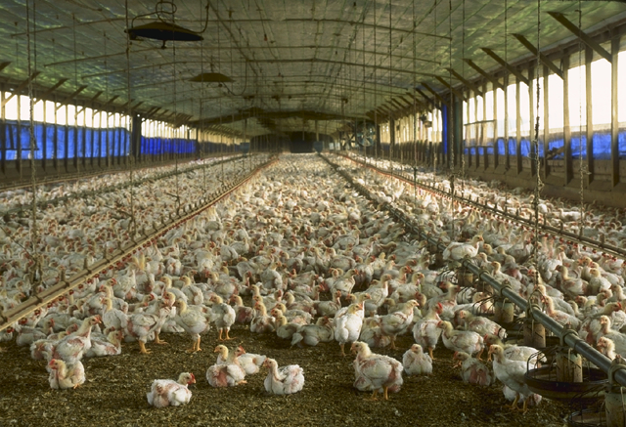
The DIVA Approach
Another method is to use sentinel unvaccinated birds among the vaccinated population to monitor presence of virus or antibodies
Poultry mortality or morbidity should be monitored and tested for early recognition of infection among vaccinated flocks
OIE http://www.oie.int/downld/AVIAN%20INFLUENZA/Guidelines%20on%20AI%20vaccination.pdf
Notes:
Another DIVA method is….
Photo source: https://commons.wikimedia.org/wiki/File:Florida_chicken_house.jpg

Slide 21
Knowledge Check: Vaccination - Exit Strategy
When should AIV vaccination stop?
Notes:
Note:
When should AIV vaccination stop? (See Next Slide/Slide 17 for information)

Slide 22
Vaccination - Exit Strategy
When should AIV vaccination stop?
When the last infected premises in a control area is clean and disinfected and no virus isolated or detected by PCR from animals or environmental samples for at least 42 days
Surveillance should be continued to
  Show absence of residual circulation of virus
  Detect any new introduction early so other measures can be implemented
Monitoring of vaccinated flocks should be implemented
USDA Policy and Approach to HPAI Vaccination https://www.aphis.usda.gov/animal_health/animal_dis_spec/poultry/downloads/hpai_policy.pdf
Notes:
Vaccination should stop when the last infected premises in a control area is clean and disinfected and no virus has been isolated from animals and environmental samples for at least 42 days (USDA policy, 2 times OIE incubation period for AI). Surveillance should continue after vaccination is stopped to demonstrate that there are no residual strains circulating and to detect a new introduction early so that other measures can be implemented (stamping out). Monitoring for infection among vaccinated flocks (DIVA) should be implemented.

Slide 23
Discussion Questions
Does your country have an AIV vaccination exit plan?
If yes, how often is the plan reviewed and updated?
How often do people receive training on the plan?
Notes:
Facilitator notes: Take 5 minutes to lead a brief discussion with the entire group.
Does your country have an AIV vaccination exit strategy? (More info on slide 22)
+If so, are people in your institution familiar with the plan?
+Is the plan reviewed and updated from time to time?
+Have people been trained on how to implement the plan? If so, describe the frequency of trainings, audience, etc.

Slide 24
Knowledge Check: Vaccination - Exit Strategy
What to do if a vaccinated flock tests positive for AIV?
Notes:
Note:
What to do if a vaccinated flock tests positive for AIV? (See Next Slide/Slide 19 for information)

Slide 25
Vaccination - Exit Strategy
What to do if a vaccinated flock tests positive for AIV?
Depopulation and financial compensation should be considered
If the flock is of very high value, authorities / veterinary services should evaluate and make a decision to depopulate or not, considering the economic impact to the poultry industry as a whole
USDA Policy and Approach to HPAI Vaccination https://www.aphis.usda.gov/animal_health/animal_dis_spec/poultry/downloads/hpai_policy.pdf
Notes:
If a vaccinated flock has a positive test result for AIV, depopulation and financial compensation should be considered. This minimizes disease transmission. If the vaccinated flock that is infected is of very high value, the government authorities/veterinary services should evaluate and make a decision to depopulate or not. Should consider the economic impact of such depopulation to the poultry industry as a whole.

Slide 26
Related Literature and Other Resources
USDA Policy and Approach to HPAI Vaccination https://www.aphis.usda.gov/animal_health/animal_dis_spec/poultry/downloads/hpai_policy.pdf
OIE http://www.oie.int/downld/AVIAN%20INFLUENZA/Guidelines%20on%20AI%20vaccination.pdf
FAO http://www.fao.org/3/a-i5625e.pdf
Swayne DE, 2009. Avian influenza vaccines and therapies for poultry. Comp Immunol Microbiol Infect Dis. 32:351-363
Swayne DE, Pavade G, Hamilton K, Vallat B, Miyagishima K. 2011. assessment of national strategies for control of high-pathogenicity avian influenza and low-pathogenicity notifiable avian influenza in pultry, with emphasis on vaccines and vaccination. Rev Sci tech Off Int Epiz. 30 (3): 839-870
Swayne DE, Spackman E, Pantin-Jackwood M. 2014. Success factors for avian influenza vaccine use in poultry and potential impact at the wild bird-agricultural interface. EcoHealth 11, 94-108

Slide 27
Thank you

Slide 28
Extra Slides:
Additional Information and Resources

Slide 29
Factors to Consider Before Vaccination
Evaluate and discuss the probability that the disease cannot be rapidly contained; in this case, vaccination may help by suppressing disease
Consider the proximity of birds with high-value genetics to the outbreak location and the rate of disease spread
Poultry density in the local area and adjacent regions
Evaluate the risk of AIV introduction in the country due to the presence of HPAI in neighboring countries
Consider monitoring/surveillance of disease in other wild birds, backyard flocks, low-investment poultry farms, live bird markets, etc.
Availability of resources, both financial and human resources to launch an AIV vaccination program
USDA Policy and Approach to HPAI Vaccination https://www.aphis.usda.gov/animal_health/animal_dis_spec/poultry/downloads/hpai_policy.pdf

Slide 30
Prioritizing Vaccination
When resources are limited, consider these criteria for your strategy of AIV vaccination
  vaccine efficacy in target species
  bird product that will be impacted by disease
  geographic proximity to outbreak
  population density
  outbreak pattern (e.g., rate of transmission)
  type of flock (e.g., grandparents versus commercial flock)
Consider the use of epidemiological models to simulate the spread of disease and the economic impact of the outbreak, and evaluate with and without AIV vaccination intervention
In areas with a high density of commercial poultry
  Epidemiological models in the US suggest disease spread is more predictable and vaccination may benefit by reducing the number of depopulated flocks
  Earlier times of vaccination show shorter outbreaks with fewer infections
  There is an economic benefit of reducing disease spread with vaccination that may offset the costs of trade restrictions (US models, USDA)
USDA Policy and Approach to HPAI Vaccination https://www.aphis.usda.gov/animal_health/animal_dis_spec/poultry/downloads/hpai_policy.pdf

Slide 31
Approval of Vaccine and Supervision
Government authority could approve the potential use of vaccine based on criteria that includes (an example from USDA):
efficacy of the vaccine
availability of doses
status of the outbreak
Committee/working group of government authorities, regional authorities and the association of poultry farmers/industry may be empowered to be in charge of developing and implementing:
an action plan for vaccination
reporting vaccination
identifying vaccination flocks
movement restrictions
monitoring activities
USDA Policy and Approach to HPAI Vaccination https://www.aphis.usda.gov/animal_health/animal_dis_spec/poultry/downloads/hpai_policy.pdf

Slide 32
Approval of Vaccine and Supervision
Government authorities might work with the poultry industry to prepare a memorandum of understanding (MOU) that will commit both parties to an approved eradication plan that will use vaccination
USDA Policy and Approach to HPAI Vaccination https://www.aphis.usda.gov/animal_health/animal_dis_spec/poultry/downloads/hpai_policy.pdf

Slide 33
Elements of an agreement between Government and Industry
  Maintain accurate records of all vaccine purchased and used
  Confirm that vaccine is strictly used under the defined vaccination zone
  Confirm that parties have adhered and follow vaccination protocol
  Ensure that active monitoring is taking place among vaccinated poultry (diagnostic testing of vaccinated poultry, or sentinel birds and dead bird surveillance)
  Allow government authorities access to all production and mortality records
  Records kept of all vaccinated premises, including details of vaccination; documents should be signed by Veterinary Services as well as the producer
  Records should be kept for GPS coordinates for each vaccinated premises
  All-in/all-out systems should have records of vaccination (show records that only vaccinated birds were housed) and monitoring (test-negative) before any movement
USDA Policy and Approach to HPAI Vaccination https://www.aphis.usda.gov/animal_health/animal_dis_spec/poultry/downloads/hpai_policy.pdf

Slide 34
Approval of Vaccine and Supervision
Government authorities / Veterinary services could commit to providing:
  technical support, oversight and monitoring on how to use the vaccine, and testing of vaccinated or sentinel birds as needed
  laboratory support
  logistical support, testing equipment, and assistance to local authorities and poultry industry/farmers, to ensure compliance with the vaccination program
The plan might be re-evaluated if:
  genetic evidence that the strain causing the outbreak has mutated and the vaccine is no longer effective
  other factors that indicate vaccination is inadequate for the purpose of controlling disease spread (e.g. problems with delivery of vaccine)
USDA Policy and Approach to HPAI Vaccination https://www.aphis.usda.gov/animal_health/animal_dis_spec/poultry/downloads/hpai_policy.pdf

