Slide 1
SCIENTIFIC WRITING
The Basics

Slide 2
Welcome
Notes:
Facilitator Script:
Welcome! Thank you for taking the time to attend this training. Your presence here shows that you care deeply about the scientific community at large, as well as about the advancement of your own career. My name is ______________, and I’ll be facilitating this training.
Facilitator Notes:
Introduce yourself. Share why you are passionate about the subject of scientific writing for publication. Perhaps share a bit about any work you may have published.
Review any important housekeeping items, such as where the restrooms are, if and where smoking is permitted, and where breaks will take place.

Slide 3
Getting Started
Ask questions.
Don’t be afraid of success.
Work together.
Be respectful.
Have fun!
Notes:
Facilitator Script:
Let’s take a few moments to cover some ground rules for our time together. Ground rules help to create and support a positive learning environment. I’ve put up some very basic ground rules here. These rules will contribute to the learning environment and will help keep us on track.
Asking questions is an important part of our lives as scientists. I want to encourage that here. Ask lots of questions!
This topic may seem intimidating, but don’t be afraid of succeeding. Everyone here can be successful scientific writers, and this training will help you achieve that success.
We are all here to learn and grow. You can help yourself and your fellow participants by working together on various activities throughout the training. Working together goes with being respectful, too. Be respectful of yourself, be respectful of the other participants, be respectful of me as the facilitator, and be respectful of the space we’re in. There are breaks scheduled throughout this training and being respectful also means being on time to sessions!
The last rule is to have fun. This is a serious training about an important topic, but I’ll try to make it fun as we learn. Approaching seemingly difficult tasks with a sense of joy helps make the task less intimidating!
Are there any other rules you think we should add?
(Get input from the group or move forward with the rules as they are.)

Slide 4
Overview
Writing, revising and publishing data may feel difficult.
Do not be intimidated!
You can overcome challenges through determination, drive and the will to improve.
Notes:
Facilitator Script:
Writing, revising and publishing data is an exciting part of life for scientists but getting started may feel difficult.
Do not worry, and do not be intimidated. It is all a process, and like most challenges, it can be overcome through determination, drive and the will to improve your skills!

Slide 5
Overview
This training will cover the full scientific writing process, from determining when and why to write through to revision and submission.
You will leave better prepared to share your findings with the wider scientific community.
Your work can change the world!
Notes:
Facilitator Script:
Through this training, you will learn about the scientific writing process. We will start by looking at when and why one should write a scientific paper, and we will go through the entire process, all the way to revising the papers and submitting them.
You will leave this training better prepared to share your findings with the wider scientific community.
Now, more than ever, we need diverse voices in the scientific community. Your findings and your work can change the world!

Slide 6
Getting to Know You
Introduce yourself to the person sitting next to you. Spend the next 10 minutes getting to know this person. You will then introduce your partner to the rest of the participants.
Remember, you both need to know each other, so use your time and questions wisely!
Some example questions you might ask:
  Where are you from?
  What field do you work in?
  Do you have any experience with scientific writing? If so, what sort of experience?
  What do you hope to learn in this training?
Notes:
Facilitator Script:
Before we proceed, let’s get to know one another through an activity. Here’s what to do:
Introduce yourself to the person sitting next to you.
Spend the next 10 minutes getting to know this person. You will then introduce your partner to the rest of the participants. You are encouraged to take notes in your workbook!
Remember, you both need to know each other, so use your time and questions wisely!
Some example questions you might ask:
Where are you from? (Provide your own answer!)
What field do you work in? (Provide your own answer!)
Do you have any experience with scientific writing? If so, what sort of experience? (Provide your own answer!)
What do you hope to learn in this training? (Provide your own answer!)
Facilitator Notes:
Participants should turn to the person next to them (or the facilitator can create partner pairs, etc.) and introduce themselves. Set a timer for (or check a clock to time out) 10 minutes. At the 5-minute mark, advise participants to switch interviewer/interviewee roles if they have not already done so.
After 10 minutes, give participants a few moments to collect their notes. You can either ask for volunteers to begin sharing or go in order around the room. Make sure to thank each participant for sharing!

Slide 7



Course Agenda
This training has four modules:
Module 1: Overview of the Scientific Writing Process
Module 2: Manuscript Preparation
Module 3: Manuscript Revision
Module 4: Wrapping Up
Notes:
Facilitator Script:
This training has four modules.
Module 1 is an overview of the scientific writing process.
Module 2 covers manuscript preparation.
Module 3 looks at the revision process.
Module 4 concludes the training.

Slide 8
Learning Objectives
By the end of this training, you will be able to:
Describe the scientific writing process and its key stages.
Describe the purpose and structure of each of the sections of a typical scientific manuscript.
Demonstrate an ability to present data.
Analyze and review scientific manuscripts for key messages, consistency and justification.
Understand the importance of informal peer review and feedback.
Notes:
Facilitator Script:
By the end of this training, you will be able to:
Describe the scientific writing process and its key stages.
Demonstrate an understanding of and ability to analyze and present data.
Analyze and review scientific manuscripts for key messages, consistency and justification.
Understand the importance of informal peer review and feedback.
Before we get started, what questions do you have?
Facilitator Notes:
You may wish to write participant’s questions on a white board or keep track of them in a notebook. This way, you can return to participants’ questions when you cover relevant material throughout the course.

Slide 9
Module 1
Overview of the
Scientific Writing Process

Slide 10

Module 1 Agenda
Module 1: Overview of the Scientific Writing Process
Chapter 1: Principles of Scientific Writing
Chapter 2: Scientific Writing Steps
Notes:
Facilitator Script:
Module 1 includes two chapters. Chapter 1 looks at the principles of scientific writing. Chapter 2 covers the organized steps we follow when writing a scientific paper.

Slide 11
Module 1 Learning Objectives
By the end of Module 1, you will be able to:
Describe the key principles of scientific writing.
Understand the ways in which scientific writing differs from general writing.
Determine when and why to participate in scientific writing.
Familiarize yourself with the steps of the scientific writing process.
Notes:
Facilitator Script:
By the end of Module 1, you will be able to:
Describe the key principles of scientific writing.
Understand the ways in which scientific writing differs from general writing.
Determine when and why to participate in scientific writing.
Familiarize yourself with the steps of the scientific writing process.

Slide 12
Principles of
Scientific Writing
Chapter 1:

Slide 13

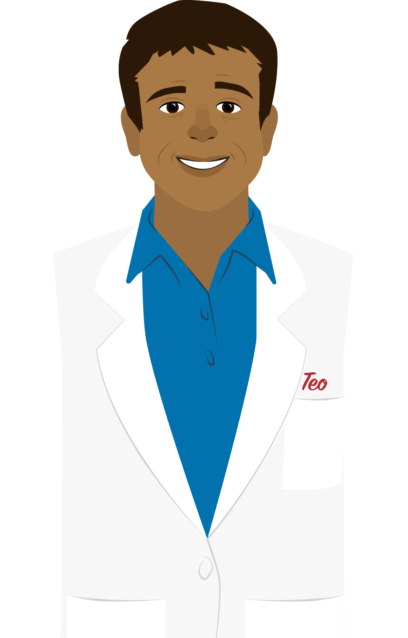



Case Study: Teo Barrera
Turn to Module 1–Case Study Part 1 your workbook
Notes:
Facilitator Script:
We will start Chapter 1 with a case study. Case studies let us explore specific situations through fictional characters who reflect some of the experiences others have during the writing process.
Meet Teo Barrera, who works as a hematologist. Mr. Barrera is at the very beginning of his scientific writing journey and isn't sure if he wants to publish his findings. He will be our companion through Part 1.
I need a volunteer to read Mr. Barrera’s text, which you can find under Module 1, Case Study part 1 in your participant’s workbook. Who would like to read aloud? (Choose a participant to read aloud. This is a good opportunity to learn student names!)
Teo’s text:
“I am a clinical researcher, which means I'm far more comfortable viewing specimens through a microscope than writing about them for a journal. Still, my team and I noticed an unusual pattern of infections transmitted from blood donations made at rural clinics. When we performed a literature review, we found plenty of articles on transfusion infections. We were surprised and excited to find that no one had written about the issue we identified in our rural area. Our research could improve the intake process and reduce the risk of infection in our community, and in other rural communities around the world.
My supervisor has been encouraging us to publish our findings. I have contributed to a few scientific papers, but I've never been a lead author before. I'm worried that I don't have enough experience to be a lead writer on a paper. If I'm being honest, I'm also nervous about writing the bulk of a paper in English, since it's not my first language.”
Thank you (reader’s name)! We’ll revisit Teo again throughout this module.
Facilitator Notes:
You may wish to ask participants if, and how, Teo’s story relates to their own experiences. For example, are any participants feeling nervous about writing a scientific manuscript? Why?

Slide 14
Why Write a Scientific Manuscript?
Reasons to write a manuscript include:
Strengthening and improving your field of work.
Contributing to a greater body of scientific knowledge.
Informing, persuading and motivating change.
Notes:
Facilitator Script:
There are many reasons to write a scientific manuscript. They strengthen and improve your field and contribute to a greater body of knowledge. They can also inform, persuade and motivate change. We all want to make the world a better place–this is a good way to start!

Slide 15
What is Scientific Writing?
Scientific writing is not like general writing.
Scientific writing is:
Strengthening and improving your field of work.
Contributing to a greater body of scientific knowledge.
Informing, persuading and motivating change.
Notes:
Facilitator Script:
Scientific writing is not like most other writing. It’s very specific.
Scientific papers represent a form of technical writing designed to inform and engage other scientists.
Scientific writing is concise, precise, and communicates clearly, without any redundancies.
Often, scientific work builds on previous experiments and discoveries, so your writing should demonstrate any connections while highlighting new findings and emerging ideas.
What questions do you have about scientific writing?

Slide 16
The Scientific Method
Scientific writing is part of the scientific method.
Begins with a question.
Concludes when a researcher shares their results (often in a journal or other publication).
Notes:
Facilitator Script:
Scientific writing is part of the scientific method, which begins with a question and concludes when a researcher shares their results, often by publishing their work in a journal or other publication.

Slide 17
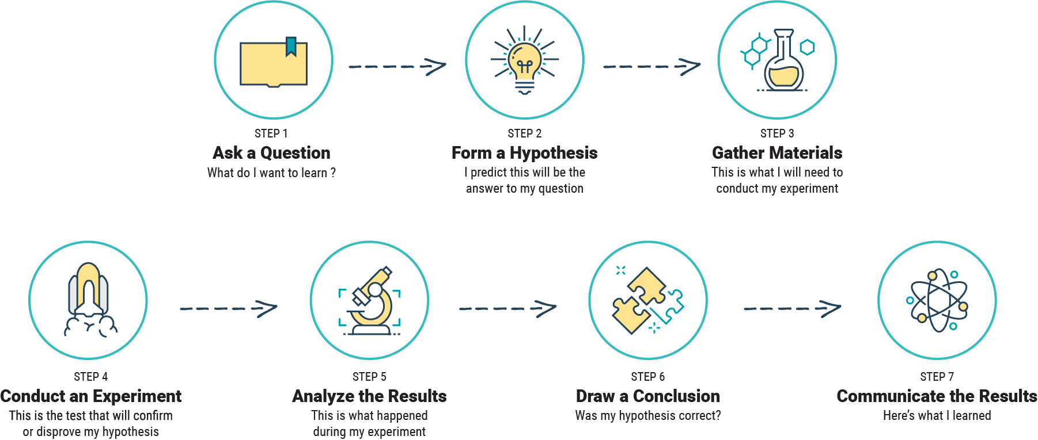
The Scientific Method
Notes:
Facilitator Script:
Let’s review the scientific method.
(Ask a participant to read out – or read out yourself – each step of the Scientific Method.)
Step 1: Ask a question. “What do I want to learn?”
Step 2: Form a hypothesis. “I predict this will be the answer to my question.”
Step 3: Gather materials. “This is what I will need to conduct my experiment.”
Step 4: Conduct an experiment. “This is the test that will confirm or fail to confirm my hypothesis.”
Step 5: Analyze the results. “This is what happened during my experiment.”
Step 6: Draw a conclusion. “Was my hypothesis correct?”
Step 7: Communicate the results. “Here is what I learned.”
(Thank the reader.)
As we move forward, keep this process in mind and think about how each step is presented in scientific writing.

Slide 18
What is the Purpose of Scientific Manuscripts?
Scientific manuscripts:
Aim to inform, not impress
Should be easy to read and understand.
Are published in peer-reviewed publications after a rigorous review process.
Notes:
Facilitator Script:
So, what is the purpose of scientific manuscripts? The following principles will help us answer this question.
Scientific manuscripts aim to inform, not impress, which means they must be easy to read and understand.
Peer-reviewed journals often publish scientific manuscripts. Experts review papers to make sure the information presented is both high quality and scientifically valid before publishing the manuscript.

Slide 19
What is the Purpose of Scientific Manuscripts?
Scientific manuscripts:
Should appeal to two audiences:
  Reviewers
  Readers
Convince audiences that the research is important, valid and relevant.
Notes:
Facilitator Script:
Scientific manuscripts have two audiences. First, we have the reviewers. Reviewers help the journal editor decide whether a manuscript is suitable for publication. The second audience includes the readers themselves, who may know a lot or nothing at all about the topic addressed in the manuscript.
Scientific manuscripts must convince these audiences that the research presented is important, valid and relevant to other scientists in the field. Manuscripts must state both the motivation for the work and the outcome of that work, with enough evidence to establish the validity of the outcome.
What questions do you have about the basics of scientific manuscripts?

Slide 20
When to Write a Scientific Manuscript
Are you ready to write a scientific manuscript?
Think about your research and answer the following questions
in your workbook.
 | YES | NO
Will my manuscript contribute something new and original?
Will my manuscript advance knowledge in my ﬁeld?
Will my manuscript create an impact in my ﬁeld?
Will my manuscript ﬁll a gap in knowledge?
Will my manuscript demonstrate something new or improved
Is my data correct and accurate?
Is my data recent and relevant?
Will my study be interesting or useful to the audience?
Notes:
Facilitator Script:
Based on what we've covered so far, here are some questions that can help you determine when to write a scientific manuscript. Find this slide in Module 1, Chapter 1 in your workbook. With your current research, or research you plan to do in the future, in mind, answer each of these questions.
(Give participants two minutes or so to answer these questions.)
Now, turn to the person next to you and share your answers. Give them some of the details about the work you had in mind while answering these questions. Ask them about their work and take notes! What new things will your work contribute? How will your work advance the knowledge in your field? What gap in knowledge will your work fill? Get to know your neighbor and their work better over the next few minutes.
(Give participants 10 or so minutes to share their answers. At the 5 minute mark, encourage them to switch speaker and listener. Once time is up, encourage students to share their answers and work with the group as a whole. This is a good opportunity to get to know your participants and their work more deeply.)

Slide 21
Types of Scientific Papers
Original articles
  Original articles provide new information based on original scientific research, including methods used and supporting data.
  Case reports
    Case Reports are unique events or novel interpretations of individual cases along with a review of other previously-published cases to put the new event in context.
Notes:
Facilitator Script:
If you aren't ready to publish your work in a peer-reviewed journal, you could consider other forms of scientific writing. Let’s learn about the different types of scientific writing.
Original Articles
Original articles provide new information based on original scientific research, including methods used and supporting data.
Case Reports
Case reports are unique events or novel interpretations of individual cases along with a review of other previously-published cases to put the new event in context.
Technical Notes
Technical notes describe a technique or piece of equipment that has been modified from its original form to be new or more effective.
Pictorial Essays
Pictorial essays teach or demonstrate a topic through a series of high-quality images accompanied by brief text

Slide 22
Types of Scientific Papers
Technical notes
  Technical notes describe a technique or piece of equipment that has been modified from its original form to be new or more effective.
  Pictorial essays
    Pictorial essays teach or demonstrate a topic through a series of high-quality images accompanied by brief text.
Notes:
Facilitator Script:
Technical Notes
Technical notes describe a technique or piece of equipment that has been modified from its original form to be new or more effective.
Pictorial Essays
Pictorial essays teach or demonstrate a topic through a series of high-quality images accompanied by brief text

Slide 23
Types of Scientific Papers
Reviews
  Reviews are detailed analyses of recent developments on a topic
  Commentaries
    Commentaries summarize an author’s personal experience, expertise or opinion on a certain topic.
Reviews
  Reviews are detailed analyses of recent developments on a topic
Letters to the editor
  Letters to the editor address the editor of a publication or author of an article to ask questions or provide constructive criticism of published work.
Notes:
Facilitator Script:
Reviews
Reviews are detailed analyses of recent developments on a topic.
Commentaries
Commentaries summarize an author's personal experience, expertise or opinion on a certain topic.
Editorials
Editorials are short reviews or critiques of original articles or invited opinion pieces on current issues important to the research community.
Letters to the Editor
Letters to the editor address the editor of a publication or author of an article to ask questions or provide constructive criticism of published work.
Take a moment to think about your current work, or work you aspire to do in the future. What kind of paper would best suit that work? (Provide an example from your own work if possible! “For example, I published an original article on…” or “I recently read an editorial on…”)
What questions do you have about the different types of scientific papers?

Slide 24
Case Study: Teo Barrera
Turn to Module 1–Case Study Part 2 your workbook
Notes:
Facilitator Script:
Let’s go back to the case study with Mr. Barrera. Turn to Module 1–Case Study Part 2 your workbook. Who wants to read aloud?
(Select a participant to read Barrera’s text aloud to the class.)
Teo Barrera’s text:
“Asking myself questions about whether or not to write and submit a manuscript helped me discover that I really am ready to write a scientific manuscript and publish our important findings. Now, I just need to understand the steps involved in writing a scientific manuscript.”

Slide 25
You’ve reached the end of Chapter 1!
What questions do you have?
Turn to the Knowledge Check section for Module 1 in your workbook and answer Knowledge Checks 1 and 2.
Notes:
Facilitator Script:
Mr. Barrera has decided to pursue publication! We will follow his lead on to chapter two after we take a short break. First, what questions do you have about what we covered in Chapter 1?
(Solicit questions from participants and provide answers!)
Before our break, let’s do a quick review.
Turn to the Knowledge Check section for Module 1 in your workbook and silently, answer Knowledge Checks 1 and 2. We’ll go over them as a group as soon as you’re done.
(Allow participants 2-3 minutes to answer questions in their workbooks. Remember to collect participants’ worksheets at the end of this session.)

Slide 26


Knowledge Check
Which of the following are true about scientific manuscripts?
Select all that apply.
Scientiﬁc manuscripts aim to inform, not impress.
Scientiﬁc manuscripts are essential to the evolution of modern science. Scientiﬁc manuscripts feature technical, clear and concise writing.
Scientific manuscripts follow the scientific method.
Notes:
Facilitator Script:
(Ask participants to volunteer their answers.)
Correct answer: All these answers are true about scientific manuscripts. Scientific manuscripts aim to inform, not to impress. They are essential to the evolution of modern science and feature technical, clear and concise writing that follows the scientific method.

Slide 27
Knowledge Check
Which of the following are good reasons to write a scientific manuscript?
Select all that apply.
When your work advances the knowledge of the field.
When your work would add new and original results or methods to the scientific conversation.
When your work has already been published.
When your work would fill a gap in existing knowledge.
Notes:
Facilitator Script:
(Ask participants to volunteer their answers.)
Correct answer: You should write a scientific manuscript when your work advances the knowledge of the field, adds new and original results or methods to the scientific conversation, fills a gap or takes a leap in knowledge.

Slide 28
Chapter 2:
The Scientific
Writing Process

Slide 29












The Scientific Writing Process
Research and Prepare
Choose Your Target Audience
Begin Writing
Finish the First Draft of Your Manuscript
Conduct Your Study
Prepare Your Abstract
Summarize Your Results
Revise Your Manuscript
Get Feedback
Finalize the Details
Formulate your Key Message
Submit Your Manuscript
Notes:
Facilitator Script:
The scientific writing process, like the scientific method, is relatively straightforward. These are the steps writers typically follow. (Read through the steps as listed on the slide.) Throughout this chapter, we’ll take a closer look at each step.

Slide 30

Step 1: Research and Prepare
Preparation is the key to success!
Notes:
Facilitator Script:
Preparation is the key to success. You should start thinking about your manuscript and preparing to write even before you conduct your study.

Slide 31
Step 1: Research and Prepare
Conducting a literature review:
Involves searching for and reading scientific papers.
Enhances your knowledge of the topic.
Prevents you from duplicating an existing study.
Situates your work in the larger scientiﬁc discussion.
Exposes gaps in existing knowledge.
Notes:
Facilitator Script:
Research is an integral part of this step, which often begins with a literature review. This involves searching for and reading scientific papers related to your intended study.
Literature reviews will enhance your knowledge of the topic, prevent you from conducting studies that have already been done and situate your work in the larger scientific discussion.
The information gained will help inform and strengthen your study. You will find the gaps in existing knowledge and better understand the relevance and importance of your own original work.

Slide 32
Step 1: Research and Prepare
Literature reviews:
Reveal published research, themes, concepts and writers in your area of study.
Show connections between previous research questions, studies and ideas.
Identify knowledge gaps and disagreements that your study may address.
Illustrate how your topic is different and makes new contributions in your field.
Demonstrate essential scientific skills, such as asking good questions and gathering and analyzing evidence.
Notes:
Facilitator Script:
Literature reviews are very important.
They reveal published research, themes, concepts and writers in your area of study.
They show connections between previous research questions, studies and ideas.
They identify knowledge gaps and disagreements that your study may address.
They illustrate how your topic is different and makes new contributions in your field.
They demonstrate essential scientific skills, such as asking good questions and gathering and analyzing evidence.
What questions do you have about literature reviews? Does anyone have an experience related to literature reviews that you’d like to share?

Slide 33
Step 1: Research and Prepare
When conducting a literature review:
  Choose topic and deﬁne question.
  Determine scope of literature review.
  Select sources.
  Begin search and ﬁnd literature.
  Review literature.
Notes:
Facilitator Script:
Follow these simple steps when performing a literature review.
First, choose your topic and define your question. This will help you search for and isolate articles specific to your research question.
Next, determine the scope of your study and literature review. Are you focusing only on a particular type of procedure? Then you don’t need to include other types of testing in your inquiry or literature review. Are you only focusing on a specific bacterial strain? You probably don’t need to read or research other bacteria.
To complete your literature review, select the sources you will access, such as libraries, online databases, specific journals, and more.
Use those sources to begin your search and find your literature.
Finally, review the research with a critical and analytical eye.

Slide 34
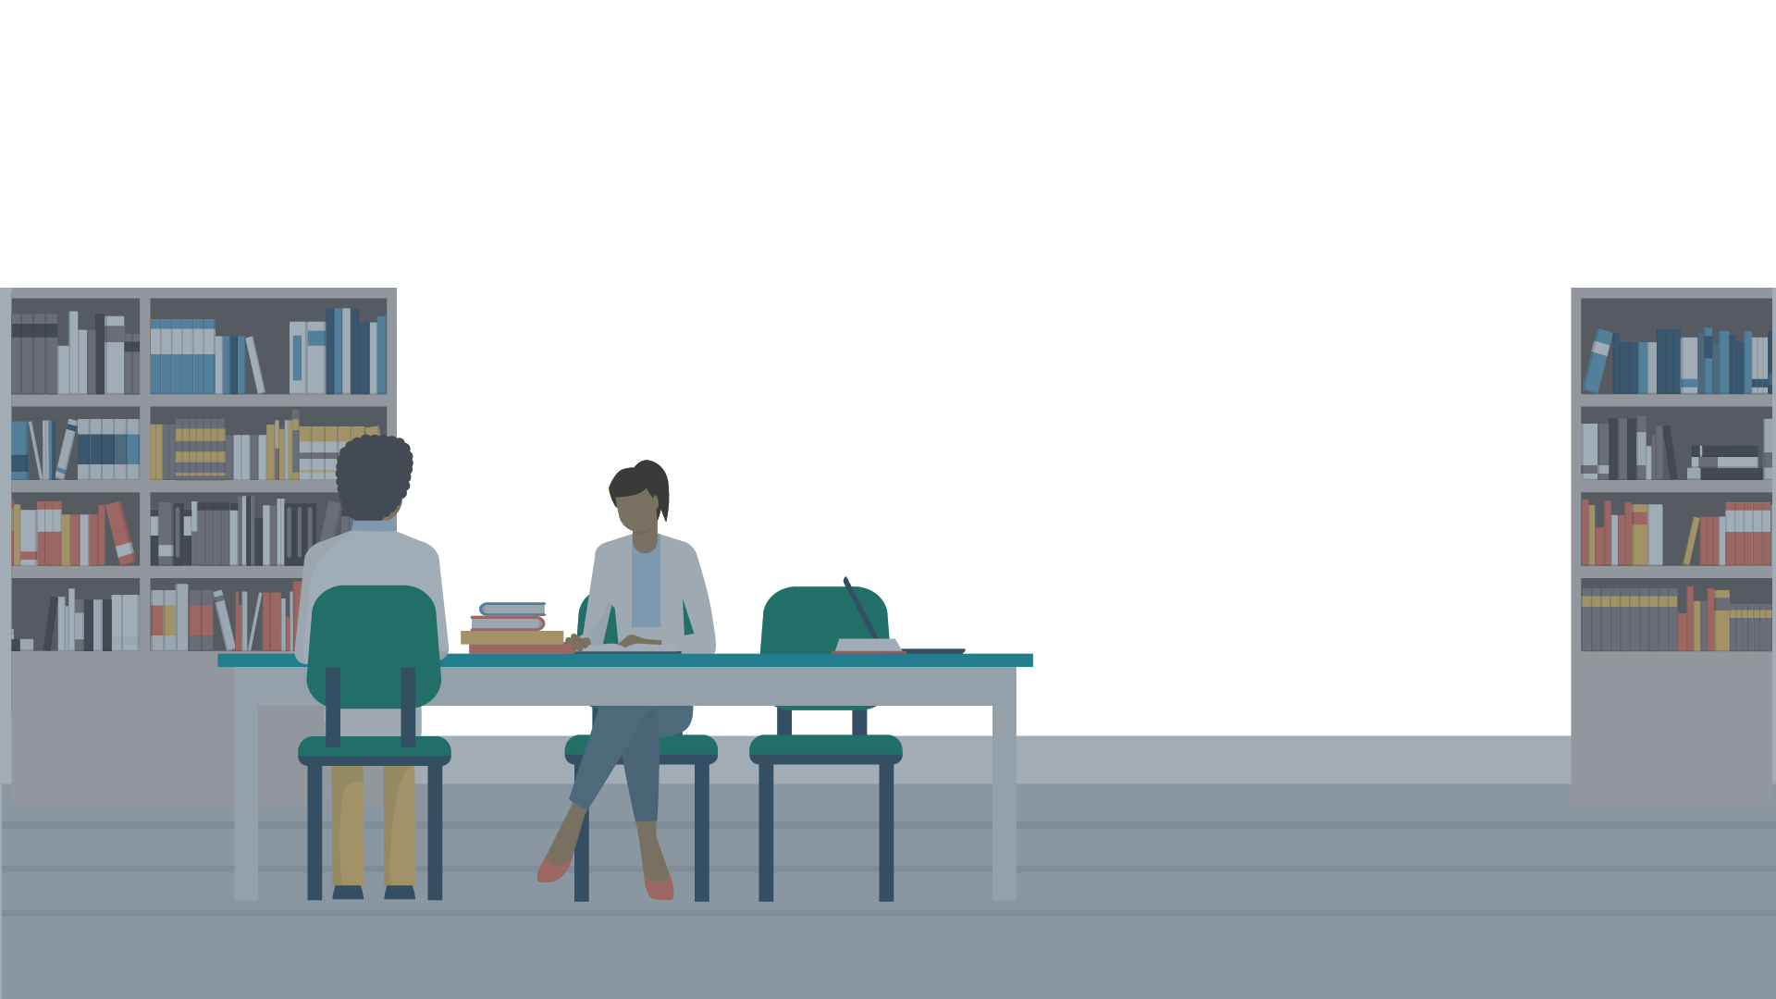
Case Study: Teo Barrera
Turn to Module 1–Case Study Part 3 your workbook
Notes:
Facilitator Script:
Let’s return to Teo Barrera’s case study to see how he prepared to write his manuscript. You can find it in Module 1, Case Study part 3. Who wants to read for us? (Select a participant to read aloud.)
Teo Barrera’s Text:
Conducting a thorough literature review is so important. My team and I red more research than we could possibly fit into our final paper, but it gave us a full background on our subject matter and confirmed that we weren't doing the same work as someone else. We limited our search to recently published papers in well known journals, such as The Lancet, the New England Journal of Medicine, and the Journal of Hematology and Oncology. Then, we took detailed notes on what we red, summarized what we learned and organized that information in a table that we could access later when writing the manuscript.
(Thank the reader!)

Slide 35
Step 1: Research and Prepare
PubMed:
Contains free resource linking to more than
30 million citations and abstracts.
Does not include full-text articles but links to
full-text.
Finds related data in other National Center for Biotechnology Information (NCBI) databases.
Focuses your search with topic-specific queries.
Offers advanced search options to combine search sets.
Offers a free account with customizable filters,
save searches, alerts, sharing and more.
Notes:
Facilitator Script:
As Mr. Barrera noted, the sheer number of publications discovered through a literature review can be overwhelming. Let’s explore some resources you can use to identify the best publications. We’ll start with PubMed.
PubMed is a free resource linking to more than 30 million citations and abstracts. The United States National Library of Medicine at the National Institutes of Health maintain the database.
It does not include full-text articles. Instead, it provides links to those full-text articles.
PubMed finds related data in other National Center for Biotechnology Information (NCBI) databases.
PubMed helps to focus your search by using topic-specific search queries.
It offers a variety of advanced search options and allows you to combine search sets to make your searches even more specific.
PubMed offers a free account with customizable filters, allows you to save searches, share your searches, and more.
Facilitator Notes:
If you have steady internet access, this is a great opportunity to show your participants how to navigate PubMed!

Slide 36
Step 1: Research and Prepare
MEDLINE:
A bibliographic database from the U.S. National Library of Medicine (NLM).
Contains more than 26 million references to journal articles.
Concentrates on biomedicine.
Includes literature published from 1966 to present.
OLD MEDLINE covers 1946 to 1956.
Notes:
Facilitator Script:
MEDLINE is the U.S. National Library of Medicine® (NLM) premier bibliographic database.
It contains more than 26 million references to journal articles in life sciences with a concentration on biomedicine.
MEDLINE includes literature published from 1966 to the present, and OLD MEDLINE includes literature published from 1946 to 1956.
Facilitator Notes:
If you have steady internet access, this is a great opportunity to show your participants how to navigate MEDLINE!

Slide 37
Step 1: Research and Prepare
Other resources:
Use Google Scholar's "Cited By" feature to find related articles and manuscripts.
Use the CDC Library for resources and training if access permitted.
Contact leading researchers to learn about in-press or unpublished work.
Notes:
Facilitator Script:
There are many, many more resources for you to explore, but starting with Google Scholar’s “Cited By” feature will allow you to find articles and manuscripts related to ones you’ve already found worthwhile.
(If you have steady internet access, this is a great opportunity to show your participants how to navigate Google Scholar!)
The CDC’s online library provides free resources and training, if you are permitted to access it.
(If you have steady internet access, this is a great opportunity to show your participants how to navigate the CDC Library!)
You can and should contact the leading researchers in your field of interest to learn about any currently published or yet-to-be published work they think would be relevant to your studies! This includes contacting journal editors, professors, or other scientists who work in your field.
(Feel free to include any other resources or tips that might benefit your participants!)
What questions do you have about databases and resources for research?

Slide 38
Step 1: Research and Prepare
Tips & tricks for an effective search for literature:
Identify key search terms.
Decide on filters/limits.
Use Boolean operators like AND, OR, NOT.
Find associated search terms for proximity searching.
  E.g.: searching for "curriculum" and "theories" retrieves many phrases formed with those two words.
  Use truncation or wildcard searching for a word with multiple endings.
    E.g.: vaccin* will retrieve vaccine, vaccines, vaccinate, vaccination, etc.
Notes:
Facilitator Script:
A Literature Review is much easier if you search effectively.
Identify key search terms for your work. For example, if you’re working on analyzing developments in STD testing, you’ll want to look at a wide range of STDs, and you’ll want to include those in your searches.
Most search engines have advanced search features or tips for better searches, allowing you to be more specific with your search and refine your search results. You can use the following search limits and filters:
Published date or web page update
Filetype (doc, docx, ppt, etc)
Search for phrases ("quotation marks")
Eliminate from results those page that include unwanted search terms (NOT or -)
Use Boolean operators, like AND, OR, and NOT. Instead of looking for “human immune responses to live-attenuated tularemia vaccine,” look for “live-attenuated” AND “immune responses” AND “tularemia vaccine" in your searches.
Find associated search terms for proximity searching. Searching for words like “curriculum” and “theories” will retrieve many phrases formed with those two words.
Use truncation or wildcard searching for a word with multiple endings. For example, “vaccin*” will return search results for “vaccine,” “vaccines,” “vaccinate,” “vaccination,” etc.
Facilitator Notes:
If you have stable internet access, this can be a very important opportunity to provide examples and demonstrations of good search protocols! Take your time to demonstrate the navigation of whatever search engine or database you are most familiar with.

Slide 39
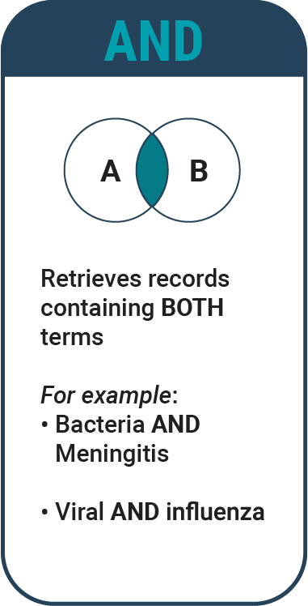
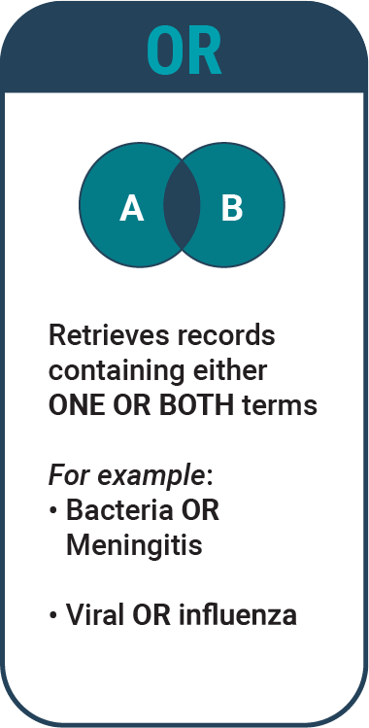
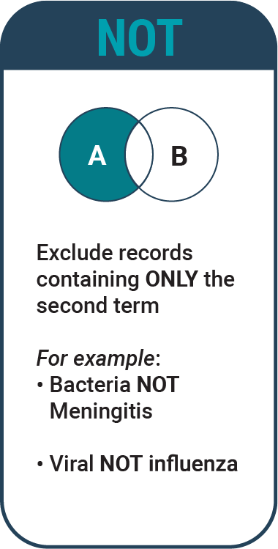
Step 1: Research and Prepare
Notes:
Facilitator Script:
AND, OR, and NOT are Boolean operators. These operators allow users refine their searches and produce more relevant results.
AND retrieves records containing BOTH terms entered. For example, using “Bacteria AND Meningitis” will return only results that include both the terms “bacteria” and ”meningitis.” Using “viral AND influenza” will return only results that include both terms.
OR retrieves records containing either one or both search terms. For example, using “Bacteria OR meningitis” will return everything including the terms “Bacteria” OR “Meningitis.” Using “viral OR influenza” will return everything related to each search term.
NOT excludes records containing ONLY the second term. By using the phrase “Bacteria NOT meningitis,” We are asking the database to search for pieces that contain the word “bacteria,” but to exclude any pieces that also contain the word “meningitis.” This will also exclude all pieces that just include the word “meningitis.” Likewise, if we use the phrase ”viral NOT influenza,” the search will return only pieces that include the word “viral” and do not contain the word “influenza.”
What questions do you have about Boolean searches?
(Ensure these terms are clear to participants!)

Slide 40
Step 1: Research and Prepare
Evaluating the literature: CRAAP test
Currency | How current is the piece?
Relevance | How relevant is the piece?
Authority | Does the author have authority?
Accuracy | How accurate is the piece?
Purpose | What was the author’s purpose?
Notes:
Facilitator Script:
With so many sources available today, it can be difficult to verify their reliability.
One technique that may help is this memorable mnemonic device: the CRAAP test. CRAAP stands for:
Currency or Timeliness;
Relevance;
Authority;
Accuracy;
and Purpose.
The questions on the next slide will help you analyze and evaluate each source for your literature review.

Slide 41
Step 1: Research and Prepare
Evaluating the titerature: CRAAP test
Currency | Consider the timeliness of this piece. When was it written? Is it out of date, or is it still current?
Relevance | Is this piece relevant to your study or your research question? Is the information presented at an appropriate level for your needs?
Authority | Who wrote this piece? Are they an authority on the topic? Are they a reputable source of information? Has this piece been cited by other reputable sources?
Accuracy | How accurate is the information in this piece? How detailed is the methodology? Does the research seem to be complete? What further questions does the study raise? Are those questions addressed?
Purpose | What was the author’s purpose in writing this piece? Is it to inform, teach, sell, entertain, or persuade? Do they have other motivations? Who funded their studies?
Notes:
Facilitator Script:
These questions can help you analyze and evaluate each source for your literature review.
Currency
Consider the timeliness of this piece. When was it written? Is it out of date, or is it still current? An out-of-date piece may no longer be accurate or relevant to your studies.
Relevance
Is this piece relevant to your study or your research question? If it’s irrelevant, you can discard it.
Is the information presented at an appropriate level for your needs?
Authority
Who wrote this piece? Are they an authority on the topic? What are the author's credentials? Do these identify the author as an authority in the field?
Are they a reputable source of information?
Has this piece been cited by other reputable sources?
Accuracy
How accurate is the information in this piece? Is the information reliable and free from errors?
Information that is full of spelling, grammatical, or other proofreading errors comes across as unprofessional and unpolished, and therefore unreliable. Additionally, the information itself should be correct and not faulty or wrong.
How detailed is the methodology? A detailed methodology ensures replicability of the study, and is an important part of most accurate, reliable pieces.
Does the research seem to be complete?
What further questions does the study raise? Are those questions addressed?
Purpose
What was the author’s purpose in writing this piece? Is it to inform, teach, sell, entertain, or persuade? Do they have other motivations?
Who funded their studies? Funding can lead to conflicts of interest and knowing who funded a study may help you determine if the authors were swayed by money, or if they had a financial interest in a specific outcome.
What questions do you have about evaluating literature?

Slide 42
Before we move on…
Turn to the Knowledge Check section for Module 1 in your workbook and answer Knowledge Check 3.
Notes:
Facilitator Script:
In just a moment, we will move on to the next step in the scientific writing process. First, let's test your knowledge of literature reviews.
Turn to the Knowledge Check section for Module 1 in your workbook and answer Knowledge Check 3. We’ll go over this question as a group as soon as you’re done.
(Allow participants 2 minutes to answer questions in their workbooks.)

Slide 43
Knowledge Check
Literature reviews are important because they...
Select all that apply.
Explain the background of research on your study topic.
Exhaustively detail every work written on your topic.
Discover relationships between previously performed research studies and ideas.
Identify important research themes, concepts, and writers who have focused on your topic.
Identify gaps and disagreements that your study may address.
Notes:
Facilitator Script:
(Ask participants to volunteer their answers.)
Correct answers: Every answer except the second is correct! Literature reviews can very rarely be fully exhaustive. However, they do explain the background of research on your study topic, discover relationships between previously performed research studies and ideas. identify important research themes, concepts, and writers who have focused on your topic, and identify gaps and disagreements that your study may address.

Slide 44

Step 2: Begin Writing
Begin writing about your topic before you conduct your study.
Notes:
Facilitator Script:
Beginning to write about your topic BEFORE you conduct your study may seem strange, but it's surprisingly important.
You must have your topic and manuscript in mind when you perform the study. Otherwise, you run the risk of not having enough documentation.

Slide 45
Step 2: Begin Writing
How to start:
Draft the introduction of your future manuscript.
Work on your study protocol.
Write a grant proposal.
Build dummy tables and figure axes for the results section.
Notes:
Facilitator Script:
You may start by drafting the introduction section of your future manuscript, working on your study protocol or writing a grant proposal.
Starting dummy tables or figures for the Results section is another way to get you thinking about exactly what you want to achieve— through your study and in your future publications.

Slide 46

Step 3: Perform Your Study
While conducting your study, take note of the following:
Reason for study
Research methods
Materials, including any specific technologies used
Study outcomes
Notes:
Facilitator Script:
After all this preparation, it's time to conduct your study. Remember to take lots of notes as you work. These will be invaluable later.
Take notes on your reason for completing the study, your research methods, your materials and tools, any specific technologies used and all your outcomes.

Slide 47

Step 4: Summarize Your Results
Ask yourself:
What am I trying to say with my data?
Which results will best support my key message?
Notes:
Facilitator Script:
After performing your study, organize your data and summarize your results. Ask yourself a few key questions as you do this. What am I trying to say with my data? Across my findings, which results will best support the main message I want to convey in my manuscript?

Slide 48

Step 5: Get Feedback
Ask for feedback frequently!
Ask your co-authors, colleagues, and peers to review your work as you go.
  Get suggestions on how to make your writing clear, concise, and understandable.
Present at conferences.
Gather diverse feedback.
Notes:
Facilitator Script:
Ask your co-authors, colleagues and peers to review your work as you go. Have them look at everything you create and offer suggestions on how to make your writing clear, concise and understandable.
Don't wait to get feedback until you've finished writing. Ask for it frequently. Presenting information to your colleagues and at conferences can also be an excellent way to gather diverse feedback.

Slide 49
Step 5: Get Feedback
Seek feedback when you are:
Frustrated
Confused
Close to a breakthrough
In need of a fresh perspective
Notes:
Facilitator Script:
Getting feedback and incorporating it into your writing is necessary throughout the entire writing process. Seek feedback whenever you are frustrated, confused, or when you’ve made a breakthrough.
Feedback is an important part of writing, and is a good way for your colleagues, coworkers and friends to support you.
What questions do you have about getting feedback?

Slide 50

Step 6: Formulate Your Key Message
Your key message:
Conveys the most important point for readers to remember.
Distills your paper down to one sentence.
May change as you write your paper.
Notes:
Facilitator Script:
What is the most important thing for your readers to understand? Answer that question and you should have your key message. The key message is what you will get if you distill your entire paper down to one simple sentence.
Your key message may change as you write your manuscript. That's okay! Just make sure that during the editing process, you go back and update your key message.

Slide 51
Case Study: Teo Barrera
Mr. Barrera’s
research question
Why are blood donations collected in rural areas of our community testing positive for high rates of transfusion-transferrable infections?
Mr. Barrera’s
main findings
Blood donors were not disclosing infections because our screening tools did not effectively explain the need for this information. We can reduce donations of infected blood by creating new educational materials for blood donors and by making our screening tools and procedures easier to use.
Key message of
Mr. Barrera’s manuscript
Improved donor education and screening procedures may prevent blood donations that test positive for transfusion-transmissible infections.
Turn to Module 1–Case Study Part 4 your workbook
Notes:
Facilitator Script:
Let’s go back to the case study with Mr. Barrera. Turn to Module 1–Case Study Part 4 in your workbook to see how Mr. Barrera narrowed down his key message.
Who wants to read aloud?
(Select participants to read each section aloud.)

Slide 52
Step 6: Formulate Your Key Message
Sample key messages:
In Ethiopia, diarrheal disease kills more children
aged <5 years than malaria. (12 words)
Vitamin A deﬁciency is common despite widespread distribution of free capsules. (11 words)
Intermittent availability of tuberculosis drugs leads to an increase in multidrug-resistant tuberculosis
(MDR-TB). (13 words)
Notes:
Facilitator Script:
Here are a few more sample key messages. As you see, they’re short and to the point! A key message is often quite concise. Who wants to read them aloud? (Select a participant to read the key messages aloud).
What questions do you have about formulating a key message?

Slide 53
Step 6: Formulate Your Key Message
What’s your key message? Questions to consider:
If you only had a minute to describe your work to someone else in passing, what would you say?
If your readers could only remember one thing from your manuscript, what would you want that one thing to be?
If someone outside your ﬁeld read your key message, would they understand it?
Remember, your key message must be clear, concise and direct.
Notes:
Facilitator Script:
Find this slide in your workbook. Use the space provided to work on your key message. Think about your current manuscript topic, or about a topic you'd like to work on in the future. Using space in your workbook, answer the following questions:
If you only had a minute to describe your work to someone else, what would you say?
If your readers could only remember one thing from your manuscript, what would you want that one thing to be?
If someone outside your field read your key message, would they understand it?
Take 10 minutes to work on your key message. When that 10 minutes is over, we’ll share our work together.
Facilitator Notes:
Time 10 minutes.
Alert participants when there are two minutes left.
When participants are finished, ask for volunteers to share their key message.
See if any other participants have feedback on the shared key message.
Offer your own feedback.
Do this several times, with several participants.

Slide 54

Step 7: Choose Your Target Audience
To determine your target audience, ask yourself:
Who is interested in my message? What are their job titles?
What conferences do they attend?
Potential Audiences:
Laboratorians, Public Health Practitioners, Clinicians, Scientists, Policymakers
Notes:
Facilitator Script:
When writing your manuscript, it's helpful to determine who you're writing for, or your target audience.
How do you find your target audience? Well, ask yourself: who is interested in my message? What job titles do they have? What conferences do they attend? Write for that audience.
Potential audiences for our work might include laboratorians, public health practitioners, clinicians, scientists and policymakers. Can you think of any other audiences that might be interested in your work?
(Take suggestions! If no suggestions are presented, add your own or move forward.)

Slide 55
Step 7: Choose Your Target Audience
Write for your audience members.
What journals do they read and respect?
  Select journals that reach your target audience
Notes:
Facilitator Script:
Knowing your target audience also helps when it's time to submit your work for publication. Select journals based on their match with your target audience. Writing for a journal that your audience doesn't read is a waste of your valuable time.
Feel free to ask your colleagues for suggestions. What journals do they read and respect?
What about right here in the room? What scientific journals do you read and respect? Why do you like these journals?
(Take suggestions! If there are none, offer your own favorites, and explain why you like them.)

Slide 56
Step 7: Choose Your Target Audience
When selecting a journal for submission:
Review and follow the style guidelines and submission requirements.
Submit to publications that best match your topic.
Notes:
Facilitator Script:
When you're ready to submit your work, look for a journal's style guidelines and submission requirements. They will help you write precisely what the journal wants. Following those guidelines makes it much easier for journal editors to accept your work.
(This is a good opportunity to show examples of style guidelines and submission requirements. Examples can be found at
The American Society for Clinical Laboratory Science: https://www.ascls.org/communication/clinlabsci-journal
Practical Laboratory Medicine: https://www.elsevier.com/journals/practical-laboratory-medicine/2352-5517/guide-for-authors
Clinical Chemistry: https://academic.oup.com/clinchem/pages/General_Instructions
Blood, the journal of the American Society of Hematology: https://ashpublications.org/blood/pages/style-guide )
Consider aiming high with your manuscript. It can be challenging to get published in top journals, but reviewer comments can be valuable, even if they choose not to publish your work.
What questions do you have about target audiences?

Slide 57

Step 8: Finish the First Draft of Your Manuscript
Take your research findings, the draft of your
key message, and finish writing the first complete draft of your manuscript!
Notes:
Facilitator Script:
In Step 8, you’ll take your research findings, the draft of your key message, and finish writing the first complete draft of your manuscript!
In Module 2 of this training, we'll discuss in detail the typical sections included in a manuscript to help you with this step in the process. For now, let’s complete our review of the steps.

Slide 58

Step 9: Finish the First Draft of Your Manuscript
The abstract is:
Revised and finalized throughout the manuscript preparation process.
A focused paragraph highlighting essential points of the study.
A summary and analysis of the research.
Developed enough to stand on its own.
Notes:
Facilitator Script:
The abstract is a critical part of your manuscript that you'll begin early in your writing process, and revise and finalize as you revise and finalize your manuscript. The abstract is the first thing, after the title, that anyone will read.
The abstract is a focused paragraph highlighting the essential points of your study.
It acts as both a summary and analysis of your research.
Write the abstract with enough detail so that it can stand on its own, even without the rest of the paper. We will spend more time on abstracts later in the training.

Slide 59

Step 10: Revise Your Manuscript
Revising your manuscript involves:
Reworking.
Adjusting.
Editing.
Notes:
Facilitator Script:
Revising your manuscript involves reworking, adjusting, editing or adding to your work based on feedback you've received.

Slide 60

Step 11: Finalize the Details
Read, re-read and perfect your manuscript.
Notes:
Facilitator Script:
After revising your manuscript, the last step is finalizing the details. Here you must read and reread your manuscript to find and fix anything you don't like. Printing a paper copy of your manuscript may help with this process because you can take notes by hand.
(Add any other tips you might have for revision!)

Slide 61

Step 12: Submit Your Manuscript
Notes:
Facilitator Script:
After all this hard work, you'll be ready to submit your manuscript!

Slide 62
You’ve reached the end of Chapter 2!
What questions do you have?
Turn to the Knowledge Check section for Module 1 in your workbook and answer Knowledge Checks 4-6.
Notes:
Facilitator Script:
What questions do you have about what we’ve covered in Chapter 2? (Allow participants time to formulate and ask questions!)
You’re almost done with Module 1. We’ll take a break in just a moment, but let’s review before moving on to Module 2.
Turn to the Knowledge Checks section in Module 1 to answer questions 4-6. We’ll go over them as a group as soon as you’re done.
(Allow participants 2-3 minutes to answer questions in their workbooks.)

Slide 63
Knowledge Check
When should you conduct a literature review?
Select one answer.
Before conducting your study.
After conducting your study.
Notes:
Facilitator Script:
(Ask participants to volunteer their answers.)
Correct answer: Conducting a literature review before performing your study will enhance your knowledge on the topic, help you to understand the gaps in existing knowledge, and the relevance of your own original work. It will also ensure you are not performing a study that has already been done!

Slide 64
Knowledge Check
True or False?
  Performing a literature review
  will make you an expert on your topic.
  False
Notes:
Facilitator Script:
(Ask participants to volunteer their answers.)
Correct answer: Literature reviews will help enhance your knowledge, but only experience, time, and dedication will make you an expert!

Slide 65
Knowledge Check
When should you conduct a literature review?
Select one answer.
What have I found that is interesting?
What have I found that is new?
What have I found that could have an impact?
Notes:
Facilitator Script:
(Ask participants to volunteer their answers.)
Correct answer: Asking yourself ALL three questions will help formulate your key message, which should be one sentence that can be supported by your findings.

Slide 66
Congratulations!
You’ve now completed
Module 1: Overview of the Scientific Writing Process!
Notes:
Facilitator Notes:
Congratulate your participants on finishing the first part of the training! If appropriate, break for the day. If not, give students an appropriate break before beginning Module 2.

