Slide 1
SCIENTIFIC WRITING
The Basics

Slide 2
Module 2
Manuscript Preparation
Notes:
Facilitator Script:
Welcome to Module Two. In Module One, we presented an overview of the scientific writing process and its steps. Now, let's take a closer look at the manuscript and its individual sections.

Slide 3

Module 2 Agenda
Module 1: Manuscript Preparation
Chapter 1: Principles of Scientific Writing
Chapter 2: Scientific Writing Steps
Chapter 3: The Introduction and Methods Sections
Chapter 4: The Results Section
Chapter 5: The Discussion, Acknowledgements and Citations
Notes:
Facilitator Script:
Part 2 includes five chapters. Chapter 1 looks at the manuscript outline. Chapter 2 explores the development of a title and abstract. Chapter 3 covers the introduction and methods sections. Chapter 4 digs into the results section, and Chapter 5 covers the discussion, acknowledgements, and citations sections.

Slide 4
Module 2 Learning Objectives
By the end of Module 2, you will be able to:
Describe the scientific writing process and each of its key stages.
Describe and understand the importance of each section of scientific manuscript
Demonstrate an understanding of and ability to analyze and present data.
Notes:
Facilitator Script:
By the end of Part 2, you will be able to:
Describe the scientific writing process and each of its key stages.
Describe and understand the importance of each section of a scientific manuscript.
Demonstrate an understanding of and ability to analyze and present data.

Slide 5
The Manuscript
Outline
Chapter 1:

Slide 6
The Scientific Writing Roadmap
The structure of a manuscript is like a roadmap.
The sections of the manuscript are signposts!
Notes:
Facilitator Script:
Writing is, at its core, a creative pursuit. Novelists and poets have to create a new path every time they write. Fortunately, we scientists already have a well-worn path for writing a manuscript. Think of the structure of a manuscript like a roadmap. The sections of the manuscript are our signposts, each logically following the last to lead us to our destination.

Slide 7
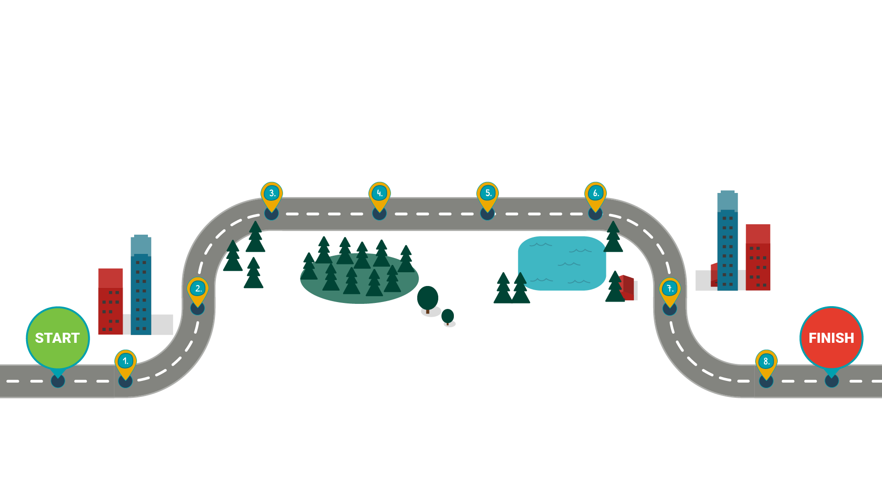
The Scientific Writing Roadmap
Methods
Results
Introduction
Discussion
Abstract
Acknowledgments
Title
References/Citations
Notes:
Facilitator Script:
Here is that roadmap. It goes from the title of the piece all the way to the references and citations.
Facilitator Notes:
Click to reveal each part of the "scientific writing roadmap." As you click, the names of each section will appear as signposts for the roadmap!

Slide 8
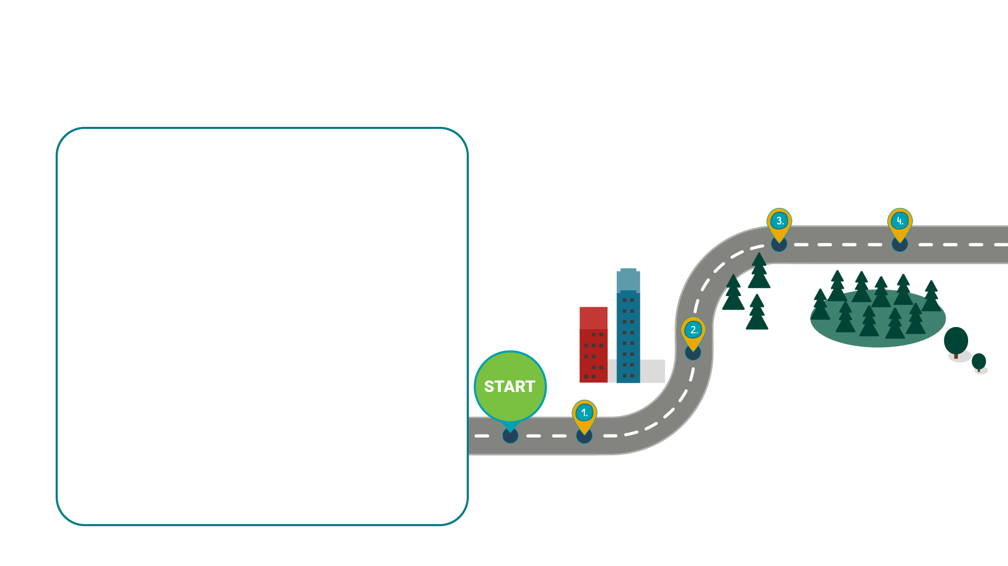




The Scientific Writing Roadmap
INTRODUCTION
Key Questions to Answer:
    Why was the study undertaken?
    What was the research question, the tested hypothesis or the purpose of the study?
METHODS
Key questions to answer:
    When, where and how was the study undertaken?
    What materials were used in the study?
    If there were study groups, who was in those study groups?
TITLE
Key Questions to Answer:
What was the subject, and what particular aspect of that subject was studied?
ABSTRACT
Key Questions to Answer:
  Manuscript summary
    What was the main reason for the study?
    What were the primary results of the study?
    What were the major conclusions of the study?
Notes:
Facilitator Script:
Each section of your manuscript must answer specific questions and fulfill some specific needs. Turn to Part Two, Chapter One in your workbooks to go over this brief overview of each of the sections.
Facilitator Notes:
Click to reveal content about each section of the scientific manuscript. As you click, new information will appear!
TITLE
The title must answer, “What was the subject, and what particular aspect of that subject was studied?”
ABSTRACT
The abstract must summarize the manuscript and answer the following questions:
What was the main reason for the study?
What were the primary results of the study?
What were the major conclusions of the study?
INTRODUCTION
The introduction must answer the question of why the study was undertaken. It must also state the research question, tested hypothesis or purpose of the study.
METHODS
The methods section must cover when, where and how the study was undertaken. It must also explain what materials were used in the study and explain any study groups that were involved.

Slide 9
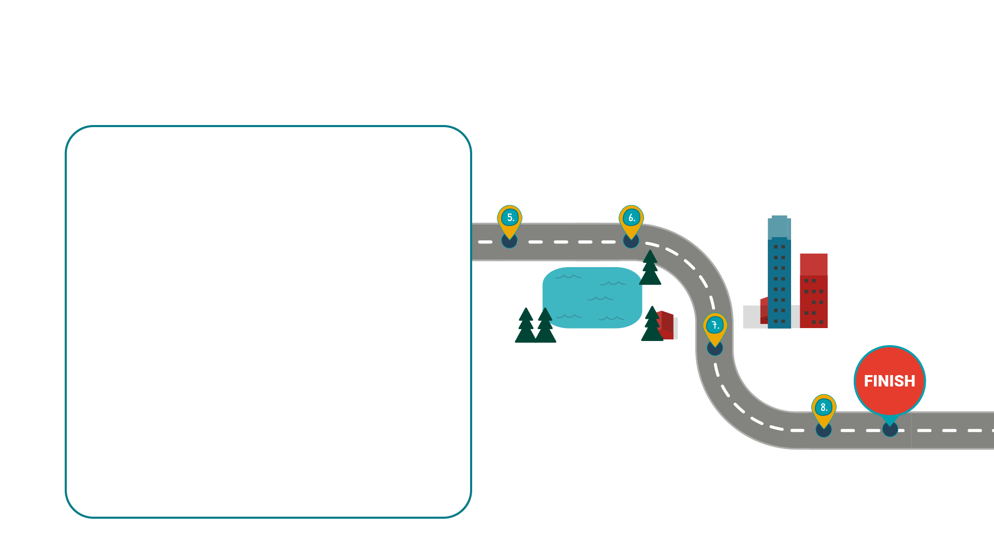




The Scientific Writing Roadmap
REFERENCES/CITATIONS
Key questions to answer:
    What scientific literature was used in conducting the study and writing this manuscript?
ACKNOWLEDGMENTS
Key Questions to Answer:
    Who helped with this study?
    Who should be thanked?
RESULTS
Key Questions to Answer:
What observations were made during the study?
What was the outcome of the tested hypothesis or research questions?
DISCUSSION
Key Questions to Answer:
    What do the outcomes of the study imply, and why is that important?
    How does this study and its outcomes fit with what other researchers have found or published?
    What future research is possible or needed?
Notes:
Facilitator Notes:
Click to reveal content about each section of the scientific manuscript. As you click, new information will appear!
Facilitator Script:
RESULTS
The results section looks at what observations you made during the study. You must also provide the outcome of your tested hypothesis or research question.
DISCUSSION
In your discussion section, you need to answer questions about the outcome of your study. What do those outcomes imply? Why is that important?
You must also situate your study and its outcomes within what other researchers have found or published. What does your study say about previous work?
Last, you need to address the question of future research. What future research is possible? What future research is needed?
ACKNOWLEDGMENTS
Your acknowledgements section needs to acknowledge the people who helped you with your study. These people need to be thanked, and this is the place to do it.
REFERENCES/CITATIONS
The references and citations section is where you lay out all the scientific literature you used in conducting the study and writing the manuscript.

Slide 10
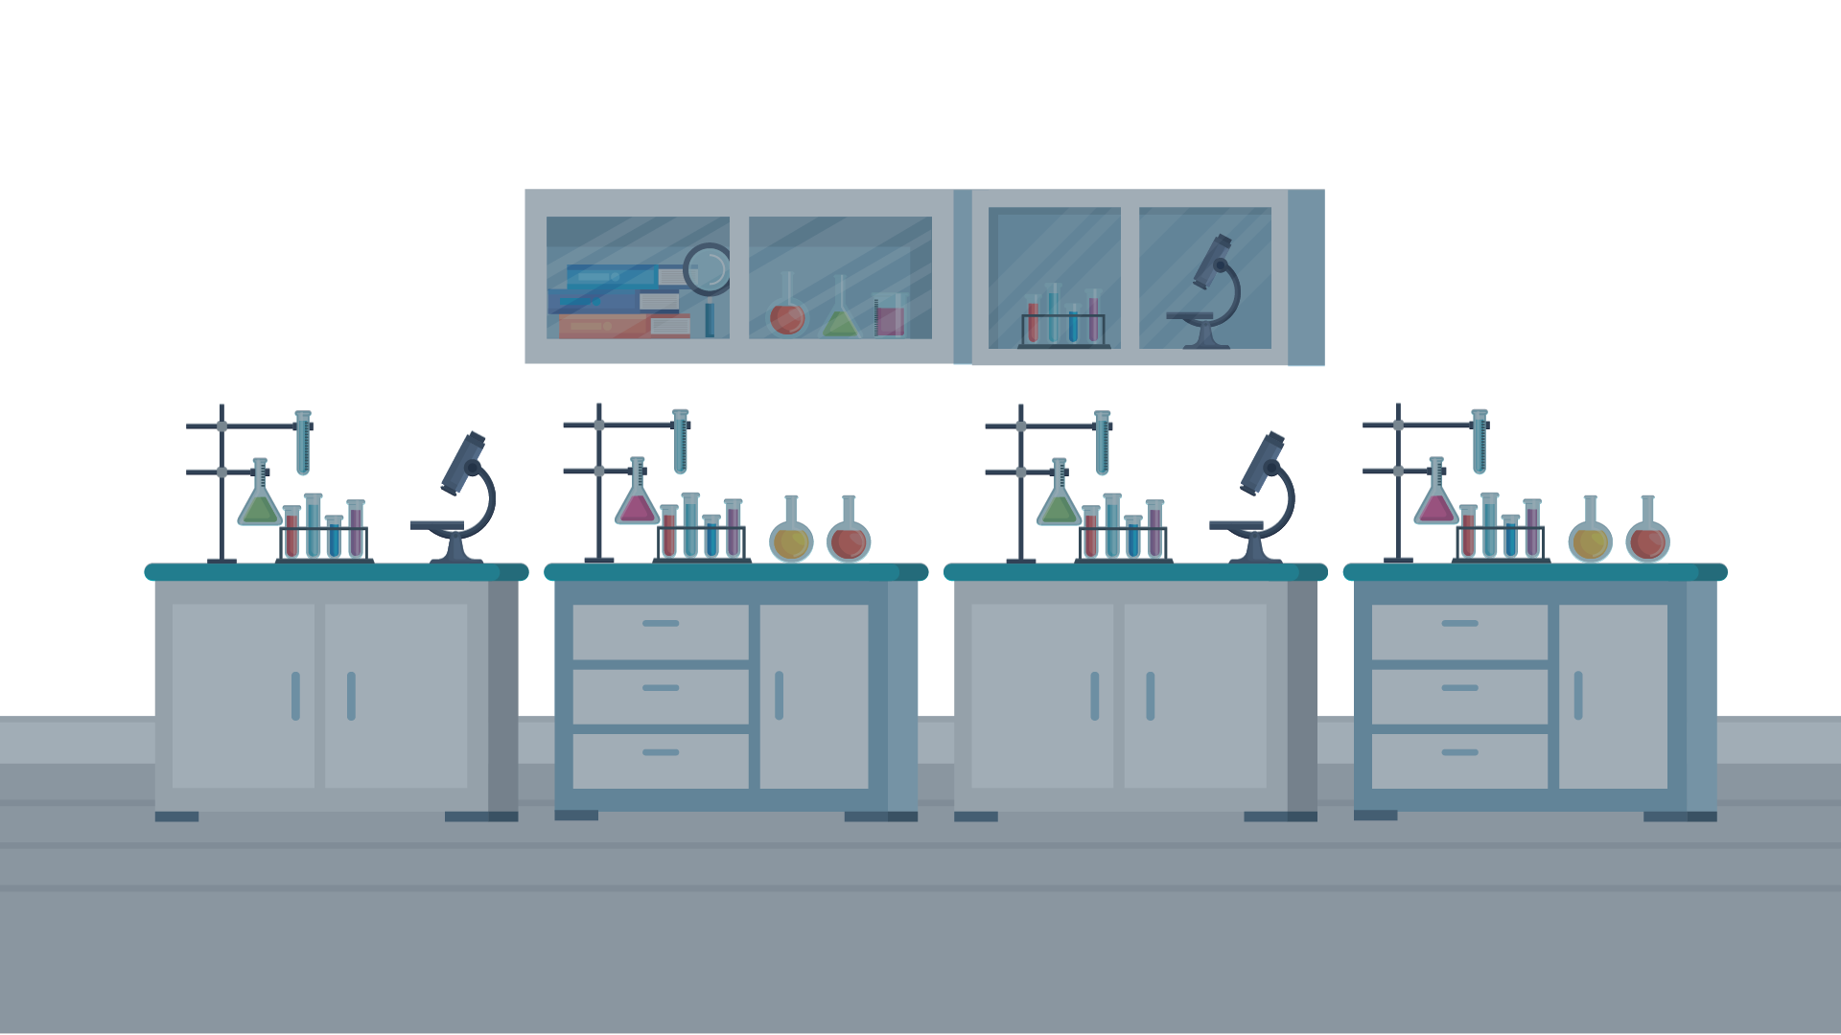

Case Study: Netra Chey
Turn to Module 2–Case Study Part 1 your workbook
Notes:
Facilitator Script:
Now that we have a basic understanding of the structure of a scientific manuscript, let’s look at a case study. In this part, we will meet Netra Chey, who has some useful ideas on how to organize your manuscript.
I need a volunteer to read Ms. Chey’s text, which you can find in the Case Study section of Module 2 in your participant’s workbook. Who would like to read the first part aloud? (Choose a participant to read aloud!)
Netra’s text:
Staying organized and taking notes as you work will help you manage the writing process. I referred to the manuscript outline, or roadmap, many times as I wrote--to add new details, make changes, or track what I was missing.
If you're working on a scientific journal article, like I am, you may already be familiar with the IMRaD structure. IMRaD is a mnemonic device that helps us remember the most important elements of a journal article, which are also part of the manuscript outline. These are the Introduction, Methods, Results and Discussion.
Thank you (reader’s name)!

Slide 11
IMRaD
Title
Abstract
Introduction
Methods
Results
Discussion
Acknowledgements
References/Citations
Notes:
Facilitator Script:
Netra mentioned IMRaD. While each section of the manuscript plays an integral role, the most crucial parts are the Introduction, Methods, Results and Discussion. Can anyone tell me why this is?
(Encourage participants to raise their hands to answer the question.)
These are the most important parts of the manuscript because they are the body of the manuscript. What questions needs to be answered in the Introduction? (Remind participants that they can check their notes if they need to.) The introduction must answer why the study was undertaken, and it must state the research question, tested hypothesis or purpose of the study. In the introduction, you make the case for why your research is important.
What questions must be answered in the methods section? (Remind participants that they can check their notes if they need to.) The methods section states what you did in your study. It must cover when, where and how the study was undertaken, and it must explain what materials were used in the study. It must also explain any study groups that were involved.
What questions must be answered in the results section? (Remind participants that they can check their notes if they need to.) The results section states the findings of your study. What observations did you make? You must also provide the outcome of your tested hypothesis or research question.
What questions must be asked in the discussion section? (Remind participants that they can check their notes if they need to.) The discussion section is where you get to explain what your results mean. To do that, you need to answer questions about the outcome of your study. What do those outcomes imply? Why is that important You must also situate your study and its outcomes within what other researchers have found or published. What does your study say about previous work? Last, you need to address the question of future research. What future research is possible? What future research is needed?
IMRaD covers the body of your manuscript, and that body is important because it covers the salient details of your entire study.

Slide 12
You have reached the end of Chapter 1!
What questions do you have?
Notes:
Facilitator Script:
We'll examine IMRaD and the other sections of the manuscript more closely in the following chapters, starting with the title and the abstract.

Slide 13
Developing a
Title and Abstract
Chapter 2:

Slide 14
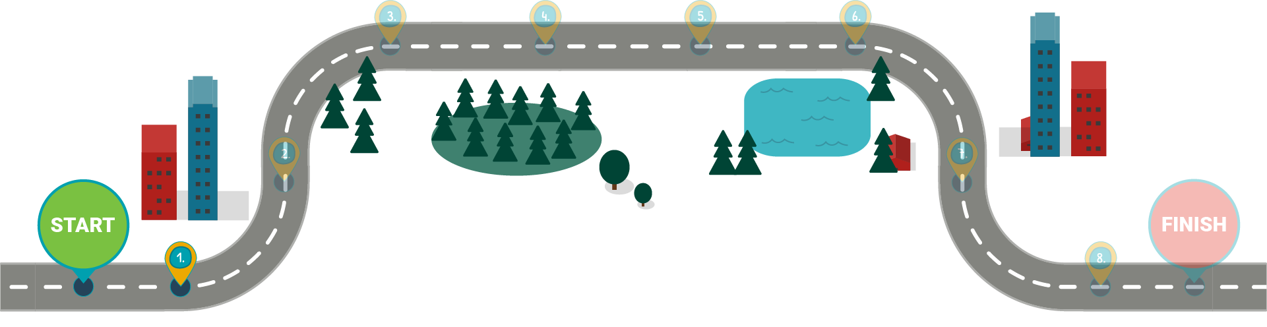
The Scientific Writing Roadmap
Title
Notes:
Facilitator Script:
Now that you have learned what all the manuscript sections are, let's consider the first pieces of information your readers will encounter. A title is the first stop on the scientific writing roadmap.

Slide 15
Title
A good title:
Attracts attention
Shows up when searching for indexes and citations
Summarizes paper accurately
Identifies manuscript’s main topic
Notes:
Facilitator Script:
The title and the abstract should tell your readers a lot about the rest of your paper as a whole. Both need to represent the essence of your manuscript.
This may seem like an obvious statement, but the most frequently read part of any scientific paper is the title. A good title attracts the reader's attention, is readily found when readers search indexes and citations, accurately summarizes the paper and identifies the manuscript's main topic.

Slide 16
Title
Example titles:
”Evaluation of diabetes care parameters”
”Reagent strip test: A simplified method for prompt analysis of cerebrospinal fluid in neurological disorders in emergency”
“Comparison of patient hospital length of stay”
“Point of care testing for fecal calprotectin as a substitute for routine laboratory analysis”
“Effects of different test tubes on patient classification”
“Traditional verses reverse syphilis algorithms:
A comparison at a large academic medical center”
Notes:
Facilitator Script:
This slide includes example titles, both strong and weak. You can also find them on your workbook. Take a moment to read them all and then determine which titles you think are strong, and which you think are weak.
Facilitator Notes:
Give participants approximately two minutes to read all titles and determine which they think are strong and which they think are weak. The correct designations are assigned below. Then, facilitate a discussion by inviting participants to share a title they thought was strong or a title they thought was weak. Ask them why they thought the title was strong or weak. Continue the discussion if possible.
Weak titles:
”Evaluation of diabetes care parameters”
“Comparison of patient hospital length of stay”
“Effects of different test tubes on patient classification”
Strong titles:
”Reagent strip test: A simplified method for prompt analysis of cerebrospinal fluid in neurological disorders in emergency”
“Point of care testing for fecal calprotectin as a substitute for routine laboratory analysis”
“Traditional verses reverse syphilis algorithms: A comparison at a large academic medical center”

Slide 17
Title
Strong titles:
“Reagent strip test: A simplified method for prompt analysis of cerebrospinal fluid in neurological disorders in emergency”
“Point of care testing for fecal calprotectin as a substitute for routine laboratory analysis”
“Traditional verses reverse syphilis algorithms: A comparison at a large academic medical center”
Notes:
Facilitator Script:
These are the strong titles. They are self-explanatory. Even without reading the papers, you have an idea of their content. That is a mark of a good title.

Slide 18
Title
Weak titles:
“Evaluation of diabetes care parameters”
  “Evaluation of diabetes care parameters in capillary blood collected with a novel sampling device”
“Comparison of patient hospital length of stay”
“Effects of different test tubes on patient classification”
Notes:
Facilitator Script:
Now, let's look at the weaker titles. These titles are incomplete. They do not detail the study or summarize the paper. What could we add to these titles to strengthen them?
I’ll start off – we could add specificity to these titles. “Evaluation of diabetes care parameters” doesn’t tell us much. What kinds of care parameters are we evaluating? How was the evaluation performed?
(Click to reveal a reworked version of the first insufficient title.)
A title like “Evaluation of diabetes care parameters in capillary blood collected with a novel sampling device” tells us so much more. Now we know that the paper is about an evaluation of specific blood samples collected in a specific way.
What could we add to the others?
Facilitator Notes:
Allow participants to suggest ways to strengthen the weak titles. Type these into the PowerPoint. You may need to get the conversation started. Examples include:
“Evaluation of diabetes care parameters in urine samples after providing patients with a specific medication”
“Comparison of patient hospital length of stay as it relates to specific test results done following a specific procedure”
“Comparison of patient hospital length of stay pre and post implementation of a specific testing protocol designed to screen for a particular result”
“Effects of different tube types on patient classification using a specific testing procedure”
“Effects of different test tube types on patient classification using a specific testing technology”
After the activity, ask participants what questions they have about titles. Encourage questions from participants and answer them to the best of your ability.

Slide 19
A Good Title
Take a moment to brainstorm and write down potential titles for current or future manuscript.
Make sure these draft titles are:
Descriptive
Informative
Concise
Without punctuation or acronyms
Keep these ideas for future use!
Notes:
Facilitator Script:
Find this slide in your workbook. Brainstorm and write down potential titles for your current or future manuscript. Make sure these draft titles are:
Descriptive
Informative
Concise
Without punctuation or acronyms
In a few minutes, I’ll tell you to turn to the person next to you, and you’ll share your brainstorming and ideas together. Help each other strengthen each partner’s ideas. Then we can share with the rest of the group.
Facilitator Notes:
Allow participants around 10 minutes (using your best judgement) to brainstorm and work on their titles. Let them know when their work time is over, and remind them to share their work with the person next to them. Allot participants 5-10 more minutes (using your best judgement) to discuss and workshop their title ideas together. When half of their allotted time has elapsed, remind them to save time for each partner.
When the time is over, encourage students to volunteer their best attempts at titles. You may want to volunteer a title for your own recent work first! See if students can help you (and each other) strengthen their suggested titles. Feel free to use whatever materials you have to best workshop the titles – chalkboards, paper and pencil, a blank slide in this presentation, etc. Keep track of time for this activity, as it has the potential to run long.
Remind participants to keep their brainstorming documents for future use.

Slide 20
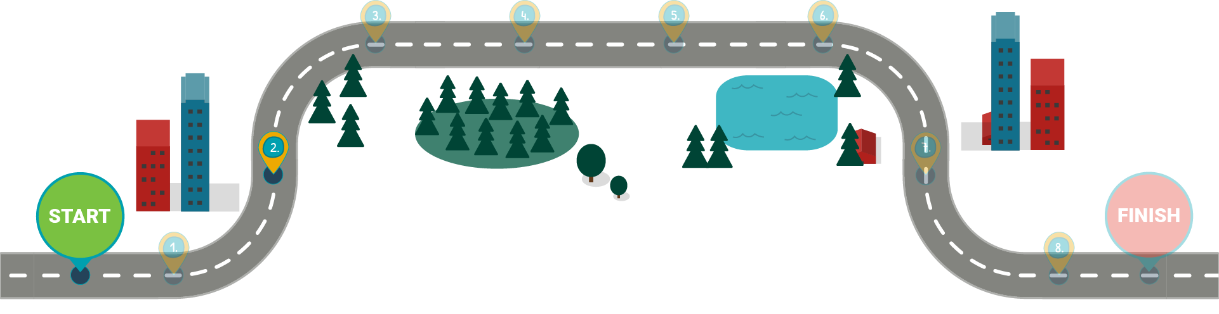
The Scientific Writing Roadmap
Abstract
Notes:
Facilitator Script:
After your title, the Abstract is the next thing your readers will see when reading your manuscript.

Slide 21
Abstract
The abstract:
  Helps readers decide whether they will read the entire manuscript.
  Should stand on its own.
  Enables readers to understand the key points of the piece.
  Is like a miniature version of the manuscript.
Notes:
Facilitator Script:
The abstract will help readers decide whether they will read the entire manuscript.
A good abstract stands on its own.
The abstract should enable a reader to understand the key points of your manuscript without reading the full text. It should be organized in the same way your manuscript is organized.
Think of it almost like a miniature version of your manuscript.

Slide 22
Abstract
A good abstract has:
  A clear exciting message.
  Logical flow, appropriate methodology and clear conclusions.
  An appropriate topic for the audience.
  Followed the submission guidelines.
Notes:
Facilitator Script:
A good abstract has a clear and exciting message. You want your abstract to grab the attention of your readers! It also flows logically, has appropriate methodology and clear conclusions. Remember, the abstract is like a miniature version of your manuscript. You wouldn’t want to forget any of that in the rest of your manuscript, so don’t forget it in your abstract. A good abstract also covers an appropriate topic for the audience. We’ll talk more about choosing an appropriate audience later. Last, a good abstract follows the submission guidelines.

Slide 23
Abstract
When developing the abstract:
  Make it informative.
  Revise continuously before submission.
  Finalize your abstract when your manuscripts is complete.
Notes:
Facilitator Script:
When developing your abstract, focus on the following points.
Make the abstract informative. It must be consistent with the rest of the manuscript but contain fewer details.
Revise the abstract continuously as you work on your manuscript. Just because the abstract comes early in the manuscript doesn’t mean you have to write it first! Starting early and continuing to revise your abstract is a better idea than writing it all in one go.
Finalize your abstract when your manuscript is complete. This ensures that the abstract accurately reflects the content of the manuscript. In fact, much of the content of your abstract will come directly from your manuscript.
What questions do you have about abstracts?

Slide 24
Abstract
Sample abstract guideline:
  Background and purpose
  Methods
  Results
  Conclusions
  Keywords
  250-300 word limit
Notes:
Facilitator Script:
Most scientific journals require a specific abstract structure. And almost all abstracts have a word limit. Always follow the journal's submission guidelines when preparing your abstract.
Guidelines may also require the abstract to be structured or unstructured.

Slide 25


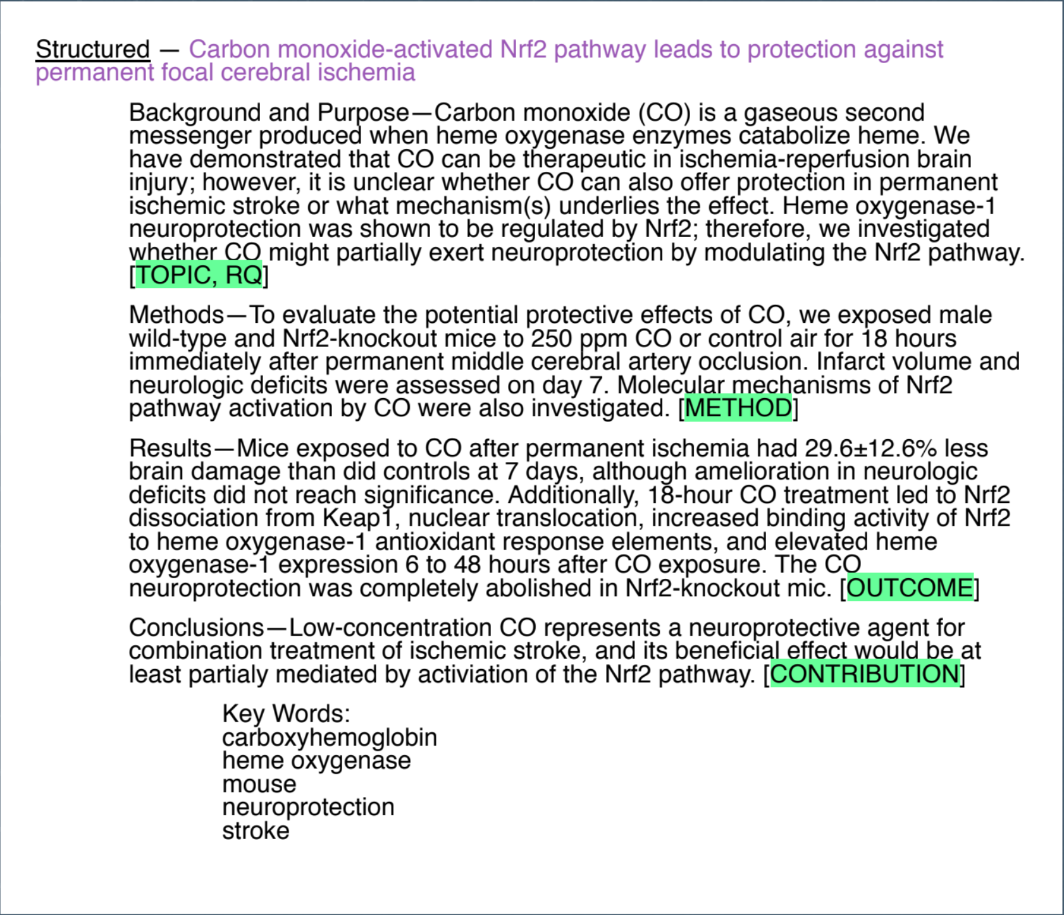
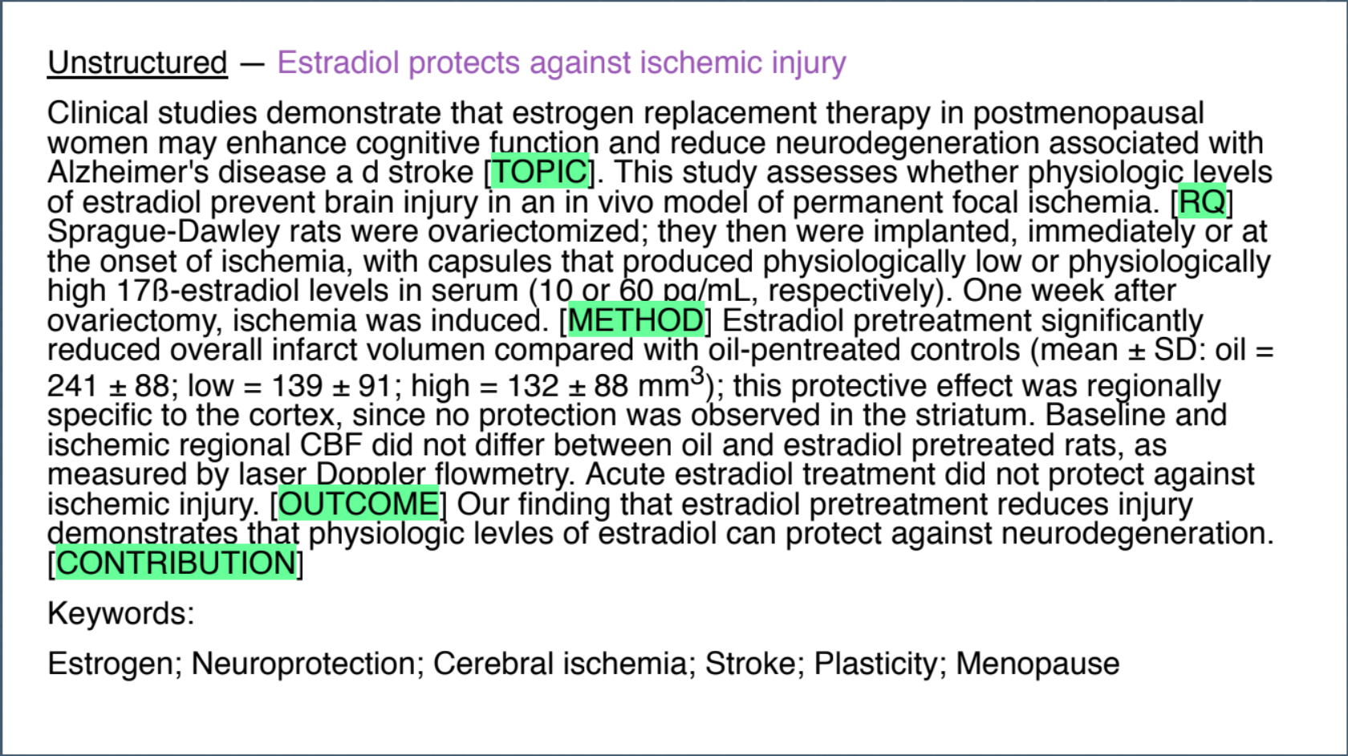
Abstract
Notes:
Facilitator Script:
You can find this slide in your workbook under Part 2, Chapter 1. Let's look at two ways you can format your abstract: structured and unstructured. A structured abstract features sections with clearly marked section headers. An unstructured abstract follows the traditional abstract format of a paragraph. In this slide, “RQ” stands for Research Question.
(Point to the specific sections of the structured abstract and to the traditional paragraph format of the unstructured abstract.)

Slide 26
Case Study: Netra Chey
Turn to Module 2–Case Study Part 2 your workbook
Notes:
Facilitator Script:
Let’s go back to the case study with Ms. Chey. Turn to Part 2 of Case Study section for Module 2 in your workbook to see what she has to say about the abstract. Who wants to read for her? (Select a student to read aloud)
Netra’s Text:
The abstract may seem intimidating at first because it's so short, but that's actually what makes it easy. Think of writing the abstract as taking one or two sentences from each of your manuscript sections and reworking it. When you break it down, the abstract needs an introductory sentence, a sentence stating the research question, a sentence outlining your main techniques or procedures, a few sentences describing your results and one final sentence describing your major conclusion. Easy!
(Thank the reader!)

Slide 27
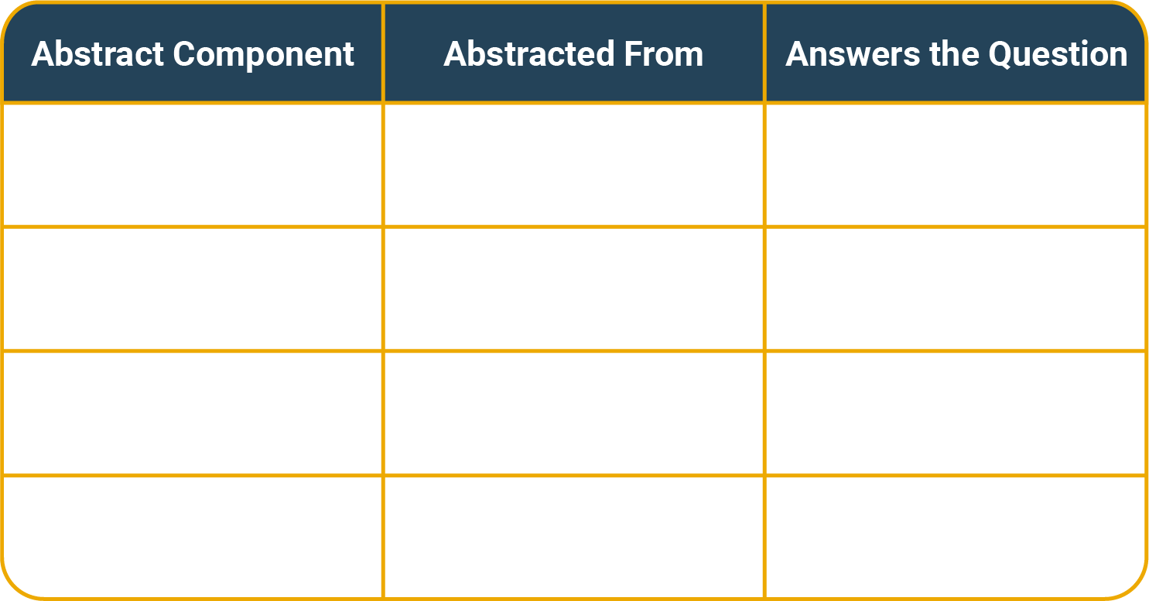
Abstract
Objective/Major Purpose of the Study | Introduction | What is known and why is this study needed?
Basic Procedures | Methods | What did we do?
Main Findings | Results | What did we find out?
Principal Conclusions | Discussion | What does it mean? So what?
Notes:
Facilitator Script:
This table helps explain typical components of an abstract and how to develop them. You can find it in your workbook.
Objective/Major Purpose of the Study → Comes from the Introduction → Answers the question ”What is known, and why is this study needed?
Basic Procedures → Comes from the Methods section → Answers the question “What did we do?”
Main Findings → Comes from the Results section → Answers the question “What did we find out?”
Principal Conclusions → Comes from the Discussion section → Answers the question “What does it mean? So what?”
That is almost everything you need for your conclusion!

Slide 28
Abstract
Important reminders:
  An abstract should stand on its own.
  Proper formatting helps readers digest information quickly.
  Cleary and concisely state the main purpose of your study.
  Formulate the argument and make it easy to understand.
Notes:
Facilitator Script:
Keep the following things in mind when working on your abstract.
An abstract should be able to stand on its own--meaning that someone can read your abstract and quickly understand the purpose of your entire paper.
Proper formatting helps readers digest information quickly. Always remember your audience.
Focus on the main purpose of your study. Be clear and concise.
Formulate the argument you’re trying to convey and make sure your audience will understand it.
What questions do you have about abstracts?
(Encourage questions from participants and answer them to the best of your ability.)

Slide 29
You have reached the end of Chapter 2!
What questions do you have?
Turn to the Knowledge Check section for Part 2 in your workbook and answer Knowledge Check 1.
Notes:
Facilitator Script:
We will continue to chapter two after we take a short break. First, what questions do you have about what we covered in this chapter?
(Solicit questions from participants and provide answers!)
Before our break, let’s do a quick review.
Turn to the Knowledge Check section for Part 2 in your workbook and, silently, answer Knowledge Check 1. Then we’ll go over it as a group.
(Allow participants a minutes to answer question in their workbooks.)

Slide 30
Knowledge Check
True or False?
  An abstract should stand on its own.
  False
Notes:
Facilitator Notes:
Solicit answers to this question from the group, then go over the correct answer.
Facilitator Script:
This is statement false. The abstract is a concise digest of the manuscript that should be able to stand on its own. The abstract should enable the reader to understand the manuscript's content without reading the entire paper.

Slide 31
The Introduction and Methods Sections
Chapter 3:

Slide 32
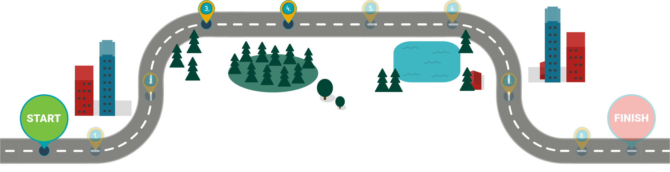
The Scientific Writing Roadmap
Methods
Introduction
Notes:
Facilitator Script:
In this chapter, we will address the Introduction and Methods sections in greater detail.
Once you’ve hooked your reader with the Title and Abstract, you want to lead them into the Introduction.
We spoke about IMRaD earlier in the training.
Now are ready to explore this first section of the IMRaD mnemonic device.

Slide 33
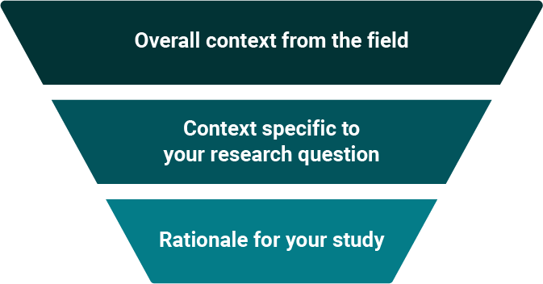
Introduction
Developing the introduction
Notes:
Facilitator Script:
Think of the introduction as a funnel. You pour your broad information from the field into it. Then, the introduction filters out everything but the specific research question or hypothesis you have for this work. You're left with the rationale for your study.

Slide 34
Introduction
Common structure of the introduction:
Significance of the topic
Scope of the study
Highlights of relevant research
Research question and study reasoning
Study design summary
Notes:
Facilitator Script:
Here's a common Introduction structure and its elements.
First, tell us why your topic is important.
Then, tell us what the study is about and highlight other relevant research.
Identify your research question and reasons for performing the study.
Finally, briefly summarize your study design.

Slide 35
Introduction
Explain why the topic is important.
Compare and contrast your work with other current literature.
Be concise yet detailed enough for readers with no knowledge of your subject matter.
Include information that allows readers to better understand the relevance of your work.
Anchor your work in time (e.g., use phrases like "recently," "in the past 10 years," "since the 1990s").
Notes:
Facilitator Script:
When it comes to explaining why your topic is important, you may want to start by comparing and contrasting it with other current literature. Be clear and concise and remember that the reader may know nothing about your subject matter. Provide the most recent information that will allow a broad range of readers to better understand the need for your work. You can communicate the timeliness of your work by using phrases like "recently, in the past ten years, since the 1990s.

Slide 36
Introduction
Identify and narrow down your problem statement.
Note any knowledge gaps.
Include the scope and nature of knowledge gaps.
Explain how filling knowledge gaps will be useful.
Prompt the right questions in your reader's mind.
Notes:
Facilitator Script:
As you continue working on the introduction, identify and narrow down your Problem Statement.
Note any gaps in knowledge, including the size and nature of those knowledge gaps.
Explain how filling the gaps will be useful. And prompt the right questions in the reader's mind.

Slide 37
Introduction
Writing the problem statement:
Focus on only one problem.
Too many problems and too many solutions lead to reader confusion.
Save additional problems for future manuscripts.
Writing the purpose statement:
Present your approach to filling knowledge gaps through your study.
Specify how your study will answer the stated problem.
Clarify your approach as new.
Include your solution with related data in final paragraph.
Notes:
Facilitator Script:
When developing the introduction, it is important to specify both the problem your study seeks to address and the purpose of your study.
When writing your problem statement, focus on only one problem. Too many problems and too many solutions can confuse the reader. Save additional problems for future manuscripts!
(Click to reveal the Purpose Statement content!)
When writing the purpose statement, present your approach to filling knowledge gaps through your study. Specifically show how your problem will answer the stated problem. Make sure to clarify that your approach is new, and include your solution and all related data in the final paragraph.

Slide 38
Case Study: Netra Chey
Turn to Module 2–Case Study Part 3 your workbook
Notes:
Facilitator Script:
Let’s go back to the case study with Ms. Chey. Turn to the third part of the Module 2 case study content in your workbook to see what she has to say about the introduction. Who wants to read for her? (Select a student to read aloud)
Netra’s Text:
If I think about the IMRaD method, I view the Introduction as the starting point of my journal article. This is where my team and I will introduce our problem statement and give readers enough information to fully appreciate the specific research question and objectives. Remember: the Introduction is like a funnel. It starts broad and gets narrower. Begin with the broadest scope, then get progressively more defined in your focus. This leads your reader steadily to your statement of objectives, which should be at the end of your introduction.
(Thank the reader!)

Slide 39
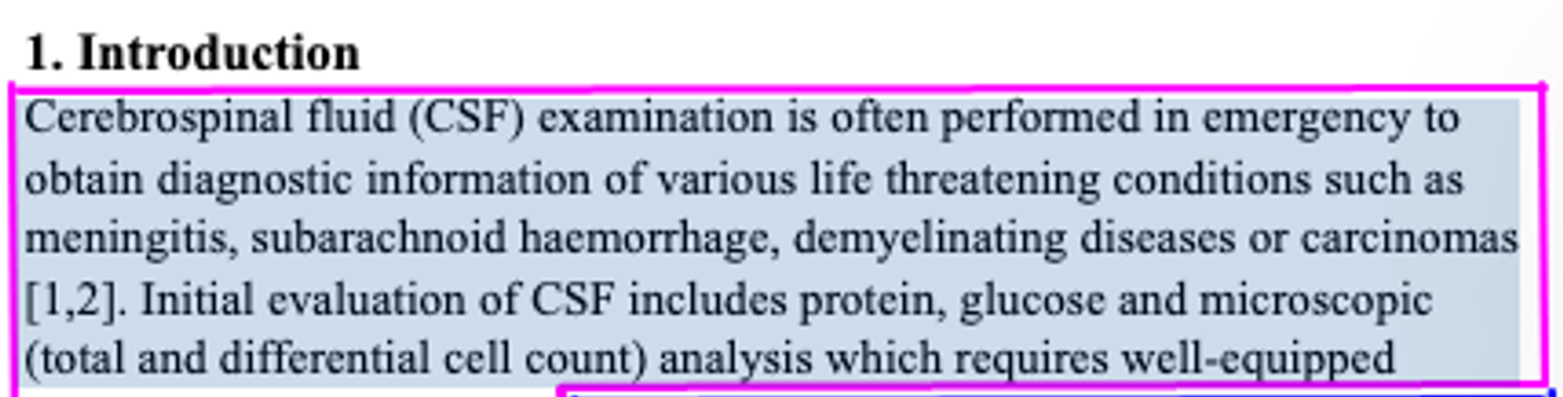
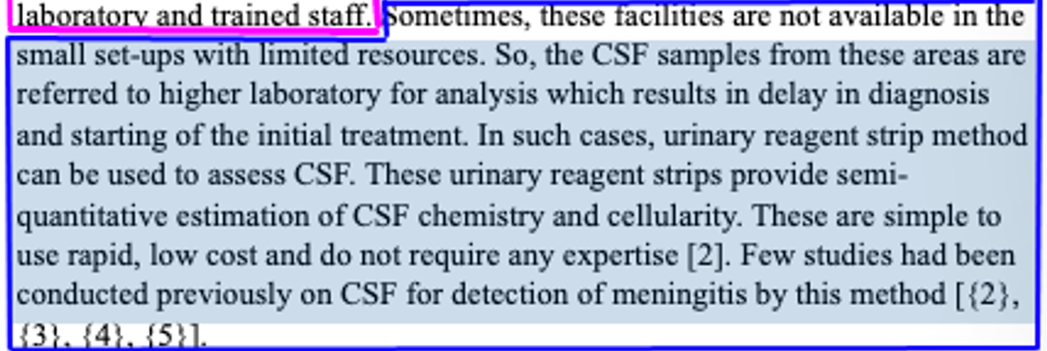
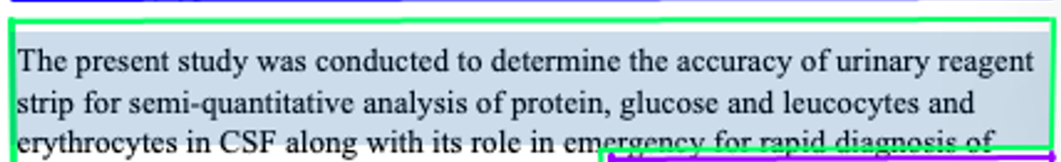
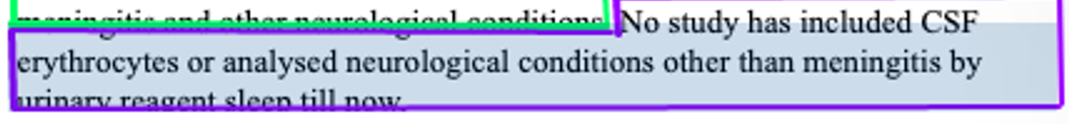
Introduction
Open with a few sentences placing your study in context.
Follow with a description of the problem and its history, including previous research.
Describe how your work addresses a gap in existing knowledge or ability, or why you’ve taken this study.
State what information your manuscript will address.
Notes:
Facilitator Script:
Here is an example Introduction. You can find this slide in your workbooks to see it more clearly. Note how brief it is. Each outlined area displays a different element of the Introduction.
(Click on the pink box to reveal informational content.) We begin with a few sentences placing the study in context. Who wants to read the first section aloud? (Select a student to read the first section aloud. If the English comprehension level of your participants is low, feel free to read these sections yourself. Remember to thank your readers!)
Those few sentences tell us about the use of cerebrospinal fluid, or CSF, examination, and what is needed for the initial evaluation of CSF.
After putting your study in context, you need to describe the problem you are addressing and its history, including previous research.
(Click on the blue box to reveal informational content.) Who wants to read the next section aloud? (Select a student to read the next section aloud. If the English comprehension level of your participants is low, feel free to read these sections yourself. Remember to thank your readers!)
That section begins with the problem: sometimes small laboratories with limited resources lack the resources needed for the initial evaluation of CSF. The samples from those areas are sent to other labs for analysis, and this creates a delay in diagnosis and starting treatment. The author then tells us about a potential solution to the problem: the urinary reagent strip method can be used to evaluate CSF. It’s a rapid, low cost test that doesn’t require expensive equipment or specialized expertise. That’s great! But few studies have been conducted on using CSF to detect meningitis using these urinary reagent strips.
Next, the author needs to describe how the manuscript will address the gap in existing knowledge, which is why the author has undertaken this study.
(Click on the green box to reveal informational content.) Who wants to read the next section aloud? (Select a student to read the next section aloud. If the English comprehension level of your participants is low, feel free to read these sections yourself. Remember to thank your readers!)
The author explicitly states that this study was conducted to determine the accuracy of urinary reagent strip for semi-quantitative analysis of protein, glucose and leucocytes and erythrocytes in CSF and the role of urinary reagent strip in emergency for rapid diagnosis of meningitis and other neurological conditions. This study will fill the gap in testing related to this method.
The last part of the introduction states what information the manuscript will address.
(Click on the purple box to reveal informational content.) Who wants to read the last section aloud? (Select a student to read the next section aloud. If the English comprehension level of your participants is low, feel free to read these sections yourself. Remember to thank your readers!)
This last section tells the reader what they will learn in the manuscript. This is the first study that has included CSF erythrocytes, and the study analyses neurological conditions other than meningitis by urinary reagent strip.
By reading the introduction, you know the context of this study, the problem it set out to address, how the study will address that problem, and the information the manuscript will share.
What questions do you have about this introduction? (Solicit questions from students and answer them to the best of your ability before moving on.)

Slide 40
Introduction
Tips for the introduction:
Tailor writing to your audience.
Formulate your argument and get to the point quickly.
Clearly state your hypothesis.
Don't present the entire literature review.
Keep it brief.
Notes:
Facilitator Script:
Here are a few tips and tricks for writing your introduction.
Make sure to aim your writing at your audience. Know who you are writing for and write for them. Keep it simple, but not so simple that you are speaking down to your readers.
Formulate your argument and make your point quickly. Make sure it is logical, but, again, keep it simple and clear.
Be sure you’re stating a clear hypothesis. Use phrases like “The purpose of this study is…” or “We investigated three possible mechanisms in order to…”
Don’t include your entire literature review. Situate your study in context, don’t make the literature review the entire point of your manuscript.
Only provoke questions that you will answer in the manuscript. Don’t get off topic.
Keep your Introduction brief. It should only take up 10 to 15 percent of your total manuscript.
Before we move on, what questions do you have about introductions? (Solicit questions from students and answer them to the best of your ability before moving on.)

Slide 41
Your Introduction
Ask yourself the following questions and write down your answers to share with your partner.
What is the issue your paper seeks to address?
Do you state it clearly and with support?
What questions does the Introduction provoke in the reader's mind?
Is there literature you can cite to support your claim that this is a problem worth addressing?
Notes:
Facilitator Script:
Find this slide in the Module 2 section of your workbook. These questions will help you with your introductions. Think about your current manuscript topic, or about a topic you'd like to work on in the future, and use the space provided to answer the following questions. You’ll share with your partner after you finish answering.
What is the issue your paper seeks to address?
Do you state it clearly and with support?
What questions does the Introduction provoke in the reader's mind?
Is there literature you can cite to support your claim that this is a problem worth addressing?
Take 10 minutes to work on these questions. When that 10 minutes is over, you’ll discuss them with your partner before sharing out to the group.
(Time 10 minutes. Alert participants when there are two minutes left. When participants are finished, ask for volunteers to share some of the information they’ve produced. See if any other participants have feedback and offer your own feedback. Do this several times, with several participants.)

Slide 42
Methods
Title
Abstract
Introduction
Methods
Results
Discussion
Acknowledgments
References/Citations
Notes:
Facilitator Script:
The M in IMRaD stands for Methods. The Methods section explains how, and, if relevant, when and where the study was conducted. Think of the Methods section as the “recipe” for your study! Another scientist should be able to follow your “recipe” and replicate your results. While some results can't be reproduced, a strong Methods section benefits the entire field.

Slide 43
Methods
The purpose of methods section is to:
Address how the study was conducted.
Describe the materials used.
Allow readers to reproduce work and evaluate the study.
Allow readers to test validity of claims.
Notes:
Facilitator Script:
You will address how you conducted your study and what materials you used in the methods section. A well-written methods section allows readers to evaluate and reproduce what you did in order to assess the validity of your claims.

Slide 44
Methods
Objectives of the methods section:
Describe study design
List and describe procedures and techniques
Note any procedure or technique modifications
List specialized equipment and software, including brand names and model numbers
Note underlying assumptions
List and describe statistical methods used
Notes:
Facilitator Script:
The methods section includes information about your study design, the procedures you followed, and the techniques you used. Not only should you describe the procedures and techniques used, but you should explain why you used them and describe any modifications. If you used specialized equipment or software, describe them here and include brand names and model numbers. And if you made any underlying assumptions or used specific statistical methods, you guessed it. Note those assumptions and statistical methods in this section.

Slide 45
Methods
Below is an example showing the sequence of steps for a polymerase chain reaction (PCR) procedure.
A Methods section will reflect this sequence:
  Sample preparation
    DNA/RNA extraction
      PCR
        Detection
          Analysis
Notes:
Facilitator Script:
You may want to outline your Methods section first to ensure that you are including all your steps. Here is an example outline of the Methods section for a polymerase chain reaction, or PCR, procedure.

Slide 46
Methods
Describe the key elements of your study design.
Settings and subjects
Study population/sample
  What/who was studied?
  Where did the study take place?
  When did the study take place?
  What were the inclusion/exclusion criteria?
Notes:
Facilitator Script:
Let's look at the individual elements of the Methods section.
In this section of your manuscript, you are going to describe the design of your study and any key components. That includes the settings and subjects and information about the study population or sample used. You will provide answers to these what, who, where and when questions. Note any inclusion or exclusion criteria.

Slide 47
Methods
Data collection:
Describe data collection activities.
Note any instruments used and provide references.
Intervention/exposure studied → outcomes measured → how you measured them
Data analysis:
Map your analysis to the research question.
Note statistics and consider defining them; explain what they mean.
Define your variables.
Note adjustments/weighting.
Note software used.
Notes:
Facilitator Script:
In the Methods section is also where you want to provide details of your study's data collection and analysis. Get as specific as possible when describing your activities, the tools you used, and how you collected and analyzed your data. You should be able to connect your analysis to the research question.
In data collection, you want to describe all of your data collection activities and note any instruments used, as well as their references. You should explain what intervention or exposure you studied, what outcomes you measured from that study, and how you measured those outcomes.
When analyzing data, you need to map your analysis to your research question. Take note of statistics and consider defining them. What do these statistics mean? Also, define your variables. Make note of adjustments or any weighting, and the software you used.

Slide 48
Methods
Tips for describing data analysis
Be clear when defining:
  Variables
  Covariates
  Missing data
  A priori and explanatory analyses
Avoid p-hacking! Analyzing your study results in multiple ways or many times until you achieve your desired results is unethical.
Notes:
Facilitator Script:
Here are some tips for data analysis. Be very clear when defining and implementing the dependent and main independent variables. Likewise, be clear when defining and explaining how you used covariates. Did you adjust your analyses? Describe those adjustments. Do you have any missing data? Explain how you accounted for that lost data. Avoid putting results in the methods section. Be honest and transparent about your hypothesis a priori analyses and your exploratory analyses. Avoid p-hacking. P-hacking is when researchers analyze their results in multiple ways or many times until they get their desired results. P-hacking is unethical. Avoid it at all costs.

Slide 49
Methods
Methods section checklist
Study design
Setting and participants
  Case definition
  Case finding methods
  Exposure and disease measurements
  Selection of exposed/unexposed or case/control
  Special analysis
  Any interventions, treatments
Notes:
Facilitator Script:
The items in this checklist all belong in your methods section.
You need to describe your study design, as well as your setting and participants. When describing your setting and participants, include:
Case definition
Case finding methods
Exposure and disease measurements
Selection of exposed/unexposed or case/control
Special analysis
Any interventions and/or treatments
What questions do you have about the Methods section? ? (Solicit questions from students and answer them to the best of your ability before moving on.)

Slide 50
Methods
Do Include:
Laboratory methods
Epidemiological investigations
Flow diagrams
Statistical analysis methods
Detailed descriptions of original methods OR references to previously described methods
Information on study design, setting and subjects, data collection, data analysis and ethical approval
References to previous publications from the same large research project, such as a study protocol, for additional information (if applicable)
Do Not Include:
Results
Discussion of your results
Information about other papers you plan to publish
Notes:
Facilitator Script:
You can find this chart in your workbook. It details elements you should and should and should not include when detailing the methods used in your study. Take a moment to read it over. As you read, circle or highlight elements you know you’ll include in your own methods section.

Slide 51
You have reached the end of Chapter 3!
What questions do you have?
Turn to the Knowledge Check section for Part 2 in your workbook and answer Knowledge Checks 2 and 3.
Notes:
Facilitator Script:
We will continue to chapter three after we take a short break. First, what questions do you have about what we covered in this chapter?
(Solicit questions from participants and provide answers!)
Before our break, let’s do a quick review.
Turn to the Knowledge Check section for Part 2 in your workbook and, silently, answer Knowledge Checks 2 and 3. Then we’ll go over it as a group.
(Allow participants a minutes to answer question in their workbooks.)

Slide 52


Knowledge Check
  How should the Methods section be organized?
  Choose one answer.
Alphabetically
Chronologically
Thematically
Whatever seems easiest
Notes:
Facilitator Notes:
(Ask participants to volunteer their answers, then click to reveal the correct answer.)
Correct answer: The methods section should be organized chronologically. Remember, the methods section is like a “recipe” for your study! Another scientist should be able to follow your “recipe” and replicate your results. If you follow a recipe out of order, the food will come out strangely. The same is true of your methods section!

Slide 53
Knowledge Check
  What is p-hacking? Choose the correct definition.
  Choose one answer.
Methods of breaching defenses and exploiting the weaknesses of a computer system or network.
When researchers misuse their results by analyzing data in multiple ways or multiple times until they get their desired result.
Notes:
Facilitator Notes:
(Ask participants to volunteer their answers, then click to reveal the correct answer.)
Correct answer: P-hacking, or data dredging, is when researchers collect or select data or statistical analyses until nonsignificant results become significant. P-value abuse directly contributes to one of the biggest problems facing the scientific community: the prominence of false-positive results in the published literature. It is unethical and should be avoided at all costs! The other answer relates to computer hacking, which is an entirely different problem.

Slide 54
The Results Section
Chapter 4:

Slide 55
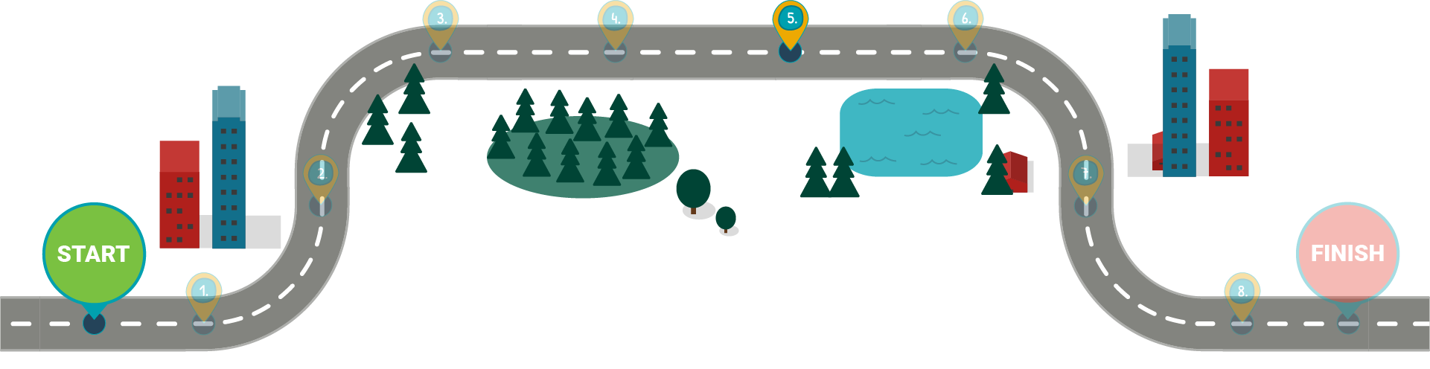
Results
Results
Notes:
Facilitator Script:
In the introduction, you stated your research question. Then, you explained the Methods you used in your exploration of that research question. Now, it's time to present your results using analyzed and summarized data.
In this chapter, we will discuss the Results section, which will contain most of your data and the many ways you can illustrate it, including tables, graphs and figures.

Slide 56
Results
Goals of the results section include:
Providing factual statements supported by evidence.
Writing concisely.
Using representative, not repetitive data.
Discussing variables that had an effect (positive or negative).
Using meaningful statistics.
Avoiding redundancy.
Notes:
Facilitator Script:
Here are some suggested goals for the Results section of your manuscript.
Provide factual statements supported by the evidence.
Write concisely, without excess wordiness.
Use representative data rather than endlessly repetitive data and discuss any variables that affected the data either positively or negatively.
Present meaningful statistics and avoid redundancy.

Slide 57
Results
The results section is where you:
Logically present the findings from your study.
Present data using figures, tables, graphs and other visualizations.
Explain how the results of your study help to answer your research questions.
Cite figures, tables and other visualizations within the text.
Save any evaluation of your results for the Discussion section!
Notes:
Facilitator Script:
Data is a large part of a scientist's life, so many researchers find the Results section easy to write. It is a logical presentation of what you found during your study, featuring tables and figures as necessary. You already know what you have to work with, so you can explain the results and show how they help to answer the research questions posed in the Introduction. Do not attempt to evaluate the results in this section. Report only what you found and reserve the significance of the results for the Discussion section. Remember to refer in the text to each figure or table you include in your paper.

Slide 58
Results
Data analysis best practices:
Involve a statistician early in the process.
Analyze and track data throughout study and manuscript writing.
Develop multiple tables or figures and solicit feedback on the most effective ones.
Notes:
Facilitator Script:
Data analysis forms the core of the Results section.
If you are working with a statistician, involve that person early in the project. Statisticians can design data projects and keep things running smoothly all the way through to data analysis.
Remember that data analysis isn’t just something to do at the end of your study. Analyze and consider your data throughout the entire manuscript process.
Provide tables or figures for the main findings so that readers can analyze the data on their own. Create a few different data visualizations and share them with early readers to get feedback on the most effective ones.

Slide 59
Results
When writing the results section:
Describe what you found, not what you did.
Consider subsections like the ones in the Methods section.
Look to published articles for potential templates!
Highlight key relationships between independent and dependent variables.
Notes:
Facilitator Script:
When working on the Results section, remember to focus on what you found. You've already described what you did in the Methods section. You may want to create subsections, but you can look for published work like yours for examples or templates you can follow. If you have discovered any relationships between independent and dependent variables, highlight them here in the Results section..

Slide 60

Results
The results section follows a logical sequence.
Recruitment/
Response
Sample Characteristics
Sample Characteristics
Secondary Analyses
Secondary Analyses
Notes:
Facilitator Script:
This is an example of a logical sequence you can follow when building your Results section. (Read out the sequence.)

Slide 61
Results
When writing the results section:
Start with tables and figures.
Use tables to highlight individual values.
Use figures to highlight trends and relationships.
Supplement visuals with text.
Notes:
Facilitator Script:
When writing the results section, start with your tables and figures and tackle the text later. Use tables to highlight individual values and use figures to highlight trends and relationships. Use text to summarize, emphasize or call out any gaps in the visualizations.

Slide 62
Methods
Do
Be clear and concise
Write in the past tense
Mirror the Methods
Answer the research questions
Highlight findings from figures and tables in text
Do Not
Interpret findings (save this for the Discussion section)
Use “significant” as shorthand for “important”
Repeat all information from figures and tables
Notes:
Facilitator Script:
Find this slide in your workbook to review advice for your results section.
(Give participants a few minutes to read and consider the do’s and don’ts.)
What questions do you have about the Results section? (Solicit questions from students and answer them to the best of your ability before moving on.)

Slide 63
Results
Results section checklist
Present findings without interpretation.
Highlight findings from tables and figures in the text.
Present estimates with 95% confidence intervals.
Consider providing additional results in tables and figures as web-only supplementary material.
Write the Results section in the past tense.
Structure roughly into:
  recruitment/response, sample characteristics, primary analyses, secondary analyses and ancillary analyses.
Match the Results section with the Methods section.
Notes:
Facilitator Script:
Here is a checklist you can follow when putting together your manuscript's Results section. You can look at it more closely in your workbook!
Present your findings; do not interpret them here.
Save interpretation for the Discussion section.
Highlight findings from tables and figures in the accompanying text.
In statistics, the 95-confidence interval means that you can be 95 percent certain that your values contain the true mean of the population. Use the 95 confidence interval for your estimates.
Consider moving extra tables and figures to a web only supplement for your paper.
Write your results section in the past verb tense.
Check to see if you’re following the rough structure found on your screen.
And make sure the data found in your Methods section matches your Results section.
What questions do you have about this checklist? (Solicit questions from students and answer them to the best of your ability before moving on.)

Slide 64
Results
When visualizing data, ask yourself:
What am I trying to say with my data?
What information is necessary to support my message?
Do I need a table, graph or figure?
Have I been consistent, concise and clear with all supplemental data?
Notes:
Facilitator Script:
Developing clear, effective data visualizations will enhance your manuscript. We will cover the basic rules for the presentation of data using these methods, and I will give you both good and bad examples to explore.
When beginning work on your data presentation, ask yourself these questions.
What am I trying to say with my data?
What information will support my message?
Do I need a table, graph, or figure?
Have I been consistent, concise, and clear with all supplemental data?

Slide 65
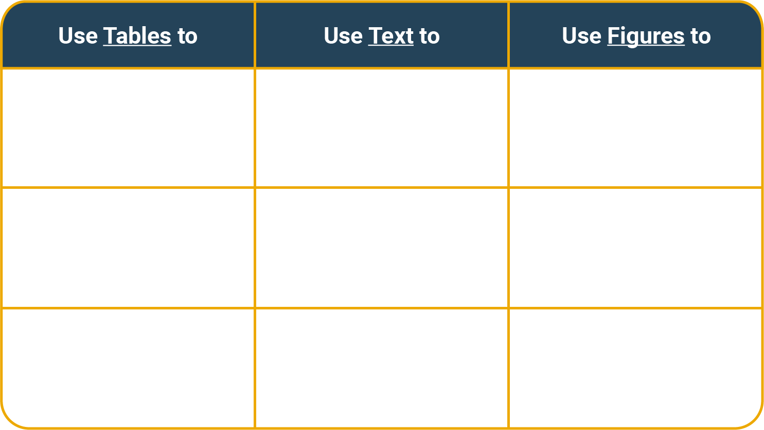
Results
Present detailed or important data | Present simple or important data | Show relationships or patterns in data
Highlight individual values
(Treat tables like expensive real estate!)
Notes:
Facilitator Script:
Tables should present data that is detailed or significant or highlight specific individual values. Think of tables as expensive real estate in your manuscript. They take up valuable space that could otherwise be used for something else. If you're going to use a table, make sure it’s worth the cost. Consider using text instead of a table if your data isn't that detailed or important. A text summary may work better. Consider using a figure instead of a table if your data shows a relationship or pattern. Relationships and patterns are easier to see in figures rather than in tables.

Slide 66
Results
Do
Include some measure of statistical precision.
    p-values or confidence intervals if appropriate
Use appropriate and consistent number of decimal places
(usually to the 10ths).
Double-check all numbers. Then check them again. Then check them again.
Present all relevant results - even the ones you don't like.
Do Not
Use grid lines.
Present unnecessary data or graphs.
Overuse visualizations.
Forget to label and explain all visualizations.
Notes:
Facilitator Script:
Find this slide in your workbook to review advice for presenting data.
(Give participants a few minutes to read and consider the do’s and don’ts.)
What questions do you have so far about presenting data? (Solicit questions from students and answer them to the best of your ability before moving on.)

Slide 67
Results
Captions for data visualization:
Summarize and contextualize
Are brief, but comprehensive
Are placed above tables and below figures
Include the title, techniques used, definitions and results
Use the appropriate verb tense:
  Past tense for completed experiments
  Present tense for facts based on results
Notes:
Facilitator Script:
All of your visualizations need captions that summarize the data and put it into context. For tables, captions need to be brief, yet comprehensive, and go above the table. Captions for figures should be placed below the figure. Captions should include the title, the technique used to obtain the data, any critical definitions, and the results displayed. You may consider using a legend to define different elements. Use the appropriate verb tense in these captions–past tense for completed experiments and present tense to describe the displayed information.

Slide 68
Results
Best practices for designing figures:
Label all parts clearly
Define any symbols used
Use complete titles and footnotes
Write out acronyms
Choose colors that will print in black and white
Use the right graphs and dimensions
(e.g., 3D figures for 3D data)
Define and include the scale
Ensure graphs show full picture of data
Notes:
Facilitator Script:
Figures show trends or relationships in data, as in graphs. They can also present schematic diagrams, images, photographs, maps, and more. When using figures, make sure that you label everything clearly, define any symbols used, and be sure to use complete titles, footnotes, and expanded acronyms. When designing a figure, choose colors that will print well in black and white. Use the right graph and right dimensions for the right data. For example, don’t use a line graph to show categorical data. Use three-dimensional figures for 3D data. Remember to define and include the scale of your figure and ensure that your graphs show the full picture of your data.
What questions do you have about figures? ? (Solicit questions from students and answer them to the best of your ability before moving on.)

Slide 69
Results
Types of Graphs
Column/Bar
Stacked Column Bar
Line
Dual Axis Line
Histogram
Pie
Scatter Plot
Notes:
Facilitator Script:
A picture may be worth a thousand words, but a well-chosen, well-designed graph may be worth even more. Let’s go over the types of graphs.

Slide 70
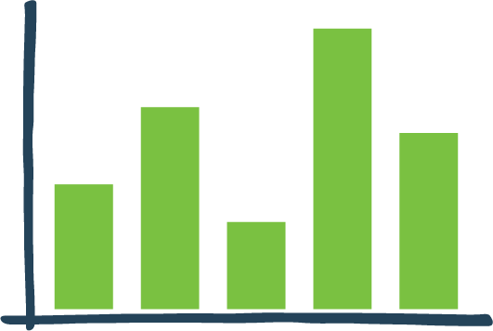
Results
Column and bar graphs:
Are similar graphs
Differ in orientation
Column: vertical
Bar: horizontal
Have X and Y axes labeled with categorical or numerical variables
Heights are scaled according to values
Length of bars can be compared
Bar graphs can be 3 dimensional and compiled for data comparison
Bars or columns arranged in order of frequency
Notes:
Facilitator Script:
Column/Bar
These are very similar graphs, but differ in their orientation. Column graphs are oriented vertically, where bar graphs are oriented horizontally. Each axis (x and y) is labeled with a categorical or numerical variable. The bars’ heights are scaled according to their values and the lengths of the bars can be compared. Bar graphs can be drawn in 3 dimensions and compiled for data comparison. Bars or columns are arranged in order of frequency to emphasize the most important categories.

Slide 71
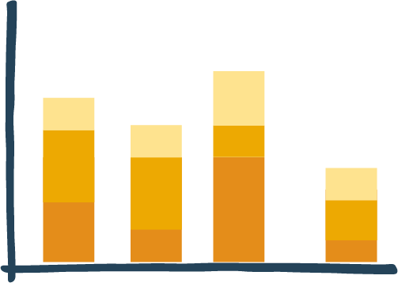
Results
Stacked bar/Stacked column graphs:
Work best to display the differences in values, production, numerical values
Can be used for dual-axis comparisons to show why results changed
Can also be used to show:
  Part-to-whole comparisons
  Subsections that clarify specific differences
Notes:
Facilitator Script:
Stacked Bar/Stacked Column
Stacked bar and column graphs work best to display the differences in values, production, or other numerical values. They can also be used for dual-axis comparisons to show why results changed from one time period to the next. Stacked bar and column graphs can also be used for part-to-whole comparisons, to highlight subsections that clarify the specific difference the graph is pointing out.

Slide 72
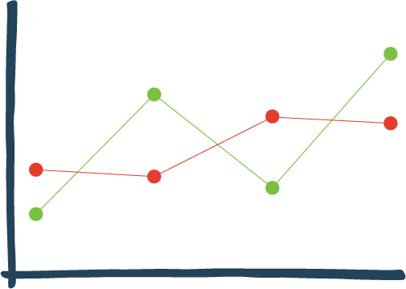
Results
Line graphs:
Involve an x-axis (horizontal) and y-axis (vertical) to show comparisons between 2 variables
Are dot-connected and grid-connected lines
Display and compare various data sets
Have an X-axis that represents time
Have a Y-axis that represents measures or percentages of quantity
Are often used for tracking variables across times
Notes:
Facilitator Script:
Line
Line graphs involve an x-axis (horizontal) and y-axis (vertical) to display comparisons between 2 variables. These graphs are dot-connected and grid-connected lines. These lines display and compare various data sets. The x-axis most commonly represents time measurements, while the y-axis represents measures or percentages of a quantity. A line graph is often used for tracking variables of one or more subjects across a span of time.

Slide 73
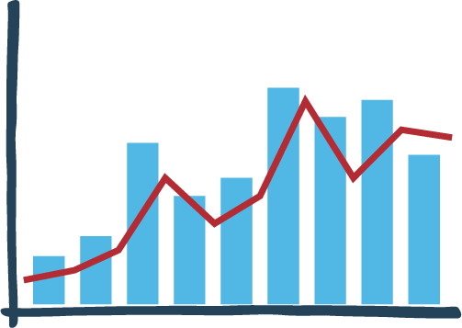
Results
Dual-axis line graphs:
Illustrate the relationships between variables
Are a good choice for limited space
Clearly show trends
Can be hard to use!
Notes:
Facilitator Script:
Dual Axis Line
These graphs can illustrate the relationship between two variables and can show a lot of data in limited space. They can be useful to clearly show trends that could otherwise be overlooked on separate graphs. They can be tricky to use well, so be cautious.

Slide 74
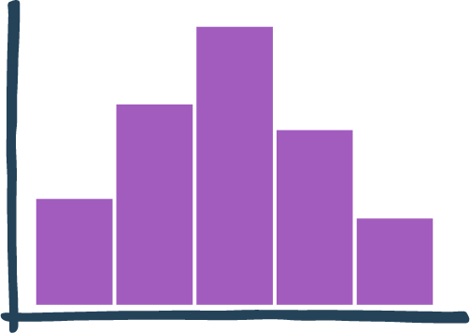
Results
Histograms:
Are used to show quantitative data that has been statistically analyzed
Use ranges of values displayed as bars, listed as “classes”
Taller bars represent classes with greater frequencies
Notes:
Facilitator Script:
Histogram
These graphs are most commonly used to show quantitative data that has been statistically analyzed. Ranges of values are often displayed as bars and are listed as “classes” at the bottom of the graph. Taller bars represent classes with greater frequencies.

Slide 75
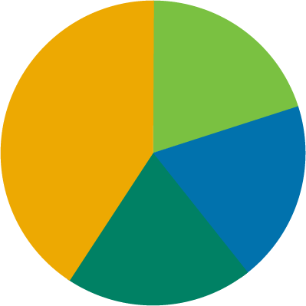
Results
Pie graphs or charts:
Can also be called a circle graph
Represent parts of a whole with each “slice” a data percentage
Display segments arranged clockwise from biggest to smallest
Are easy to compare, easy to understand!
Notes:
Facilitator Script:
Pie
Sometimes called a circle graph, pie charts represent parts of a whole. Each ‘section’ or ‘slice’ of the pie is a data percentage. Segments are arranged in a clockwise formation from biggest to smallest. This way, the pie chart features easy-to-compare subjects presented in an easy-to-understand way.

Slide 76
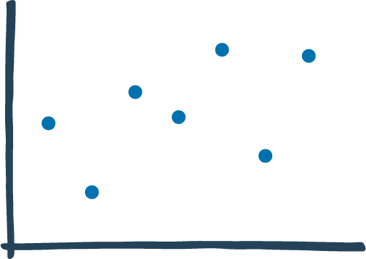
Results
Scatter plots:
Show values of two variables plotted along two axes
Use a pattern of points to display any present correlation
Notes:
Facilitator Script:
Scatter Plot
These graphs show the values of two variables plotted along two axes. The pattern of the plotted points is used to display any present correlation.
What questions do you have about graphs? (Solicit questions from students and answer them to the best of your ability before moving on.)

Slide 77


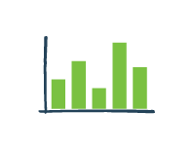
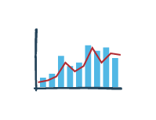
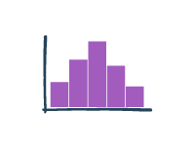
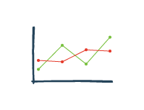
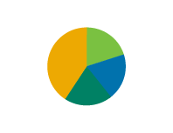
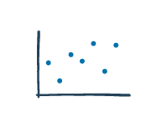
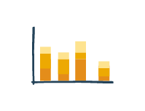
Case Study: Netra Chey
Turn to Module 2–Case Study Part 4 your workbook
Notes:
Facilitator Script:
Let’s go back to the case study with Ms. Chey. Turn to Module 2–Case Study Part 4 your workbook to see what she has to say about results. Who wants to read for her? (Select a student to read aloud)
Netra’s Text:
I love data, which is why I love working on the Results section of my papers. However, it's easy to overdo it with the statistics, tables and drawings and overwhelm your readers. That's why I always devote some time to planning the most effective ways to communicate my research, both with text and with visualizations. I focus on only the most meaningful statements supported by the evidence. I keep all text short and delete any places where my paragraphs are needlessly repeating information that readers can already find in the figures or captions. I ask myself, "Am I presenting the evidence in a logical order?" Evidence does not explain itself, so it's up to me to present the facts in the right order and explain them in a way that answers the research questions found in my Introduction.
(Thank the reader!)

Slide 78
Results
Remember to pay attention to the details!
Check your math.
Use consistent row or column summation.
Keep lines to a minimum and avoid vertical lines.
Use footnotes to clarify points.
Check headings, labels and axes for consistency.
Follow submission guidelines for your target publication.
Notes:
Facilitator Script:
Here are some additional tips for visualizing your data.
Check your math for accuracy and use consistent row or column summation.
Keep lines in your tables, graphs, and figures to a minimum. It's also a good idea to avoid vertical lines.
Use footnotes to clarify your points.
Check headings, labels, and axes for consistency.
Remember: different journals will have different rules for formatting. Follow the submission guidelines for your target publication.

Slide 79
Results
Carefully read the instructions for authors provided by your target journal.
Check for:
  Limits on file and figure size or table numbers
    If the limit is low, check and see if supplemental online-only materials are an option
  Specific file format requirements for figures
  Guidance for table formatting
  Footnotes and abbreviations
  Instructions for submission
    Order/arrangement
    One file or multiple files
Notes:
Facilitator Script:
Here are some of the rules you can expect to find when you search for a publication's submission guidelines or Instructions for Authors.
Some publications limit file sizes or the number of figures used. If you have more visualizations or information, there may be an opportunity to post supplemental materials online.
Look for formatting requirements, guidance on footnotes, abbreviations and figures. Overall, you want to make it as easy as possible for the editors to accept your manuscript.
Creating a credible scientific manuscript is all about attention to detail!
What questions do you have about the Results section? (Solicit questions from students and answer them to the best of your ability before moving on.)

Slide 80
You have reached the end of Chapter 4!
What questions do you have?
Turn to the Knowledge Check section for Part 2 in your workbook and answer Knowledge Checks 4 and 5.
Notes:
Facilitator Script:
We will continue to chapter five after we take a short break. Before our break, let’s do a quick review.
Turn to the Knowledge Check section for Part 2 in your workbook and answer Knowledge Checks 4 and 5. Then we’ll go over it as a group.
(Allow participants a few minutes to answer question in their workbooks.)

Slide 81
Knowledge Check
  What graph types would use if you were comparing values?
  Select all that apply.
Column
Stacked Bar
Bar
Line
Dual-Axis Line
Histogram
Scatter Plot
Notes:
Facilitator Notes:
(Ask participants to volunteer their answers, then click to reveal the correct answers.)
Correct answer:
Column
Bar
Line
Histogram

Slide 82
Knowledge Check
  What graph types would use if you were comparing values?
  Select all that apply.
Dual-Axis Line
Scatter Plot
Line
Column
Stacked Bar
Notes:
Facilitator Notes:
(Ask participants to volunteer their answers, then click to reveal correct answers.)
Correct answer:
Dual Axis Line
Line
Column

Slide 83
The Discussion, Acknowledgements and Citations
Chapter 5:

Slide 84
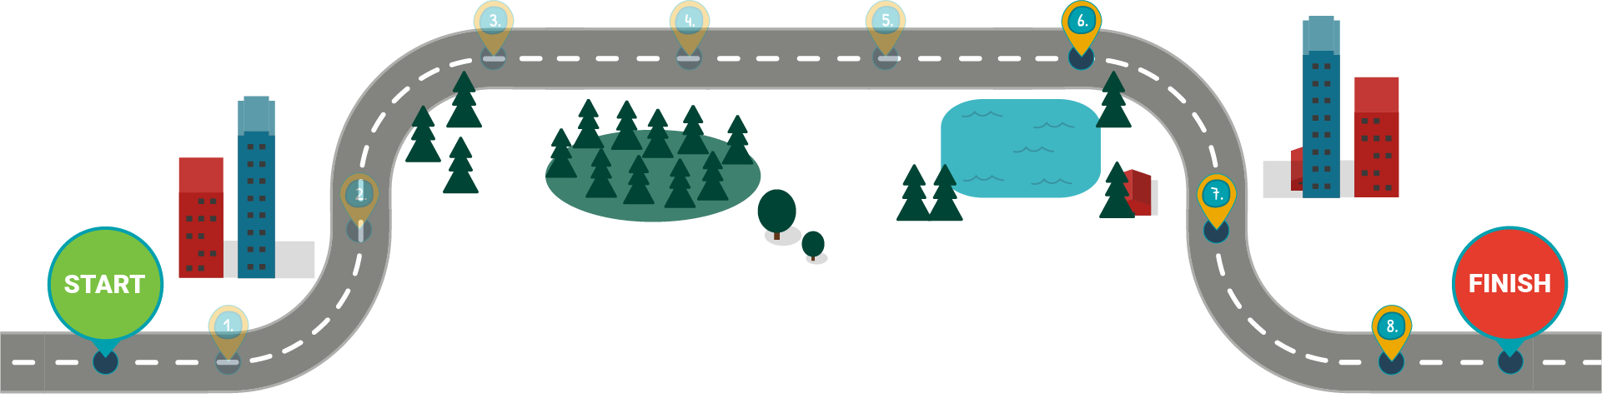
Discussion
Discussion
Acknowledgments
References/Citations
Notes:
Facilitator Script:
We've made it to the final step on the IMRaD path, the Discussion. This is where we interpret the data presented in the Results section. It's also our last major stop before reaching the final manuscript signposts, the Acknowledgments and Citations. In this chapter, we will look at the key points to include in your Discussion, the best ways to perform precise analyses and interpretations, and how to draw a clear line between your Results and your Discussion sections. Then we'll finish our detailed view of the manuscript sections by properly thanking and citing those whose work helped you write your paper.

Slide 85
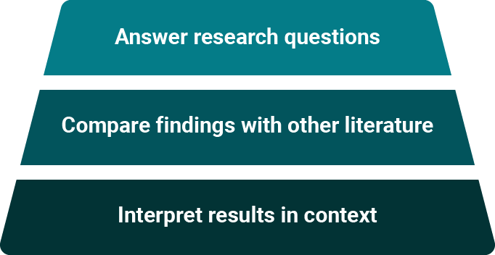
Discussion
Notes:
Facilitator Script:
The Discussion section is where you distill the essence of your study down to its finest point. Think of it as an inverted funnel – the compliment to your Introduction. Here, you will describe your main results, answer your research questions and interpret your results in light of the existing knowledge and findings from other literature. Then you will highlight the major implications of your findings and interpret your results in context. While the Discussion section is the most conversational of the manuscript sections, it still follows specific guidelines and must fulfill specific criteria.

Slide 86
Discussion
The structure of the discussion section
Restate key results.
  State the main conclusion.
  Be clear.
  Maintain a connection with the purpose of the study.
Interpret your study in the context of existing literature.
  Compare your study and results to methods and results from related studies.
  Emphasize the strengths of your study.
Notes:
Facilitator Script:
State the limitations and caveats of your study. Being frank and unapologetic about these limitations may neutralize criticism from reviewers and other readers.
Finally, make recommendations. What do you think should happen now as a result of your study? Suggest changes in practice or policy or call for future research.
What questions do you have so far about the Discussion section? (Solicit questions from students and answer them to the best of your ability before moving on.)

Slide 87

Case Study: Netra Chey
Turn to Module 2–Case Study Part 5 your workbook
Notes:
Facilitator Script:
Let’s go back to the case study with Ms. Chey. Turn to Module 2–Case Study Part 5 your workbook to see what she has to say about results. Who wants to read for her? (Select a student to read aloud)
Netra’s Text:
When it's time for me to write the Discussion section, I begin by re-reading the Introduction to my manuscript. That way I can relate my results back to
what I first presented in the Introduction. I can explain how my work answers my original research question, compare or contrast my findings with other
published literature and describe the wider implications or areas for future exploration.
(Thank the reader!)

Slide 88
Discussion
Make sure your discussion has a clear inverted funnel shape with distinct sections providing:
A summary of main findings
Comparisons with other studies
Strengths and limitations
Implications
Turn to the Knowledge Check section for Part 2 in your workbook and answer Knowledge Checks 6 and 7.
Notes:
Facilitator Script:
Does your Discussion section invert the funnel and have broader applications? Make sure your Discussion section includes a summary of your main findings, comparisons to other studies, the strengths and the limitations of your study and wider implications for the scientific community. Let's check your knowledge before moving on to the final sections of the manuscript.
(Click to reveal Knowledge Check directions!)
Let’s check your understanding of the discussion. Turn the Knowledge Check section for Part 2 in your workbook and answer Knowledge Checks 6 and 7. Then we’ll go over them as a group.

Slide 89
Knowledge Check
  Using the examples below, choose which one
  is the more appropriate way to conclude your Discussion.
  Select one answer.
We found that providing a Session Zero was feasible in our setting and appeared to contribute to the success of the lifestyle change program.
Our study proves that providing a Session Zero is feasible and effective
Notes:
Facilitator Notes:
(Ask participants to volunteer their answers, then click to reveal the correct answer.)
Correct answer:
We found that providing a Session Zero was feasible in our setting and appeared to contribute to the success of the lifestyle change program. → This statement specifically notes aspects of success, and limits applicability of "effectiveness."
Incorrect answer:
Our study proves that providing a Session Zero is feasible and effective. → This statement is too broad, and does not specify results. The other statement specifically notes aspects of success, and limits applicability of "effectiveness."

Slide 90
Knowledge Check
  Using the examples below, choose which one
  is the more appropriate way to conclude your Discussion.
  Select one answer.
There was no discussion in weight loss between participants enrolled based on a risk test only and those with a blood test diagnosis of prediabetes.
The difference between participants enrolled based on a risk test only and those enrolled based on a blood test diagnosis or prediabetes did not reach statistical significance at the p-.05 level.
Notes:
Facilitator Notes:
(Ask participants to volunteer their answers, then click to reveal the correct answer.)
Correct answer:
The difference between participants enrolled based on a risk test only and those enrolled based on a blood test diagnosis or prediabetes did not reach statistical significance at the p-.05 level. → This statement is clear, specific, and presents results.
Incorrect answer:
There was no difference in weight loss between participants enrolled based on a risk test only and those with a blood test diagnosis of prediabetes.. → This statement is clear, but does not present any results or state specific facts.

Slide 91
Acknowledgements
Acknowledgements vs. Citations
Acknowledgments give credit to the people or institutions that helped in your research or writing.
Citations list all the information referenced anywhere in the text of your manuscript.
Notes:
Facilitator Script:
At the end of your manuscript come the acknowledgements and citations. Acknowledgments give credit to the people or institutions that have helped you in your research or with writing your work. Citations list all of the published information referred to anywhere in the text of your manuscript. Both are essential parts of the manuscript, and are relatively easy to flesh out!

Slide 92
Acknowledgements
People or institutions to acknowledge:
Colleagues, advisors, professors or peer-reviewers
People who offered intellectual conversations, mentorship or advice
Equipment specialists and those who provided technical assistance
Field workers
Statisticians and laboratorians
(if their contributions do not qualify them as
co-authors)
Donors, agencies, foundations and other funding
or grantmaking institutions
Notes:
Facilitator Script:
Acknowledgments list the people or institutions that have helped with your study or writing process. If you're having a difficult time remembering all of the people or organizations that you'd like to acknowledge, you can review this list for some potential ideas. Find this slide in Module 2 of your workbook. Read it over, as well as the information on the next slide.

Slide 93
Acknowledgements
Be specific in your acknowledgements!
Thank people for their specific contributions.
  Example: "We thank Dr. X and Dr. Y for performing the surgeries." or "We thank the physicians who performed the surgeries."
Disclose your funding or financial interests. This may be under a "Funding" heading.
  Example: The author(s) disclosed receipt of the following financial support for the research, authorship, and/or publication of this article: This work was supported by the Medical Research Council [grant number xxx].
Remember, acknowledging grants and fellowships is required by many funding agencies and research institutions.
Notes:
Facilitator Notes:
Allow participants a few moments to read over this information in their workbooks, then solicit questions. “What questions do you have about acknowledgements?” (Solicit questions from students and answer them to the best of your ability before moving on.)

Slide 94
Case Study: Netra Chey
Turn to Module 2–Case Study Part 6 your workbook
Notes:
Facilitator Script:
Let’s go back to the case study with Ms. Chey. Turn to Module 2-Case Study part 6 in your workbook to see how she writes the acknowledgements section. Who wants to read for her? (Select a student to read aloud)
Netra’s Text:
Acknowledgments are easy! Thank the people who helped you, and make note of how they helped. Here is my acknowledgments section.
First, I thanked the doctors and staff of the National Institute of Hygiene and Epidemiology in Hanoi, Vietnam, because they provided most of the serum and respiratory specimens used in our study.
Next, I thanked Dr. James Luby, an expert in the isolation and propagation of human enteric coronaviruses, who provided the strains we used in our study.
I didn’t thank any of my co- or sub-authors, because they get credit for writing the paper as well!
(Thank the reader!)

Slide 95
Citations
The citations section:
Credits authors of works cited in manuscript.
Adds credibility to your paper.
Relates your work to previous works.
Leads your readers to other relevant work.
Notes:
Facilitator Script:
The citations section, often titled “Literature Cited,” is where you list all published information referenced in the text of your manuscript. Make sure to follow the formatting guidelines for the journal to which you are submitting. The Citations section is a bit like your Methods section. In the Methods section, you provided readers with enough information to be able to evaluate and recreate your study. The Citations section should provide readers all the information they need to find the same articles or manuscripts you used to support your claims throughout your piece.

Slide 96
Citations
Reminders for citations:
Cite original sources
Cite only references for which you have read the entire paper.
  List everything you reference in your manuscript and nothing else.
Notes:
Facilitator Script:
Keep these tips in mind while creating your citations.
Cite original sources. Do not cite a source that references or cites someone else's findings.
Cite only references for which you have read the entire paper (not just the abstract).
List everything you reference in your manuscript and nothing else (e.g., sources you did not quote or reference).

Slide 97
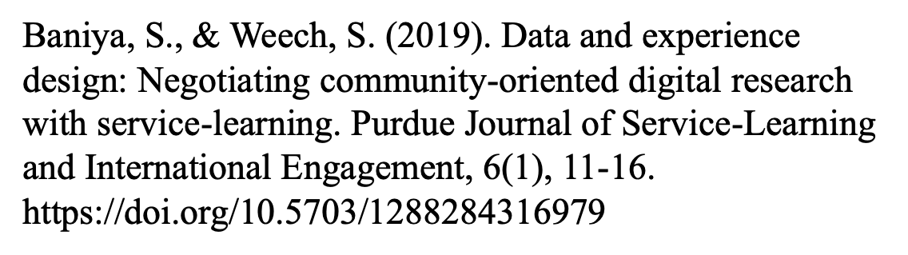
Citations
Author
Date
Title of Article
Title of Journal,
Volume Number,
Issue Number, and Pages
DOI/URL
Notes:
Facilitator Script:
Let’s explore an example citation. You can find these citations in your workbook, along with other examples.
(Click to reveal content!)
APA style dictates that authors are named with their last name followed by their initials; publication year goes between parentheses, followed by a period.
The title of the article is in sentence-case, meaning only the first word and proper nouns in the title are capitalized.
The periodical title is run in title case, and is followed by the volume number which, with the title, is also italicized.
If a digital object identifier, or DOI has been assigned to the article that you are using, you should include this after the page numbers for the article. If no DOI has been assigned and you are accessing the periodical online, use the URL of the website from which you are retrieving the periodical.
What questions do you have about citation formatting? (Solicit questions from students and answer them to the best of your ability before moving on.)

Slide 98
Citations
Double check all references for correct:
Order
Format
Authors
Page numbers
Spelling
Punctuation
Double check all references for correct:
  New, relevant work has been published.
  Your late reviewers connect you to new information or experts that you use in your paper.
Notes:
Facilitator Script:
Here are some ways to ensure that your Citations page is correct.
Inaccurate references are embarrassing and don't impress reviewers. Double-check all citations during the revision process. Are they listed in the right order and do they follow the correct format according to the publication's style guidelines? Have you included the correct authors, page numbers and more?
If necessary, update your references after the peer review. Sometimes your reviewers or late readers are authors of the works you're citing or they have connections and information about the works cited. Check to make sure new studies haven't been published.
What questions do you have about citations? (Solicit questions from students and answer them to the best of your ability before moving on.)

Slide 99
The Scientific Writing Roadmap
Methods
Results
Introduction
Discussion
Abstract
Acknowledgments
Title
References/Citations
Notes:
Facilitator Script:
We’ve now touched on each component of a typical scientific manuscript, and we’ve covered quite a bit of information!
What can you tell me about a good title? (Solicit answers from students. Guide discussion as necessary. Do the same for the abstract, introduction, methods, results, discussion, acknowledgements and references/citations sections. Revisit past content if there is confusion or misunderstandings!)

Slide 100
Congratulations!
You’ve now completed
Module 2: Manuscript Preparation!
Notes:
Facilitator Notes:
Congratulate your participants on finishing the first part of the training! If appropriate, break for the day. If not, give students an appropriate break before beginning Module 2.

