Slide 1
SCIENTIFIC WRITING
The Basics

Slide 2
Module 4
Wrapping Up
Notes:
Facilitator Script
We have almost reached the end of this training! Let’s review what you’ve learned, and then I’m going to send you off to write your own scientific manuscript.
Writing your manuscript should be an empowering experience. What you have studied and what you have to say are important. Do not forget that, even if you feel overwhelmed. You can do this!

Slide 3
REVIEW: Module 1
Overview of the
Scientific Writing Process
Notes:
Facilitator Script
We've covered a lot of information in this training. Let's take a few minutes now to review what we've learned, starting with Module One.

Slide 4
Module 1: Review
In Module 1, you learned how to:
Describe the key principles of scientific writing.
Understand the ways in which scientific writing differs from general writing.
Determine when and why to participate in scientific writing.
Begin he scientific writing process.
Notes:
Facilitator Script
In Module One, we covered the key principles of scientific writing, how it differs from general writing and when to begin the scientific writing process.

Slide 5
Module 1: Review
Summary of scientific manuscript writing
Scientific manuscripts are about getting messages across clearly, concisely, and completely.
Strive to convince your audience that your work is important, valid, and relevant.
In the Introduction, emphasize the motivation for your work.
In the Conclusion, emphasize the outcome of your work.
In the body of the manuscript (Methods, Results, Discussion), present enough evidence to establish the validity of this outcome.
At the paragraph level, present first what you want your readers to remember before developing this message in the rest of the paragraph. With each sentence, convey one idea.
After you have drafted your manuscript, revise it using whatever tools are most helpful to you.
Notes:
Facilitator Script:
The goal of scientific writing is to communicate your ideas clearly, concisely, and completely. You want to validate your work to your target audience and convince readers and reviewers that you are making important and relevant contributions in your field.
Use the Introduction to emphasize the motivation for your study and the Conclusion to emphasize the outcome. In the body of the manuscript--which includes the Methods, Results, and Discussion sections--present enough evidence to prove the outcome.
After you have drafted your manuscript, revise it. Make sure that you are following your target publication's style guide and submission guidelines.

Slide 6
Module 1: Review
Conduct a literature review:
Before you conduct your study.
To enhance your knowledge of the topic.
To identify gaps in existing scholarship.
To better understand your work's significance.
Notes:
Facilitator Script
Before you conduct your study, begin the research process with a literature review. This involves searching for and reading scientific papers related to your intended study. The literature review will enhance your knowledge of the topic, identify any gaps in existing scholarship, and help you better understand the significance of your work.

Slide 7
Before we move on…
What questions do you have?
Turn to the Knowledge Check section for Module 4 in your workbook and answer the Module 1 review questions.
Notes:
Facilitator Script
What questions do you have about what we covered in Module 1?
(Solicit questions and answer them to the best of your ability.)
Turn to the Knowledge Check section for Module 4 in your workbook and answer the Module 1 review questions. Then we’ll go over them as a group.
(Give participants 5 minutes to answer the questions before moving on.)

Slide 8


Knowledge Check
Which of the following options best completes this sentence?
Scientific writing is ____________ writing.
general
technical
impressive
unreviewed
Notes:
Facilitator Notes:
Ask participants to volunteer their answers before clicking to reveal correct answer.
The correct answer is technical. Scientific writing is unlike most general writing. It is technical and specific, meant to inform rather than to impress, and goes through rounds of review before being published.

Slide 9
Knowledge Check
  Which of the following reasons support your writing a scientific manuscript?
  Select all that apply.
My Study fills a gap in existing knowledge
My work has already been published in other journals
My work takes a leap into new territory.
My work explores well known studies, but tests a new method or approach
My work is only interesting to my intended audience.
Notes:
Facilitator Script:
(Ask participants to volunteer their answers, then click to reveal correct answers.)
Closely reading a variety of scientific papers will make you a better writer and a better reviewer because you will have expanded your understanding of good writing as a whole. Being mindful of deadlines is essential for a good reviewer, as is asking for extensions if you need them. Reading review guidelines is necessary so you can provide the feedback requested by the author, and ignoring these guidelines is rude and shows poor professionalism. Joining a writing critique group will help you grow as a writer and a reviewer through experience and comparison to other reviewers. An eager reviewer is a good reviewer. The more papers you review, the more experience you’ll have! Remember to be specific with your feedback. General feedback is only useful to a certain point.

Slide 10
Knowledge Check
True or False?
The abstract distills your entire paper down to one
simpler sentence.
  False
Notes:
Facilitator Notes:
Ask participants to volunteer their answers before going over correct answers.
This statement is false. Don't confuse the abstract with the key message, which is a one-sentence description of your paper's most important information. The abstract is a focused paragraph that highlights the essential points of your study. After the title of your paper, the abstract is the first thing that people will read. It acts as both a summary and analysis of your research.

Slide 11
REVIEW: Module 2
Manuscript Preparation

Slide 12
Module 2 Overview
Module 2, you learned how to:
Describe and understand the importance of each section of scientific manuscript.
Demonstrate an understanding of and ability to analyze and present data.
Notes:
Facilitator Script:
In Module Two, we taught you to visualize the outline of a scientific manuscript like a roadmap. We visited each of the sections, or signposts of the roadmap, including the IMRaD mnemonic device to help you remember the sections found in a journal article. We also covered the ways to analyze and present data in your writing.

Slide 13
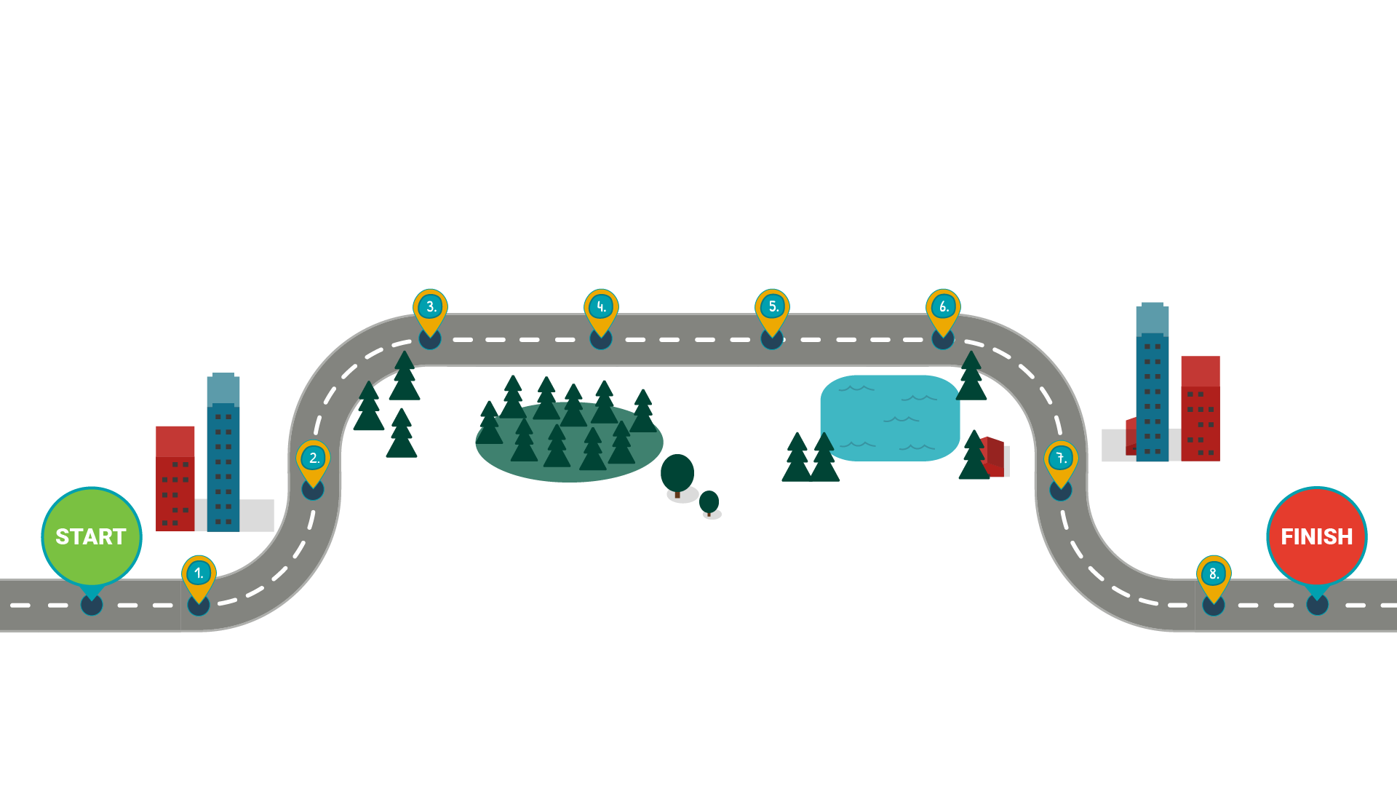
The Scientific Writing Roadmap
Methods
Results
Introduction
Discussion
Abstract
Acknowledgments
Title
References/Citations
Notes:
Facilitator Script
We introduced you to this roadmap in Part 2. It’s a key part of this training and something you can return to if you ever get lost in the process of preparing a scientific manuscript. Remember that each section of your manuscript answers specific questions and fulfills some specific needs.
(Click to reveal the parts of the manuscript)
The Title conveys the subject of your paper and the aspects of the subject studied.
The Abstract is a one-paragraph summary that covers the main reason for your study, the primary results, and the major conclusions.
The Introduction explains why you chose the topic of your manuscript and lays out the research question, tested hypothesis, or purpose of your study.
The Methods section describes how you conducted your study, what materials you used, and the makeup of any study groups.
The Results section presents your data and communicates the essence of your research, as well as your outcomes.
The Discussion includes an interpretation of your data, implications of your findings, and what potential research may follow. Ambiguous or controversial findings should be examined and analyzed here. The discussion concludes with a concise but complete interpretation of your findings.
You thank everyone who helped you in the Acknowledgements section.
The References and Citations section is where you list the locations and titles of all scholarly work you used in the creation and execution of your study, as well as everything you cited throughout your manuscript.

Slide 14
Before we move on…
What questions do you have?
Turn to the Knowledge Check section for Module 4 in your workbook and answer the Module 2 review questions.
Notes:
Facilitator Script
Turn to the Knowledge Check section for Module 4 in your workbook and answer the Module 2 review questions. Then we’ll go over them as a group.
(Give participants 5 minutes to answer the questions before moving on.)

Slide 15
Knowledge Check
  What is the most frequently read part of any scientific paper?
  Select the correct answer.
Title
Abstract
Introduction
Methods
Results
Discussion
Notes:
Facilitator Notes:
Ask participants to volunteer their answers before clicking to reveal the correct answer.
Correct answer: The most frequently read part of any paper is the title. It's how your paper will be indexed and cited. An accurate and concise title helps readers find your work and determine whether or not they want to read more.

Slide 16
Knowledge Check
  Which section of the manuscript do many scientists write first?
  Select the correct answer.
Title
Abstract
Introduction
Methods
Results
Discussion
Notes:
Facilitator Notes:
Ask participants to volunteer their answers before clicking to reveal the correct answer.
Correct answer: Many researchers find it easy to write the Results section of their papers first. Right after you end your study, when the information is fresh in your mind and you have your notes all organized, write up your results and include any supporting tables and figures.

Slide 17
Knowledge Check
  You should evaluate the results of your study in which section of the manuscript?
  Select the correct answer.
Title
Abstract
Introduction
Methods
Results
Discussion
Notes:
Facilitator Notes:
Ask participants to volunteer their answers before clicking to reveal the correct answer.
Correct answer: Many researchers find it easy to write the Results section of their papers first. Right after you end your study, when the information is fresh in your mind and you have your notes all organized, write up your results and include any supporting tables and figures.

Slide 18
REVIEW: Module 3
Manuscript Revision

Slide 19
Module 3: Review
In Module 3, you learned how to:
Understand the importance of revision to the scientific writing process.
Follow the proper methods for analyzing and reviewing scientific papers.
Request feedback from your peers and outside experts.
Improve your writing through reviewing others’ work.
Notes:
Facilitator Script:
In Module Three, we reviewed some general tips for developing your writing style and the scientific voice. We explained why revising your manuscript is so essential to the writing and submissions process. We emphasized the importance of soliciting feedback from your peers and outside experts, and suggested that reading and reviewing others' work can make you a better writer and editor of your own work.

Slide 20
Module 3: Review
To develop your writing style and scientific voice:
Make informed choices about content and organization.
Keep things simple.
Avoid using jargon, acronyms or abbreviations.
Read the literature and adopt the language used in scientific publications.
Define and label things consistently in your paper.
Notes:
Facilitator Script:
To develop your writing style, make informed choices about everything that goes into your paper and how you organize it. Keep things simple by writing short, concise sentences and breaking down complex ideas into smaller parts. Avoid using jargon, acronyms or abbreviations, and make sure you clearly define them when you do use them. The scientific voice refers to the writing style often dictated by scientific publications. Read the literature and adopt the language used in scientific publications. Define and label things consistently throughout your paper and provide the reader with enough information to interpret your data and arrive at the same conclusions. Essentially, your goal should be to help another person be able to reproduce your study.

Slide 21
Module 3: Review
Asking for feedback
Ask others to review your manuscript!
  Ask colleagues, friends, co-writers and other collaborators.
  Contact 3-4 experts outside your organization.
  Provide guiding questions around any key issues.
  Collect opinions, suggestions and comments.
  Incorporate feedback into revision process.
Notes:
Facilitator Script:
Ask others to review your work throughout the writing process. Peer reviewers and outside experts can provide valuable feedback on how to make your writing easier to read and understand. Provide reviewers with some guiding questions and be sure to thank them for the time they spend reading and evaluating your work. The editing and revision process will boost your confidence and prepare you to submit the best version of your manuscript to your target publication.

Slide 22
Module 3: Review
Reading others’ work
Developing your skills as an editor by:
  Reading articles published in peer-reviewed scientific journals.
  Offering to review your colleagues' manuscripts.
A finished draft does not become a manuscript that you would be proud to submit without revision.
Notes:
Facilitator Script:
A finished draft does not become a manuscript that you would be proud to submit without revision. To develop your skills as an editor, read articles published in peer-reviewed scientific journals and offer to review your colleagues' or critique partners' manuscripts. Reading others' work will help you identify what you like and dislike about the papers and refine your writing style.

Slide 23
Before we move on…
What questions do you have?
Turn to the Knowledge Check section for Module 4 in your workbook and answer the Module 3 review questions.
Notes:
Facilitator Script
Turn to the Knowledge Check section for Module 4 in your workbook and answer the Module 3 review questions. Then we’ll go over them as a group.
(Give participants 5 minutes to answer the questions before moving on.)

Slide 24
Knowledge Check
  Which of the following activities may help improve your editing skills?
  Select the correct answer.
Taking a break from reading scientific articles so they won’t influence your writing.
Joining a journal club or writing group where you can read and critique others’ work.
Rejecting requests to review your colleagues’ work so you can focus on your own manuscript.
Taking English lessons or using language apps to practice good grammar, fluency and comprehension.
Ignoring multiple reviewers’ suggestions to change a particular section in your manuscript.
Notes:
Facilitator Notes:
Ask participants to volunteer their answers before clicking to reveal the correct answer.
The more scientific articles you read, the better. Just make sure that you properly cite any articles you use in your paper!
Journal clubs and writing groups are wonderful opportunities to improve your writing, because they give you the chance to read and critique others’ work. You will also probably have your work read and critiqued by other members of the group, which will improve your writing even further!
Reading and reviewing your colleagues’ work takes time and effort, but will make you a better editor and writer in the end. Additionally, your colleagues may repay the favor by helping to edit your manuscript later!
Papers written in proper English are published faster because they require less editing. Improving your English is a good way to improve your editing skills!
If multiple reviewers suggest changing the same particular section in your manuscript, you should seriously consider revising that section. Ignore your reviewer’s comments at your own risk!

Slide 25
Knowledge Check
  How should you handle acronyms in your scientific manuscript?
  Select the correct answer.
Don’t include acronyms in your scientific manuscript. Write everything out so you won’t confuse the reader.
Use acronyms as much as possible to make your paper easier to read
Use acronyms consistently and define each acronym in its first instance.
Notes:
Facilitator Notes:
Ask participants to volunteer their answers before clicking to reveal the correct answer.
If you must use acronyms, define them the first time you use them and then use them consistently throughout the paper.

Slide 26
Knowledge Check
  What is the recommended writing style to adopt when writing a scientific manuscript?
  Select the correct answer.
APA Style
The writing style of your target publication
American English
British English
Notes:
Facilitator Notes:
Ask participants to volunteer their answers before clicking to reveal the correct answer.
It’s best practice to follow the style guide provided by your targeted journal or publication. Whether you follow the rules of APA (American Psychological Association) style, American English or British English, or other prescribed number and lettering schemes, the key is consistency.

Slide 27
Wrapping Up!
Notes:
Facilitator Script:
(Solicit any final questions. Give out your contact information if you want participants to follow up with you about their work. Any closing statements should be made here.)
It has been an honor to guide you through the scientific writing process. You have all the tools you need to write, edit and publish a successful scientific manuscript! Now you just need to go out and do it!

Slide 28
Congratulations!
You’ve now completed
Module 4 and the Introduction to Scientific Writing course!
Notes:
Facilitator Notes:
Congratulate your participants on finishing the first part of the training! If appropriate, break for the day. If not, give students an appropriate break before beginning Module 2.

